Slide 1

SafeStreets
Software Engineering 2 mandatory project presentation
Matteo Secco Professor Rossi
Mohammad Rahbari

Slide 2

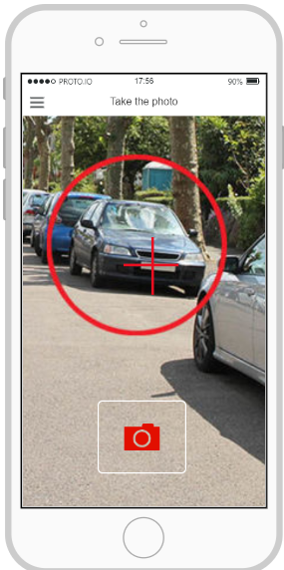
Reporting a violation
Access to the application

Slide 3
Reporting a violation
Access to the application
Take a picture of the violation,
focusing the plate

Slide 4
Reporting a violation
Access to the application
Take a picture of the violation,
focusing the plate
Automatic data gathering

Slide 5
Reporting a violation
Access to the application
Take a picture of the violation,
focusing the plate
Automatic data gathering
Send to the server

Slide 6
Reporting a violation
Access to the application
Take a picture of the violation,
focusing the plate
Automatic data gathering
Send to the server
Receive acknowledgment

Slide 7
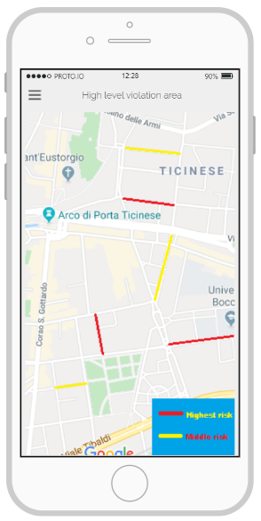
Highlighted map view
Access to the application
Insert the position
(automatically if possible)

Slide 8
Highlighted map view
Access to the application
Insert the position
(automatically if possible)
Request the map

Slide 9
Highlighted map view
Access to the application
Insert the position
(automatically if possible)
Request the map
Receive the formatted map

Slide 10
Highlighted map view
Access to the application
Insert the position
(automatically if possible)
Request the map
Receive the formatted map
Display the map

Slide 11
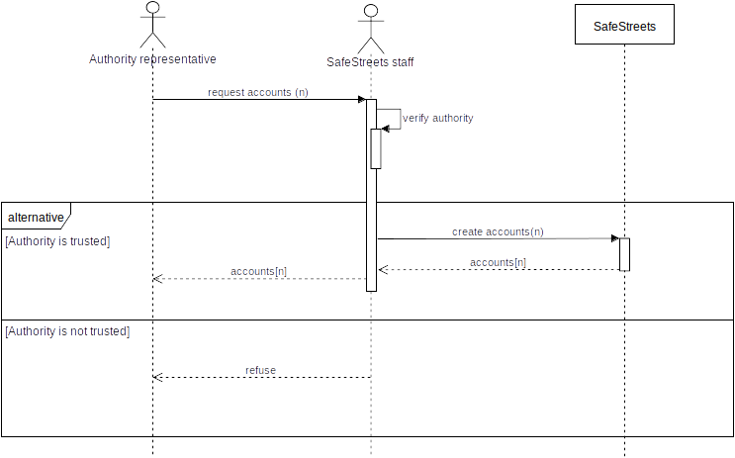
Authority registration
Request accounts to our staff

Slide 12
Authority registration
Request accounts to our staff
We’ll verify your public role

Slide 13
Authority registration
Request accounts to our staff
We’ll verify your public role
If you are verified, we’ll create
your accounts

Slide 14
Authority registration
Request accounts to our staff
We’ll verify your public role
If you are verified, we’ll create
your accounts
And send the to you

Slide 15
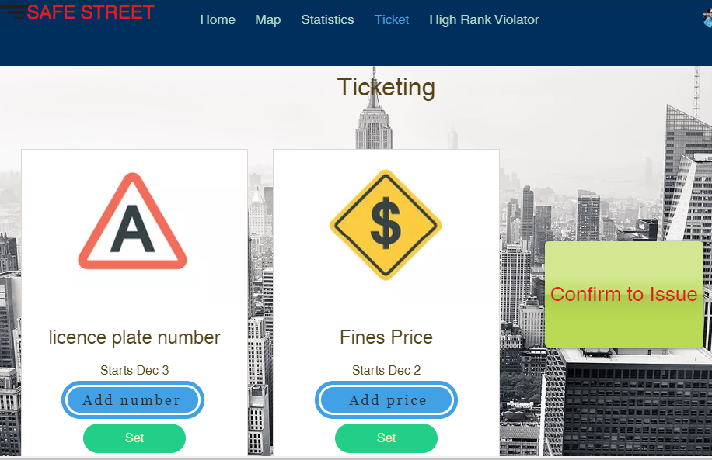
Ticket validation
Query eligible tickets

Slide 16
Ticket validation
Query eligible tickets
Pick one

Slide 17
Ticket validation
Query eligible tickets
Pick one
Verify if can be issued

Slide 18
Ticket validation
Query eligible tickets
Pick one
Verify if can be issued
Send the decision

Slide 19
Requirements
Automatically read the plate from the sent photo

Slide 20
Requirements
Automatically read the plate from the sent photo
Exploiting device sensors for collecting data, or insert data manually

Slide 21
Requirements
Automatically read the plate from the sent photo
Exploiting device sensors for collecting data, or insert data manually
Notify the user of successful submission, or failure

Slide 22
Requirements
Automatically read the plate from the sent photo
Exploiting device sensors for collecting data, or insert data manually
Notify the user of successful submission, or failure
Only send complete notifications

Slide 23
Requirements
Automatically read the plate from the sent photo
Exploiting device sensors for collecting data, or insert data manually
Notify the user of successful submission, or failure
Only send complete notifications
Don’t store any altered notification

Slide 24
Requirements
Automatically read the plate from the sent photo
Exploiting device sensors for collecting data, or insert data manually
Notify the user of successful submission, or failure
Only send complete notifications
Don’t store any altered notification
Don’t store notifications invalidated by some permission

Slide 25
Requirements
Automatically read the plate from the sent photo
Exploiting device sensors for collecting data, or insert data manually
Notify the user of successful submission, or failure
Only send complete notifications
Don’t store any altered notification
Don’t store notifications invalidated by some permission
Save every other violation

Slide 26
Requirements
Automatically read the plate from the sent photo
Exploiting device sensors for collecting data, or insert data manually
Notify the user of successful submission, or failure
Only send complete notifications
Don’t store any altered notification
Don’t store notifications invalidated by some permission
Save every other violation
Issued tickets must be reported to the server

Slide 27







Are them right?
We tested them with the Alloy tool for formal verification, and all the goals seems to be satisfied

Slide 28
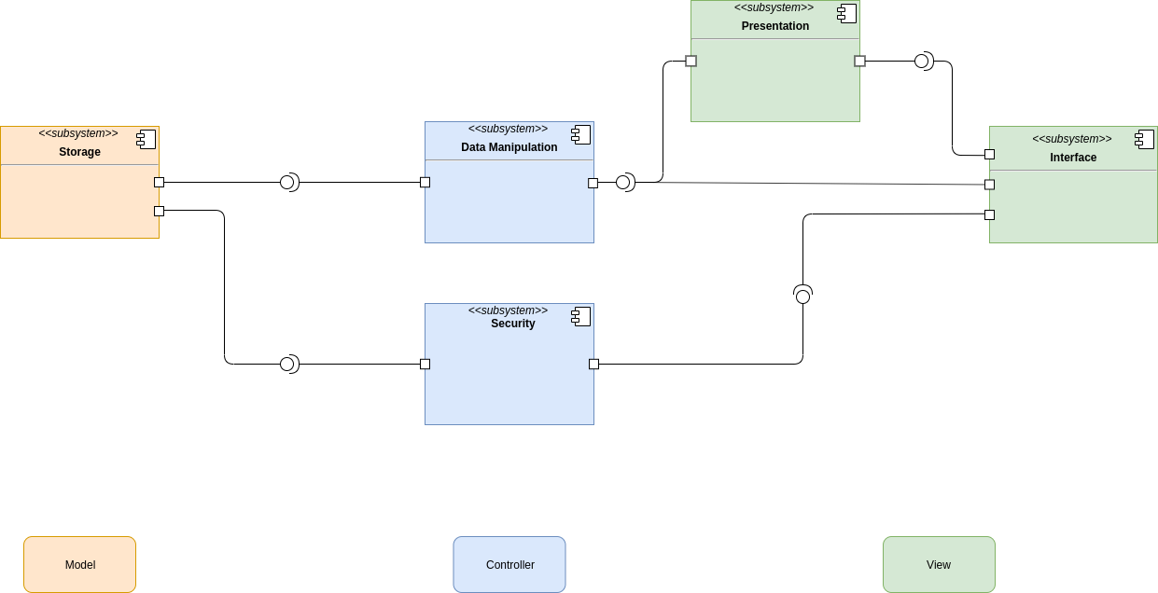
High level architecture

Slide 29
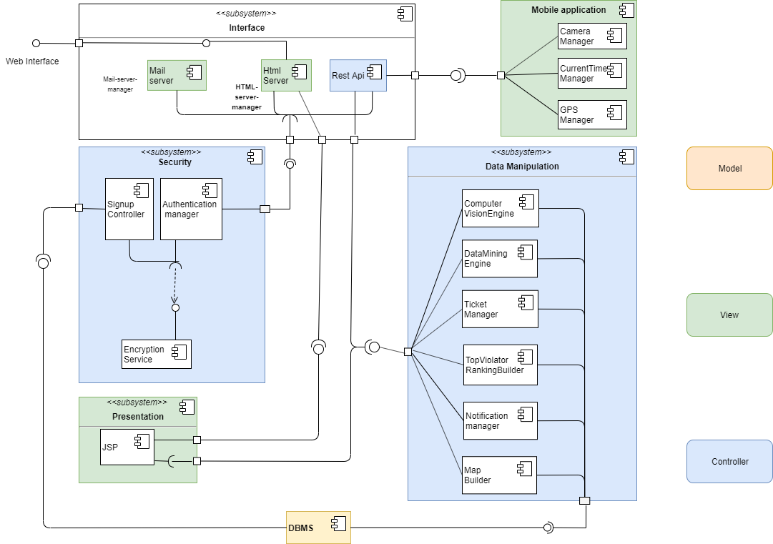
Detailed component view

Slide 30
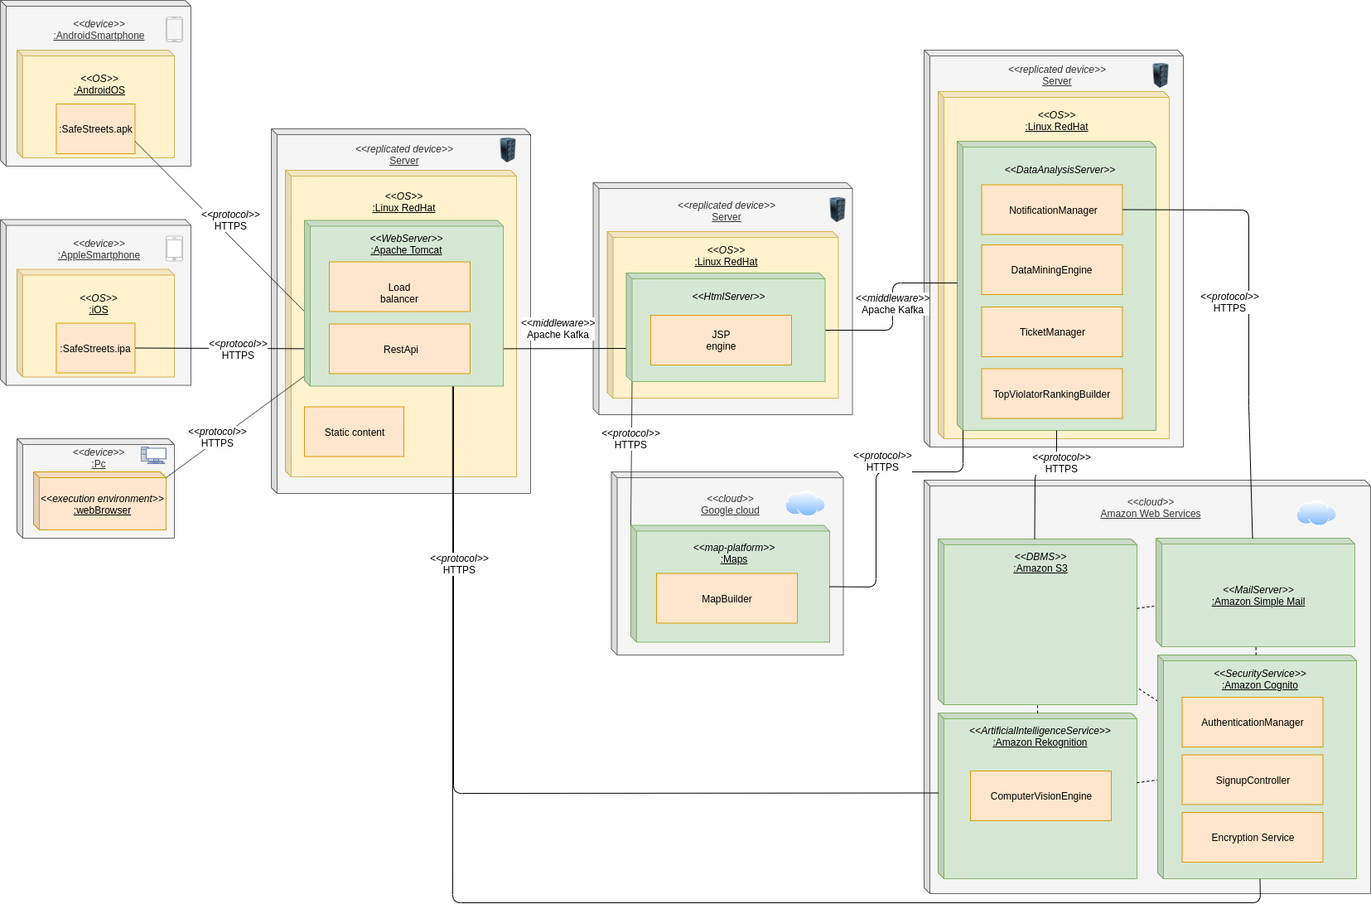
Deployment

Slide 31
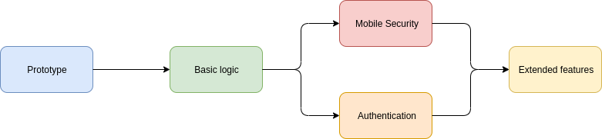
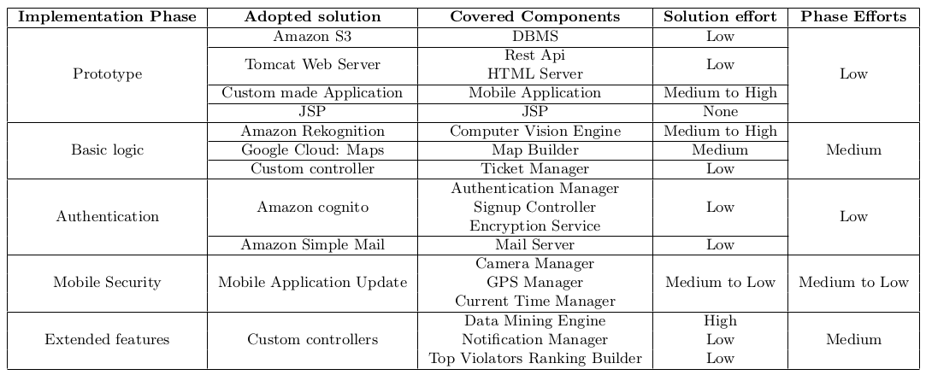
Implementation and testing

Slide 32
This structure could lead to an easy and cheap implementation of the system, and the cloud-oriented deployment allows the company to split the initial cost all over the system’s lifetime

