Slide 1

Repositories & API
Maksim Mišin
Digital Humanities Conference
https://www.flickr.com/photos/internetarchivebookimages/14784841223

Slide 2
In this workshop, you will learn
What is an API
How to use APIs
How to get (a lot of) data from repositories

Slide 3
In this workshop, you will need
Internet access
Google Chrome browser
Postman app

Slide 4
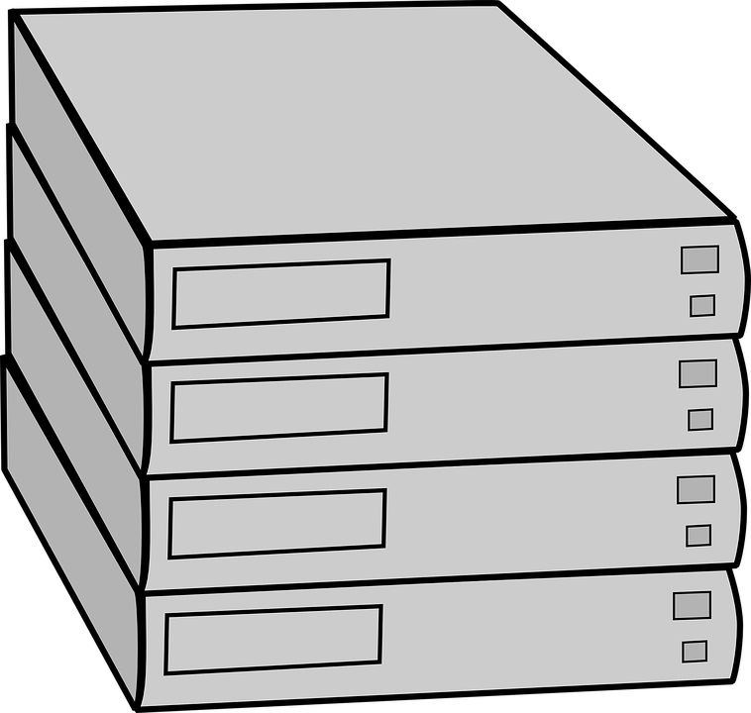


What is an API
API = Application Programming Interface = a protocol that programs use to talk to each other
REQUEST
API
DATA
Your Phone
Google Servers

Slide 5
Standard request
Look up Tartu in Google Maps https://www.google.com/maps/place/Tartu

Slide 6
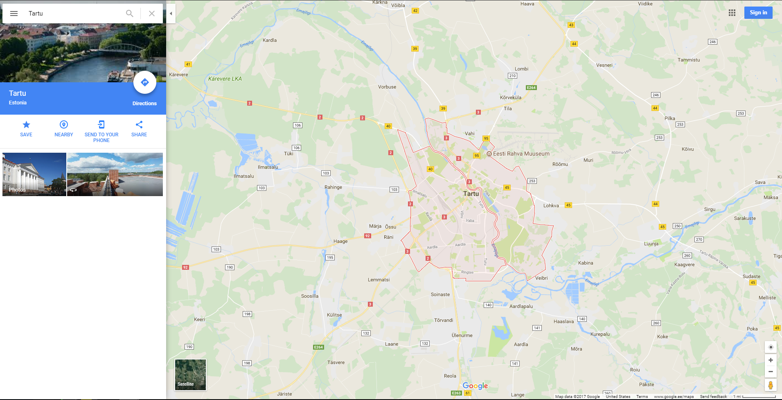

Slide 7
API request
Look up Tartu using Google Maps API https://maps.googleapis.com/maps/api/geocode/json?address=tartu

Slide 8
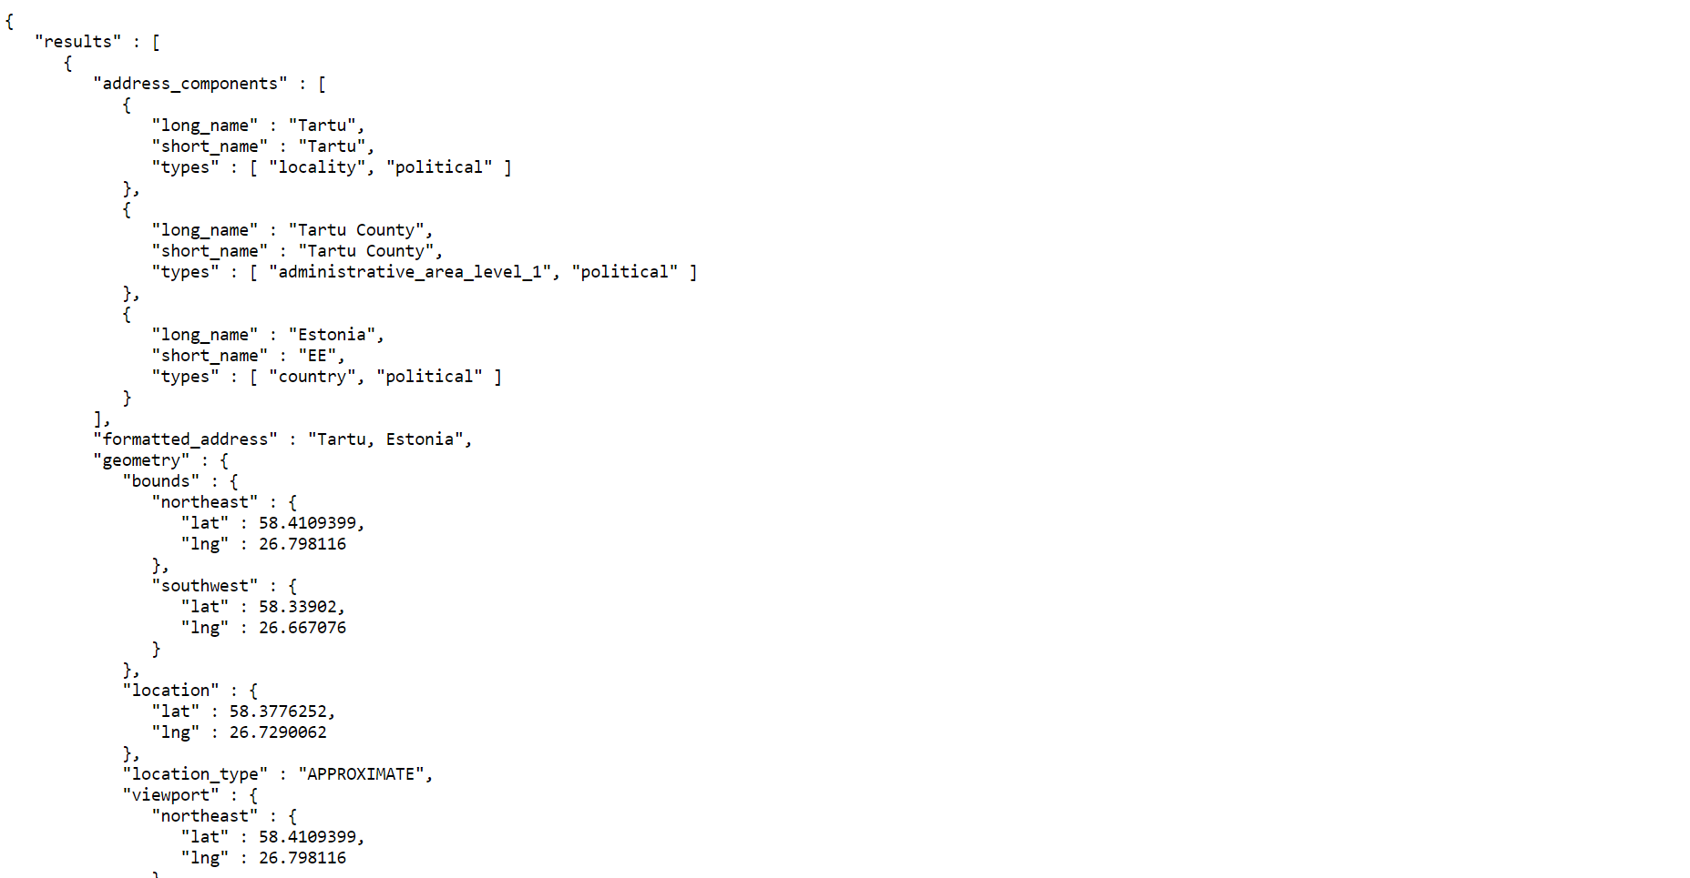

Slide 9
Introducing JSON
Keys:
double quoted sequence of
characters (string)
Values:
number
string
boolean
array (list of values)
object, collection of key-value pairs surrounded by { }
{
"firstName": "John",
"lastName": "Smith",
"isAlive": true,
"age": 25,
"address": {
"streetAddress": "21 2nd Street",
"city": "New York"
},
"phoneNumbers": [
{
"type": "home",
"number": "212 555-1234"
},
{
"type": "mobile",
"number": "123 456-7890"
}
],
"hobbies": ["fishing", "running", "cooking"]
}

Slide 10
Anatomy of API call – GET request
method
root url
endpoint
GET
https://maps.googleapis.com/maps/api/geocode/json?address=Paris&components=country:US
parameters

Slide 11
Anatomy of API call – POST request
method
root url
endpoint
POST
https://www.googleapis.com/geolocation/v1/geolocate?key=AIzaSyAkG2V0TmuDTlcneoEsWyyVyCMfS
parameters
{
"considerIp": "false",
"wifiAccessPoints": [
{
"macAddress": "a4:b1:e9:2f:83:ee",
"signalStrength": -40,
"signalToNoiseRatio": 0
},
...
]}
body

Slide 12
Making API calls with Postman
Open Google Chrome
Launch Postman app
Choose continue without registering

Slide 13
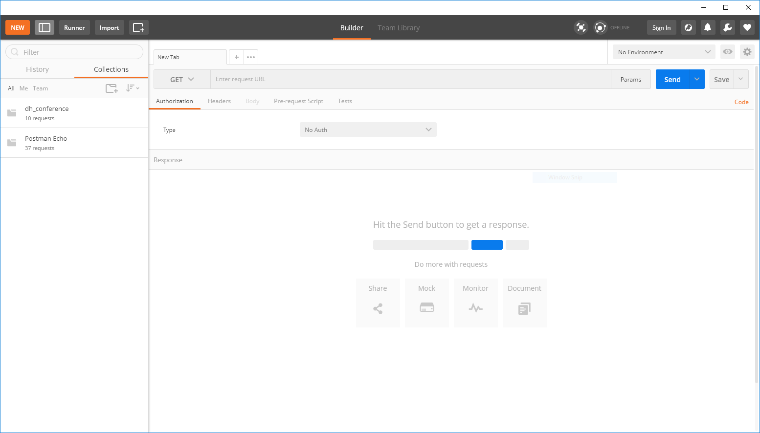

Slide 14
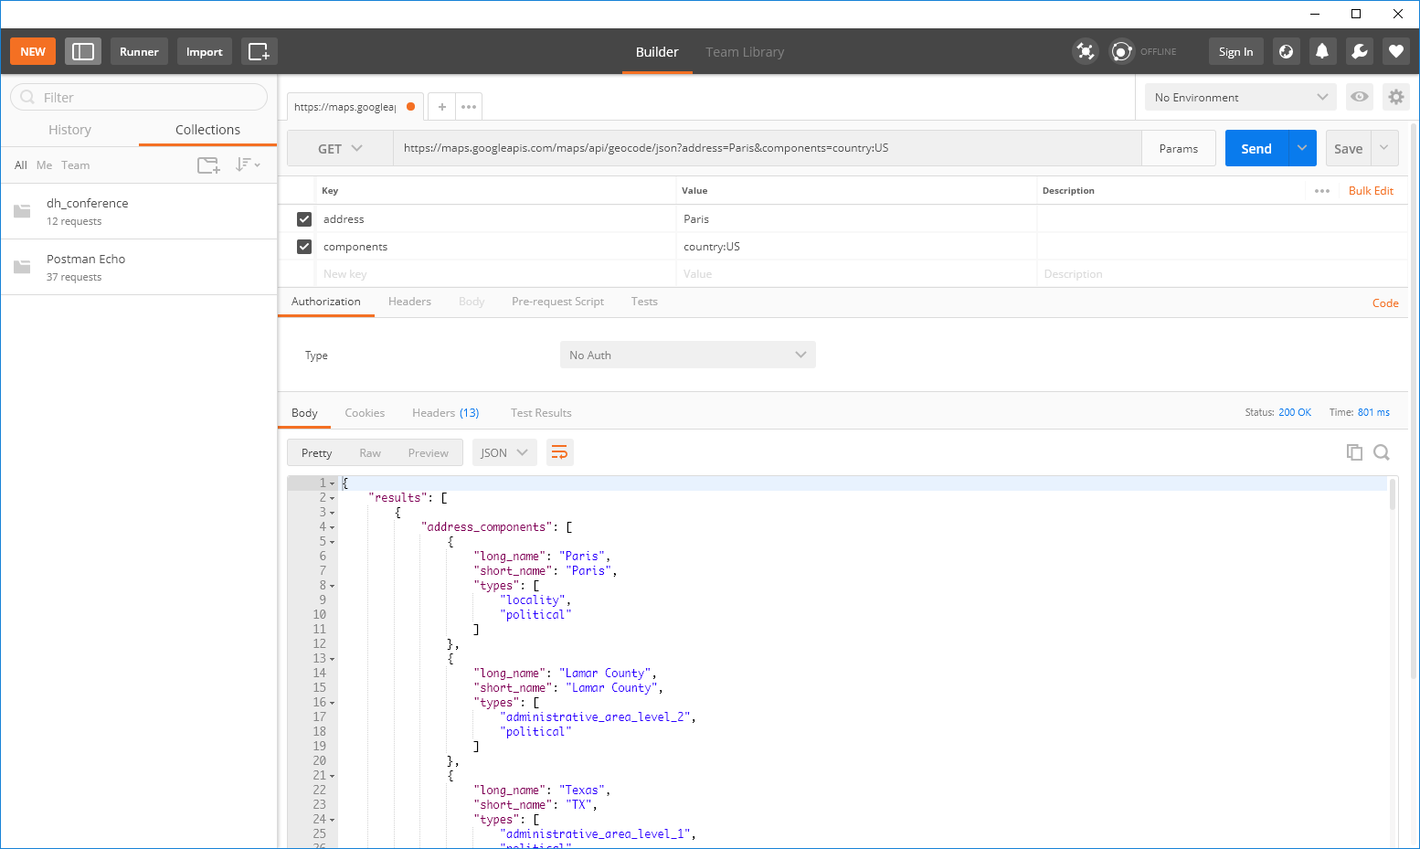

Slide 15
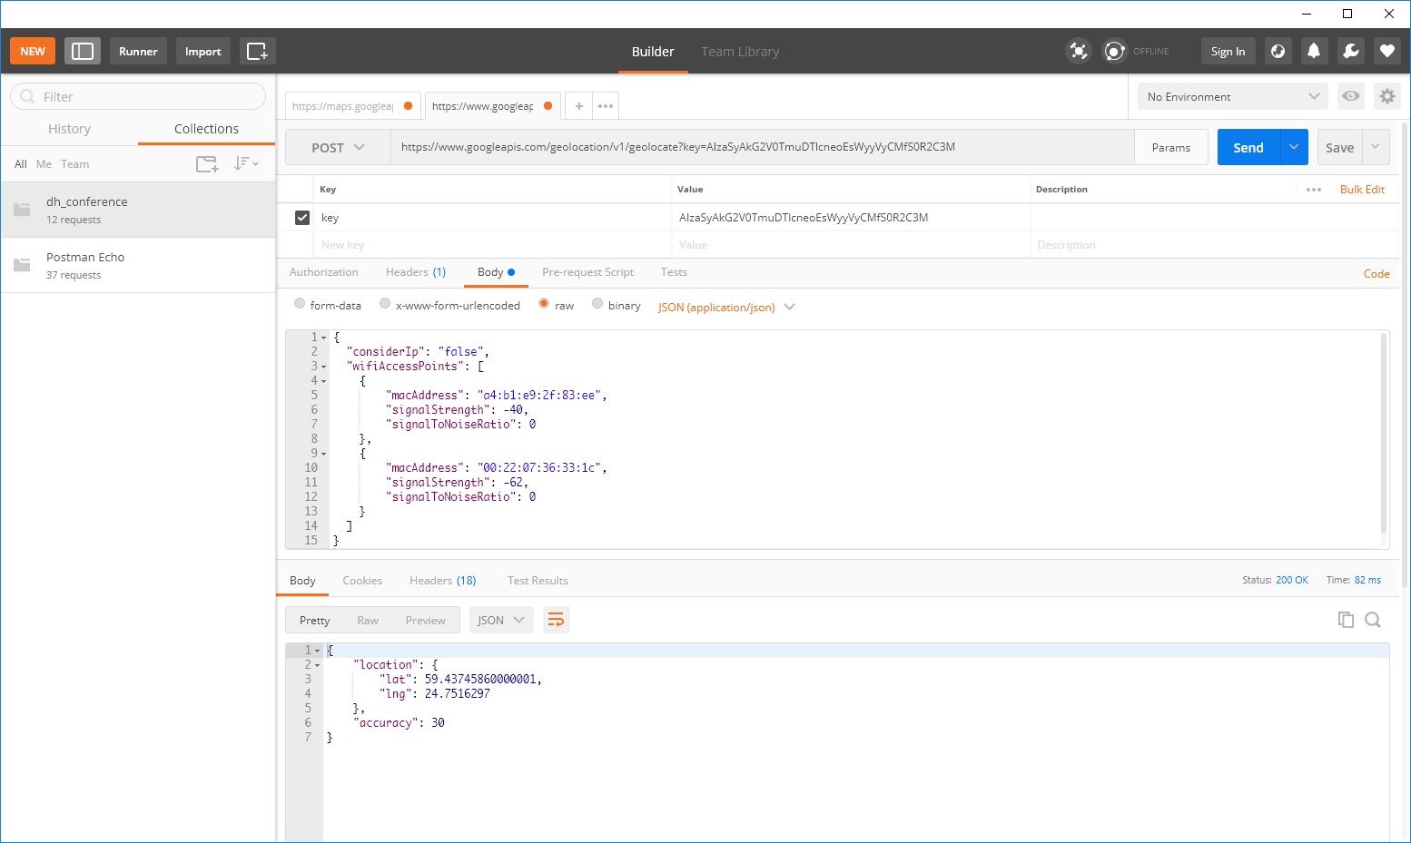

Slide 16
Exercise time!

Slide 17
Further reading
Code Academy's API tutorials:
https://www.codecademy.com/apis
Programming Historian lessons:
https://programminghistorian.org
Programmable Web collection of APIs:
https://www.programmableweb.com/apis/directory

Slide 18
Thank You!

