Slide 1
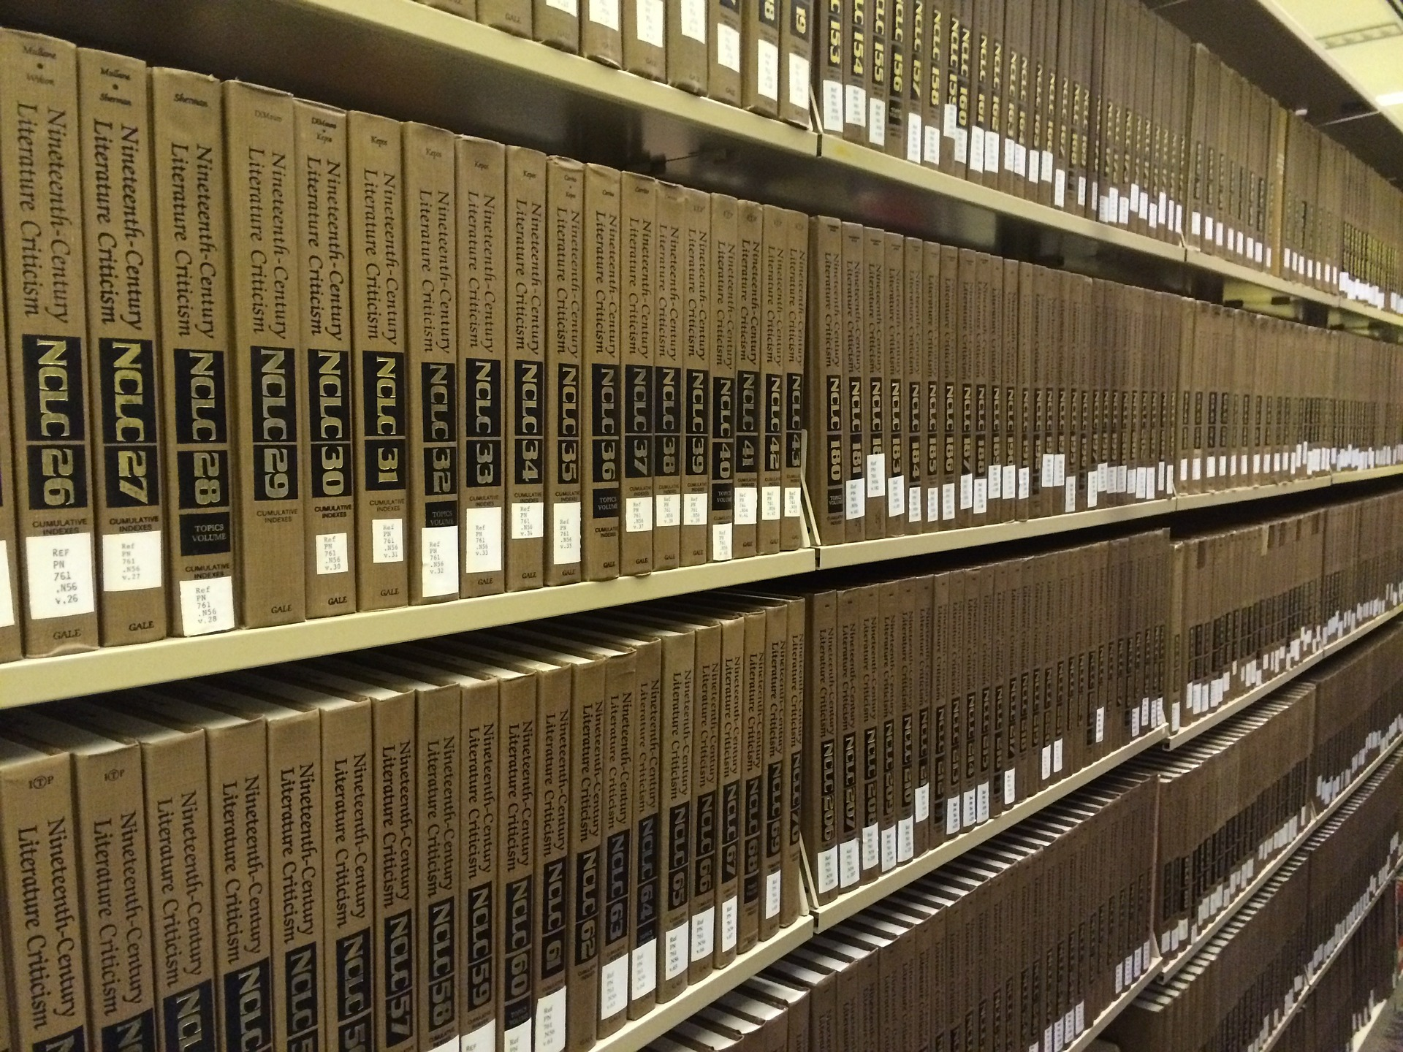
Citation management
Maksim Mišin & Kristel Uiboaed
University of Tartu Library

Slide 2
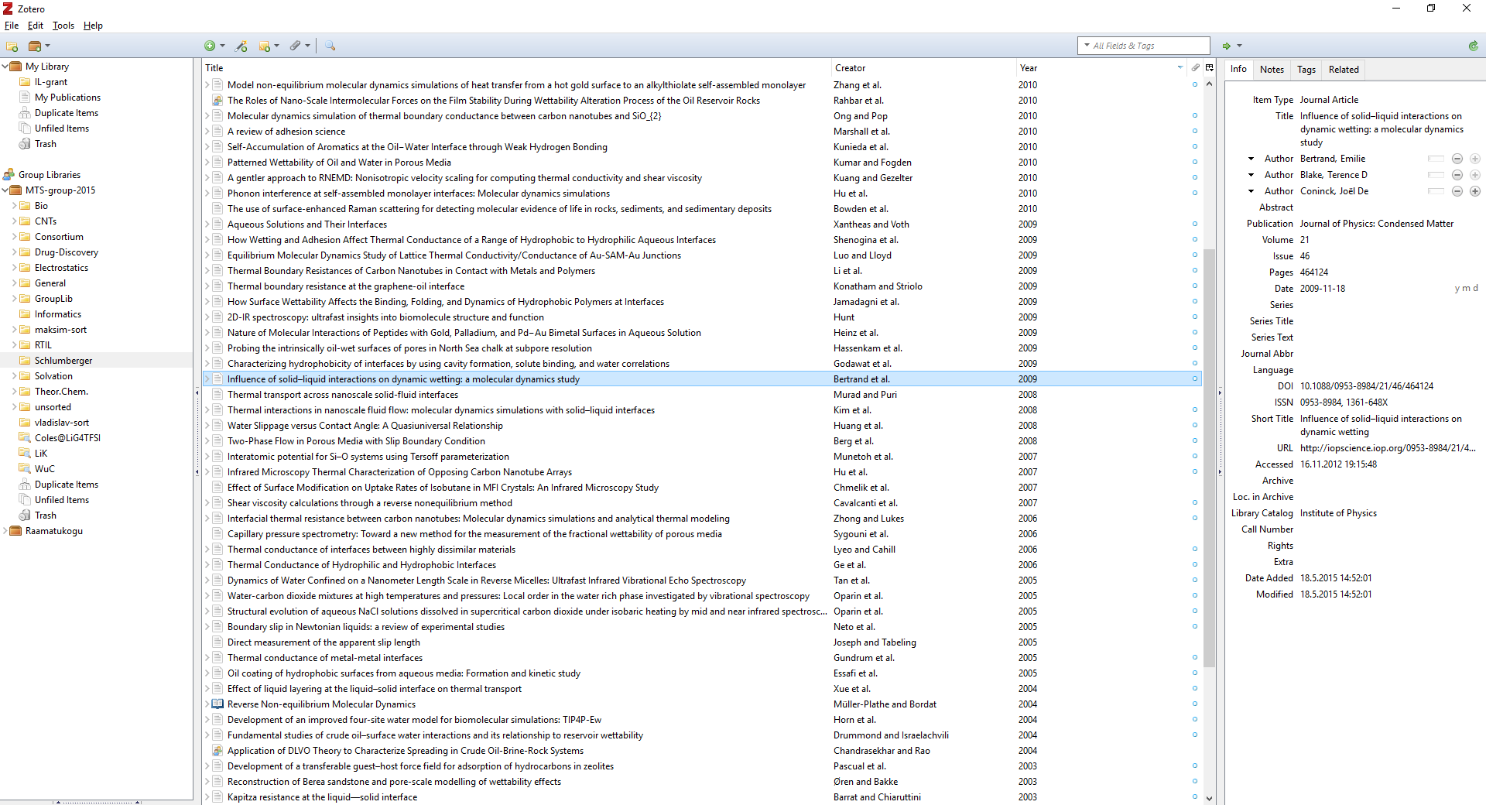

Slide 3
Reference management software
Import references
Systematize, synchronize, share references
Integrate with word processor

Slide 4




Reference management software
 | Zotero | Mendeley | Paperpile | EndNote
Software price | Open Source | Free | $2.99/month | $249.95
Group storage pricing | 300 MB Free Unlimited $120/year | <2 GB Free Unlimited ??? | Uses Google Drive | Free
Browser plugin | + | +/- | + | -
Word processors | Word, LibreOffice | Word, LibreOffice | Google Docs | Word
PDF Annotation | Third party | + | + | +

Slide 5
Demo time!
https://github.com/University-of-Tartu-Library/Zotero_workshop

Slide 6
Further reading
Zotero tutorial
http://research.library.gsu.edu/c.php?g=115275
Zotero tutorial in Estonian
https://sisu.ut.ee/zoterojuhend/avaleht
Zotero documentation
https://www.zotero.org/support

Slide 7
Do not forget about your library
Introduction to Information Research OIAO.06.051
Ask a question using a chat or email on the website
https://utlib.ut.ee

Slide 8
Thank You!

