Slide 1
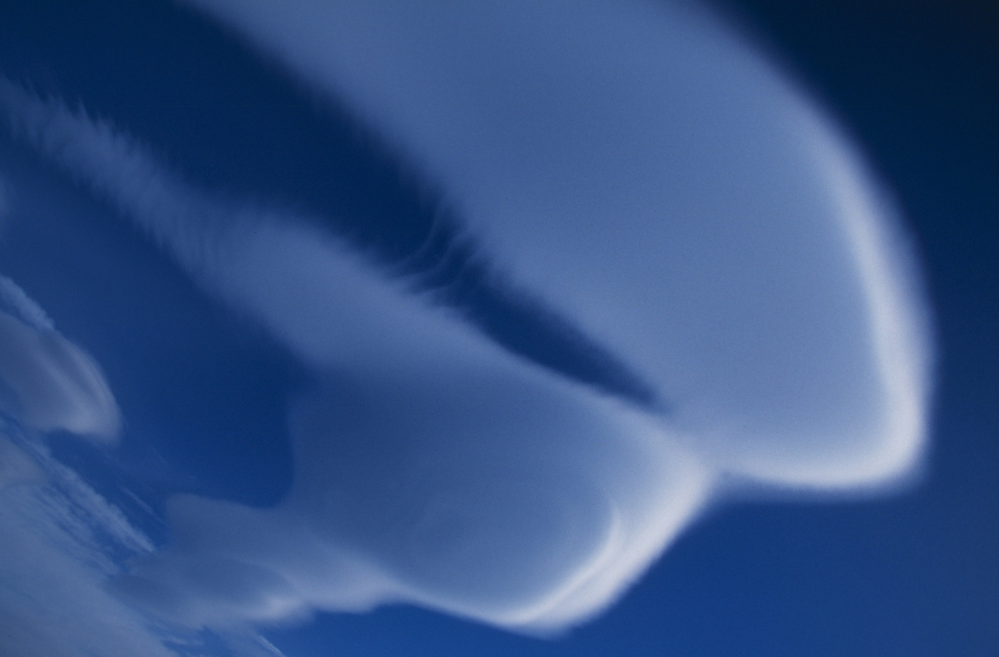
Heard Island
2000

Slide 2
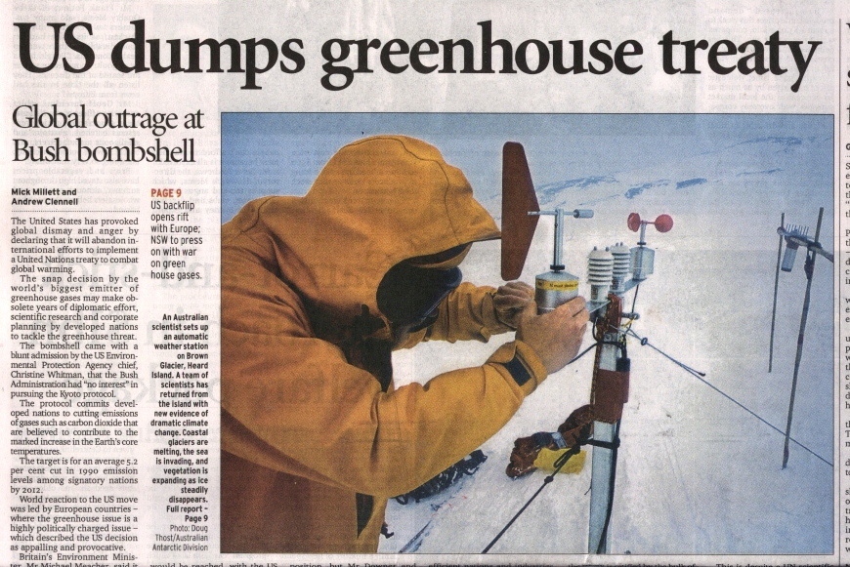
Sydney Morning Herald, March 30, 2001

Slide 3
Heard Island 2000
Study of the Brown Glacier
Introduction
Why the Brown Glacier?
What we did
Weather data & results
Herr Truffer … (the Australian Scientist)

Slide 4
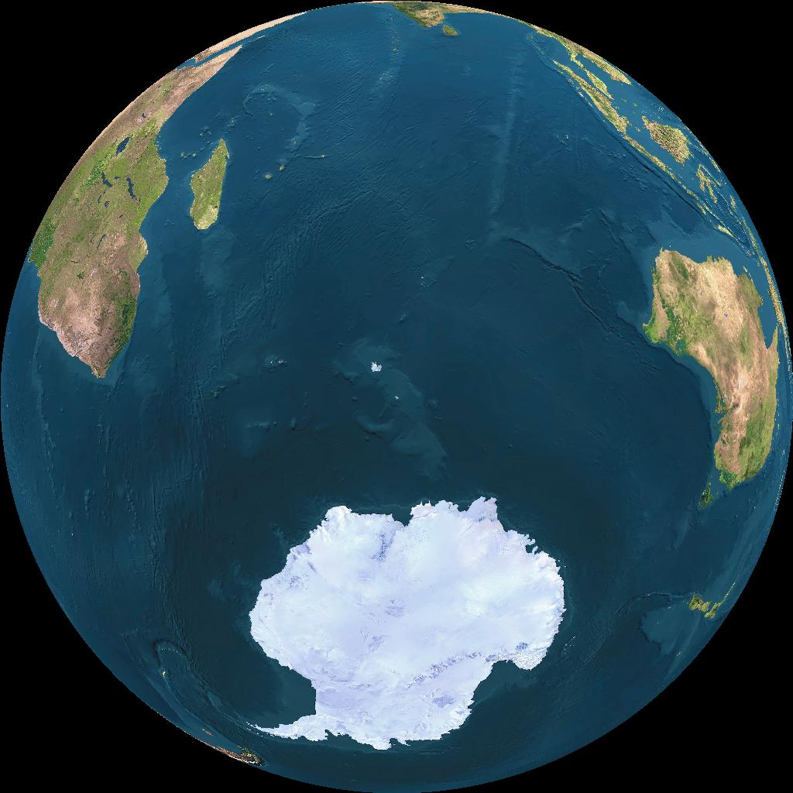
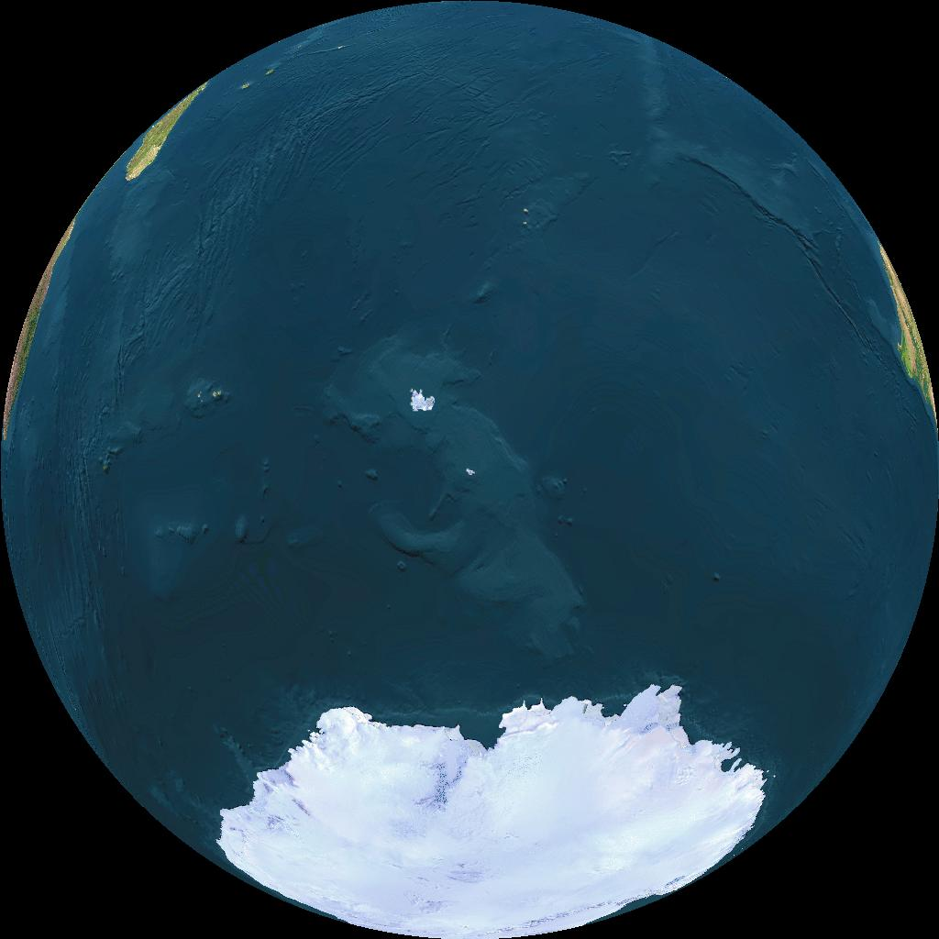
Heard Island 2000
Location
53 S
73.5 E
463
4122
1751

Slide 5
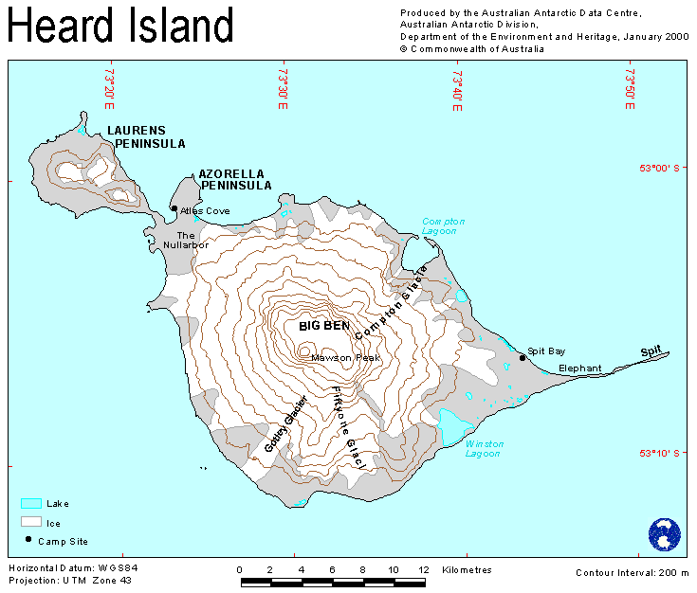
Heard Island 2000
Location

Slide 6
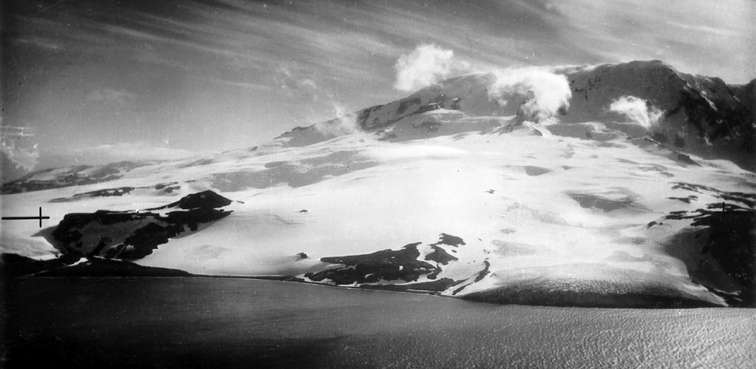
Scarlet Hill
Brown Glacier
Skua Beach
1947

Slide 7
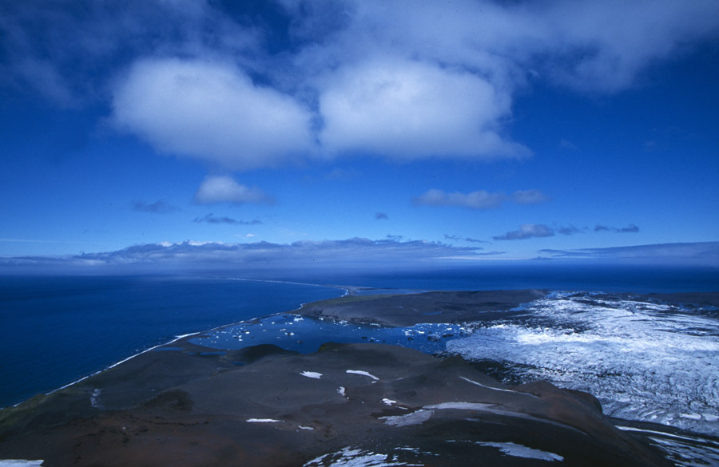
November 2000

Slide 8
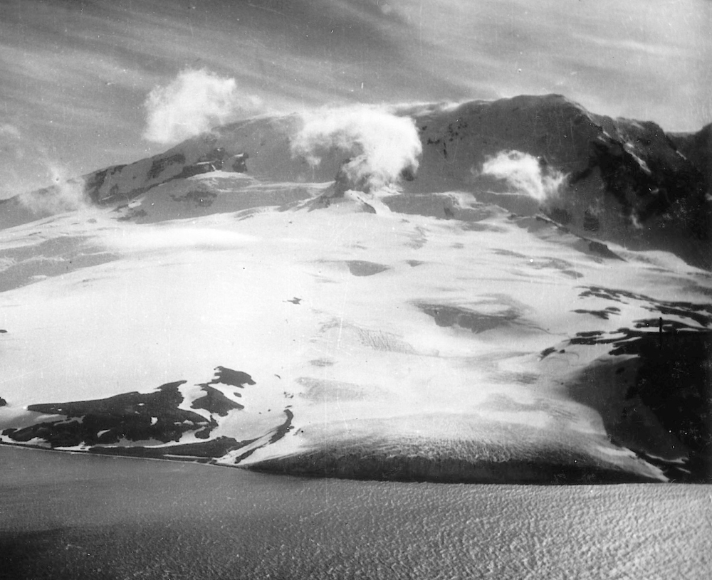
1947

Slide 9
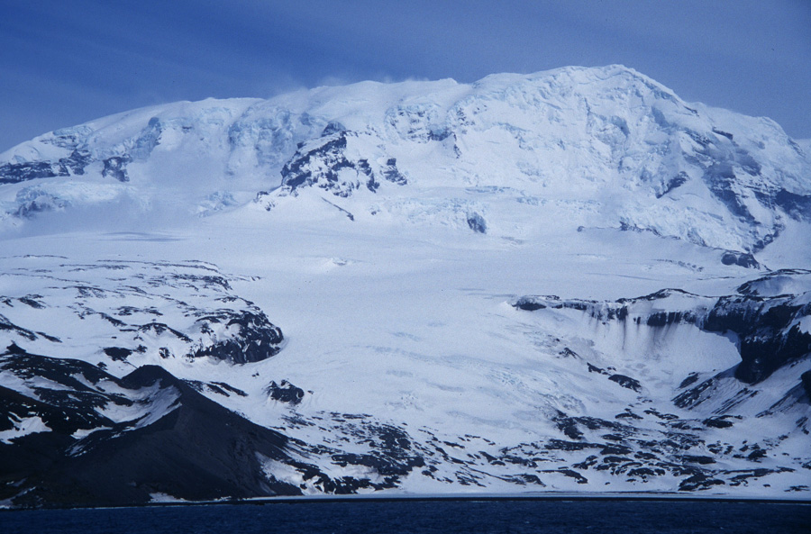
 BG05



Rock AWS


 BG35


 BG50
November 2000

Slide 10
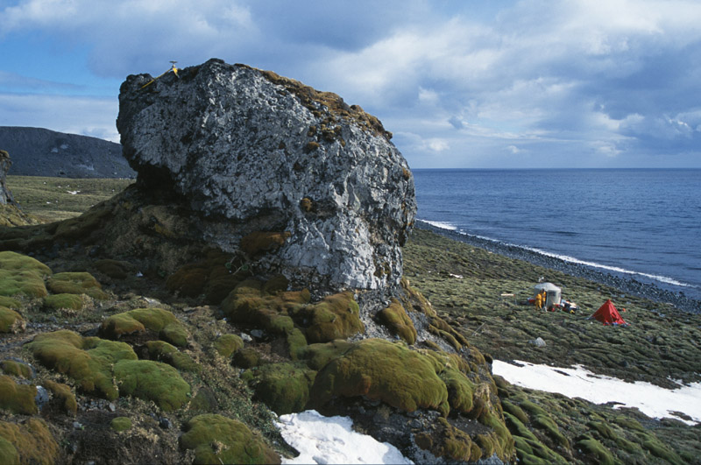

Slide 11
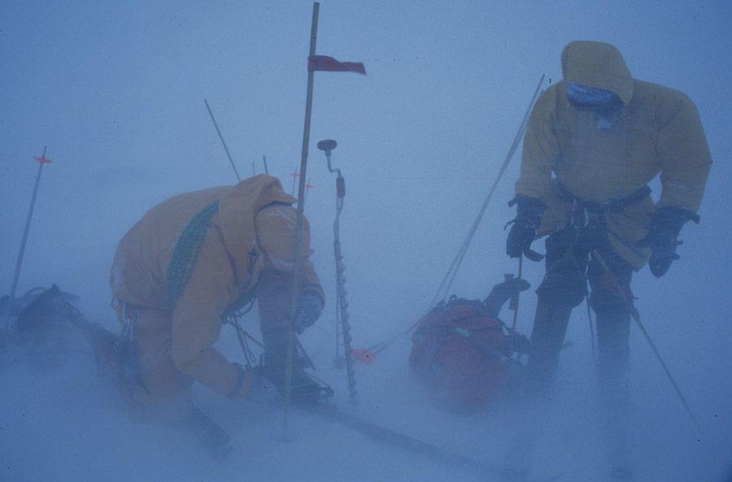

Slide 12
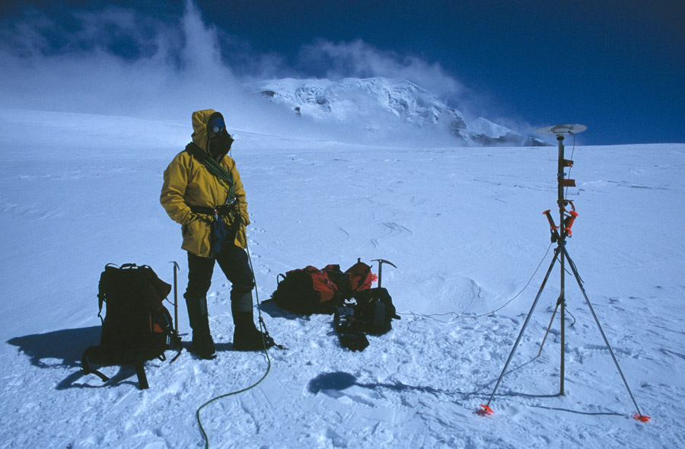

Slide 13
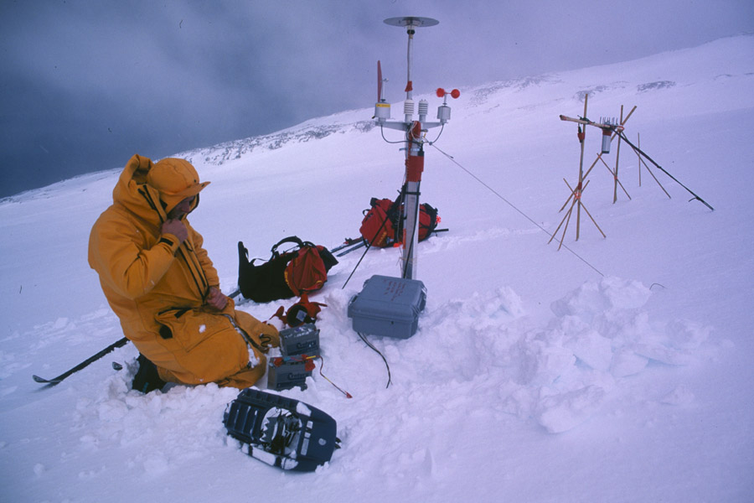

Slide 14
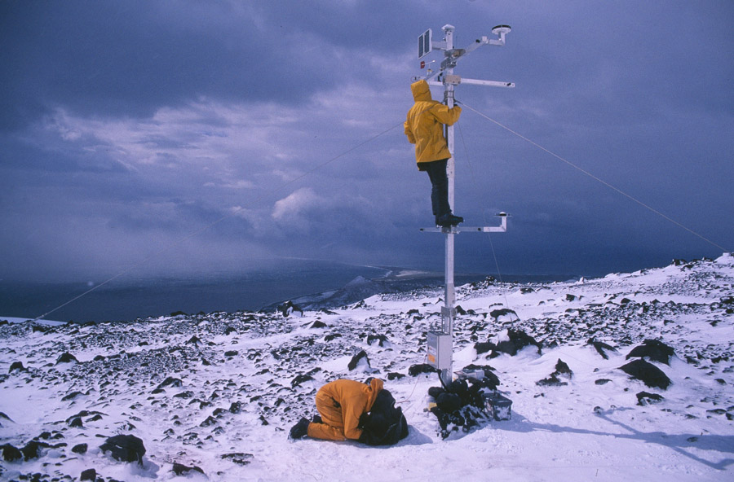

Slide 15
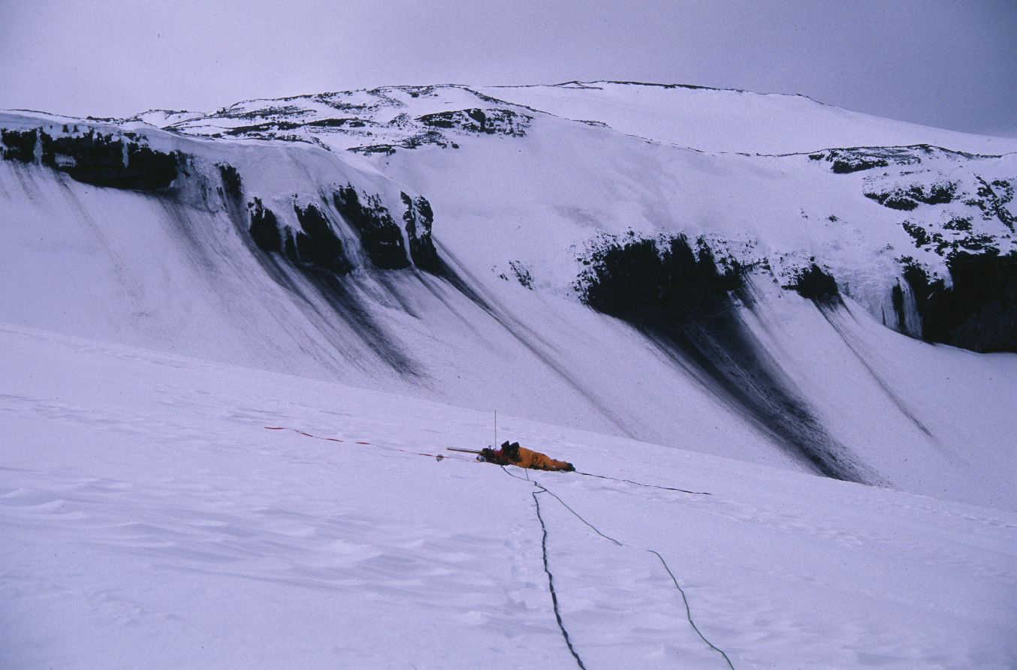

Slide 16
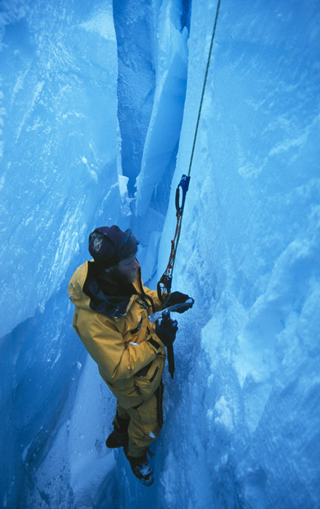

Slide 22
March 2.76 ºC/100a
Average 1.74 ºC/100a
August 0.64 ºC/100a

Slide 23
Lapse rate 0.72 ºC

Slide 24












Föhn Winds
33 hours >7 ºC
Rock AWS, 550m asl

Atlas Cove AWS, sea level

Slide 25
Rock AWS, 550m asl
Spit Bay AWS, sea level

Slide 26
Föhn Winds
strong, gusty, dry and warm winds which develop on the lee side of a mountain range when stable air is forced to flow over the barrier by the regional pressure gradient
Rises, loses moisture, cools at saturated adiabatic lapse rate (0.65 °C per 100 m)
Decends, warms at dry adiabatic lapse rate (1.0 °C per 100 m)
Heard Island e.g.: T difference as much as 13 °C at sea level after 2700 m
In many instances however, there may be no precipitation over the mountain, and in such cases the föhn effect is the result of standing wave motions forcing air from higher levels to descend (Barry & Chorley, 1976)

Slide 27
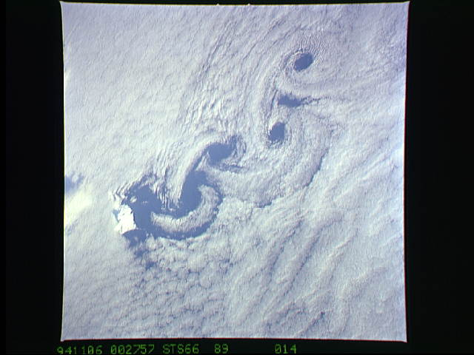
von Karmen Vortices

Slide 29
Precipitation
0.75 m snow fall, 25 days in November
Using precipitation data from 1948-54 dataset
Gives average water equivalent accumulation at BG35 of 6.20 m

Slide 31
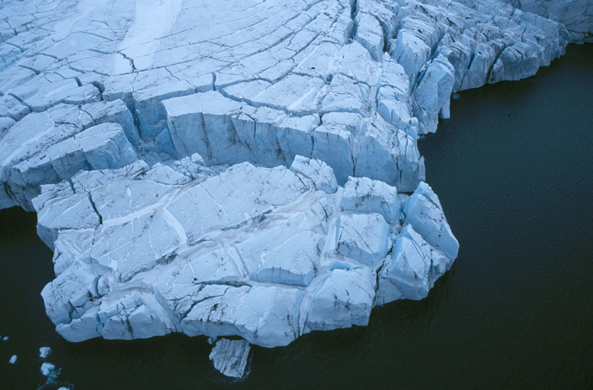

Slide 32
