Slide 1
Service Bus DTF on Dropbox
Avik Mazumder- 1100187

Slide 2
Scope of The Project
In this project focused on Drop box there are several social platform here just login the dropbox via token then upload file.
In the Durable task framework integrated project, after getting the access token using that token login the social platform and upload the files to the dropbox

Slide 3
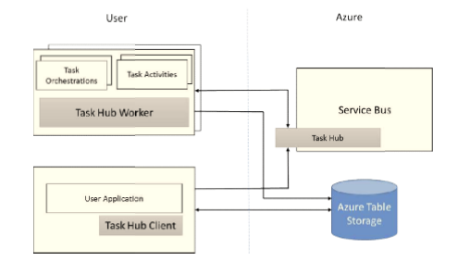
Core Concepts
Task Hub
Task Activities
Task Orchestrations
Task Hub Worker
Task Hub Client

Slide 4
Project Cases
Successful Authentication: Enters correct username and password and login the dropbox.
Authorization: User Should allow the notification.
Upload File: After Authorization File uploaded on the Dropbox.

