Slide 1

MULTILAYER PERCEPTRON
PRESENTED BY
ABOBARIN OPEYEMI
NARAYAN NARVEKAR
Directed by: Prof. Damir Dobric

Slide 2
INTRODUCTION
A neural network is a machine designed to model the way in which our brain can perform a particular task of interest.
The heart of a neural network is the learning algorithm, whose function is to modify the weights of the neural network in an optimized manner to achieve the desired objective.
A multilayer perceptron (MLP) is a class of feed forward artificial neural network that is used to solve linearly non-separable problems.

Slide 3
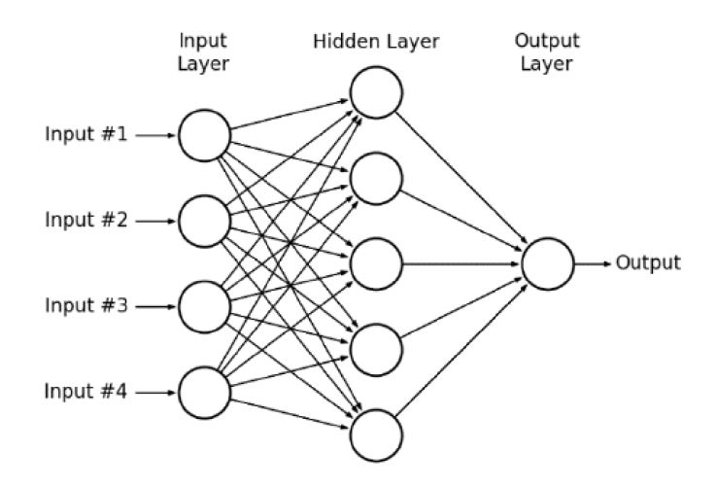
ARCHITECTURE OF MULTILAYER PERCEPTRON

Slide 4
IMPLEMENTATION DETAILS
STEP 1 Input a set of training examples: The training datasets are fed to the MLP neural network, which is thus trained by updating the weights and biases at each neuron such that the error at the output is minimized.
STEP 2 Feed forward path: If L is the total number of layers in the network, then for each l = 2, 3..., L, the weighted sum is computed at each neuron as follows:
z^{x,l} = w^{l}a^{x,l} + b^{l}
This weighted sum is then used to calculate the output at each neuron by passing it through the activation function, σ.
STEP 3 Output layer error: The output error for each neuron in the output layer is given by the equation:
δ^{x,L} = ∇_{a}C_{x} ⊙ σ|(z^{x,L})
STEP 4 Back Propagation: For each l = L-1, L-2,…, 2, we need to compute the error at each neuron. This error is given by,
δ^{x,l} = ((w^{l+1})^{T} δ^{x,l+1} ) ⊙ σ|(z^{x,l})
The rate of change of cost function with respect to the biases is given by,
∂C/∂b^{l}_{j} = δ^{l}_{j}
Similarly, the rate of change of cost function with respect to the weights is given by,
∂C/∂w^{l}_{jk} = a_{k}^{l-1} δ^{l}_{j}
STEP 5 Gradient Descent: For l = L, L-1, L-2,…, 2, the biases are updated according to the following rule,
b^{l}_{j} -> b^{l}_{j} – (α δ^{l}_{j})
Similarly, the weights are updated according to the following rule,
w^{l}_{jk} -> w^{l}_{jk} – (α a_{k}^{l-1} δ^{l}_{j})

Slide 5
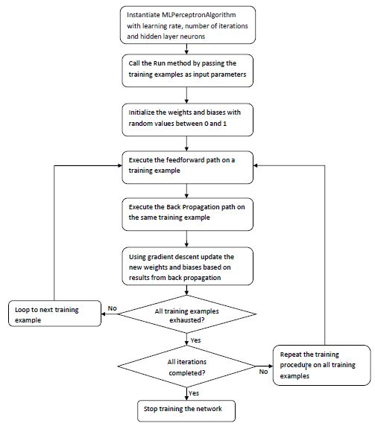
TRAINING PROCESS FLOWCHART

Slide 6
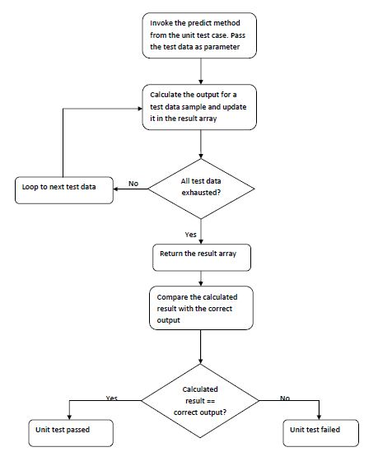
VALIDATION PROCESS FLOWCHART

Slide 7
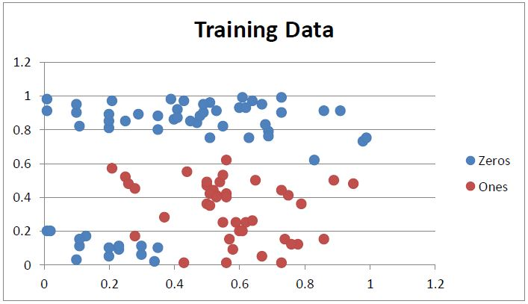
TRAINING DATASHEETS FOR UNIT TEST 1
The first unit test consists of the following training data pattern. The blue dots have the label 0 and the red dots have the label 1.
The MLP learning algorithm was run on the above training data set, with learning rate = 0.1, number of iterations = 1000, hidden layer neurons = 6.

Slide 8
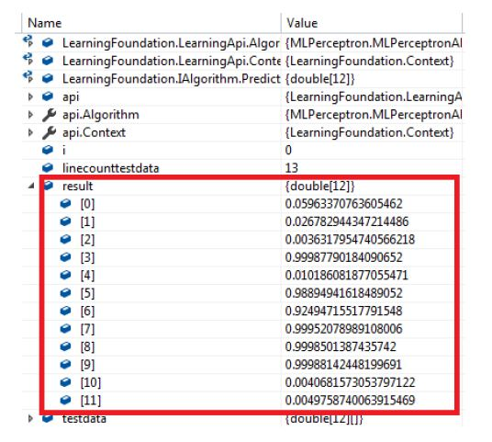
RESULTS FOR UNIT TEST 1
Applying the rule that a value greater than or equal to 0.5 represents a 1 and less than 0.5 represents a zero and comparing the calculated results with the actual output from the test data table, we see that the MLP learning algorithm has correctly classified all the test data.

Slide 9
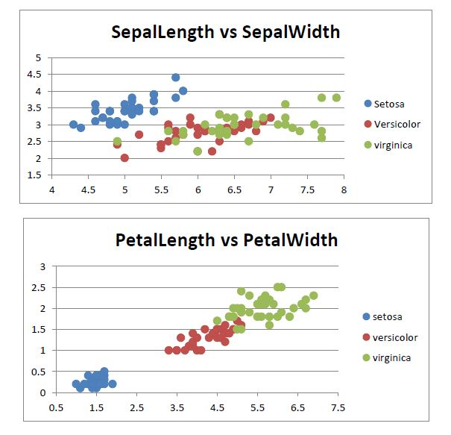
TRAINING DATASHEET FOR UNIT TEST 2
The second unit test consists of the “Iris” dataset which classifies iris plants into three species. It includes 100 samples distributed between three species, with some properties about each flower. The columns in this dataset are:
Sepal Length
Sepal Width
Petal Length
Petal Width
Species

Slide 10
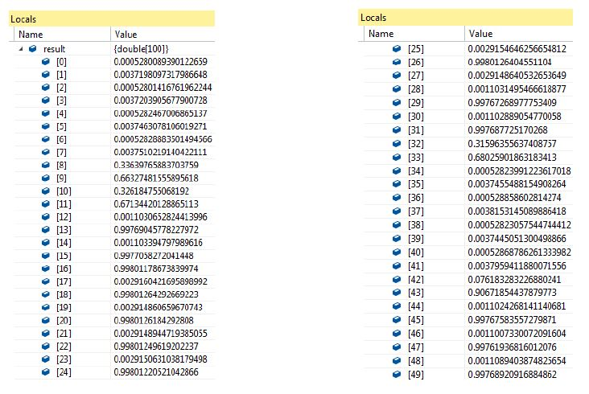
RESULTS FOR UNIT TEST 2
The MLP learning algorithm was run on the above training data set, with Learning rate = 0.1, number of iterations = 10000 and hidden layer neurons = (3, 4, 3) and hyperbolic tangent activation function for the hidden layers and sigmoid activation function for the output layer.
The attached snapshots indicate the results calculated on the test data by the MLP learning algorithm

Slide 11
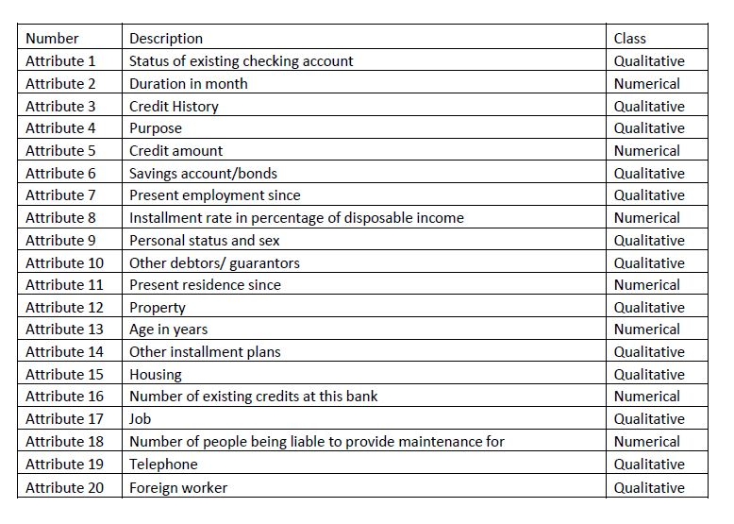
TRAINING DATASHEET FOR UNIT TEST 3
This test case uses the German Dataset as the training dataset. This dataset classifies people described by a set of attributes as good or bad credit risks. The following table describes the original attributes in the German dataset

Slide 12
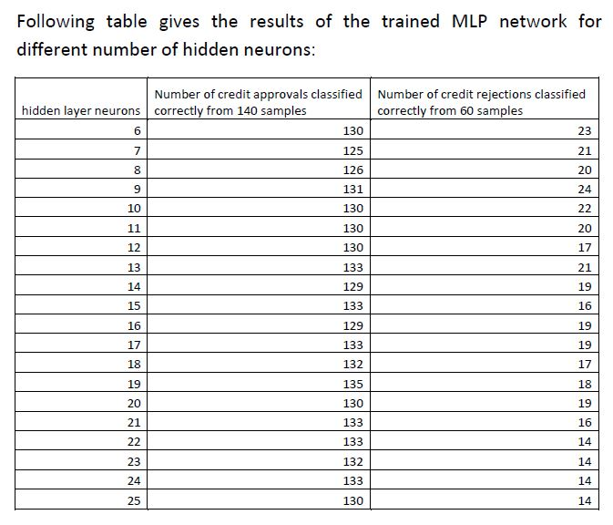
RESULTS FOR UNIT TEST 3
From the above table, the observation is that the model with 9 hidden neurons gives the best results, with a correct result percentage of 77.5%.
The number of hidden neurons can have a great impact on the network performance. Too few hidden neurons cannot solve complex credit rating problems, while too many of them may result in low efficiency and accuracy.

Slide 13
CONCLUSION
Key factors affecting the performance of MLP network:
Activation function: The Sigmoid and HyperbolicTan functions are the activation functions supported by MLP network. Both these functions suffer from the problem of vanishing gradients. The ReLU activation function can be used to solve the problem of vanishing gradients.
Gradient Descent vs. Stochastic Gradient Descent: Stochastic gradient descent often converges much faster compared to gradient descent but the error function is not as well minimized as in the case of gradient descent. Another advantage of stochastic gradient descent is that the randomness or noise introduced by it allows escaping from local minima to reach a better minimum.
Learning rate: In general, we need to find a learning rate that is low enough for the network to converge to something useful, but high enough such that we don’t have to spend years training it.
Epoch: There is no hard and fast rule on the right number of epochs for a network. The answer is different for different datasets and is generally dependant on how diverse the data is.
Number of hidden layers: we can get decent performance by setting the hidden layer configuration using the below two rules:
1. Number of hidden layers equals one
2. Number of neurons in that layer is the mean of the neurons in the input and output layers.

Slide 14


