Slide 1

Implementation Of Test Save And Load For “Delta Rule Learning Algorithm”
Information Technology Course Module Software Engineering
by Damir Dobric / Andreas Pech
Presented By:
Aamir Muhammad
Matriculation No : 1272918

Slide 2
INTRODUCTION
The scope of the project is to implement test Save and Load Methods.
Implementation Algorithm is “Delta Rule Learning Algorithm”.
Save and Load are two different functions implemented in Learning-api.
Save and Load to be implemented in Test Method.

Slide 3
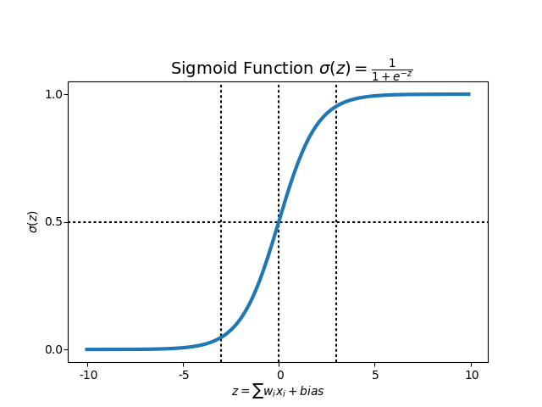
DELTA RULE LEARNING
The Delta Rule uses the difference between target activation (i.e., target output values) and obtained activation to drive learning.
The Delta Rule employs the error function for what is known as Gradient Descent learning, which involves the ‘modification of weights along the most direct path in weight-space to minimize error.
change applied to a given weight is proportional to the negative of the derivative of the error with respect to that weight.
The strength of network connections (i.e., the values of the weights) are adjusted to reduce the difference between target and actual output activation (i.e., error).

Slide 4
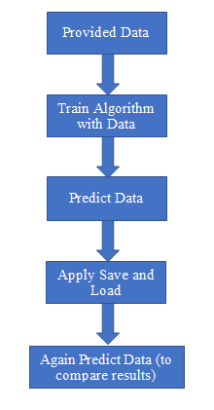
SAVE & LOAD ARCHITECTURE
Save and Load functions were built already in Learning-api. The task is to test Save and Load methods on “Delta Rule Learning ” algorithm .

Slide 5

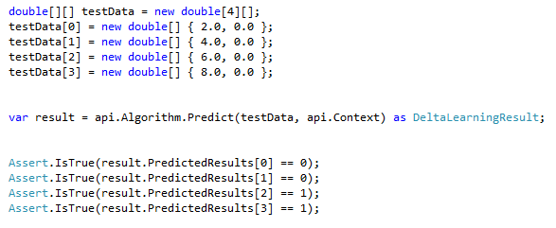
TRAINING AND PREDICTING DATA
The first step is to train the Algorithm with provided data.
Training Syntax:
Second step is to define data for prediction and then predicting data.
Prediction Syntax:

Slide 6

SAVE FUNCTION
Save function will save the previously trained data in some .JSON file.
Syntax:
This will create a .JSON file named “DeltaRuleLearningSave1”.
All data will be saved in this .JSON file:

Slide 7
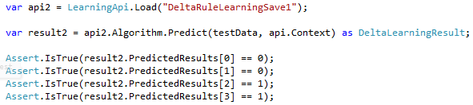
LOAD FUNCTION
Load function will load the data from that .JSON file mentioned in save function.
Syntax:
Again Predicting data after load to match results.

Slide 8
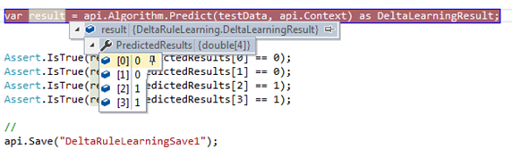
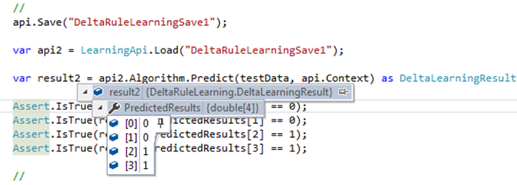
RESULTS
The corresponding two figures shows the result of only one test method.
Output Values Before Save
Output Values after Load

Slide 9
Conclusion
Therefore it can be concluded that Save and Load function have been successfully implemented.
The output values before Save (Predicted Values) are equal to the output values after Load (Predicted Values).
The Predicted Values are achieved to be same before Save and after load.

Slide 10
THANK YOU

