Slide 1

Implementation of Kernel Logistic Regression Software Engineering WS 18/19
Lecturer: Damir Dobric StudentName : Chandrima Biswas Professor: Prof. Dr. Andreas Pech Matriculation Number : 1248515 Email : cbiswas@stud.fra-uas.de

Slide 2
Content
Introduction
Kernel Logistic Regression
The RBF Kernel
Ordinary Logistic Regression
Formulation of KLR
Implementation
Result

Slide 3
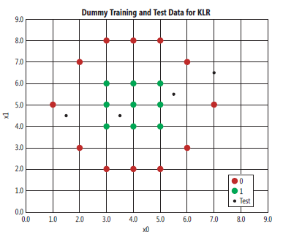
Overview
Logistic Regression
problematic linearity
Low performance
Kernel Logistic Regression
Also used for binary prediction (False=0 or True=1)
Handle non-Linearly separable data
Use RBF function
RBF Function used for similarity between two vector
Equation for RBF:
K(v1,v2 ) = K(v1, v2) = exp( - || v1 - v2 ||^2 / (2 * sigma^2) )
Less value of K- not similar.

Slide 4
Implementation
Integrated Modules:
LearningApi
XUnit
CSVReader
Implemented Modules:
Run and Train Data
Prediction
Unit Tests
Data Source
CSV File
Start LearningApi
Read csv file for input data
Data Splitting
Train Data to get Score
Predict data
Test Predict data
End
Figure: Project Architecture

Slide 5
Implementation
Start
Start
Get Training Data
Get Test Data
Pre-compute Kernel Matrix
(Item-item similarity)
Compare Current Test Data Against All Training Data Using Kernel Function
Train Algorithm to Calculate Alpha values and Bias
Calculate Predicted Values Using Pre-Computed Alpha and Bias
Return Predicted Values
Return Alpha and Data
End
End
Flow diagram of Run() and Train() methods.
Flow diagram of Predict() methods

Slide 6
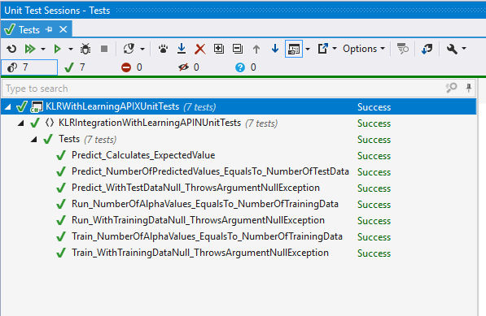
Result
Unit Test using xunit

Slide 7
Thank You for your Attention!!

