Slide 1

Implementation of a Euclidean Color Filter in Learning API
Software Engineering WS 18/19
Lecturer: Mr. Damir Dobric Student: Deepali Ashok Betkar Professor: Prof. Dr. Andreas Pech Matr. Nr: 1324536
Notes:
Good morning, Professor Trick and everyone. Today, I am going to introduce to you about Service Layer Core Protocol.

Slide 2
Contents
Euclidean color filter overview
RGB-Colors and Euclidean distance
What does the Euclidean filter do?
2. Architecture of the Project
Implementation
Tests
Notes:
In my presentation, I will follow this agenda. Firstly, the brief definition and the goal of Service Layer is shown. In the next part, the architectural of Service Layer is explained in details.
And then principles and functions are mentioned. Finally is the reference.

Slide 3
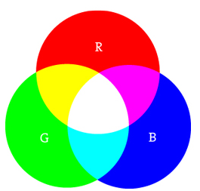
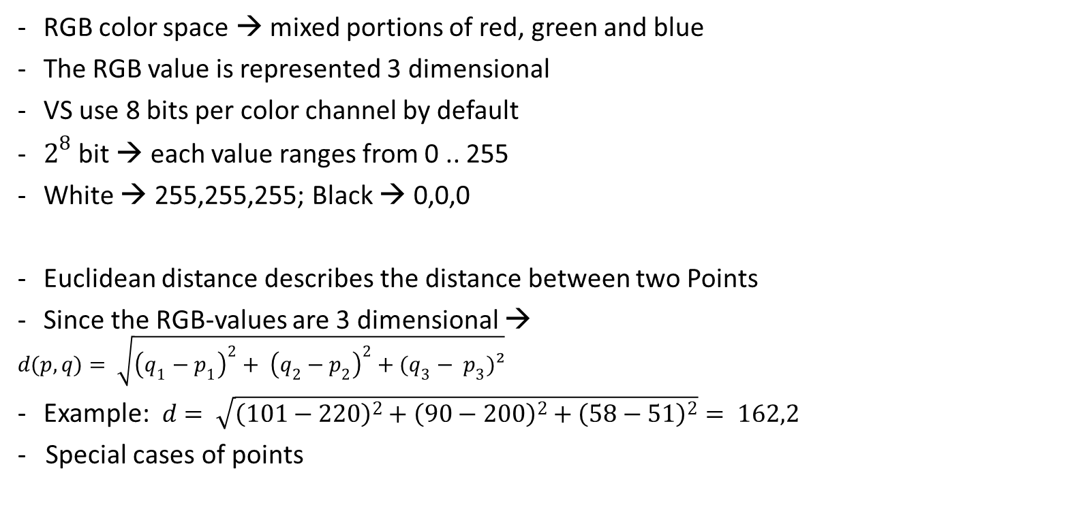
Euclidean color filter overview RGB-Colors and Euclidean distance
RGB color space → mixed portions of red, green and blue
The RGB value is represented 3 dimensional
VS use 8 bits per color channel by default
$2^{8}$ bit → each value ranges from 0 .. 255
White → 255,255,255; Black → 0,0,0
Euclidean distance describes the distance between two Points
Since the RGB-values are 3 dimensional →
$$d(p,q)= \sqrt{{\left(q_{1}−p_{1}\right)}^{2}+ {\left(q_{2}−p_{2}\right)}^{2}+(q_{3}− p_{3})²}$$
Example: $d= \sqrt{{\left(101−220\right)}^{2}+{\left(90−200\right)}^{2}+{\left(58−51\right)}^{2}}= 162,2$
- Special cases of points

Slide 4
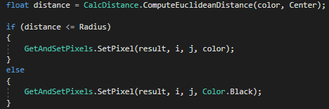
Euclidean color filter overview What does the Euclidean Filter do?
Two parameters to specify: Color center and float radius
Loops through all pixel of an image
Calculates the Euclidean distance between the RGB value of the pixel and the specified center value
If the the Euclidean distance is within the radius
→ Pixel keeps its RGB value
If the Euclidean distance is bigger than the radius
→ Pixel is set to color Black.
If/else statement for filtering

Slide 5
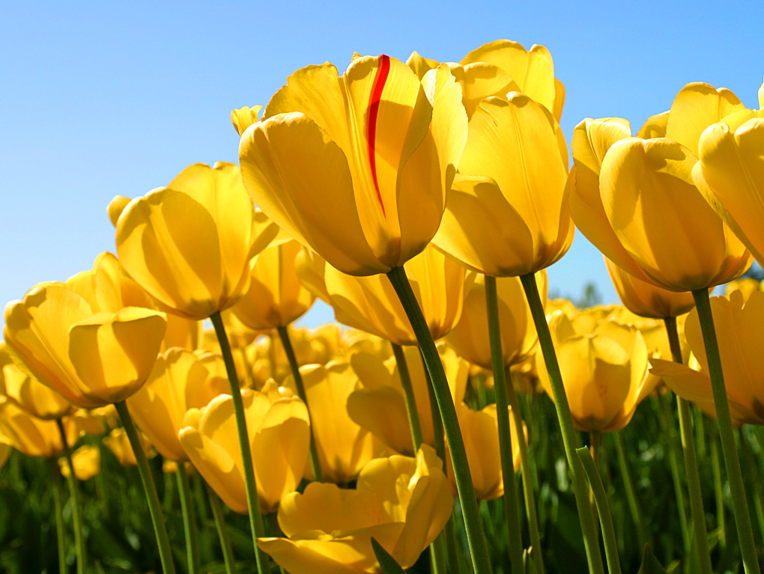
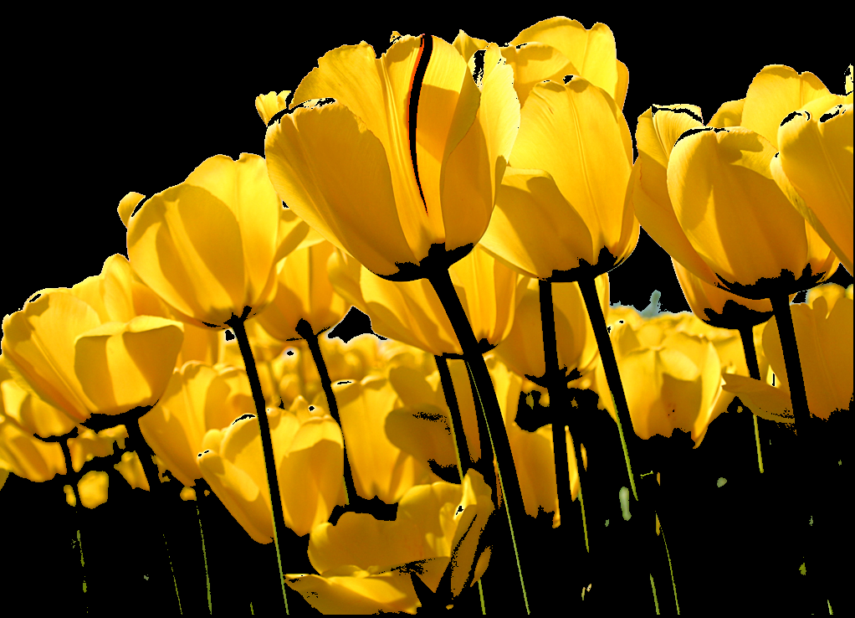
Euclidean color filter overview Example
Original image (before running the algorithm)
Filtered image (after running the algorithm)

Slide 6
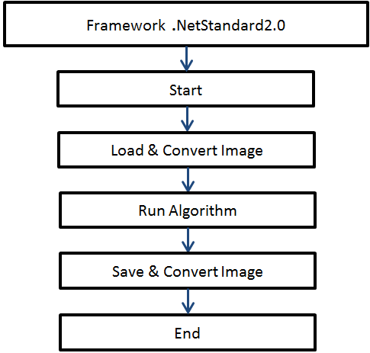
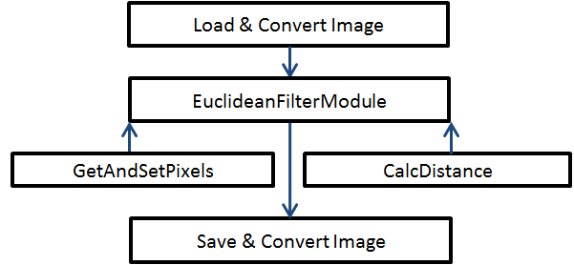
Architecture of the Project
Overview of the classes which are necessary for the filter
The main architecture of the progream

Slide 7
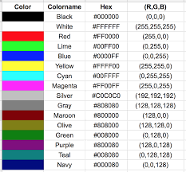
Euclidean Color Filter Code Implementation:
EuclideanFilterModule.cs
EuclideanFilterModuleExtension.cs
GetAndSetPixel.cs
CalDistance.cs
EuclideanFilterTest
EuclideanFilterWinFormApp

Slide 8
Thank you for your attention!
Do you have any questions?

