Slide 1

Implementation of Convolutional Network using .NET CORE Framework
Software Engineering WS 18/19
Lecturer: Mr. Damir Dobric Student: Devan Nair Professor: Prof. Dr. Andreas Pech Matr. Nr: 1274369
Taimour Yousef
Matr.Nr:1276574
Notes:
Good morning, Professor Trick and everyone. Today, I am going to introduce to you about Service Layer Core Protocol.

Slide 2
Contents
Convolutional Networks overview
MNIST datasets for classification and convolutional filters
How does multiple convolutional layers classify images?
2. Architecture of the Project
3. Implementation
Notes:
In my presentation, I will follow this agenda. Firstly, the brief definition and the goal of Service Layer is shown. In the next part, the architectural of Service Layer is explained in details.
And then principles and functions are mentioned. Finally is the reference.

Slide 3
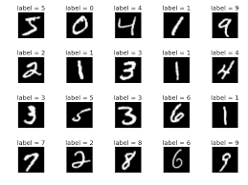
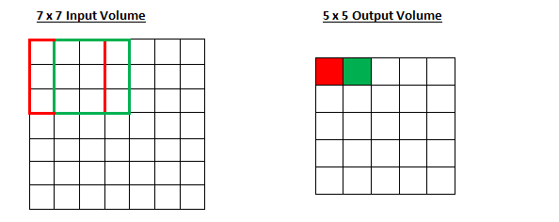
Convolutional Networks overview Convolutional filters and MNIST dataset
Handwritten digits → grayscale images with pixel values in range 0-255
Convolutional filters → 2D matrices which are of constant size
Filter Size is 5x5 for an image size of 28x28(MNIST image)
Multiple convolutional filters are stacked each extracting features
Each filter convolves over a section of the image to produce a ‘filter output’
- Example of how the filter passes over entire image

Slide 4
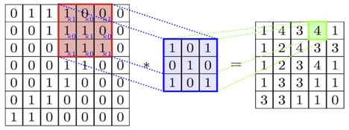
Convolutional filter overview What does the Convolutional Filter do?
Each continuum of non zero value in an image matrix represents a geometry
When filter convolves over the entire image it finds geometry to which it is configured to
In the result of convolution operation one gets the weights for which the given geometry is detected inside the image.
The entire convolution operation is summing up all pointwise multiplication of pixel value with the filter co-efficients
It is these filter co-efficients which are learnt by the network through back propogation algorithm
The corresponding adjusted weights would lead to the filter correctly identifying a geometric feature like a curve or a loop etc.
For e.g. Convolutional Filter weighing out pattern ‘X’ in image

Slide 5
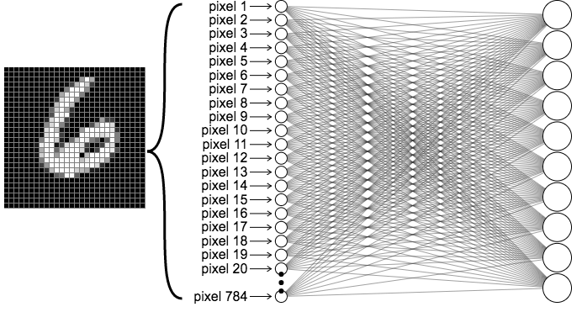
Convolutional Network Hypothetical
Convolutional Filters
Rectified Linear Units
Pooling Layer
Original image (At the input layer)
Classified Labels(output layer)

Slide 6
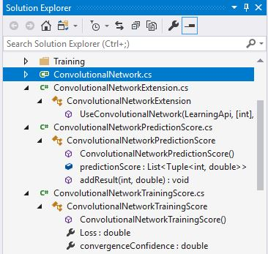
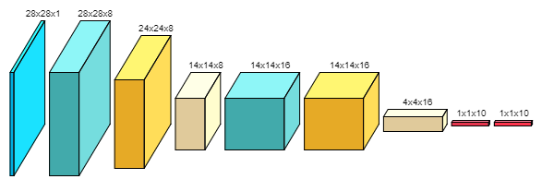
Architecture of the Project
The main architecture of the program
Overview of the Learning API Implementation classes

Slide 7
Implementation
Code explanation…

Slide 8
Thank you for your attention!
Do you have any questions?

