Slide 1
Title: American English Sign Language Classification Using Transformer(ViT)
Supervisor: Name: Dr. Manar Samad Assistant Professor Department of Computer Science Tennessee State University
Presented by: Name: AL AMIN Department of Electrical and Computer Engineering Tennessee State University
Presentation Date: 04/25/2023

Slide 2



CONTENT
1
Problem
2
Objective & Goal
3
Litarature Review
4
Dataset& Pre-processing
5
Hyperparameters & Methodology
6
Result
7
Discussion
8
Conclusion & Future work

Slide 3


PROBLEM
Speech impairment presents a communication barrier between sign language users and non-signers, but recent advancements in machine learning and deep learning techniques offer promising solutions to bridge this gap and facilitate effective communication through the interpretation of English Sign Language.
Figure: Communication by Sign language

Slide 4


GOAL & OBJECTIVE
Goal
The primary objective of this research is to develop a cutting-edge machine learning model that effectively interprets American Sign Language, enabling smooth communication between deaf individuals and the general population. By achieving a minimum of 90% precision rate, the proposed model aims to surpass existing state-of-the-art solutions in terms of accuracy, precision, and recall, thereby enhancing the inclusivity and accessibility of communication for the deaf community.
Objectives
Deployed machine learning approach vision based transformer (ViT).
Data pre processing techniques.
Minimize the need for large amounts of data.
Dataset:1634images in 26 classes(A-Z)
We also deployed Naive Bayes for comparison purpose.

Slide 5


Literature Review
Problem: Interpretation of Swedish Sign Language Using Convolutional Neural Networks and Transfer Learning
Model: pre-trained InceptionV3.
Dataset: 9400 images
Accuracy: 85%
Problem: A Method of Classifying Japanese Sign Language using Gathered Image Generation and Convolutional Neural Networks
Model: A multi-class support vector machine (SVM) and CNN.
Dataset: 4000 images
Accuracy: 84.2%
Azerbaijani sign language recognition using machine learning approach
Model: TensorFlow Objection API algorithms, Mobile Net v2 pre-trained model has been leveraged for this task
Dataset: 10000 images
Mean average precision results: 83%
American Sign Language Recognition using Deep Learning and Computer Vision
Model: CNN & RNN
Dataset: 4000 images
Mean average precision results: 88%

Slide 6

METHODOLOGY
Why Vision Transformer (ViT):
Scalability
Global context understanding
Simplified architecture
Transfer learning capability
End-to-end training
Multi-modal applicability
Performance consistency

Slide 7
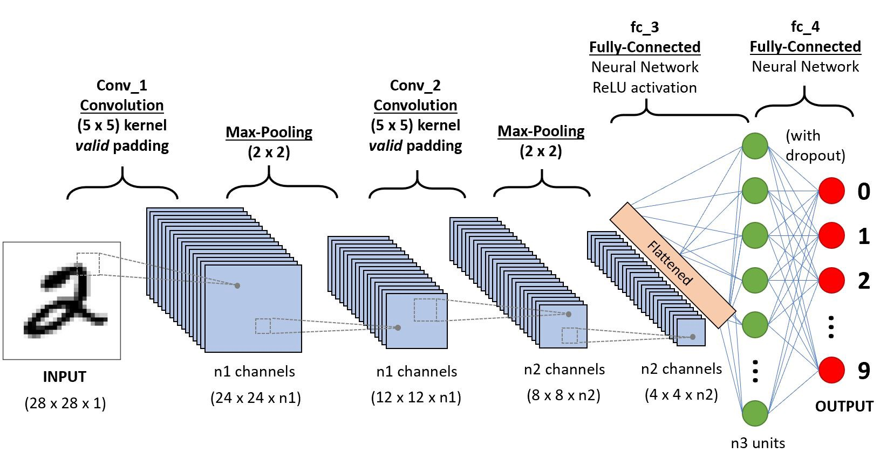
METHODOLOGY
Architectural deference between CNN and Transformer:
CNN Architecture:
ViT Architecture:

Slide 8

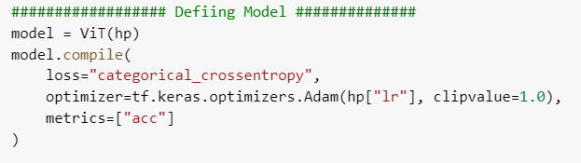
MODEL DETAILS
Model:
The model is defined using the ViT class with the hyperparameters hp as an argument. The ViT class represents a Vision Transformer model, a type of deep learning architecture designed specifically for computer vision tasks.
Model. compile:
The compile method is called on the model to set the loss function, optimizer, and evaluation metrics for training.
Loss function: Categorical Cross-Entropy, which is suitable for multi-class classification problems.
Optimizer: Adam optimizer with a learning rate specified in the hyperparameters hp["lr"]. The optimizer's clipvalue is set to 1.0, which prevents gradients from becoming too large and causing unstable training.
Evaluation Metric: Accuracy, which measures the proportion of correctly classified examples.

Slide 9
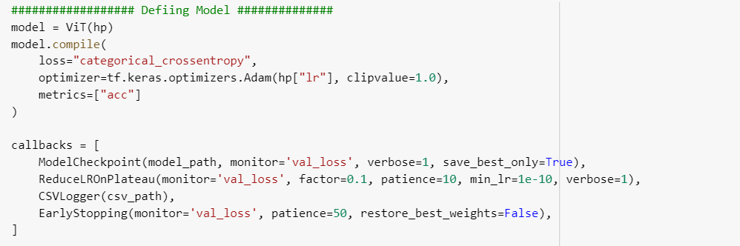
MODEL DETAILS
Callbacks are used to monitor and adjust the training process based on the performance of the model.
ModelCheckpoint: Saves the model with the best validation loss during training, meaning only the model with the lowest validation loss will be saved.
ReduceLROnPlateau: Reduces the learning rate when the validation loss plateaus (i.e., stops improving). The monitor parameter is set to 'val_loss', and factor, patience, and min_lr are set to control the rate of learning rate reduction and the minimum learning rate.
EarlyStopping: Stops training when the validation loss stops improving for a specified number of epochs (patience).

Slide 10

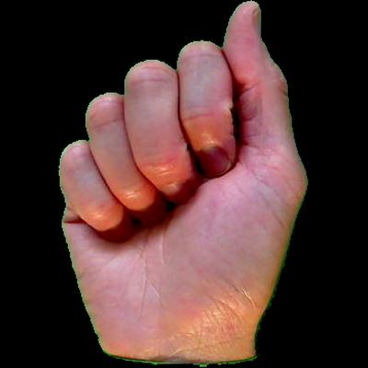
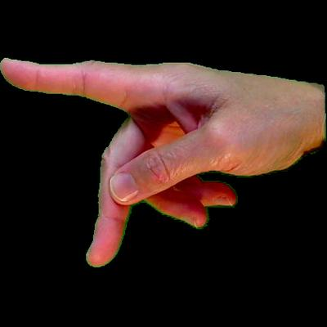
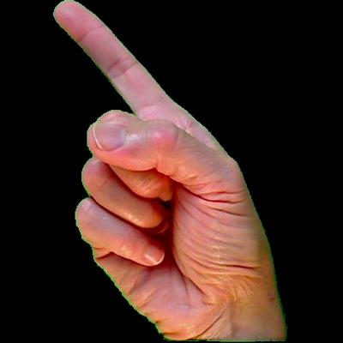
DATASET
Dataset Samples:
Data Distributions:
Sign (A)
Data Collection: Open source Kaggle[American sign Language Dataset]
Sign (P)
Data Pre-processing:
Image Reading and Resizing
Image Normalization
Image Patch Extraction
Label Processing
Sign (Z)

Slide 11
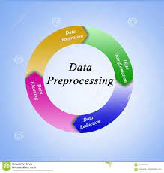
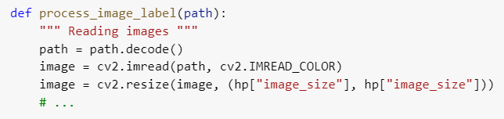
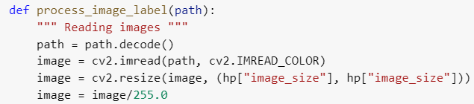
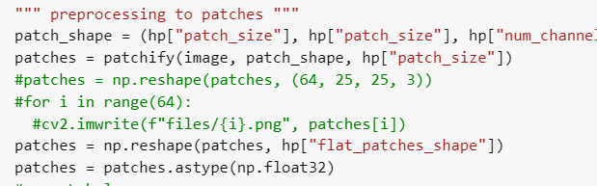
DATA-PREPROCESSING
Image Reading and Resizing
Image Normalization
Image Patch Extraction

Slide 12
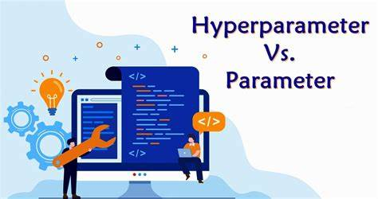
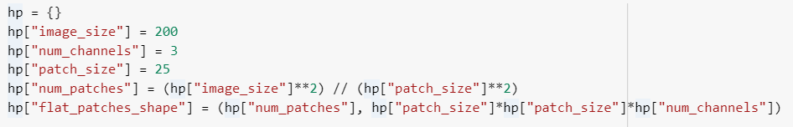
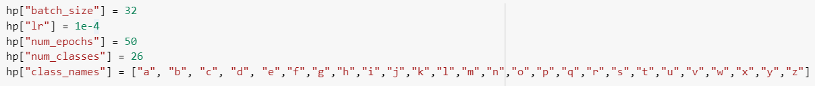
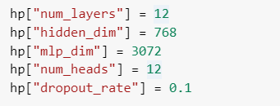
Hyperparameters
Hyperparameter Definition
Setting Training Hyperparameters
Model Architecture Hyperparameter Definition

Slide 13

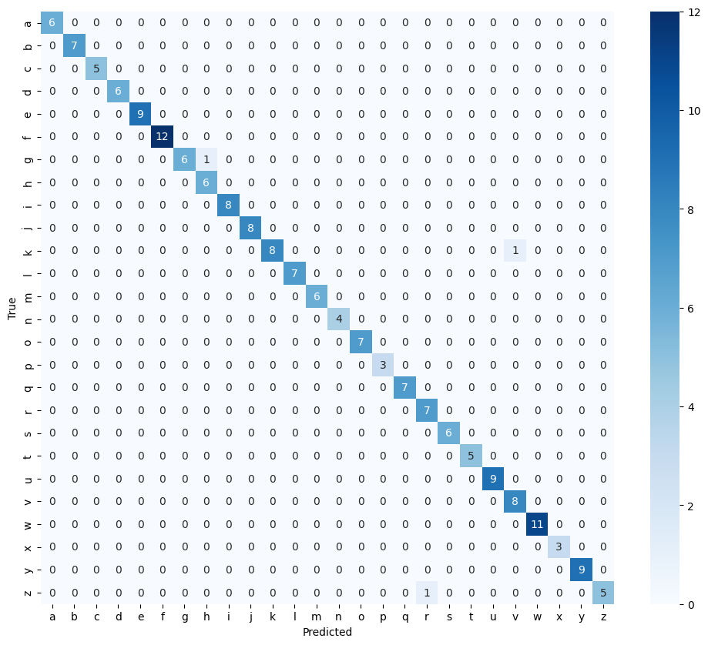
Result
Confusion Matrix

Slide 14
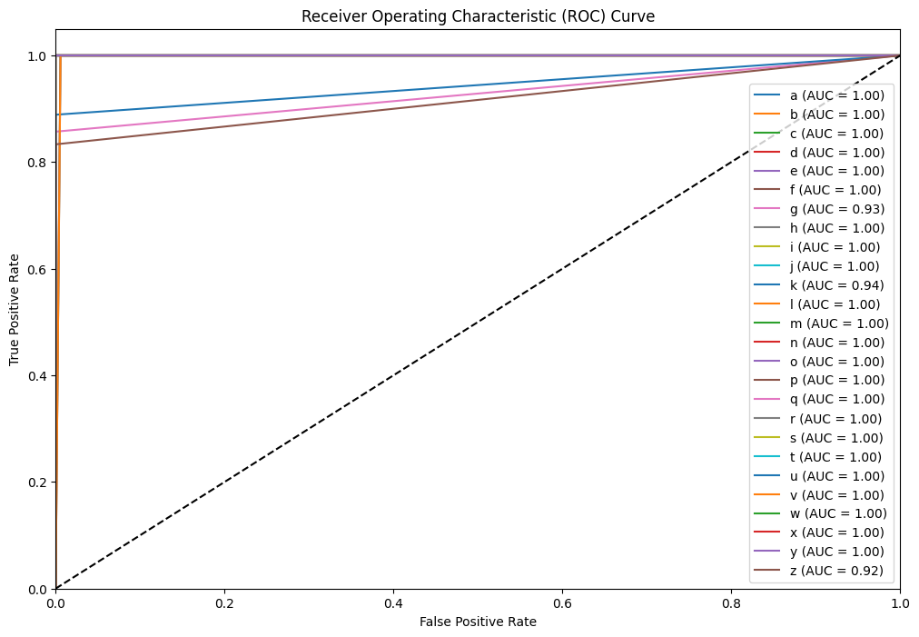
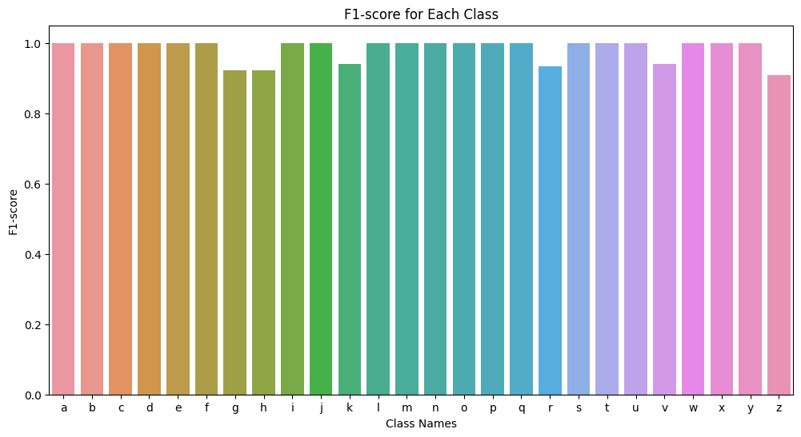
Result
ROC Curve
F1- Score

Slide 15


Discussion
Comparison Table:
Model | Dataset | Accuracy | Precision | Recall | F1-Score
Transformer(ViT) | 1634 | 90% | 90% | 89% | 89%
Naive Bayes | 5000 | 0.884% | 0.8934% | 0.8654% | 0.8637%
CNN | 6000 | 90% | 89% | 90% | 89%

Slide 16
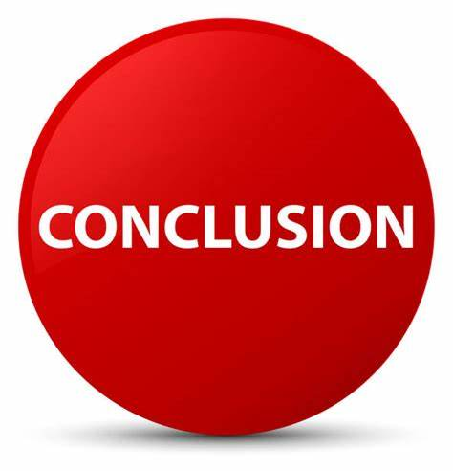
CONCLUSION
In conclusion, this project demonstrates the application of a Vision Transformer (ViT) model for the interpretation of English Sign Language. The primary goal is to bridge the communication gap between sign language users and non-signers by accurately recognizing and classifying sign language gestures..

Slide 17

FUTURE WORK
Future Work :
We can broaden this task to encompass real-life video gestures, allowing for two-way communication between both communities.
This can be implemented in real-life scenarios to assist deaf individuals, ensuring smooth communication similar to those without sign language barriers.
In addition to computer vision methods, we can also suggest incorporating Natural Language Processing (NLP) techniques to deploy real life devices like Amazon Google Alexa.

Slide 18

Question:
ANY QUESTION

Slide 19


THE END
THANK YOU

Slide 20
