Slide 1
JPEG2000
Image Compression Standard
Doni Pentcheva
Josh Smokovitz

Slide 2

Goal of Project
Explain the uses and advantages of the JPEG2000 image compression standard.
Create a naive version of the JPEG2000 using:
  the biorthogonal wavelet transform
  thresholding techniques

Slide 3
Advantages of JPEG2000
Eliminates the blocky appearance of the JPEG image standard.
  This is because it uses a wavelet transform instead of the discrete cosine transform (DCT).
  In the previous DCT version, blocks of the image are compressed individually without reference to the adjoining blocks.
  Using a DWT creates a much smoother image.

Slide 4
Advantages of JPEG2000
The compression rate is much higher, while the retention rate is the same, and often, better resolution is exhibited.
  20%-200% better than JPEG Standard with lossy compression
  Able to compress lossless with same engine, whereas, JPEG Standard only achieves lossy compression

Slide 5
Advantages of JPEG2000
Very versatile in its applications because the code can be modified to accommodate the various needs of users.
  Large pictures and low-contrast medical images are areas where the JPEG2000 far exceeds the JPEG Standard.

Slide 6
Building Naïve JPEG2000
The simplified version of the steps of this “naïve” process is illustrated below.
Source
Forward
Entropy
Compressed
Input Data
Transform
Quantization
Encoding
Image Data

Slide 7
Step 1
The first step is to obtain the biorthogonal wavelet transform.
Implementing the biorthogonal wavelet transform is important because it filters at signal boundaries, which is called symmetric extension.
In turn, symmetric extension adds a mirror image of the signal to the outside of the boundaries so that large errors are not introduced at the boundaries.

Slide 8
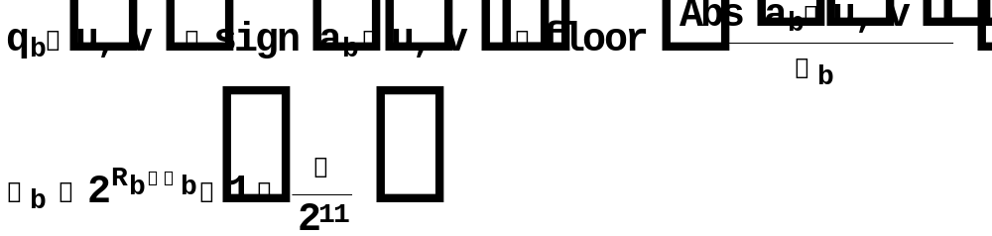
Step 2
The second step is to define a thresholding function.
This comprised the bulk of our project.

Slide 9
Step 2 (cont.)
Simple quantizing equation is defined by setting our step size (μ to 0).
In turn, that eliminated Δb.
So, our simple quantizer adheres to the following:
  First, the equation takes the sign of coefficient of the element in the subband, i.e., sign[-8]=-1.
  Then, the equation floors the absolute value of the element of the transformed subband.
  Finally, the equation multiplies the previous two calculations to obtain our quantized value.

Slide 10
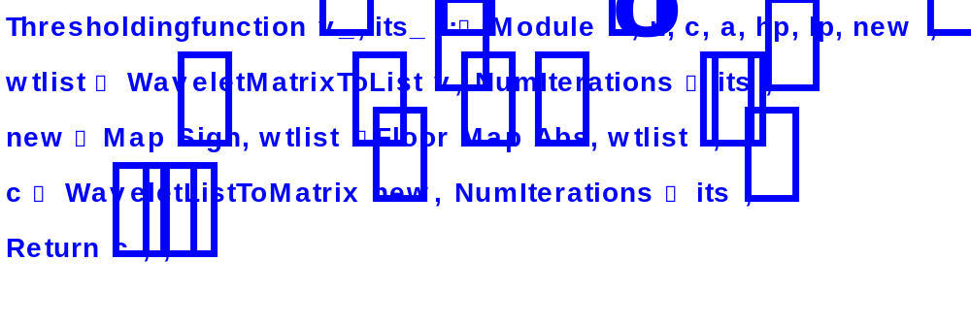
Step 2 Simple Version Code

Slide 11

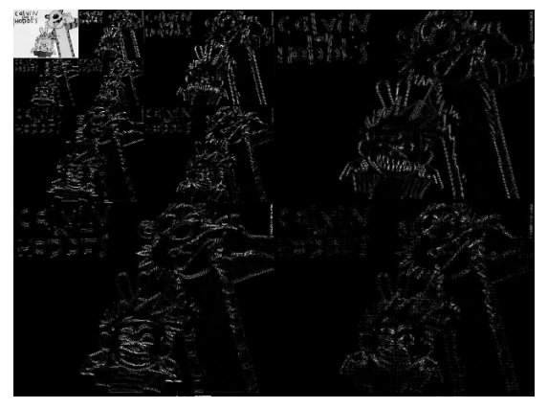
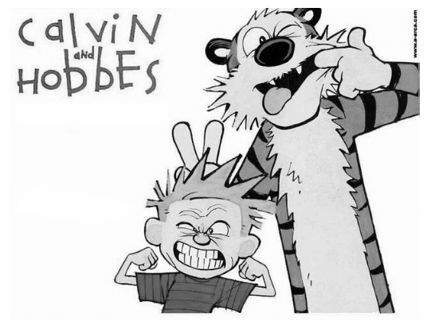
Step 2 Simple Version Results
Original
Transformed
Inverse Transform
Bit length = 2457600
Bit length = 2457600
Bit length = 2457600
Coded bit length = 1663063
Coded bit length = 1221194
Coded bit length ≈ 1663063
This simple version creates an error-free or reversible compression. The bit lengths above are prior to coding .

Slide 12
Step 2:
Irreversible Compression
Now, we define the following terms in our quantizing equation:
  εb = 8 (8 bit picture)
  μb= 7, 7.5, 8, or 8.5 (user defined)
  Rb = 8 + the number of iterations
Notes:
This part turned out to be much more complicated to produce in Mathematica, although, the concept itself is not that difficult to grasp.

Slide 13
Irreversible Compression (cont.)
This will no longer make the step size equal to one.
Therefore, Δb must be changed for every level of iteration.
Each set of subbands for a particular iteration will have a new value for Δb.

Slide 14
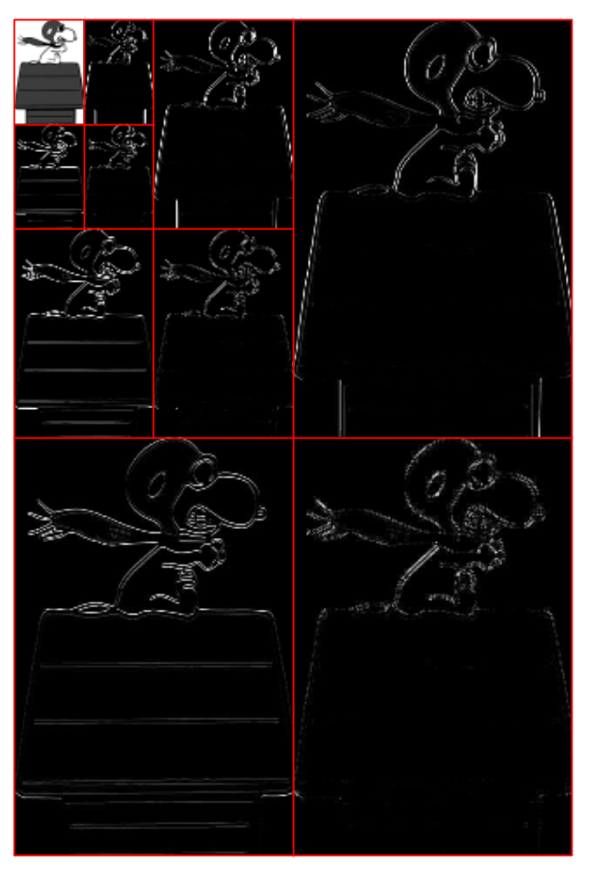
Irreversible Compression
(cont.)
Δb1
Δb3
Δb2

Slide 15
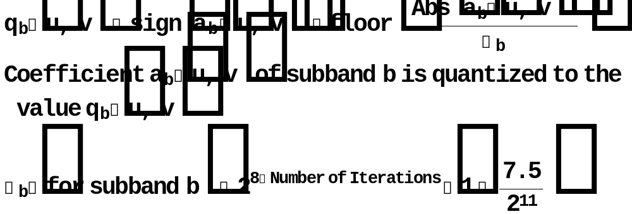
Modified Thresholding Function
Now, each element in a particular subband will be quantized by our modified equation:

Slide 16
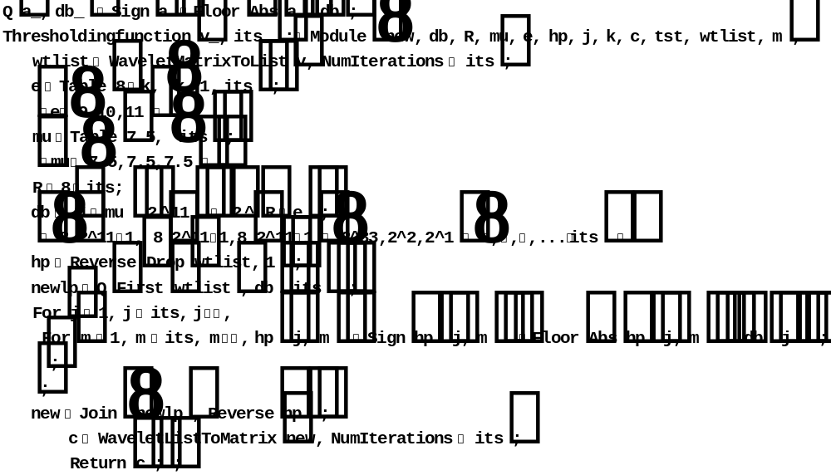
Mathematica Code for Modified Thresholding Function

Slide 17
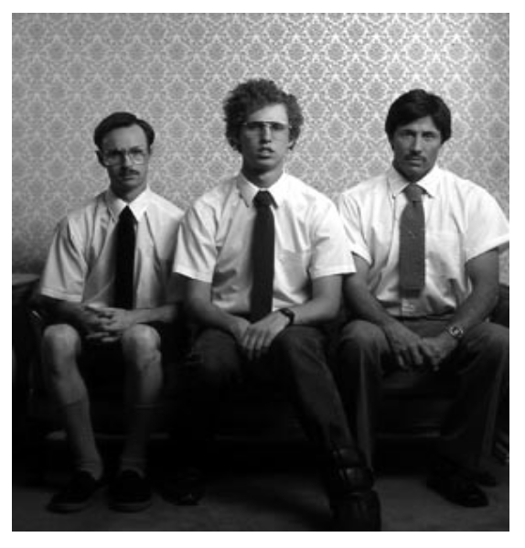
Results of New Thresholding Function
Original Image
Original Bit Length = 737280

Slide 18
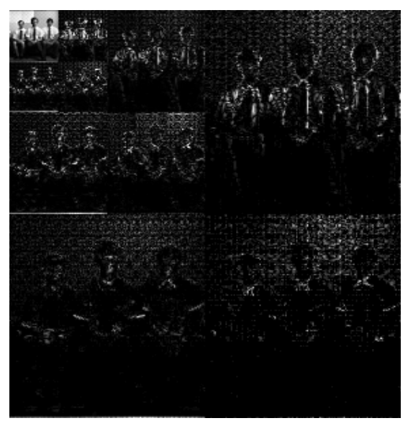
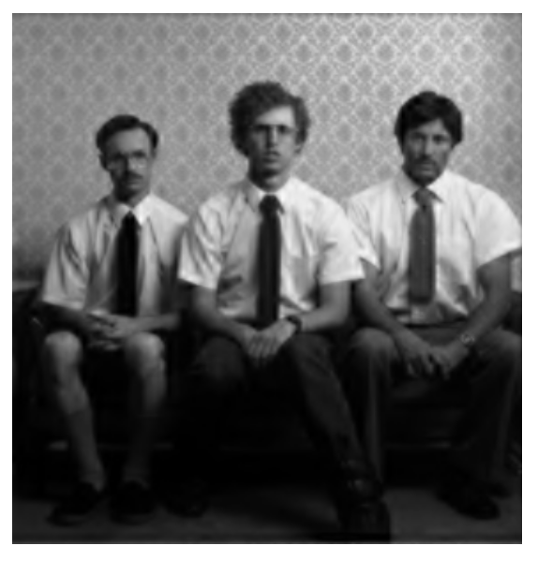
Quantized and Final Picture
Coded Bit Length = 311673
Inverse Transform
The image was compressed by 236% from the original image!

Slide 19
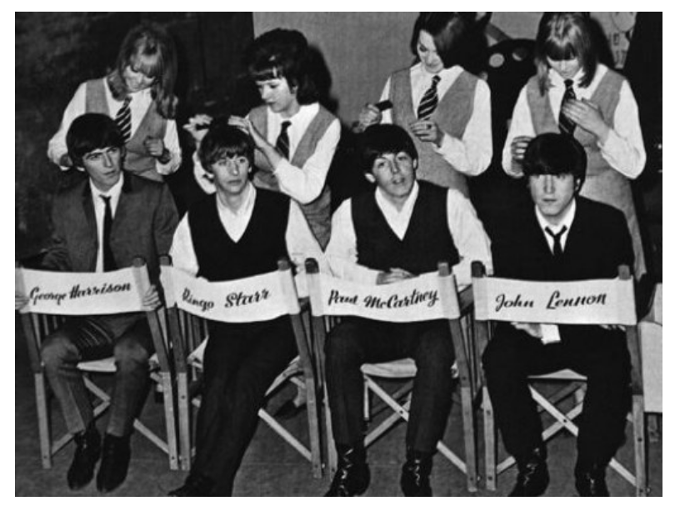
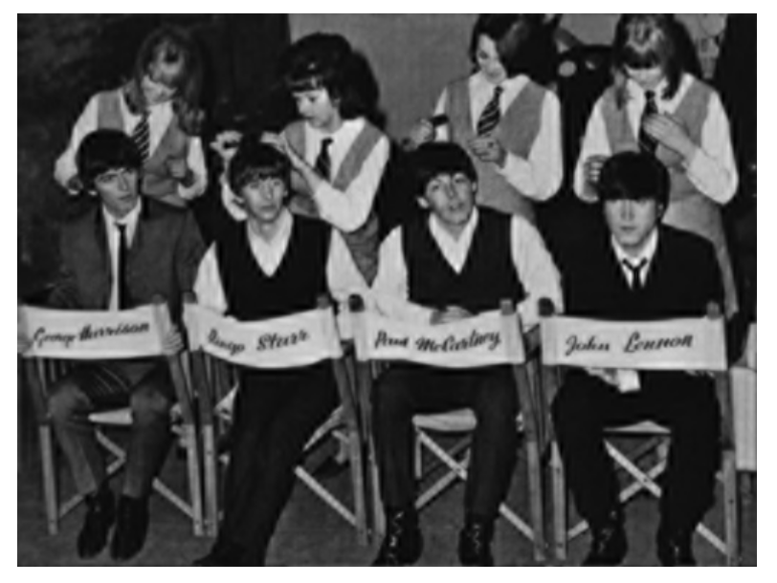
Compression of a “Real” Image
Original
Coded Bit Length = 1415338
Transformed
Coded Bit Length = 653028
Compression Rate = 216%

Slide 20
Step 3
Entropy Encoding
The Huffman Coding used is quite slow and not very efficient (as we all have discovered!).
The JPEG2000 code is much more efficient because it codes strings of characters.
Our previous compression rates would be much higher with JPEG2000 entropy encoding.

Slide 21
Shortcomings in Naïve Version of JPEG2000 Code
Lossyness is visually apparent in the previously transformed and compressed image.
This is due to the following reasons:
  A dequantizing function could be included in order to decrease lossyness.
  A variety of options can be added in order to obtain a better resolution.

Slide 22
References
http://en.wikipedia.org/wiki/JPEG_2000
http://www.gvsu.edu/math/wavelets/student_work/EF/how-works.html
http://www.dred242.com/blogvid/NapoleanDynamite/KipNapoleonRico.jpg
Gonzalez, Woods, and Eddins. Digital Image Processing Using MatLab. 2004.

Slide 23
Questions/Comments?

