Slide 1
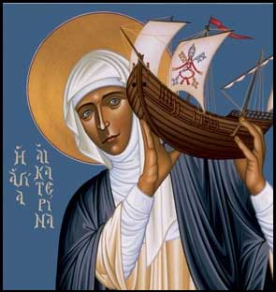

Call for papers
Celebrating the Thought of Blessed John Paul II
Women as Prophets and Servants of Truth
Robert Lenz in Trinity Stores
The Siena Symposium for Women, Family, and Culture at the University of St. Thomas invites papers examining the vision of Blessed John Paul II on how women together with men can build successful families and make history. We encourage submissions from a variety of disciplinary perspectives. Submissions from professionals and graduate students also welcome.
Presentations may explore aspects of the following topics:
Role of ethics in culture
The Uniqueness of the Woman’s Vocation
Gender Vocations and Its Complementarity with Male Vocations
Keynote and Siena Humanitarian Award Recipient: Mary Eberstadt, How the West Really Lost God
7:30 May 3rd 2014, Brady auditorium, St. Paul Campus of the University of St. Thomas
Proposals of 1-2 pages are due Feb. 17th. Presentations on May 3rd including Q&A will be 30 minutes. Submit proposals and questions to rmlemmons@stthomas.edu. Be sure to include name, affiliation, address, and email address. Sponsored by the Center for Catholic Studies.
Truth and prophecy Sexual equality, difference, gender dignity John Paul II’s personalism Love’s nature, creation, and preservation The baptismal charism of prophecy The vocation of the laity | Family challenges Role of families in culture Complementarity The role of love in culture Prolife challenges & legal developments | Women leaders healthcare religious life & spirituality education law Business

