Slide 1
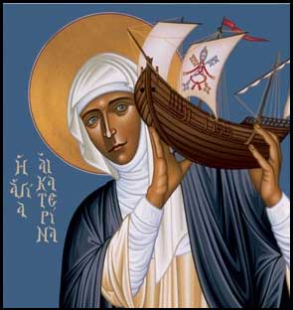

Call for papers
Celebrating the Thought of Blessed John Paul II
Woman as Prophet and Servant of Truth
Robert Lenz , Trinity Stores
The Siena Symposium for Women, Family, and Culture at the University of St. Thomas invites papers examining the vision of Blessed John Paul II on how women can---together with men---build successful families and make history. We encourage submissions from a variety of disciplinary perspectives. Submissions from professionals and graduate students also welcome.
Presentations may explore aspects of the following topics:
Role of ethics in culture
The Uniqueness of the Woman’s Vocation
Gender Vocations and Its Complementarity with Male Vocations
Keynote and Siena Humanitarian Award Recipient: Mary Eberstadt, How the West Really Lost God
7:30 May 3rd 2014, Brady auditorium, St. Paul Campus of the University of St. Thomas
Proposals of 1-2 pages are due Feb. 17th. Presentations on May 3rd including Q&A will be 30 minutes. Submit proposals and questions to rmlemmons@stthomas.edu. Be sure to include name, affiliation, address, and email address. Co-sponsored by the Center for Catholic Studies.
Uniqueness of woman’s vocation the relationship of truth and prophecy the baptismal charism of prophecy sexual equality, complementarity John Paul II’s feminism John Paul II’s gender vocations | Gender roles in marriage & families role of families in culture the civilization of love prolife challenges legal developments | Women leaders Healthcare & business religious life & spirituality Education & culture law Female Saints

