Slide 1
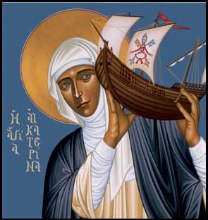

Call for papers
Celebrating the Thought of Blessed John Paul II
Women as Prophets and Servants of Truth
The Siena Symposium for Women, Family, and Culture invites papers examining the vision of Blessed John Paul II on how women together with men can build successful families , a pro-life culture, and a civilization of love. We encourage submissions from a variety of disciplinary perspectives. Submissions from professionals and graduate students also welcome.
Presentations may explore aspects of the following topics:
Role of ethics in culture
The Uniqueness of the Woman’s Vocation
Gender Vocations and Its Complementarity with Male Vocations
Keynote Speaker:
Mary Eberstadt, How the West Really Lost God at 7:30 May 3rd 2014, University of St. Thomas
Proposals of 1-2pages are due January 27th. Presentations including Q&A will be 30 minutes. Submit proposals to rmlemmons@stthomas.edu. Be sure to include name, affiliation, address, and email address. Presentations will be limited to twenty minutes followed by Q&A.
Truth and prophecy Gender Vocations Complementarity The baptismal charism of prophecy The lay vocation | Family challenges Role of families in culture Complementarity The role of love in culture Prolife challenges & legal developments | Women leaders in healthcare, religious life, education, law, business, culture Working mothers

