Slide 1
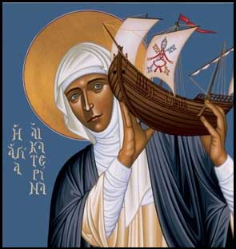

The Siena Symposium for Women, Family, and Culture
Celebrates the Thought of Blessed John Paul II
May 3, 2014
Woman as Prophet and Servant of Truth
Robert Lenz , Trinity Stores
Papers by Leading Scholars in Owens Science Building, 3M Auditorium from 8:30 am to 5 pm; Free and Open to the Public
Keynote Address by Mary Eberstadt
“How the West Really Lost God”
7:30 pm, Owens Science Building, 3M Auditorium.
St. Paul Campus of the University of St. Thomas
Sponsors include the University of St. Thomas Departments of Philosophy, History, Theology, and Catholic Studies; the Terrence J. Murphy Institute for Catholic Thought, Law and Public Policy; the Center for Catholic Studies; the John A. Ryan Institute for Catholic Social Thought; The Saint Paul Seminary School of Divinity; the Prolife Center; the Family Studies Program; the Department of Ethics and Business Law in the Opus College of Business; and the College of Arts and Sciences. For more information contact:
Dr. R. Mary Lemmons at rmlemmons@stthomas.edu or Dr. Deborah Savage at pdsavage@stthomas.edu
Woman as Prophet: The Foundations Love as Seeing in Truth: Sartre versus Stein The New Feminism, Prophetic Bodies and Freedom Women and the Seeing of Others The Feminine Genius for Recognizing and Loving Persons Woman and the Advocacy of Love | Women as Builder of Ritual and Relationship: Family, Friendship and Beyond Marriage as Friendship in Aquinas The Maternal Prophet Family Troubles and the Insights of John Paul II | Prophetic Entrepreneurs and Chiara Lubich Professional Women and Flourishing The Servant Leadership of Catholic Sisters Catholic Women Mystics St. Hildegard as Prophet and Doctor of the Church

