Slide 1
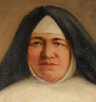
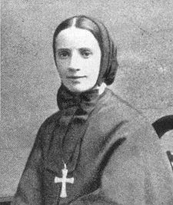
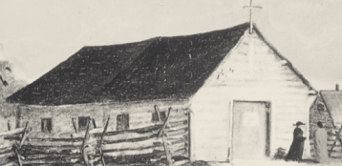
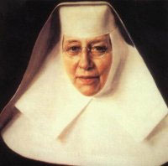
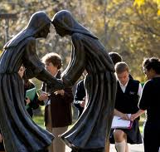
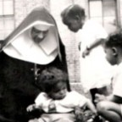


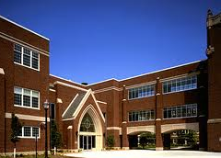
Fortnight of Freedom: Charity Under Fire
R. Mary Lemmons, Ph.D.
From the beginning, Catholics have sought ways to serve their fellow human beings.
In the United States, Catholics have founded hospitals, orphanages, and schools.
Mother St. John Fournier
Sisters of St. Joseph of Carondelet
Mother Cabrini
St. Katherine Drexel
Notes:
Mother Cabrini (1850-1917) founded the Missionary Sisters of the Sacred Heart and established 67 orphanages, schools, and hospitals in New York, Chicago, Des Plaines, Seattle, New Orleans, Denver, Los Angeles, Philadelphia, and throughout South America and Europe.
St. Katherine Drexel (1858-1955) In addition to founding the Sisters of the Blessed Sacrament for Black and Native American peoples, she dedicated her life, from the age of 33 until her death in 1955, and a fortune of $20 million to this work. In 1894, Mother Drexel took part in opening the first mission school for Indians, in Santa Fe, New Mexico and other schools quickly followed. In 1915, she also founded Xavier University in New Orleans. At the time of her death, there were more than 500 Sisters teaching in 63 schools throughout the country. http://www.womenofgrace.com/blog/?p=12906
Mother St. John Fontbonne (1759-1843) In 1778 she entered a house of the Sisters of St. Joseph which had just been established at Monistrol (Haute-Loire) by Bishop de Gallard of Le Puy. The following year she received the religious habit. On her election, six years later, as superior of the community, Mother St. John, as she was now called, co-operated with the founder in all his undertakings, and aided in the establishment of a hospital (not a medical institution, but rather a place to receive the poor). At the outbreak of the French Revolution she and her community followed Bishop de Gallard in refusing to sign the Oath of Civil Constitution of the Clergy. Forced to disperse her community, she remained until she was mobbed, and the convent taken possession of in the name of the Commune. She returned to her father's home, and was soon imprisoned at Saint-Didier. Unable to regain possession of her convent at Monistrol, she and her sister, who had been her companion in prison, returned again to their father's house. Wikipedia
Mother St. John Fournier, (1814-1875). Principal of a school for African Americans in St. Louis forced to close due to racism. One night, racists made three attempts to break down the convent door and throw the sisters out. The log cabin was the Chapel of St. Paul est in 1851 and with the cholera outbreak of 1853 became the first location of St. Joseph’s Hospital

Slide 2
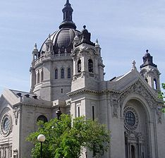
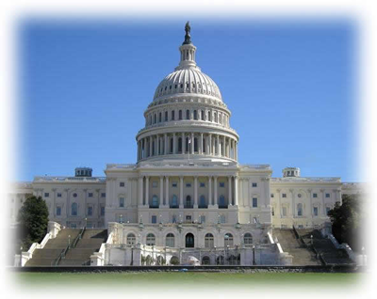
Free To Be Of Service
Catholics were free to build and administer their hospitals, schools, and other social services because the Constitution’s First Amendment guarantees the free exercise of religion:
“Congress shall make no law respecting an establishment of religion, or prohibiting the free exercise thereof.”

Slide 3
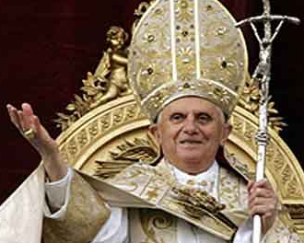

In his first encyclical, Deus Caritas Est, Pope Benedict 16th argued that Catholicism obligates social services because we are to love all others as Christ has loved us.
To so love forbids making church membership a condition for receiving care.
But this year, the federal government began requiring Catholic service organizations to act contrary to the faith and provide sterilizations, and contraceptives---even those that can induce abortions, e.g., Ulipristal.
Why?

Slide 4
Uncle Sam Is Trying Out An Egotistic Philosophy Consider the following definition of liberty found in Planned Parenthood v Casey
At the heart of liberty is the right to define one's own concept of existence, of meaning, of the universe, and of the mystery of human life.
If Casey is right, meaning originates with self-preferences---and there are no objective criteria for differentiating between those liberties that deserve legal protection and those that are so capriciously vicious as to deserve being outlawed.
Notes:
It is conventional constitutional doctrine that where reasonable people disagree the government can adopt one position or the other. That theorem, however, assumes a state of affairs in which the choice does not intrude upon a protected liberty.
Thus, while some people might disagree about whether or not the flag should be saluted, or disagree about the proposition that it may not be defiled, we have ruled that a State may not compel or enforce one view or the other. . . . .
Our cases recognize "the right of the individual, married or single, to be free from unwarranted governmental intrusion into matters so fundamentally affecting a person as the decision whether to bear or beget a child."
These matters, involving the most intimate and personal choices a person may make in a lifetime, choices central to personal dignity and autonomy, are central to the liberty protected by the Fourteenth Amendment.
At the heart of liberty is the right to define one's own concept of existence, of meaning, of the universe, and of the mystery of human life.
Beliefs about these matters could not define the attributes of personhood were they formed under compulsion of the State.” (emphasis mine)
But there are objective criteria. For instance, we do not tolerate parents who define the meaning of their own existence so selfishly that they neglect their own children. Child abuse is both immoral and illegal.

Slide 5
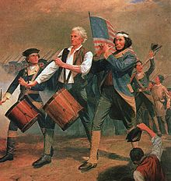
Whence these objective criteria?
From Self-preferences?
From the State?
From Nature?
What is the American Option?

Slide 6
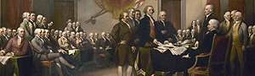
America’s Definition of Existence, the Universe and Human Life
When in the Course of human events, it becomes necessary for one people to dissolve the political bands which have connected them with another, and to assume among the powers of the earth, the separate and equal station to which the Laws of Nature and of Nature's God entitle them, a decent respect to the opinions of mankind requires that they should declare the causes which impel them to the separation.
We hold these truths to be self-evident,
[1]that all men are created equal,
[2] that they are endowed by their Creator with certain unalienable Rights,
[3]that among these are Life, Liberty and the pursuit of Happiness.—
[4]That to secure these rights, Governments are instituted among Men, deriving their just powers from the consent of the governed, --
[5] That whenever any Form of Government becomes destructive of these ends, it is the Right of the People to alter or to abolish it, and to institute new Government, laying its foundation on such principles and organizing its powers in such form, as to them shall seem most likely to effect their Safety and Happiness.” (emphasis mine)
July 4, 1776; Congress’s unanimous declaration.
Notes:
1) The Declaration adopts the natural moral law in order to argue that “the Laws of Nature and of Nature's God” entitle Americans to be independent of England, because there are natural rights and because governments are instituted to secure those God-given rights.
2) This means that America was founded on the agreement that the Creator’s natural law is the basis of government and that respect for each other’s equality and natural rights are the basis of civil society.

Slide 7
The Declaration of Independence, thus, identifies the Creator’s natural moral law as the basis of American freedom and government---not the self-preferences as put in Casey.

Slide 8
Two Objections:
First Objection:
The Declaration of Independence was mistaken: there are no objective standards to rights of life, liberty, and happiness; the natural law is indeterminate; it says whatever one wants it to say.
Response: If the Declaration was mistaken, human happiness can be attained in any way that one desires.
But such is not the case. Those who do not heed nature’s laws do not flourish but are miserable.
For instance, natural law requires love to be self-giving and other-regarding; it forbids manipulating and using human beings for one’s own gratification.
In particular, natural law argues that sexual pleasure does not suffice to bond human beings together in love.
If this natural law of love were not true, then sex would cure loneliness, only the impotent would divorce, and none would suffer the pangs of betrayal and disillusionment on discovering that one’s lover cared not for oneself but only for one’s pleasuring abilities.

Slide 9
Second Objection: Not all Americans believe in God; and so, the Declaration should be discarded as the basis for American rights.
First Response: All Americans know the Golden Rule and its obligation of respecting others.
Second Response: Even atheists and agnostics wants to be free and happy. They know that not all paths lead to happiness. Frustrating human nature leads to misery. Recognizing that fact suffices to make one an adherent of natural law---even if one does not also hold that nature is created by God.
Notes:
First Response: All Americans know the Golden Rule and its obligation of respecting others.
The human equality and rights proclaimed by the Declaration, established by the Civil War and by giving women the right to vote obligate interpersonal respect.
This obligation can be found in all moralities and religions, albeit in some form of the Golden Rule. Consequently, the Declaration’s natural law is compatible with various moralities and religions found in a pluralistic society.
Second Response: Even atheists and agnostics wants to be free and happy.
They can recognize that human beings are beings with a nature that not only establishes human equality and the obligation of respecting one’s equals and their inalienable rights, but also establishes that not all paths lead to happiness.
Frustrating human nature leads to misery. Recognizing that fact suffices to make one an adherent of natural law---even if one does not also hold that nature is created by God.

Slide 10
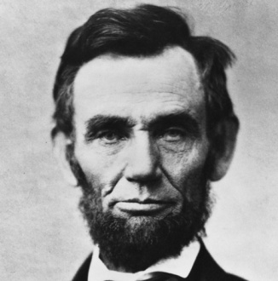
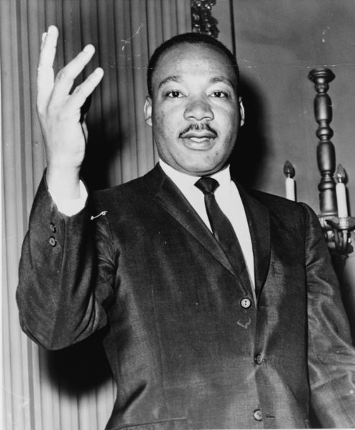
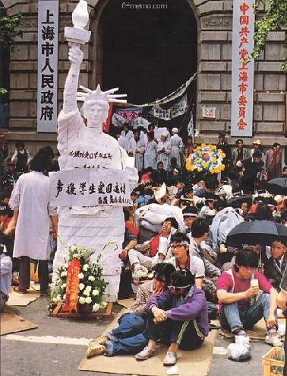
Throwing the Declaration of Independence into History’s Dustpan Would Be a Mistake.
The legacy of the Declaration of Independence lives on in the sea change of worldwide expectation that governments should honor the truth about human beings and secure objective rights rather than annihilate them.
This expectation has led to key documents: the Universal Declaration of Human Rights, the Geneva Conventions, the Genocide Conventions, and the International Covenants of Human Rights.
Discarding the Declaration’s natural law would eliminate the objectivity of human nature as the basis for identifying rights.
It would thereby leave us with only one alternative for avoiding conflicting rights, namely, the dictates of a tyrannical government--- as argued by Thomas Hobbes and as exemplified by King George III.

Slide 11
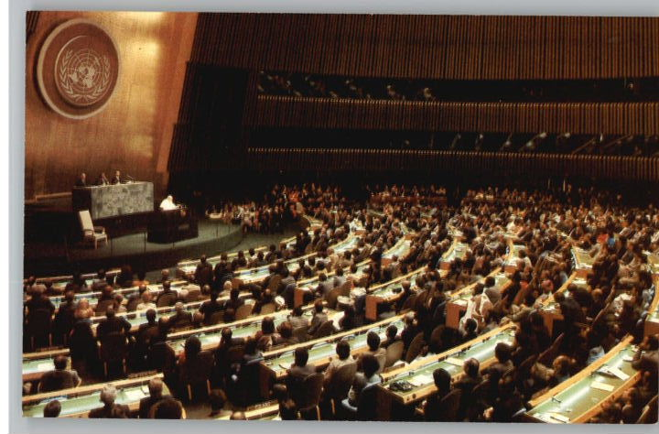
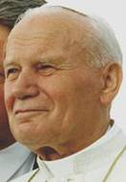
Rights based on the nature of the person opposes coercive totalitarianism while promoting a community of pluralistic liberties whereby all can be all that they can be. Without morality, no freedom.
Notes:
“There are indeed universal human rights, rooted in the nature of the person, rights which reflect the objective and inviolable demands of a universal moral law. ...
If we want a century of violent coercion to be succeeded by a century of persuasion, we must find a way to discuss the human future intelligibly. The universal moral law written on the human heart is precisely that kind of ‘grammar’ which is needed [for ]... this discussion …
[I]t is one thing to affirm a legitimate pluralism of ‘forms of freedom,’ and another to deny any universality or intelligibility to the nature of man or to the human experience.
The latter makes the international politics of persuasion extremely difficult, if not impossible” (UN Address 1995 #3, Pope in America, 11).

Slide 12
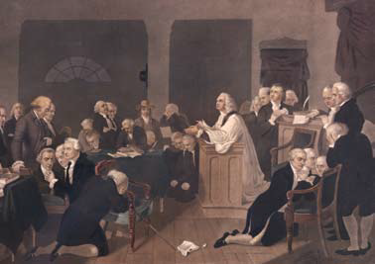
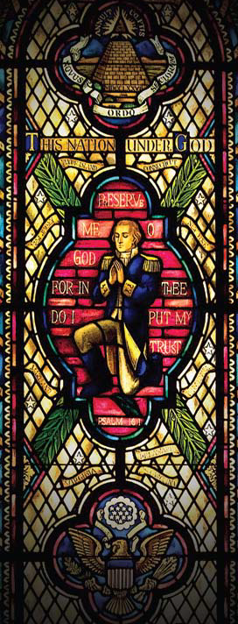

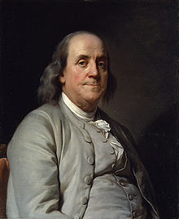
Without religion, the nation perishes. America’s founders knew this. So, starting in 1774, each session of Congress began with a prayer.
This tradition continues today.
Notes:
1774 Continental Congress began with a prayer offered by Episcopal Rector Jacob Duche. This tradition continues today in both the House of Representatives and the Senate. Each appoints their chaplains from various religious denominations. The House has had two Catholics serve as chaplains, while the Senate has had one Catholic chaplain.
“I have lived, Sir, a long time, and the longer I live, the more convincing proofs I see of this truth: that God Governs in the affairs of men. And if a sparrow cannot fall to the ground without his notice, is it probable that an empire can rise without his aid? We have been assured, Sir, ion the sacred writings, that’except the Lord build the House they labour in vain that build it. I firmly beliee this; and I also elieve that without his concurring aid we shall succeed i9n the political building no better, than the Builders of Babel . . . I therefore beg leave to move---that henceforth prayers imploring the assistance of Heaven, and its belssings on our deliberations, be held in this Assembly every monring before we proceed to buisness, and that one or more of the Clergy of this City be re2quested to focciciate in that Service.” Benjamin Franklin, June 28, 1787
George Washington’s Farewell Address:
Of all the dispositions and habits which lead to political prosperity, religion and morality are indispensable supports. In vain would that man claim the tribute of patriotism, who should labor to subvert these great pillars of human happiness, these firmest props of the duties of men and citizens. The mere politician, equally with the pious man, ought to respect and to cherish them. A volume could not trace all their connections with private and public felicity. Let it simply be asked: Where is the security for property, for reputation, for life, if the sense of religious obligation desert the oaths which are the instruments of investigation in courts of justice ? And let us with caution indulge the supposition that morality can be maintained without religion. Whatever may be conceded to the influence of refined education on minds of peculiar structure, reason and experience both forbid us to expect that national morality can prevail in exclusion of religious principle.

Slide 13
Our country needs more prayers because God’s natural moral law is no longer treasured.
Nevertheless, its sanctions exact their punishments: broken hearts, failed marriages, children living apart from their mother or their father, child abuse, poverty, desperate inner cities, and so forth.
The reproductive engine of society is broken and cannot be fixed by retreating further into the egotistical illusion that human flourishing lacks objective requirements.
The signers of the Declaration of Independence were under no such illusion.
They knew the value of the natural law---and religion as shown by their custom of praying before their sessions.

Slide 14
Catholics Likewise Know Liberty’s Truth and the Value of Natural Law
Without morality, no freedom.
Notes:
“Freedom is not simply the absence of tyranny or oppression. Nor is freedom a license to do whatever we like.
Freedom has an inner ‘logic’ which distinguishes it and ennobles it: freedom is ordered to the truth and is fulfilled in man’s quest for truth and in man’s living in the truth.
Detached from the truth about the human person, freedom deteriorates into license in the lives of individuals, and in the political life, it becomes the caprice of the most powerful and arrogance of power.
Far from being a limitation upon freedom or a threat to it, reference to the truth about the human person---a truth universally knowable through the moral law written on the hearts of all---is, in fact, the guarantor of freedom’s future.” (UN Address 1995 #3, Pope in America, 18-19).

Slide 15
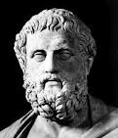
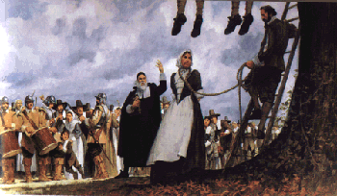
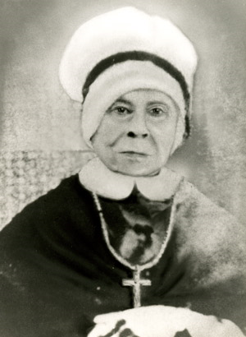
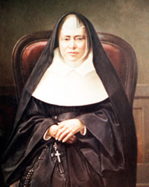
Women know that true liberty is fulfilled in lovingly caring for the physical and spiritual needs of others---even when outlawed.
Sophocles
c497/6-406/5 B.C
Mary Barrett Dyer
(c1611-1660)
Mother Mary Lange
(1784-1882)
Love counts not the cost.
Mother Mary Frances Xavier Warde (1810-84)
Notes:
The ancient Greek playwright Sophocles accordingly has Antigone defy her king’s order to leave her brother unburied: “[I did not deem] thy decrees were of such force . . . [as to] override the unwritten and unfailing statues of heaven.”
Mary Barrett Dyer, a Quaker, defied banishment by the Congregationalists and was hanged on 06-01-1660 in Boston. Her last words: “ I came to keep bloodguiltiness from you, desire you to repeal the unrighteous and unjust law made against the innocent servants of the Lord” http://www.mayflowerfamilies.com/enquirer/mary_dyer.htm
Mother Mary Elizabeth Lange (1784-1882). Born in Haiti; educated in Cuba. Arrived in Baltimore in 1813. ”Baltimore had a large population of French-speaking Caribbean Catholics. Lange, a well-educated free black woman in a slave-holding state, also had money from her merchant father. She saw a need in educating children of Caribbean immigrants and slaves, a practice which was illegal at that time. [Using her own money, she] set up a school in her home [that was free]. Founded the Oblate Sisters of Providence and took the name of Mary in 1829. The Oblate sisters educated youths and provided homes for orphans. They nursed the sick and dying and sheltered the elderly. Mother Mary Lange died Feb. 3, 1882. http://www.baltimoresun.com/features/bal-blackhistory-lange,0,2431999.story
Mother Mary Frances Xavier Warde (1810-1884) arrived from Ireland in 1843 as the leader of Sisters of Mercy established parochial schools and academies, visited the sick poor in their houses and in the poor house, prisoners. In 1846, she established a school that became in 1915 St. Xavier University in Chicago. (This University the government said that this university does not deserve exemption from the Wagner Act governing unionization). In 1850, she opened the first hospital in Pittsburgh. Then although “the "Knownothings" had recently burned the convent of the Ursulines near Boston, Mother Warde accepted the invitation of Bishop O'Reilly of Hartford to open a house in Providence. After the sisters' installation a mob surrounded the convent, threatening them with death if they would not immediately vacate the premises. Mother Warde exacted a promise from each of their Catholic defenders that no shot would be fired except in self defence, and the sisters held possession of the convent. One of the rioters had remarked to his companions:
We made our plans without reckoning the odds we shall have to contend with in the strong controlling force the presence of that nun commands. The only honourable course for us is to retreat from this ill-conceived fray. I, for one, shall not lift a hand to harm these ladies.
In 1852 Mother Warde opened houses in Hartford and New Haven to which free schools were attached; later on academies were opened and the works of mercy inaugurated. (Catholic Encyclopedia on-line)

Slide 16
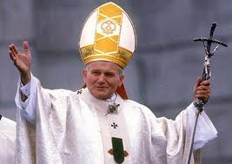
Catholic Religious Conscience promotes the dignity of the person, natural rights and liberties---especially of women, thereby enriching the secular state.
Notes:
JP II: Jesus Christ himself revealed the equality of women and protested offenses against her dignity

Slide 17
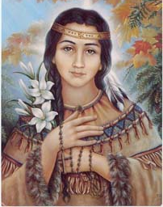
Women do not exist for the sake of men nor for the sake of the state. Religion sets them free.
Notes:
St. Kateri Tekawitha (1656-1680) Lily of the Mohawks. She was born near Auriesville, New York where the Mohawks had cruelly killed Fr. Issac Jogues and other Jesuit Missionnaries in 1646. Kateri was “the daughter of a Mohawk war chief of the Turtle Clan, named Kenhoronkwa, and Kahenta, a Christian Algonquin who had been taken captive [and then] . . . married.” Kahenta could not practice her faith openly in the Mohawk domain. Kateri lost her parents and her brother in the small pox epidemic of 1660 and, as the daughter of an important chief, went to live with her uncle. Kateri was a kind-hearted and gentle mystic who declined marriage and was reviled after her baptism---even receiving a death threat from a Mohawk warrior. She fled to a Christian enclave in Canada. http://www.blackandindianmission.org/kateri-tekakwitha/
She devoted her brief adult life to helping the old and infirm and teaching the Gospel to American Indian children. She was forced to flee to an American Indian Christian community in Quebec, where she took a vow of chastity and devoted her life to prayer and penance. She died in Canada in 1680 at the age of 24, uttering the last words “Jesus, I love you” in her native language. Her smallpox scars are said to have miraculously disappeared a few moments after her death. Her first name is an adaptation of Catherine, in honour of St Catherine of Siena, while her surname means “the one who puts things in order”. http://www.telegraph.co.uk/news/worldnews/europe/vaticancityandholysee/8968432/Pocahontas-of-the-Catholic-Church-to-become-first-American-Indian-saint.html

Slide 18

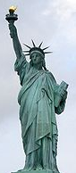
Conclusion
It is time to reaffirm the wisdom of the Declaration of Independence and renew our appreciation of its natural law tradition, reject the shallowness of Casey’s egotism, and stop burdening the free exercise of religion by requiring religious service institutions to do what their faith forbids.
Lady Liberty calls Americans to light the golden lamp of truth and to care for others.
Let us then free women and their institutions to care for others according to their conscience and their God.
Let liberty’s flame of truth be the flame of undying charity.
So help us God in whom we place our trust.
Notes:
Inscription on the Statue of Liberty
Author: Emma Lazarus
The New Colossus
Not like the brazen giant of Greek fame, With conquering limbs astride from land to land; Here at our sea-washed, sunset gates shall stand A mighty woman with a torch, whose flame Is the imprisoned lightning, and her name Mother of Exiles. From her beacon-hand Glows world-wide welcome; her mild eyes command The air-bridged harbor that twin cities frame. "Keep, ancient lands, your storied pomp!" cries she With silent lips. "Give me your tired, your poor, Your huddled masses yearning to breathe free, The wretched refuse of your teeming shore. Send these, the homeless, tempest-tost to me, I lift my lamp beside the golden door!"
Emma Lazarus, 1883

