Slide 1
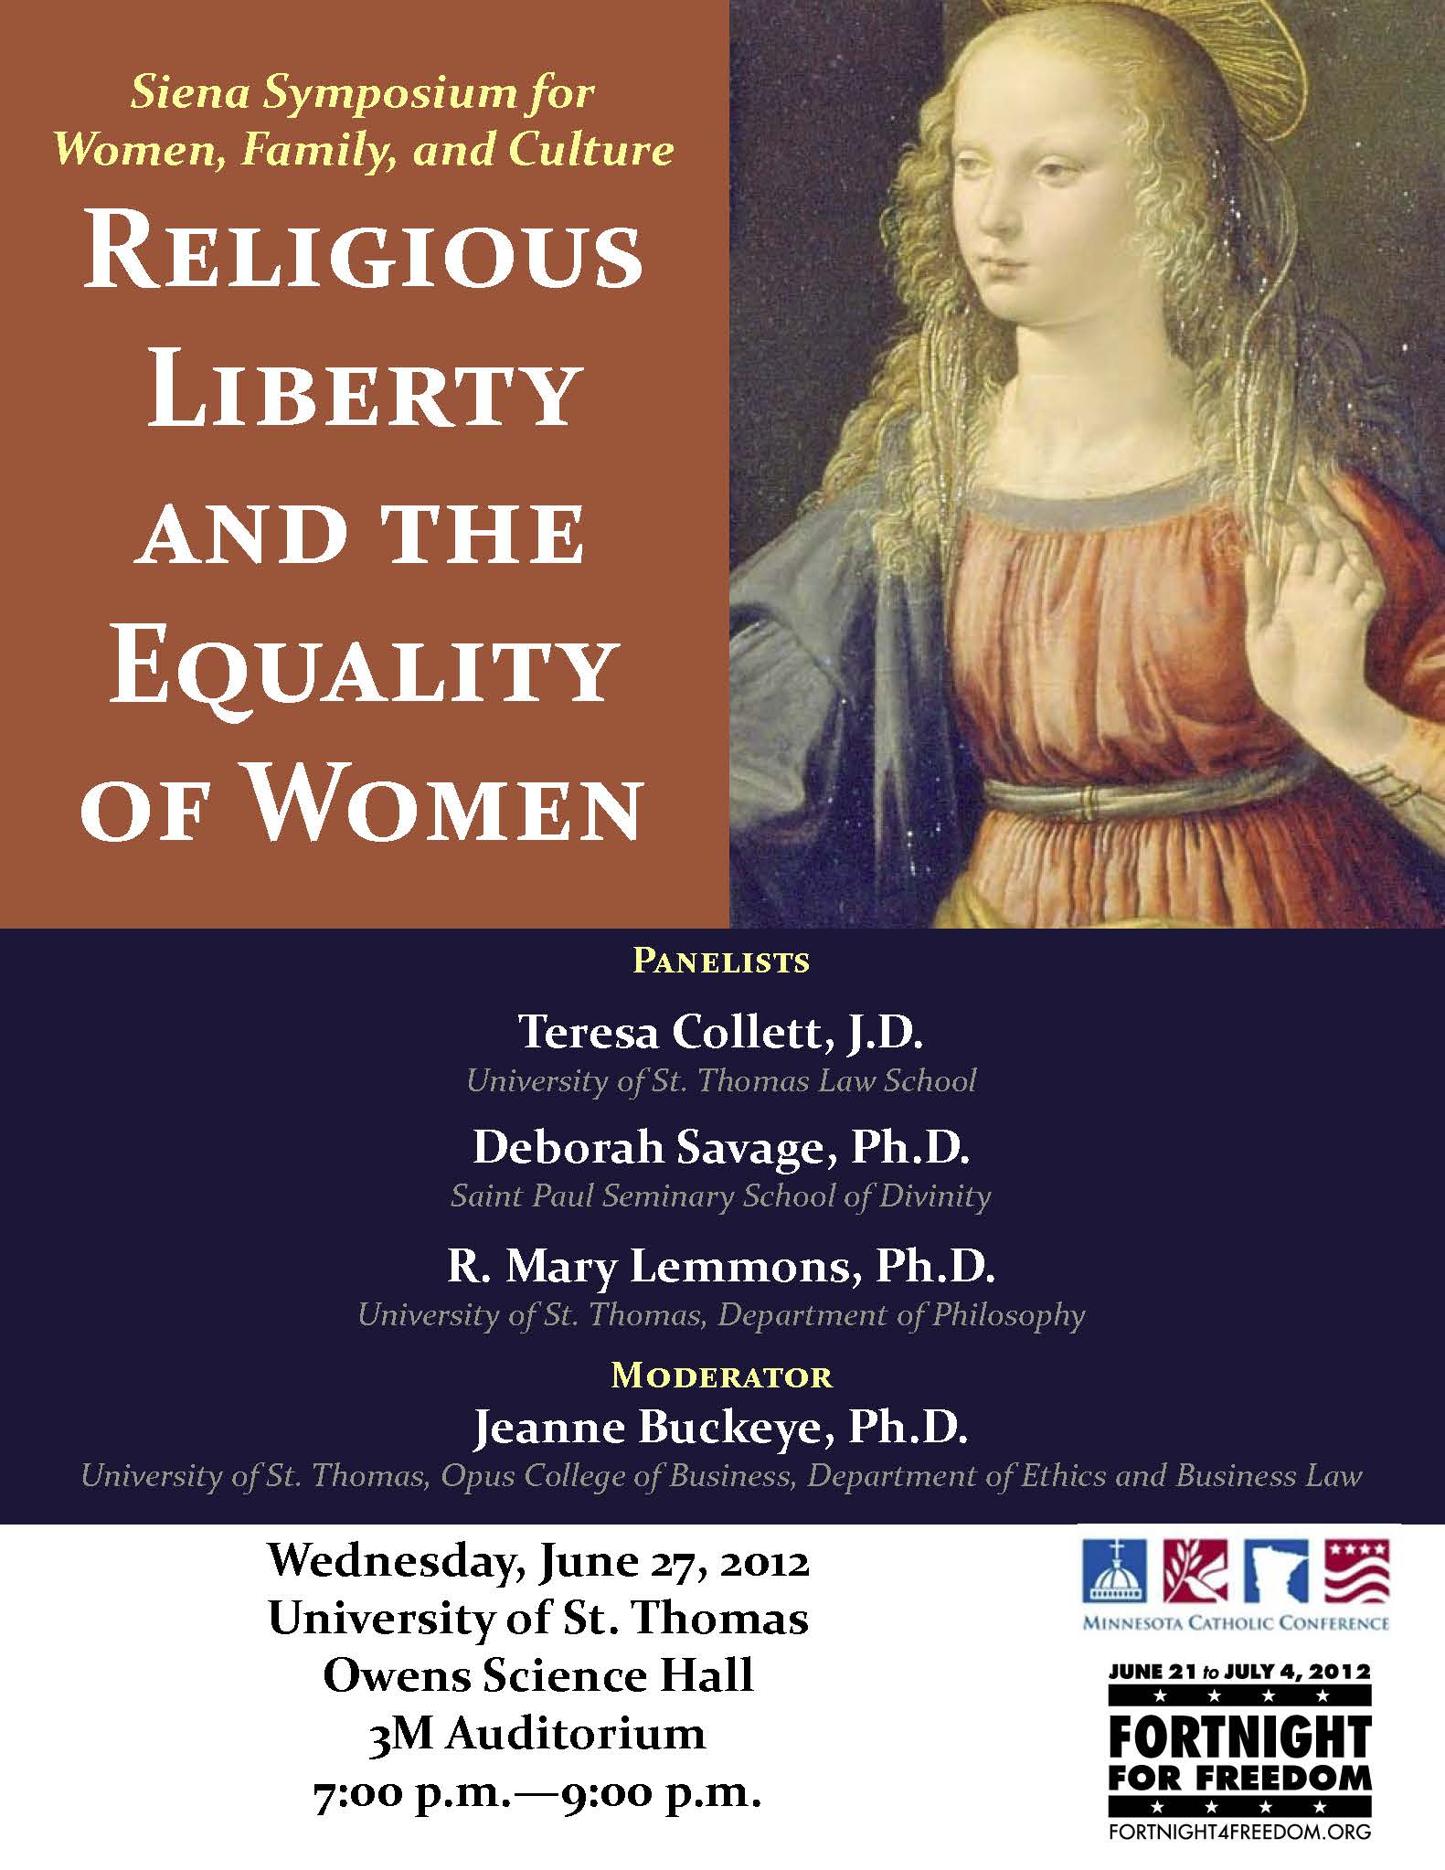
Deceits and Conceits: The False Conflict of Religious Freedom with Women’s Liberty

Slide 2
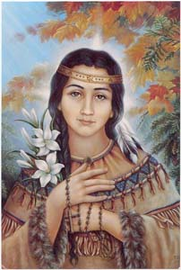
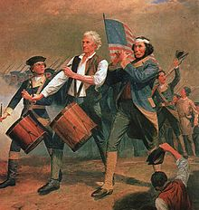
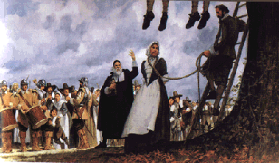
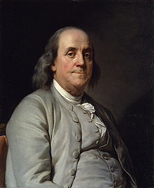
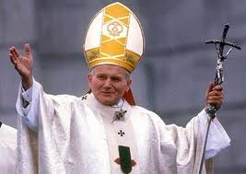
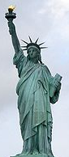
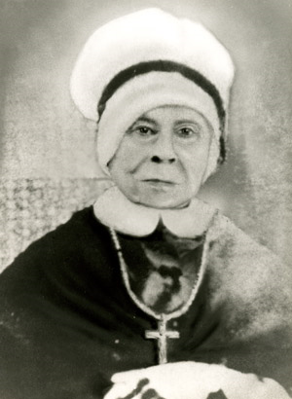
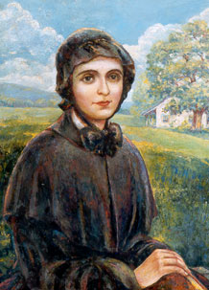
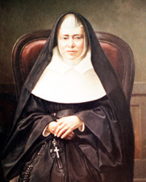
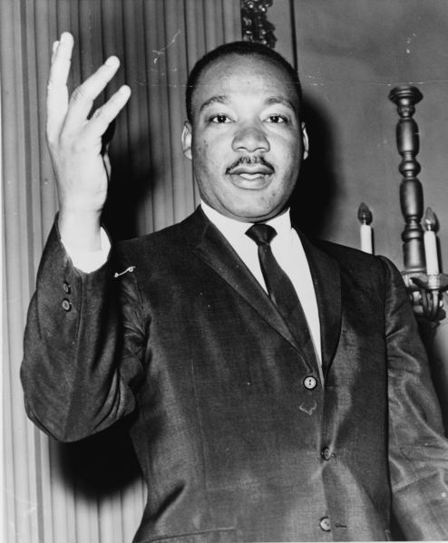
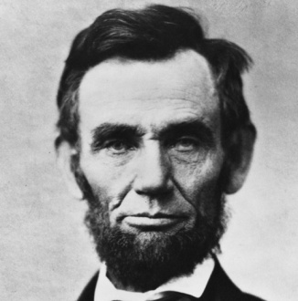
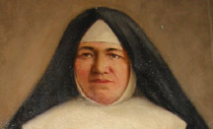
Fortnight of Freedom: Charity Under Fire
R. Mary Hayden Lemmons, Ph.D.
Notes:
Lincoln 1809-1865 pres at 1861

Slide 3
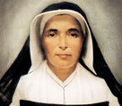
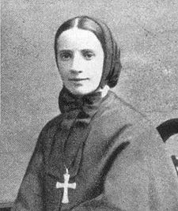
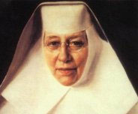
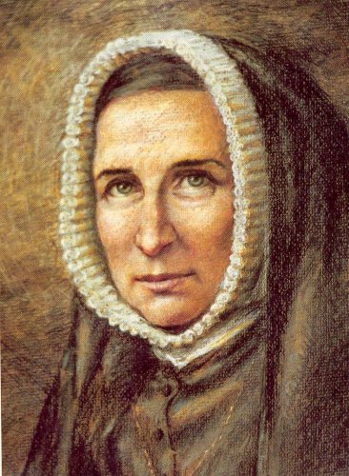
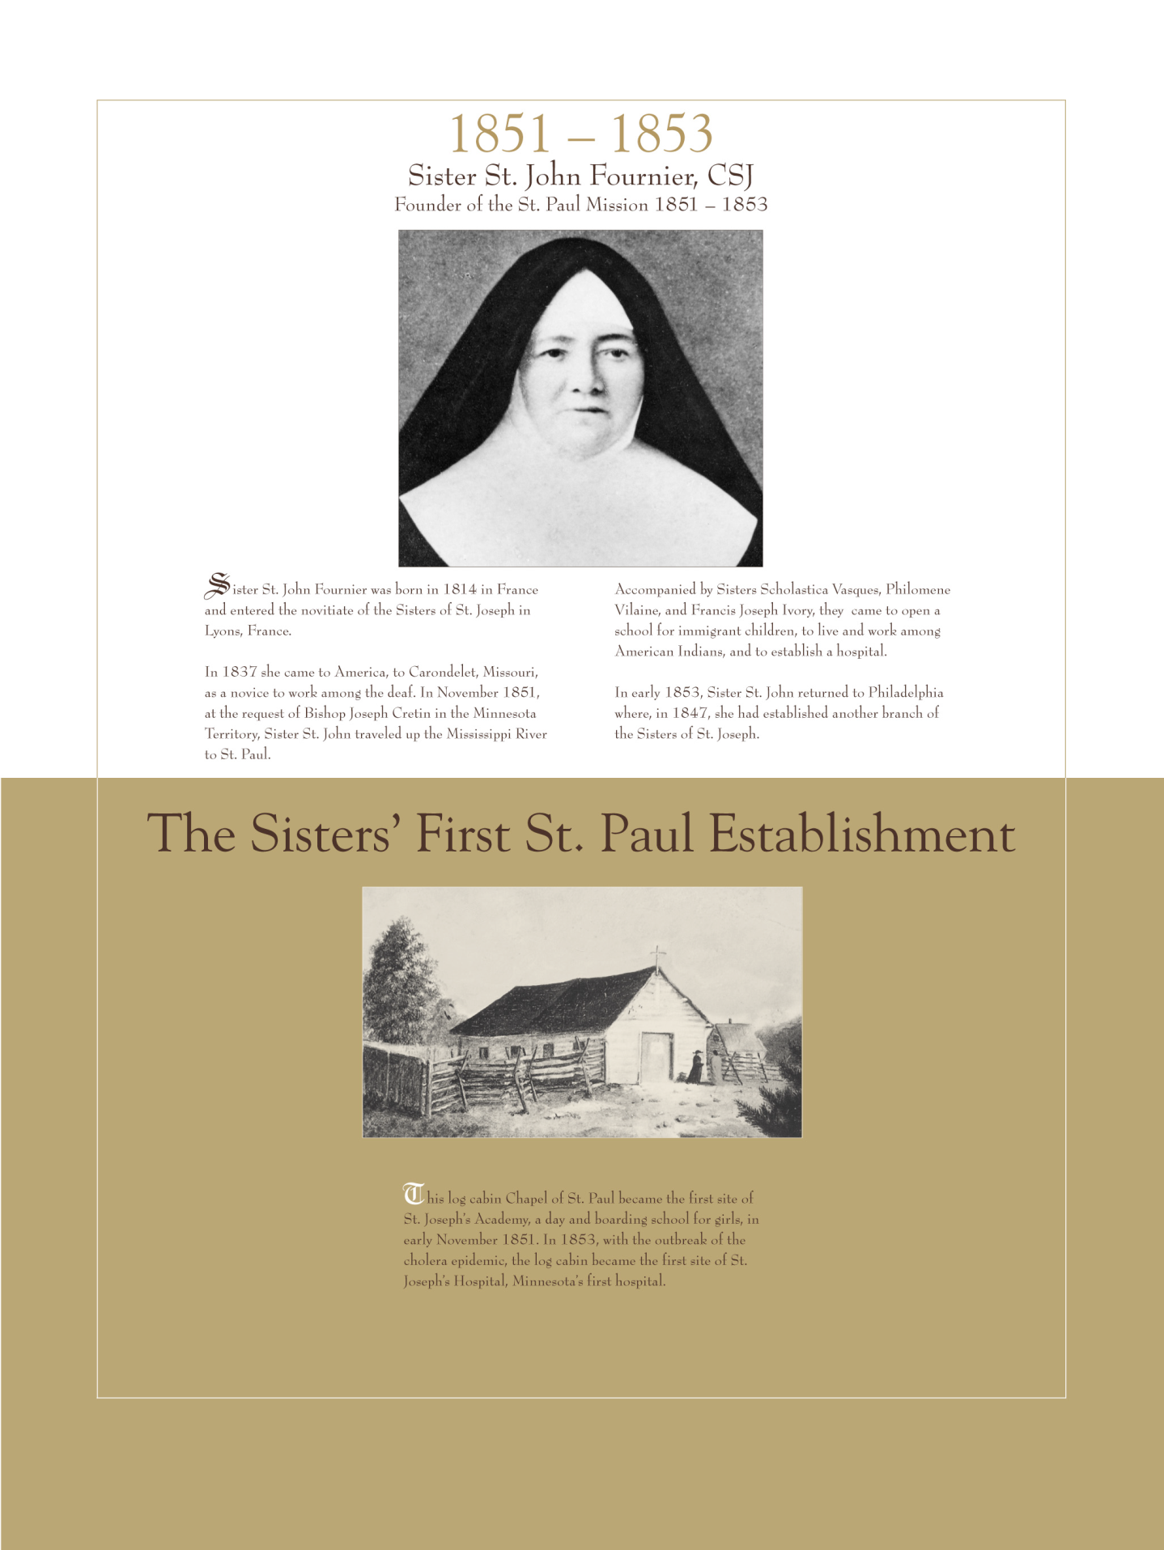

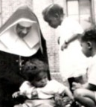
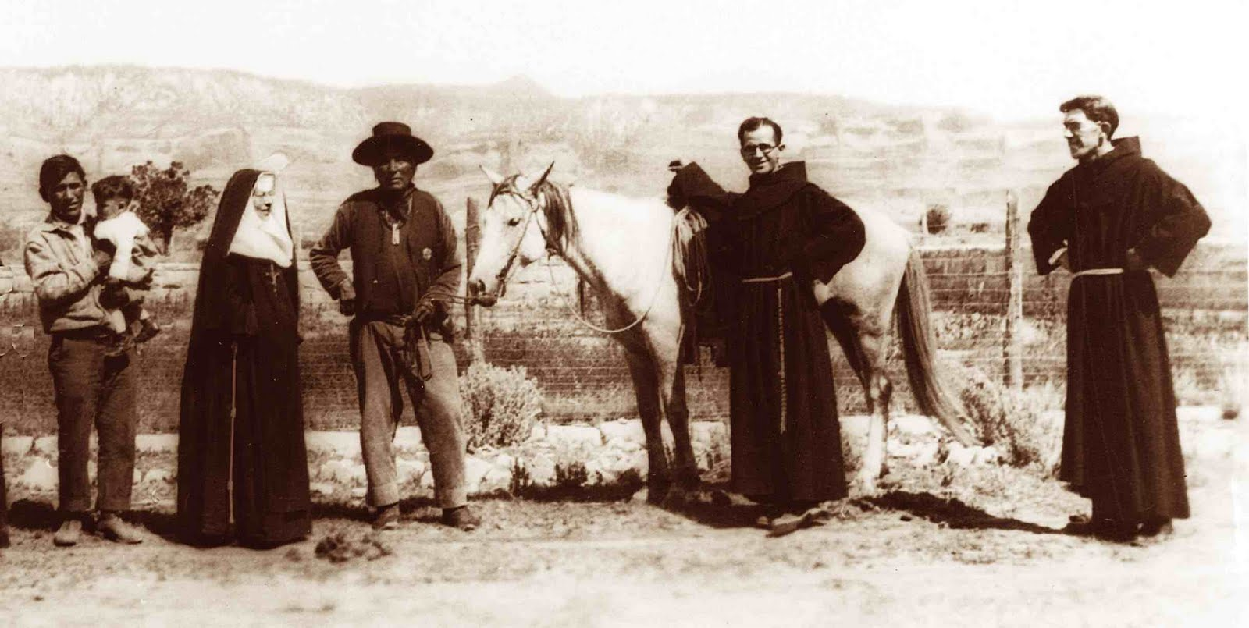

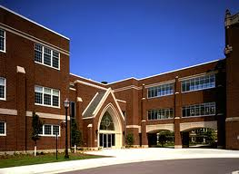
Love Seeks Service With Joy
From the beginning, Catholics have sought ways to serve their fellow human beings. In America, Catholics have founded hospitals, orphanages, and schools still functioning today.
St. Frances Xavier Cabrini, MSC
St. Elizabeth Ann Seton, SC
St. Theodora Guerin SP
Mother St. John Fournier CSJ
St. Katherine Drexel, SBS
1853
1905
St. Rose Philippine Duchesne RSCJ
1877
Notes:
Let’s look at just a few of these legacies. First up, is that of St. Elizabeth Ann Seton (1774-1821). She founded the Sisters of Charity of St. Joseph. She also established the first free Catholic school in the country on July 31, 1809 in Emmitsburg Maryland. Around fifty years later, Seton’s order joined the Daughters of Charity, which was established by St. Vincent De Paul and St. Louise de Marillac in 1633. Their Paris motherhouse is where St. Catherine Laboure—who is the one who had the 1830 Miraculous Medal made in 1830---is buried. In 1999, the five hospitals built by the Daughters of Charity joined the over thirty hospitals built by various other religious orders and formed Ascension Health Ministries. Just last week, the New York hospital that the Daughters of Charity built in 1888, St. Joseph’s, was sued by a same sex couple for not providing spousal benefits, even though St. Joe’s is privately insured. http://www.ascensionhealth.org/index.php?option=com_content&view=article&id=39&Itemid=145
St. Rose (1769-1852) established the American chapter of the Society of the Sacred Heart in St. Charles Missouri in 1818. This chapter went on to establish 21 schools and many convents dedicated to education and social justice.
St. Theodora Guerin (1798-1856) establish the Indiana chapter of the Sisters of Providence. They built two orphanages and many schools including St. Mary of the Woods College. She won a teaching award and her brain was perfectly preserved 50 years after her death.
St. Katherine Drexel (1858-1955) used her vast fortune of $20 million dollars and founded the Sisters of the Blessed Sacrament for Black and Native American peoples. She began opening mission schools for Indians in 1894 and and twenty-one years later she founded Xavier University in New Orleans for African Americans. Needless to say, the Ku Klux Klan and other racists were not happy with her. At the time of her death, there were more than 500 Sisters teaching in 63 schools throughout the country. http://www.womenofgrace.com/blog/?p=12906
Born just 8 years before St. Katerine, St. Frances Xavier Cabrini (1850-1917) founded the Missionary Sisters of the Sacred Heart and established 67 orphanages, schools, and hospitals in New York, Chicago, Des Plaines, Seattle, New Orleans, Denver, Los Angeles, Philadelphia, and throughout South America and Europe.
And finally closer to home Mother St. John Fournier, (1814-1875) arrived here in 1851 with three other sisters (Francis Joseph, Scholastica Vasques, Philomene Vilaine). That was one year after the Diocese of St. Paul was formed---and shortly after a midnight attack on their St. Louis convent forced them to close their school for African Americans in St. Louis. No such drama in St. Paul as they successfully started a school and cared for victims of the 1853 cholera outbreak in the log cabin that served as the first location of St. Joseph’s Hospital. Eventually Sister Fournier’s order, the Sisters of St. Joseph of Carondelet established around a 100 institutions of education and health care in Minnesota, North-South Dakota and Wisconsin. (Wikipedia and Sisters of St Joseph websites) During the French Revolution, her boss, Mother St. John Fontbonne, along with Bishop De Gallard refused to sign the Oath of Civil Constitution of the Clergy. She was imprisoned during the French Revolution (that began in 1789) and was scheduled for execution on 28 July 1794; but the evening before Robespierre fell and the Reign of Terror ended.
Just a last quick comment before moving on---by selecting only women for this page, I do not mean to suggest that men did not establish service institutions: e.g, Archbishop Ireland founded our own UST.

Slide 4
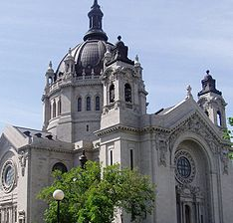
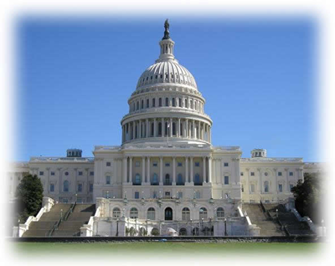
Free To Be Of Service
Thanks to the Constitution’s First Amendment:
“Congress shall make no law respecting an establishment of religion, or prohibiting the free exercise thereof.”

Slide 5
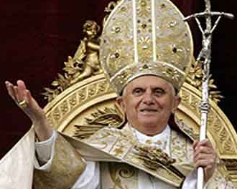

Religious free exercise is what the Church needs to fulfill its obligation to love all as Christ loved us.
To so love forbids making church membership a condition for receiving care. Pope Benedict 16th in Deus Caritas Est.
But this year, the federal government began requiring Catholic organizations that help all without regard to their religious beliefs to act contrary to the faith and provide surgical sterilizations, and contraceptives---even the ones that can induce abortions.
Why this attack on religious liberty?
Notes:
EXTRAS
HHS Mandate HHS Department of Health and Human Services January 20th rule for contraceptives
HHs eliminated conscience protection from those who do not present abortion as a medical alternative
HHS refuses to give grants to those interested in helping the 700,000 to 2 million individuals involves in sexual traffic
Washington DC required same sex marriage laws required Catholic Charities to place foster children with same sex couples
US Supreme Court traded Sherbert v Verner (government needed a compelling interest to override religious liberty) for Employment Division v Smith where government can burden as long as not discriminatory.
St. Joseph’s Hospital in New York sued over not providing spousal benefits to a same sex couple---even though it is privately insured.

Slide 6
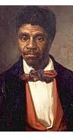
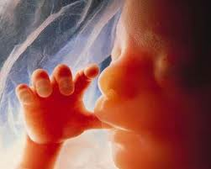
Uncle Sam is renewing its embrace of the Philosophy of Subjectivism
X
X
Uncle Sam is moving from a subjectivism about human beings to a subjectivism about liberty---as put by the U.S. Supreme Court in Planned Parenthood v Casey
At the heart of liberty is the right to define one's own concept of existence, of meaning, of the universe, and of the mystery of human life.
If Casey is right, meaning originates with self-preferences---and there are no objective criteria for differentiating between those liberties that deserve legal protection and those that are so capriciously vicious as to deserve being outlawed.
Notes:
This philosophy reared its ugly head in the 19th century in 1857 U.S. Supreme Court decision Dred Scott versus Stanford. This notorious decision declared that African-American slaves were no better than property. It took the Civil War to correct this notion.
The philosopy of subjectivism reared up again in 1973 in the U.S. Supreme Court decision that humanity of unborn babies does not suffice for giving them rights. Concern for abortion rights has now lead the U.S. Supreme Court to a subjective definition of liberty. Here is the passage from Planned Parenthood v Casey.
But there are objective criteria. For instance, we do not tolerate parents who define the meaning of their own existence so selfishly that they neglect their own children. Child abuse is both immoral and illegal.
EXTRAS:
Roe v Wade 1973 and Casey 1992
Casey: “It is conventional constitutional doctrine that where reasonable people disagree the government can adopt one position or the other. That theorem, however, assumes a state of affairs in which the choice does not intrude upon a protected liberty. Thus, while some people might disagree about whether or not the flag should be saluted, or disagree about the proposition that it may not be defiled, we have ruled that a State may not compel or enforce one view or the other. . . . .
Our cases recognize "the right of the individual, married or single, to be free from unwarranted governmental intrusion into matters so fundamentally affecting a person as the decision whether to bear or beget a child."
These matters, involving the most intimate and personal choices a person may make in a lifetime, choices central to personal dignity and autonomy, are central to the liberty protected by the Fourteenth Amendment.
At the heart of liberty is the right to define one's own concept of existence, of meaning, of the universe, and of the mystery of human life.
Beliefs about these matters could not define the attributes of personhood were they formed under compulsion of the State.” (emphasis mine)

Slide 7

Whence come these objective criteria?
From Self-preferences?
From the State?
From Nature?
Is there an American Option?
X
X
Let’s check our birth certificate and see.

Slide 8

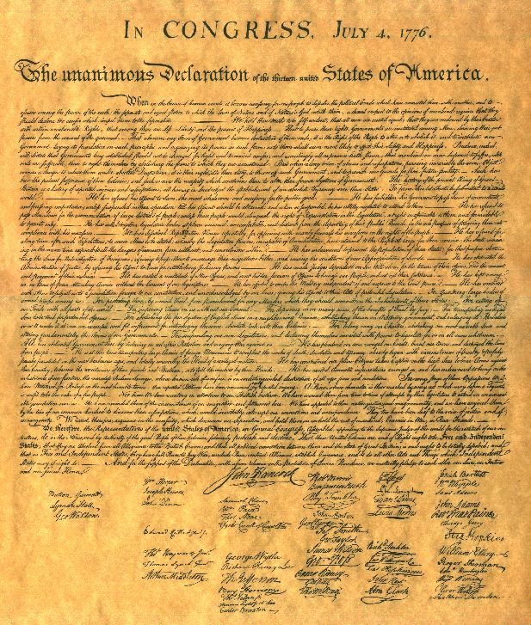
America’s Definition of Existence, the Universe and Human Life Is Objective---Not Subjective
When in the Course of human events, it becomes necessary for one people to dissolve the political bands which have connected them with another, and to assume among the powers of the earth, the separate and equal station to which the Laws of Nature and of Nature's God entitle them, a decent respect to the opinions of mankind requires that they should declare the causes which impel them to the separation.
We hold these truths to be self-evident,
[1]that all men are created equal,
[2] that they are endowed by their Creator with certain unalienable Rights,
[3]that among these are Life, Liberty and the pursuit of Happiness.—
[4]That to secure these rights, Governments are instituted among Men, deriving their just powers from the consent of the governed, --
[5] That whenever any Form of Government becomes destructive of these ends, it is the Right of the People to alter or to abolish it, and to institute new Government, laying its foundation on such principles and organizing its powers in such form, as to them shall seem most likely to effect their Safety and Happiness.” (emphasis mine)
Notes:
ANALYSIS:
The basis of American government, rights, and liberty are self-evident truths. Truths are self-evident only when objective.
The Declaration also adopts the natural moral law in order to argue that “the Laws of Nature and of Nature's God” entitle Americans to be independent of England, because there are natural rights and because governments are instituted to secure those God-given rights.
3) This means that America was founded on the agreement that the Creator’s natural law is the basis of government and that respect for each other’s equality and natural rights are the basis of civil society.

Slide 9
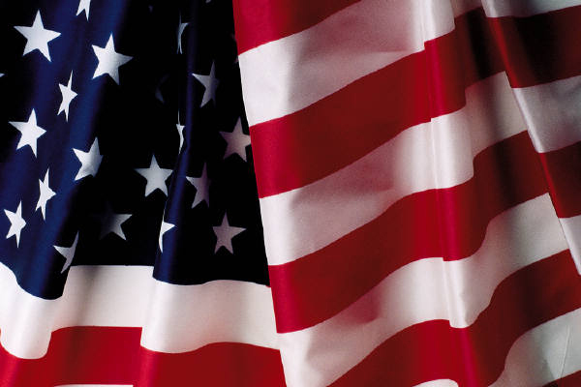
The Declaration of Independence, thus, identifies the Creator’s natural moral law as the basis of American freedom, inalienable rights, and government---not the subjectivism of self-preferences as declared by the U.S. Supreme Court in Casey.

Slide 10
Two Objections:
First Objection:
The Declaration of Independence was mistaken: there are no objective standards to rights of life, liberty, and happiness; the natural law is indeterminate; it says whatever one wants it to say.
Response: If the Declaration was mistaken, human happiness can be attained in any way that one desires.
But such is not the case. Those who do not heed nature’s laws do not flourish but are miserable.
For instance, natural law requires love to be self-giving and other-regarding; it forbids manipulating and using human beings for one’s own gratification.
In particular, natural law argues that sexual pleasure does not suffice to bond human beings together in love.
If this natural law of love were not true, then sex would cure loneliness, only the impotent would divorce, and none would suffer the pangs of betrayal and disillusionment on discovering that one’s lover cared not for oneself but only for one’s pleasuring abilities.

Slide 11
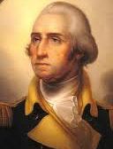
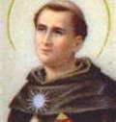
Second Objection: Not all Americans believe in God; and so, the Declaration and the natural moral law should be discarded as the basis for American rights.
First Response: Even atheists and agnostics want to be free and happy. They know that not all paths lead to happiness. Frustrating human nature leads to misery. Recognizing that objective fact suffices to make one an adherent of the natural moral law and the Declaration ---even if one does not also hold that nature is created by God.
Second Response: The Declaration says all men are created equal. Creation makes us equal; and equality requires us to respect each other. We are to treat each other as we would be treated---just like the Golden Rule says. And since the Golden Rule is ubiquitous, adherents need not be theists. So the Declaration’s core morality is compatible with the pluralistic value systems found in free society.
Third Response: The American people
need to believe in God.
Notes:
Third Response: As George Washington put it in his Farewell Address: “[Though it may be otherwise for a few individuals] reason and experience both forbid us to expect that national morality can prevail in exclusion of religious principle.”
Aquinas explains in his Summa Theologica that without Revelation, the human mind is typically too weak to come to know God and His ways without a lot of errors.
George Washington’s Farewell Address:
Of all the dispositions and habits which lead to political prosperity, religion and morality are indispensable supports. In vain would that man claim the tribute of patriotism, who should labor to subvert these great pillars of human happiness, these firmest props of the duties of men and citizens. The mere politician, equally with the pious man, ought to respect and to cherish them. A volume could not trace all their connections with private and public felicity. Let it simply be asked: Where is the security for property, for reputation, for life, if the sense of religious obligation desert the oaths which are the instruments of investigation in courts of justice ? And let us with caution indulge the supposition that morality can be maintained without religion. Whatever may be conceded to the influence of refined education on minds of peculiar structure, reason and experience both forbid us to expect that national morality can prevail in exclusion of religious principle.

Slide 12
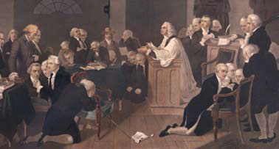
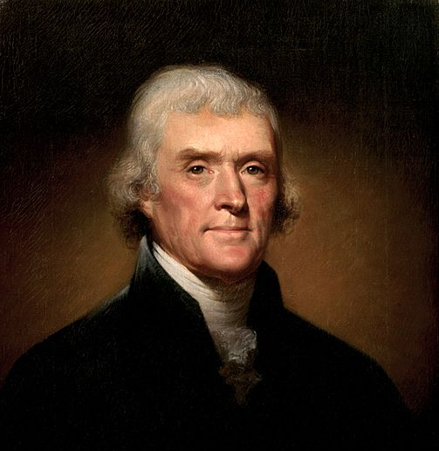
Our founders likewise knew the value of believing in God and the importance of religious liberty. They not only identified it as our first liberty but they also established the tradition of beginning each session of Congress with a prayer offered by an official chaplain.
Religious free exercise, inclusivity, and trust in the self-evident truths of nature and nature’s God thus characterize the very foundation of American beliefs.
Notes:
Perhaps, you are surprised by Benjamin Franklin showing up on this slide. He is well-known as not being very religious. Nevetheless, here is what he said on June 28, 1787 (two hundred and twenty-five years ago tomorrow): “I have lived, Sir, a long time, and the longer I live, the more convincing proofs I see of this truth: that God Governs in the affairs of men. And if a sparrow cannot fall to the ground without his notice, is it probable that an empire can rise without his aid? We have been assured, Sir, ion the sacred writings, that ’except the Lord build the House they labour in vain that build it. I firmly believe this; and I also believe that without his concurring aid we shall succeed in the political building no better, than the Builders of Babel . . . I therefore beg leave to move---that henceforth prayers imploring the assistance of Heaven, and its blessings on our deliberations, be held in this Assembly every morning before we proceed to business, and that one or more of the Clergy of this City be requested to officiate in that Service.” Benjamin Franklin, June 28, 1787 (225 years ago tomorrow)
Thomas Jefferson is likewise not known as being very religious, but he asked: . “And can the liberties of a nation be thought secure when we have removed their only firm basis, a conviction in the minds of the people that these liberties are the gift of God? That they are not to be violated but with his wrath? Indeed I tremble for my country when I reflect that God is just: that his justice cannot sleep for ever: that considering numbers, nature and natural means only, a revolution of the wheel of fortune, an exchange of situation, is among possible events: that it may become probable by supernatural interference! The Almighty has no attribute which can take side with us in such a contest. -- But it is impossible to be temperate and to pursue this subject through the various considerations of policy, of morals, of history natural and civil. We must be contented to hope they will force their way into every one's mind. I think a change already perceptible, since the origin of the present revolution. The spirit of the master is abating, that of the slave rising from the dust, his condition mollifying, the way I hope preparing, under the auspices of heaven, for a total emancipation, and that this is disposed, in the order of events, to be with the consent of the masters, rather than by their extirpation . . . ." - Notes on the State of Virginia, Query XVIII[5] from Monticello Website http://www.monticello.org/site/research-and-collections/virginia-statute-religious-freedom also http://xroads.virginia.edu/~hyper/jefferson/ch18.html
1774 Continental Congress began each day with a prayer offered by Episcopal Rector Jacob Duche. This tradition continues today in both the House of Representatives and the Senate. Each appoints their chaplains from various religious denominations. The House has had two Catholics serve as chaplains, while the Senate has had one Catholic chaplain.

Slide 13
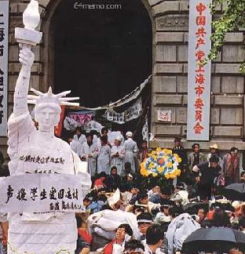
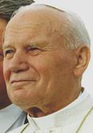
Throwing the Declaration’s Natural Law Philosophy into History’s Dustpan Would Be a Mistake: Without nature’s objective truths, freedom perishes.
The legacy of the Declaration of Independence lives on in the sea change of worldwide expectation that governments should honor the truth about human beings and secure objective rights rather than annihilate them.
This expectation has led to key documents: the Universal Declaration of Human Rights, the Geneva Conventions, the Genocide Convention, and the International Covenants of Human Rights.
Honoring these rights make true liberty possible.
To discard the Declaration is to discard the objectivity of human rights and the truth about liberty. Without these, only tyrannical government can prevent conflicting desires from making life “nasty, brutish, and short” as argued by Thomas Hobbes. It’s either despotism or liberty’s truth.
Notes:
Abraham Lincoln knew it. He argued that the Declaration of Independence was not a dead, irrelevant document but one that will always be relevant as a “stumbling block to all those who in after times might seek to turn a free people back into the hateful paths of despotism.” After Lincoln became President, he declared (p. 234-5): “I have never had a feeling, politically, that did not spring from the sentiments embodied in the Declaration of Independence . . . . which gave liberty, not alone to the people of this country, but hope to all the world for all future time.” 1861 Feb 22 at Independence Hall Philadelphia (became president in 1861)
CLICK Martin Luther King Jr. knew it. He shared Lincoln’s vision and relied on the Declaration of Independence in his arguments that it was time to end the Jim Crow laws that had persisted into the 20th century. Here is what he wrote in his Letter from Birmingham Jail: “One day the South will know that when these disinherited children of God sat down at lunch counters, they were in reality standing up for what is best in the American dream and for the most sacred values in our Judaeo Christian heritage, thereby bringing our nation back to those great wells of democracy which were dug deep by the founding fathers in their formulation of the Constitution and the Declaration of Independence.”
CLICK The protestors slaughtered in Tinanamen Square in 1989 knew it.
CLICK JOHN PAUL II knew it. As he explained to the United Nations in 1995.
“Freedom is not simply the absence of tyranny or oppression. Nor is freedom a license to do whatever we like. Freedom has an inner ‘logic’ which distinguishes it and ennobles it: freedom is ordered to the truth and is fulfilled in man’s quest for truth and in man’s living in the truth. Detached from the truth about the human person, freedom deteriorates into license in the lives of individuals, and in the political life, it becomes the caprice of the most powerful and arrogance of power. Far from being a limitation upon freedom or a threat to it, reference to the truth about the human person---a truth universally knowable through the moral law written on the hearts of all---is, in fact, the guarantor of freedom’s future.”
. . . . “There are indeed universal human rights, rooted in the nature of the person, rights which reflect the objective and inviolable demands of a universal moral law. ...” (UN Address 1995 #3, Pope in America, 18-19).
EXTRAS
Two years later in Cincinnati, Ohio on 1859 Sept 17th Lincoln said (p. 192): “I am what they call, as I understand it, a ‘Black Republican.’ I think slavery is wrong, morally and politically.” Three years earlier, Lincoln denied that he was a Knownothing: (p. 59): “I am not a Know-nothing; that is certain. How could I be? How can any one who abhors the oppression of negroes be in favor of degrading classes of white people? Our progress in degeneracy appears to me to be pretty rapid. As a nation, we began by declaring that all men are created equal. We now practically read it, all men are created equal except negroes. When the Know-nothings get control, it will read, all men are created equal except negores and foreigners and Catholics. When it comes to this, I shall prefer emigrating to some country where they make no pretence of loving liberty---to Russia, for instance, where despotism can be taken pure, and without the base alloy of hypocrisy.” Letter to Joshua Speed 1855 Aug 24th See Abraham Lincoln’s Speeches compiled by L. E. Chittenden B.W. Dodge and Company 1895
On June 26th, 1857 (155 years ago) in Springfield Illinois (p. 67), Lincoln said: “I think the authors of that notable instrument [D of I] intended to include all men, but they did not intend to declare all men equal in all respects. They did not mean to say that all were equal in color, size, intellect, moral developments, or social capacity[---but equal in] certain inalienable rights . . . They did not mean to assert the obvious untruth that all were then actually enjoying that equality . . . They meant to set up a standard maxim for free society, which should be familiar to all and revered by all, ---constantly looked to, constantly laboured for, and, even though never perfectly attained, constantly approximated, and thereby constantly spreading and deepening its influence, and augmenting the happiness and value of life to all people of all colours everywhere. The assertion that ‘all men are created equal,; was of no practical use in effecting our separation from Great Britain; and it was placed in the Declaration, not for that, but for future use. Its authors meant it to be as , thank God, it is now proving itself, a stumbling-block to all those who in after times might seek to turn a free people back into the hateful paths of despotism. They knew the proneness of prosperity to breed tyrants …”

Slide 14
Religious liberty proclaims that women do not exist for the sake of men nor for the sake of the state. Their equality and dignity do not depend on their social roles.
Without truth, power tramples all but especially women.
Religious liberty speaks truth to power.
St. Kateri Tekawitha (1656-1680)
Notes:
This is St. Kateri Tekawitha (1656-1680) Lily of the Mohawks. She is a convert named Kateri after St. Catherine of Siena, while her last name Tekawitha means “one who puts things in order.” She was born of a Christian mother near Auriesville, New York where ten years before the Mohawks had cruelly killed Fr. Issac Jogues and other Jesuit Missionnaries in 1646. Kateri was the very important “daughter of a Mohawk war chief of the Turtle Clan” and was expected to marry well and have children---even though she had become an orphan at 4 years old due to the small pox epidemic of 1660. Kateri was a kind-hearted and gentle mystic who declined marriage and was reviled after her baptism---even receiving a death threat from a Mohawk warrior. This caused her to flee to a Christian enclave in Quebec, Canada. In Canada she took a vow of chastity and devoted her life to prayer and penance. She died at age 24, uttering the last words “Jesus, I love you” in her native language. Her smallpox scars are said to have miraculously disappeared a few moments after her death. http://www.blackandindianmission.org/kateri-tekakwitha/
She devoted her brief adult life to helping the old and infirm and teaching the Gospel to American Indian children. She was forced to flee to an American Indian Christian community in Quebec, where she took a vow of chastity and devoted her life to prayer and penance. She died in Canada in 1680 at the age of 24, Her first name is an adaptation of Catherine, in honour of St Catherine of Siena, while her surname means “the one who puts things in order”. http://www.telegraph.co.uk/news/worldnews/europe/vaticancityandholysee/8968432/Pocahontas-of-the-Catholic-Church-to-become-first-American-Indian-saint.html

Slide 15
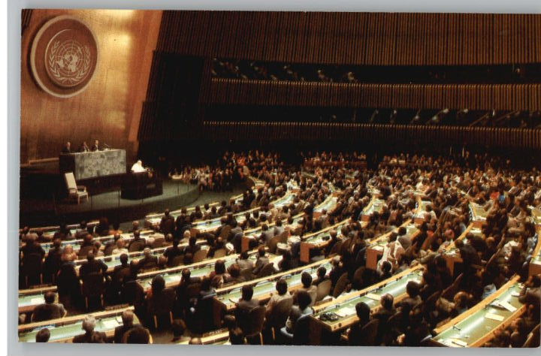
Religious liberty protects the law written on the human heart. Without this law, persuasion is difficult, if not impossible. And if impossible, then there’s no respect for human beings, no authentic peace, and no liberating pluralism. Caring cannot then be other than domination.
Notes:
After all, as Pope John Paul II explained to the United Nations: “If we want a century of violent coercion to be succeeded by a century of persuasion, [we must use the universal moral law written on the human heart]. “
That law, after all, sets us free to love and care for others so that they flourish.
This is especially important for women.
EXTRAS
“If we want a century of violent coercion to be succeeded by a century of persuasion, we must find a way to discuss the human future intelligibly. The universal moral law written on the human heart is precisely that kind of ‘grammar’ which is needed [for ]... this discussion …
[I]t is one thing to affirm a legitimate pluralism of ‘forms of freedom,’ and another to deny any universality or intelligibility to the nature of man or to the human experience.
The latter makes the international politics of persuasion extremely difficult, if not impossible” (UN Address 1995 #3, Pope in America, 11).

Slide 16
Catholic Religious Conscience promotes the dignity of the person, natural rights and liberties---especially of women, thereby enriching the secular state.
Notes:
Women, John Paul II explains in his Letter to Women, are unique in their ability to be person-centered: “Perhaps more than men, women acknowledge the person, because they see persons with their hearts. They see them independently of various ideological or political systems. They see others in their greatness and limitations; they try to go out to them and help them. In this way, the basic plan of the Creator takes flesh in the history of humanity and there is constantly revealed, in the variety of vocations, that beauty---not merely physical, but above all spiritual---which God bestowed from the very beginning on all, and in a particular way on women.”
This gift to see others as persons gives women a special place “in thought and action, which is unique and decisive. It depends on them to promote a "new feminism" which rejects the temptation of imitating models of "male domination," in order to acknowledge and affirm the true genius of women in every aspect of the life of society, and overcome all discrimination, violence and exploitation.
... Pope John Paul II. The Gospel of Life, 1995
It is then the special job of women to protect the vulnerable and to establish communities of truth, peace, and freedom that care for persons.
EXTRAS
In his Gospel of Life, he said that women have
JP II: Mulieris Dignitatem Jesus Christ himself revealed the equality of women and protested offenses against her dignity

Slide 17
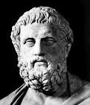
Women know that true liberty is fulfilled in lovingly caring for the physical and spiritual needs of others---even under fire.
Sophocles
Antigone
Mary Barrett Dyer
(June 1, 1660)
Mother Mary Lange OSP
(1813)
Love counts not the cost.
Mother Mary Frances Xavier Warde RSM (1855)
Notes:
For this reason, the ancient Greek playwright Sophocles (c497/6-406/5 BC has a woman, Antigone, be the one who defies her king’s order to leave her brother unburied: “[I did not deem] thy decrees were of such force . . . [as to] override the unwritten and unfailing statues of heaven.”
Mary Barrett Dyer, a Quaker, defied banishment by the Congregationalists and was hanged on 06-01-1660 in Boston. Her last words: “ I came to keep blood guiltiness from you, and desire you to repeal the unrighteous and unjust law made against the innocent servants of the Lord” http://www.mayflowerfamilies.com/enquirer/mary_dyer.htm
Mother Mary Elizabeth Lange (1784-1882) In 1813, she began using her own money to start and run an illegal school for slave children, especially for French-speaking Catholics from the Carribean in Baltimore. Then, in 1829, she founded the Oblate Sisters of Providence and took the name of Mary. The Oblate sisters are still educating children and caring for the disadvantaged. http://www.baltimoresun.com/features/bal-blackhistory-lange,0,2431999.story
Mother Mary Frances Xavier Warde (1810-1884). In 1855, the “Know-Nothings” attempted to force Mother Warde and her Sisters of Mercy from their convent in Providence by threatening them with death. Although the Know-Nothings had already burned down a convent of Ursulines near Boston, this time they met their match. Sister organized defenders and made them promise not to shoot except in self-defense. The Know-Nothings backed off; One of the rioters had remarked to his companions:
We made our plans without reckoning the odds we shall have to contend with in the strong controlling force the presence of that nun commands. The only honourable course for us is to retreat from this ill-conceived fray. I, for one, shall not lift a hand to harm these ladies.
Among the many hospitals and schools opened by Mother Warde is the school that became in 1915 St. Xavier University in Chicago. (Recently, this university made the news when the government said that it does not deserve exemption from the Wagner Act governing unionization). Currently, the Sisters of Mercy of the Americas has 4,600 Sisters and owns one of the largest hospital systems in the United States---including Saint John's Mercy Hospital in Saint Louis County, Missouri (Catholic Encyclopedia on-line and Rome of the West)

Slide 18

Conclusion
It is time to reaffirm the wisdom of the Declaration of Independence and renew our appreciation of its natural law tradition, reject the shallowness of Casey’s subjectivism, and stop burdening the free exercise of religion by requiring religious service institutions to do what their faith forbids.
Let us not betray the heart of women who proclaim with Lady Liberty, the Mother of Exiles, “Give me your tired, your poor, your huddled masses yearning to breathe free.”
Let us, then, free Catholics and every faith-based institution to care for others according to their conscience and their God.
Let liberty’s flame of truth be the flame of undying charity for all but especially for those in need.
So help us God, in whom we place our trust.
Notes:
Inscription on the Statue of Liberty
Author: Emma Lazarus
The New Colossus
Not like the brazen giant of Greek fame, With conquering limbs astride from land to land; Here at our sea-washed, sunset gates shall stand A mighty woman with a torch, whose flame Is the imprisoned lightning, and her name Mother of Exiles. From her beacon-hand Glows world-wide welcome; her mild eyes command The air-bridged harbor that twin cities frame. "Keep, ancient lands, your storied pomp!" cries she With silent lips. "Give me your tired, your poor, Your huddled masses yearning to breathe free, The wretched refuse of your teeming shore. Send these, the homeless, tempest-tost to me, I lift my lamp beside the golden door!"
Emma Lazarus, 1883

Slide 19
Lincoln 1809-1865 president in 1861; Dred Scott decision 1857. Lincoln p. 234-5: “I have never had a feeling, politically, that did not spring from the sentiments embodied in the Declaration of Independence . . . . which gave liberty, not alone to the people of this country, but hope to all the world for all future time.” 1861 Feb 22 at Independence Hall Philadelphia
Lincoln p. 192: “I am what they call, as I understand it, a ‘Black Republican.’ I think slavery is wrong, morally and politically.” Speech at Cincinnati, Ohio 1859 Sept. 17th
Lincoln p. 67: “I think the authors of that notable instrument [D of I] intended to include all men, but they did not intend to declare all men equal in all respects. They did not mean to say that all were equal in color, size, intellect, moral developments, or social capacity[---but equal in] certain inalienable rights . . . They did not mean to assert the obvious untruth that all were then actually enjoying that equality . . . They meant to set up a standard maxim for free society, which should be familiar to all and revered by all, ---constantly looked to, constantly laboured for, and, even though never perfectly attained, constantly approximated, and thereby constantly spreading and deepening its influence, and augmenting the happiness and value of life to all people of all colours everywhere. The assertion that ‘all men are created equal,; was of no practical use in effecting our separation from Great Britain; and it was placed in the Declaration, not for that, but for future use. Its authors meant it to be as , thank God, it is now proving itself, a stumbling-block to all those who in after times might seek to turn a free people back into the hateful paths of despotism. They knew the proneness of prosperity to breed tyrants . . .
p. 69: “The very Dred Scott case affords a strong test as to which party most favours amalgation, the Republicans, or the dear Union-saving Democracy.” Speech in Springfield Illinois on June 26, 1857 about the Dred Scott Decision
Lincoln p. 52: “Little by little, but readily as man’s march to the grave, we have been giving up the old for the new faith. Near eighty years ago we began by declaring that all men are created equal; but now from that beginning we have run down to the other declaration, that for some men to enslave others is a sacred right of self-government. These principles cannot stand together. They are as opposite as God and Mammon; and whoever olds to the one must despise the other. . . . Let us re-adopt the Declaration of Independence, and with it the practices and policy which harmonise with it.” Speech at Peoria Illinois 1854 Oct 16
Lincoln p. 59: “I am not a Know-nothing; that is certain. How could I be? How can any one who abhors the oppression of negroes be in favor of degrading classes of white people? Our progress in degeneracy appears to me to be pretty rapid. As a nation, we began by declaring that all men are created equal. We now practically read it, all men are created equal except negroes. When the Know-nothings get control, it will read, all men are created equal except negores and foreigners and Catholics. When it comes to this, I shall prefer emigrating to some country where they make no pretence of loving liberty---to Russia, for instance, where despotism can be taken pure, and witou the base alloy of hypocrisy.” Letter to Joshua Speed
Abraham Lincoln’s Speeches compiled by L. E. Chittenden B.W. Dodge and Company 1895
JOHN PAUL II explained this truth about liberty when he addressed the United Nations in 1995.
“Freedom is not simply the absence of tyranny or oppression. Nor is freedom a license to do whatever we like. Freedom has an inner ‘logic’ which distinguishes it and ennobles it: freedom is ordered to the truth and is fulfilled in man’s quest for truth and in man’s living in the truth. Detached from the truth about the human person, freedom deteriorates into license in the lives of individuals, and in the political life, it becomes the caprice of the most powerful and arrogance of power. Far from being a limitation upon freedom or a threat to it, reference to the truth about the human person---a truth universally knowable through the moral law written on the hearts of all---is, in fact, the guarantor of freedom’s future.”
. . . . “There are indeed universal human rights, rooted in the nature of the person, rights which reflect the objective and inviolable demands of a universal moral law. ...” (UN Address 1995 #3, Pope in America, 18-19).

