Slide 2
Agenda
Does the Church have a right to speak about the healthcare policy in the public square?
Has religious liberty been reduced by recent changes in healthcare policy and law?
What law protects the provider’s conscience?
What is the HHS mandate?
Do our teachings on sexual morality contradict common sense and good public policy?

Slide 3
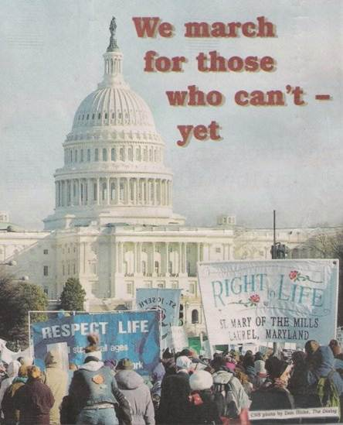
Does the Church have a Right to Speak in the Public Square?
Notes:
Picture of the annual Right to Life March in Washington D.C.

Slide 4
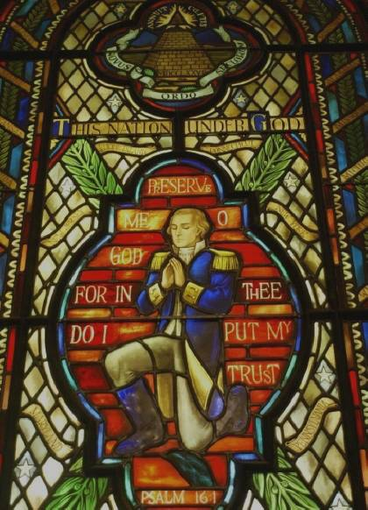
One Nation Under God
“Preserve me, O God, for in thee do I put my trust.”
Psalm 16:1
Praying George Washington stained glass window in the United States Capital building chapel.

Slide 5

Our Founders’ Understanding
Freedom requires morality, and morality requires religion, and religion requires freedom . . . . Attack any one and all will crumble.

Slide 6
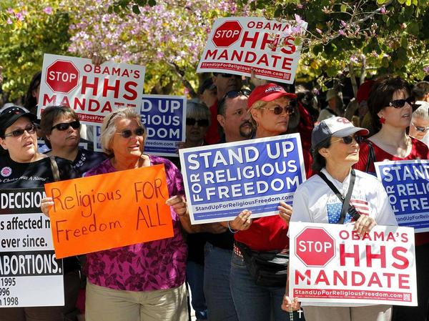
What is the HHS Mandate and why do we oppose it?

Slide 7
HHS Mandate
The HHS Mandate is a regulation promulgated by the Secretary of Health and Human Services (“Secretary Sebelius”) under the Healthcare Act.
It requires employers to provide insurance plans that provide contraception, sterilization, and abortion-inducing drugs, as “preventive medical care.”
Every employer that does not comply will incur heavy fines.
Notes:
The Department of Health and Human Services offers a chart of required coverage including the contraception mandate at http://www.hrsa.gov/womensguidelines/ (last visited June 19, 2012). The concerns of the USCCB can be found at http://www.usccb.org/issues-and-action/religious-liberty/conscience-protection/.

Slide 8
Very Limited Exemption
The exemption only applies to a “religious employer” that employs primarily members of its own faith and serves primarily members of its own faith.
Organizations such as Catholic hospitals, universities, and homeless shelters will not qualify.
Whether an organization is exempt will be decided by a government official, not the Church or religious entity.

Slide 9

Separating Facts from Fiction

Slide 10
Necessary for Women’s Health?
Claim: The HHS Mandate is central to women’s health.
Reality: Women health is not at risk from a lack of access to contraception, abortifacients, and sterilization.

Slide 11
The President’s accommodation ?
Claim: The administration has compromised with the Church as evidenced by the President’s speech.
Reality: There is and never has been an accommodation. There’s a speech – nothing more.
The regulations were finalized “without change” from the interim report.

Slide 12

Do our teachings on sexual morality contradict common sense and good public policy?

Slide 13
Contraception:
Warnings in Humanae Vitae
Increased marital infidelity
A general lowering of moral standards
Men will treat women as “mere instrument[s] for the satisfaction of [their] own desires”
Public authorities will “intervene in the most personal and intimate responsibility of husband and wife”
Notes:
The full text of this 1968 encyclical can be found on the Vatican website at http://www.vatican.va/holy_father/paul_vi/encyclicals/documents/hf_p-vi_enc_25071968_humanae-vitae_en.html .

Slide 14
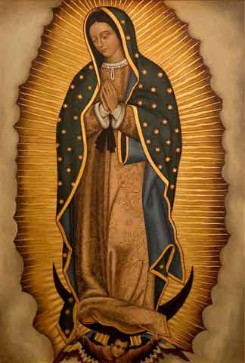
Competing Visions of the Good

Slide 15
Modern Vision for a Woman’s Life
Planned Parenthood v. Casey
“Abortion is customarily chosen as an unplanned response to the consequence of unplanned activity or to the failure of conventional birth control, and except on the assumption that no intercourse would have occurred but for Roe’s holding, such behavior may appear to justify no reliance claim. Even if reliance could be claimed on that unrealistic assumption, the argument might run, any reliance interest would be de minimis. This argument would be premised on the hypothesis that reproductive planning could take virtually immediate account of any sudden restoration of state authority to ban abortions.”
Notes:
Planned Parenthood of SE Pennsylvania v. Casey, 505 U.S. 833, 856 (1992).

Slide 16
Modern Vision for a Woman’s Life
Planned Parenthood v. Casey
“The Roe rule’s limitation on state power could not be repudiated without serious inequity to people who, for two decades of economic and social developments, have organized intimate relationships and made choices that define their views of themselves and their places in society, in reliance on the availability of abortion in the event that contraception should fail. The ability of women to participate equally in the economic and social life of the Nation has been facilitated by their ability to control their reproductive lives. “
Notes:
Planned Parenthood of SE Pennsylvania v. Casey, 505 U.S. at 856 (1992)

Slide 17
Modern Vision for a Woman’s Life
Sex education starts at kindergarten.
Gardasil HPV Vaccine administered at age 11.
Sexual intercourse between 13 and 19
6 percent of children have had sexual intercourse before age 13, and almost a third have had intercourse by the end of their 9th grade year in high school.
Casual sex and cohabitation until marriage (abortion if necessary).
First baby at 30 after establishing career.
Notes:
Materials and curriculum developed by the Sexuality Information and Education Council of the United States (SIECUS) is often relied upon by local school boards and state departments of education. SIECUS advocates for “comprehensive sex education” beginning at kindergarten. http://www.siecus.org/
The recommendation that Gardasil be administered to girls at age 11 comes from the Centers for Disease Control. http://www.cdc.gov/std/hpv/stdfact-hpv-vaccine-young-women.htm
The statistics on sexual intercourse are taken from Centers for Disease Control and Prevention, Youth Risk Behavior Surveillance – United States 2009, Surveillance Summaries, MMWR 2010;59 (No. SS-5) table 61. www.cdc.gov/mmwr/pdf/ss/ss5905.pdf
The fertility of women declines as they age. “For example, if you are a healthy 30-year-old woman, you have about a 20% chance per month to get
pregnant. By age 40, however, your chance is only about 5% per month.” American Society for Reproductive Medicine, Age and Fertility: A Guide for Patients, p. 3, available at http://www.reproductivefacts.org/FactSheetsandBooklets/.

Slide 18
Church’s Vision for a Woman’s Life
Blessed John Paul, II’s “Letter to Women”
“Necessary emphasis should be placed on the "genius of women", not only by considering great and famous women of the past or present, but also those ordinary women who reveal the gift of their womanhood by placing themselves at the service of others in their everyday lives. For in giving themselves to others each day women fulfil their deepest vocation. Perhaps more than men, women acknowledge the person, because they see persons with their hearts. They see them independently of various ideological or political systems. Cont’d on next slide
Notes:
Blessed John Paul II’s Letter to Women, para. 12, http://www.vatican.va/holy_father/john_paul_ii/letters/documents/hf_jp-ii_let_29061995_women_en.html

Slide 19
Church’s Vision for a Woman’s Life
Blessed John Paul, II’s “Letter to Women”
“They see others in their greatness and limitations; they try to go out to them and help them. In this way the basic plan of the Creator takes flesh in the history of humanity and there is constantly revealed, in the variety of vocations, that beauty-not merely physical, but above all spiritual-which God bestowed from the very beginning on all, and in a particular way on women.”

Slide 20
Church’s Vision for a Woman’s Life
Happy childhood in the home of her married mother and father.
Developing friendships with men and women based on mutual respect and care.
Discerning God’s plan and committing to follow it.
Making a total gift of self in marriage OR holy orders OR living a chaste single life.
Spiritually and often physically fruitful.

Slide 21
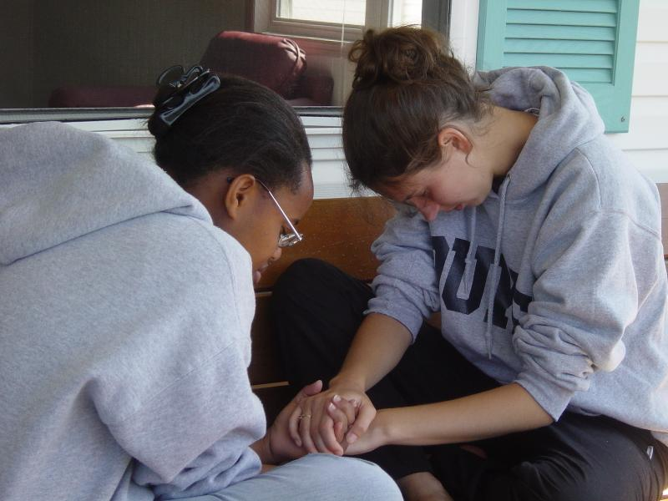
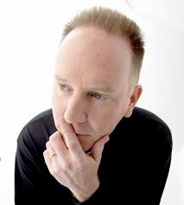
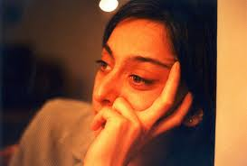

What will you do?

Slide 22
Now is the time to decide
“On some positions a coward has asked the question is it safe? Expediency asks the question, is it politic? Vanity asks the question, is it popular? But conscience asks the question is it right? And there come a time when one must take a position that is neither safe nor politic nor popular but he must take it because conscience tells him it is right.”
- Martin Luther King, Jr.
Notes:
entitled “Domestic Impact of the [Vietnam] War,” Nov. 1967 (audio available at http://www.aavw.org/audio/conscience.mp3)

Slide 23
Questions?

