Slide 1
Printed Circuit Boards
Etching and Soldering

Slide 2
Process Outline
General Introduction
Creating the PCB
Populating the board
Soldering
Conclusion

Slide 3
General Introduction
We use a heat-transfer resist material
Process is best for single-sided boards
Double-sided boards are possible but difficult
Good results are likely if you follow process and take care to keep materials clean
Trace widths should be ≥ 10 mils

Slide 4
Creating a PC Board
Generate Artwork
Prepare the PCB board material
Transfer resist material to board
Etch the exposed copper
Tin the traces
Drill holes for components

Slide 5
Generate Artwork: Preparation
First print schematics and board layout with components for reference during construction
Your artwork for the PCB image should be in a standard format printable from EE computers, or printed from an EE computer that has the layout software installed
Digital Lab is not a good place to print artwork

Slide 6
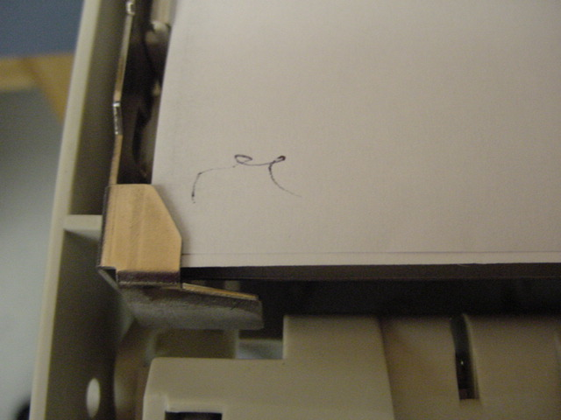
Generate Artwork: Printing 1
Use a printer you can control (so no other lab users will interfere)
Mark the page for re-orientation later

Slide 7
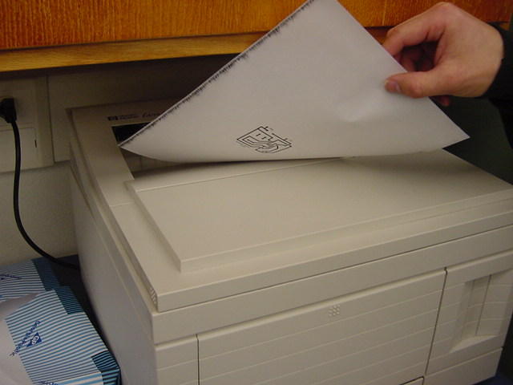
Generate Artwork: Printing 2
Print on regular paper (Solder layer only!)
Remember the leading edge that came out of the printer first

Slide 8
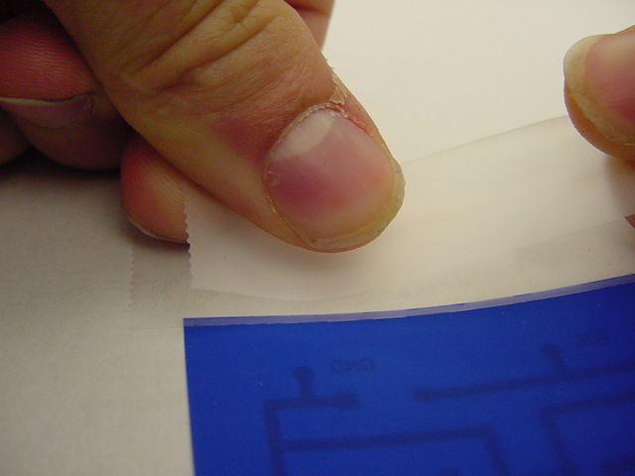
Generate Artwork: Printing 3
Cut blue paper slightly larger than PCB image
Do not touch frosty side, keeping it clean and scratch-free increases transfer quality
Place blue paper over the image you just printed, frosty side up
Tape along the full width of the leading edge only
Overlap tape as little as possible

Slide 9
Generate Artwork: Printing 4
Re-orient paper in printer again
Align mark to original position
Print solder layer again

Slide 10
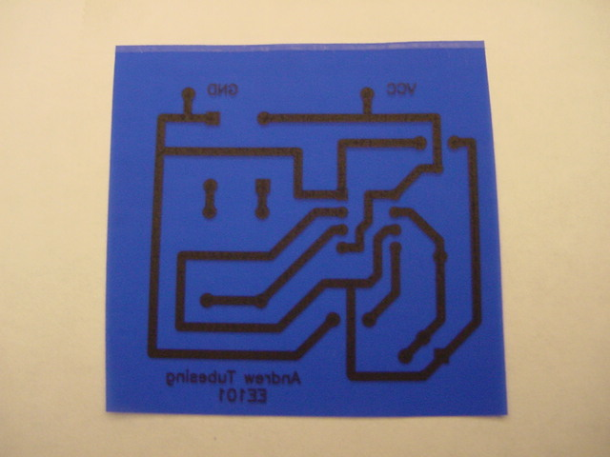
Generate Artwork: Printing 5
Artwork is now printed on blue paper
Laser toner will act like glue to bond blue resist material to copper board
Heat will transfer image to PCB

Slide 11
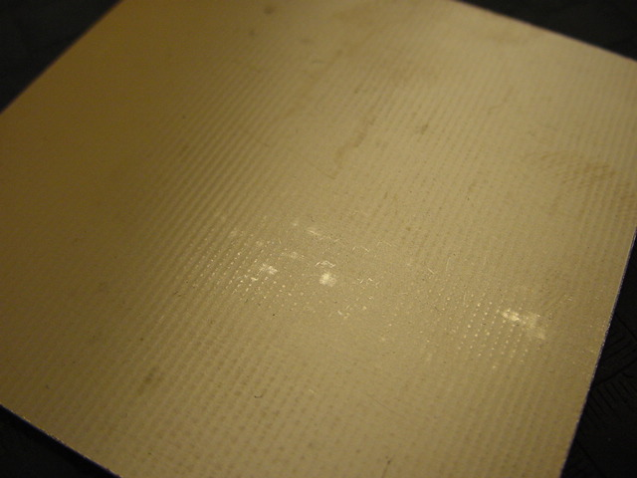
PCB Prep: Cutting & Cleaning 1
Cut board to size
Boards larger than a standard iron will be tricky
Raw PCB material will be oxidized and dirty

Slide 12
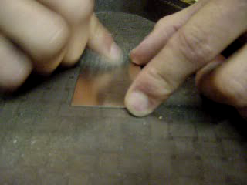
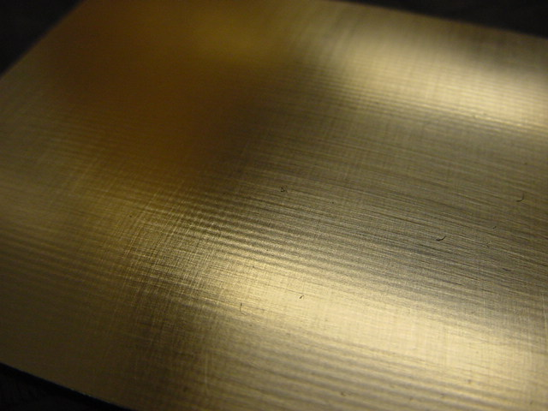
PCB Prep: Cutting & Cleaning 2
Remove oxidized layer with steel wool
Use enough pressure to remove oxidation, but not so much to gouge the surface
End with light strokes for smooth finish
Shiny surface on finished board

Slide 13
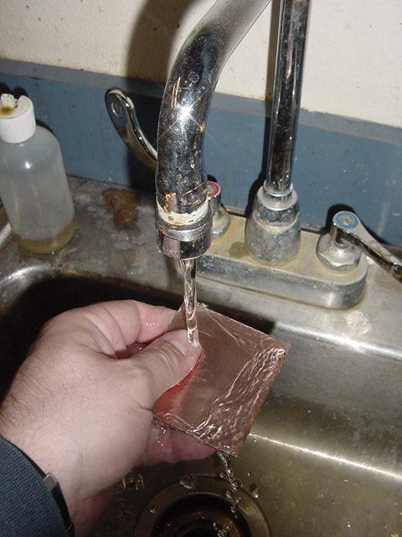
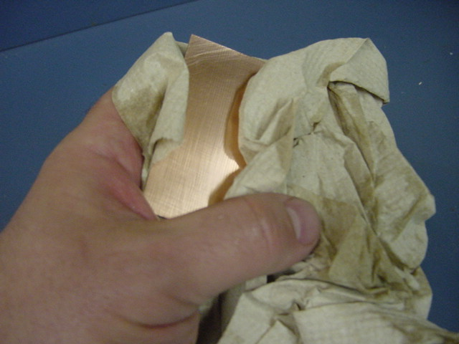
PCB Prep: Cutting & Cleaning 3
Wash with soap
Dry with paper towel leaving no residue to dry on board
Do not touch copper surface again

Slide 14
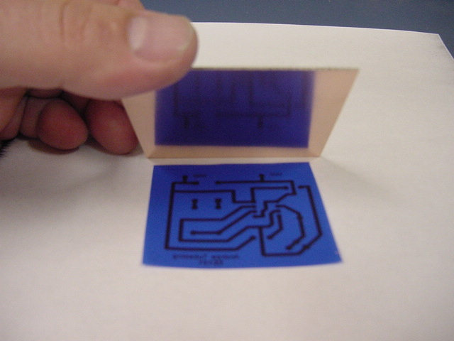
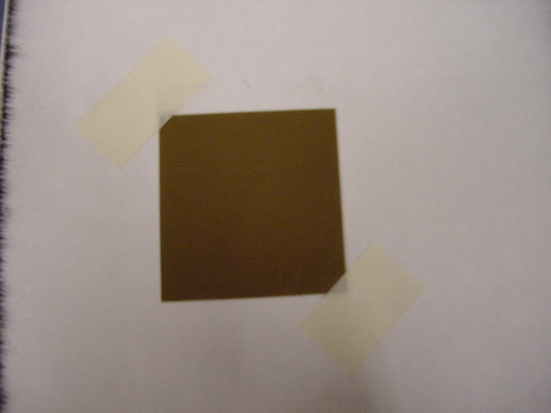
Transfer Artwork: Prep
Place PCB over blue paper
Centered & square to image
Tape down on two corners overlapping tape as little as possible (you’ll have to remove it later)

Slide 15
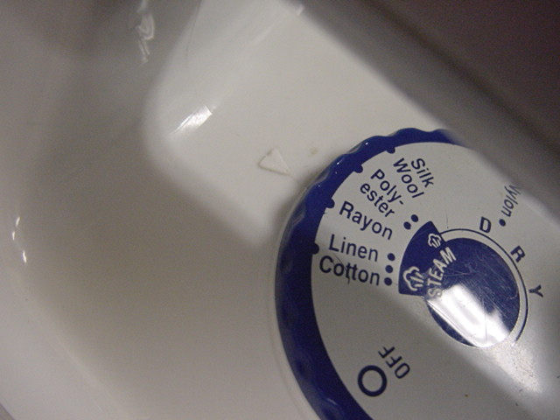
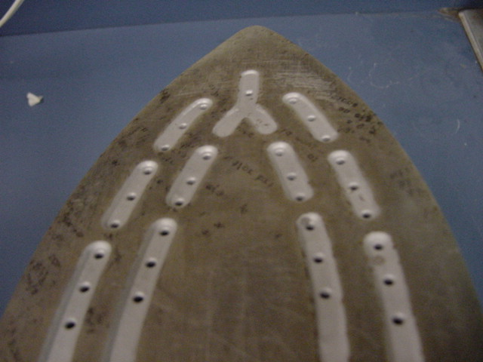
Transfer Artwork: Ironing 1
Preheat iron
Iron temp is between Polyester & Rayon
Iron surface has holes
Iron must be moved periodically to prevent cool spots under holes

Slide 16
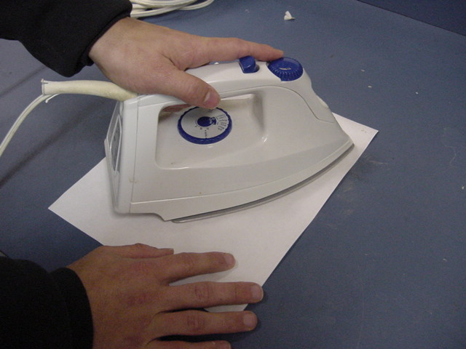
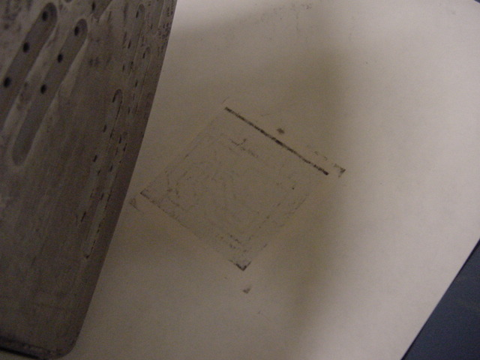
Transfer Artwork: Ironing 2
Turn board/paper copper side up and iron on blank white side
Cover entire board with iron at all times
Move iron periodically
Slight pressure on iron ensures full surface area contact
Heat for 5 minutes

Slide 17
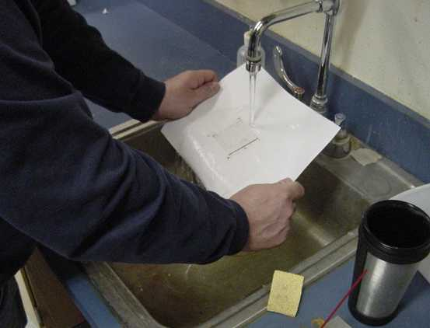
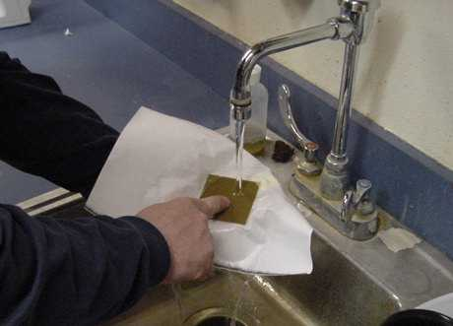
Transfer Artwork: Cooling
Hold paper tight and rinse under cold water
Do not allow water to deform paper and prematurely separate it from board
Turn over paper and cool back side
Do you take your coffee with ferric chloride?

Slide 18
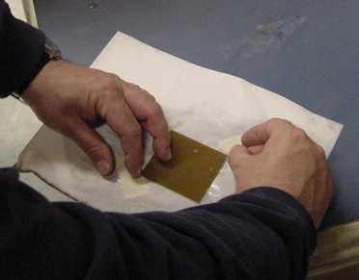
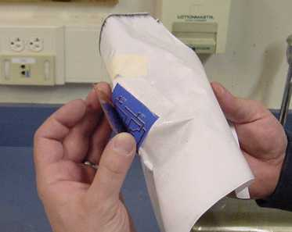
Transfer Artwork: Separation
Scrape tape off corners of board
Pick up assembly
Hold board in one hand
Slowly, carefully, peel paper away from board

Slide 19
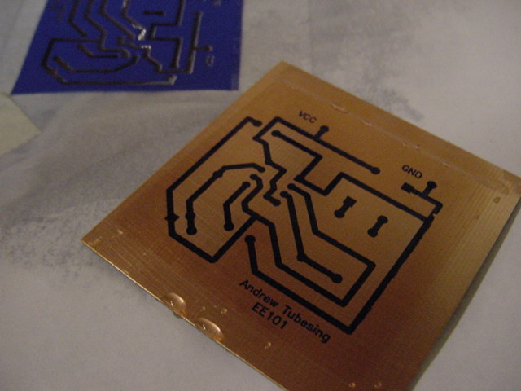
Transfer Artwork: Inspection
Blue material has transferred to board
Look for damaged traces and repair with touch-up marker
Protect blue lines from being scratched off
Blue lines will protect copper from etchant

Slide 20
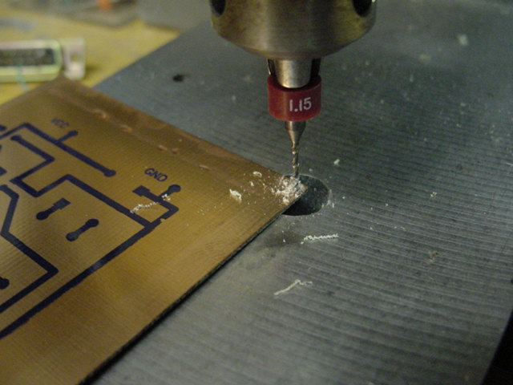
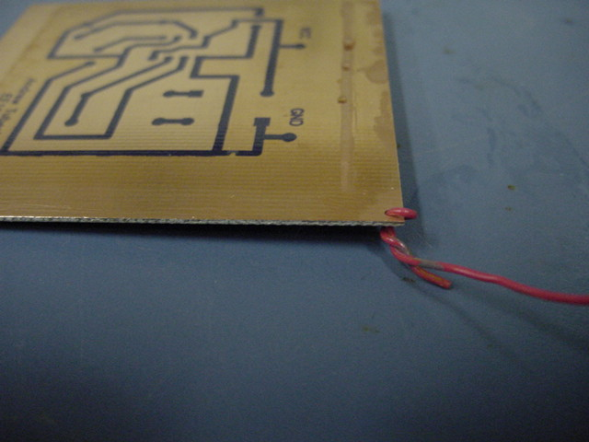
Etching: Prep
Drill a hole in an unused corner with the 1.15 drill bit (it is better to drill this hole before the art transfer)
Hold material securely so it doesn’t lift and break the bit
Attach a piece of wire through the hole to act as a leash in the chemical bath
Why shouldn’t we strip the wire?

Slide 21
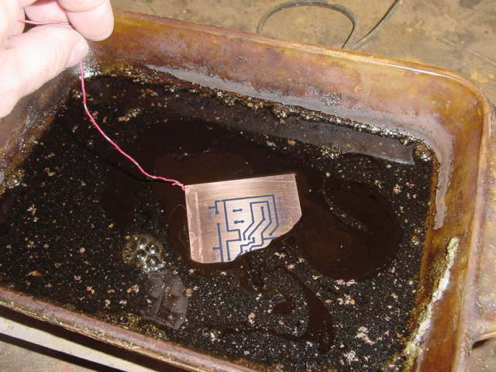
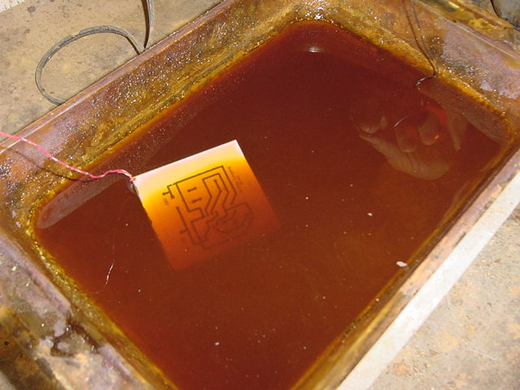
Etching: Bath 1
Preheat bath with hot plate, etching is faster at higher temp
Fully submerge PCB into etchant solution
Agitate regularly
Ferric chloride will etch away copper not protected by the blue resist material
One of these baths was previously used by design students, can you guess which?

Slide 22
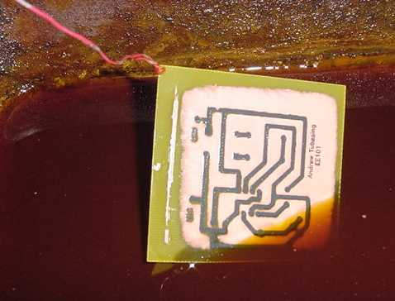
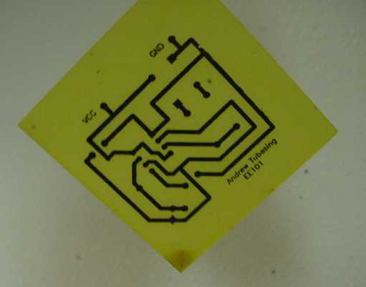
Etching: Bath 2
Etching will start at edges and move toward center
Remove from bath when all copper is etched away
Excessive bathing will dissolve traces under resist material after adjacent copper is gone

Slide 23
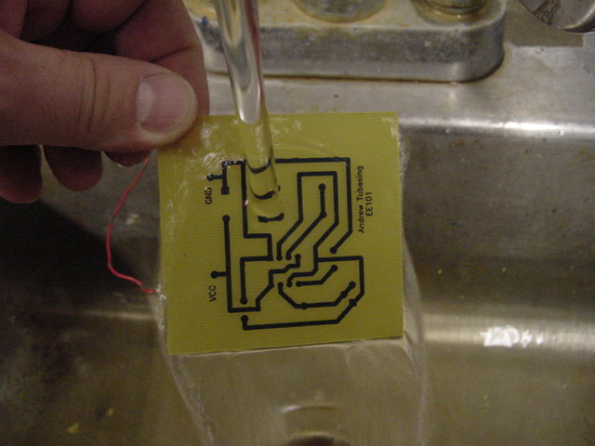
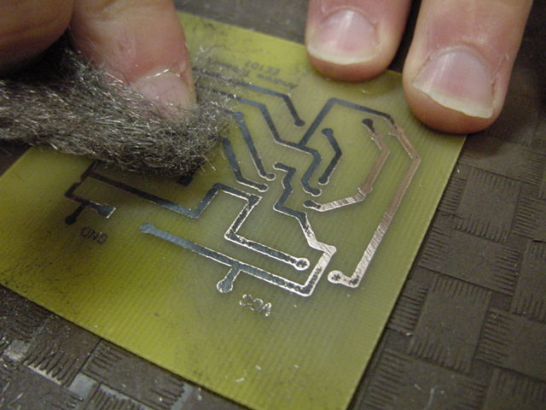
Etching: Cleanup 1
Wash with soap
Inspect for remaining unwanted copper, re-bathe if necessary
Disconnect leash wire
Remove resist material with steel wool

Slide 24
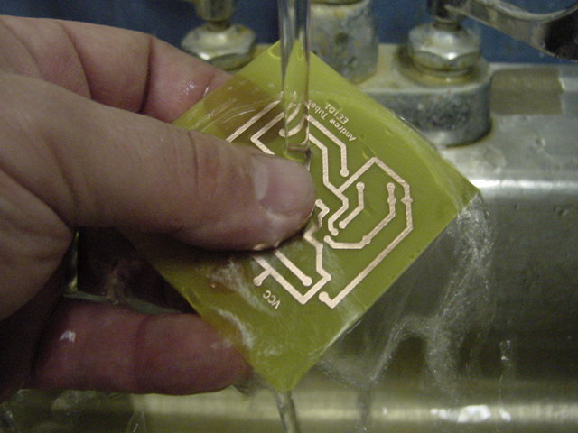
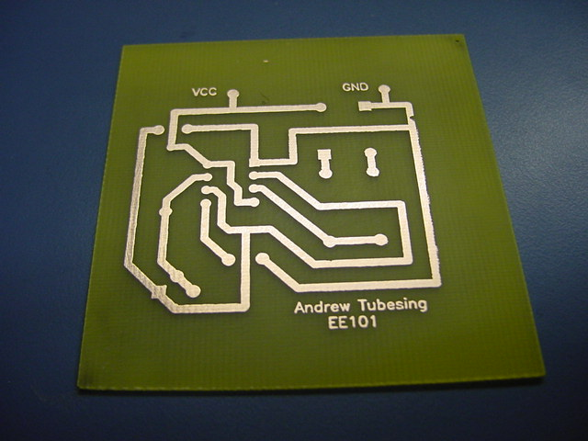
Etching: Cleanup 2
Wash again with soap
Unplug hot plate
Replace cover on bath pan after it cools
Your shiny new PCB is ready to tin

Slide 25
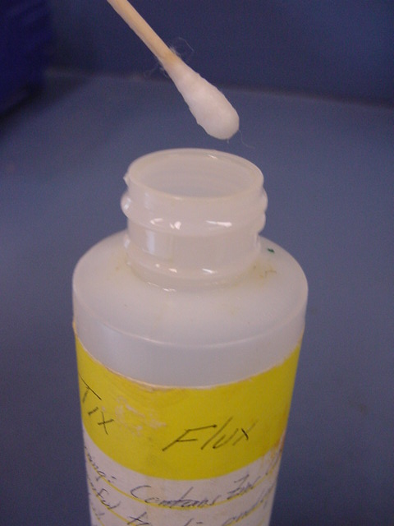
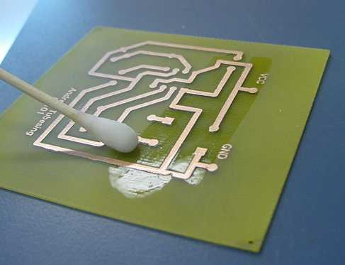
Tinning: Flux
Tinning will coat your traces with solder to protect from oxidation and help in the soldering process
Use highly-active liquid flux, one swab-full is plenty
Cover all traces
Use care, this is highly corrosive – after the tinning process it becomes inert but leftovers and spills are hazardous

Slide 26
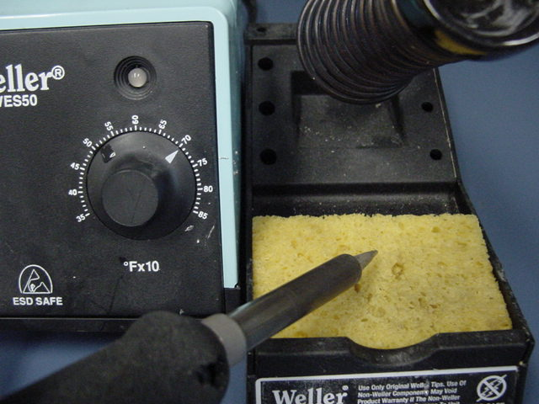
Tinning: Soldering 1
Preheat soldering iron to 700° F
Wet sponge with water
Clean tip periodically by dragging and twisting across damp sponge
Handle iron only by handle, do not touch cradle
Wear safety glasses

Slide 27
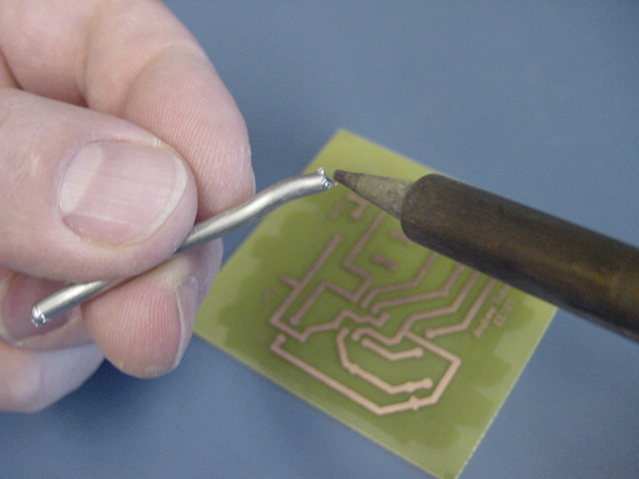
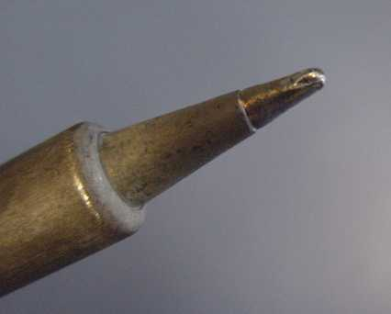
Tinning: Soldering 2
Use solid tin/lead solder
We have already provided flux, so do not use rosin-core solder
A small dot of solder on the tip is all you need for several inches of trace coverage

Slide 28
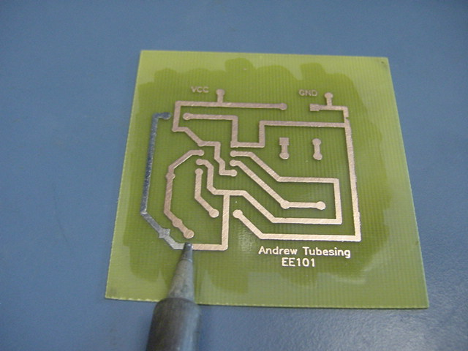
Tinning: Soldering 3
The key to soldering is heat transfer
Angle tip for maximum surface area contact
Move iron slowly so it transfers heat as you move
Solder will follow tip and wick on to trace as you move

Slide 29
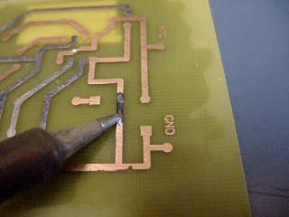
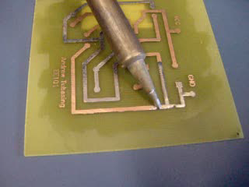
Tinning: Soldering 4
Smooth motion with constant contact transfers heat effectively
Retrace over pads to remove surplus solder
Do not “paint” with brushstrokes
Each time you lift the iron it stops transferring heat
GOOD
BAD!

Slide 30
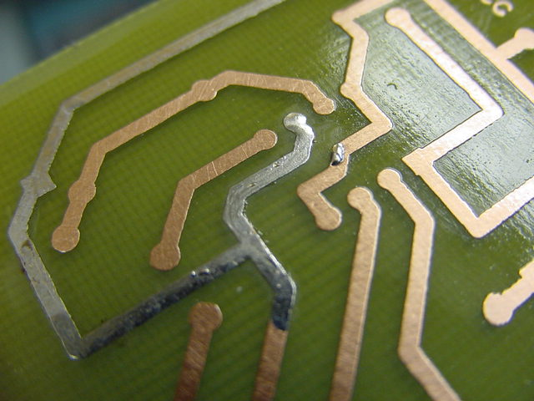
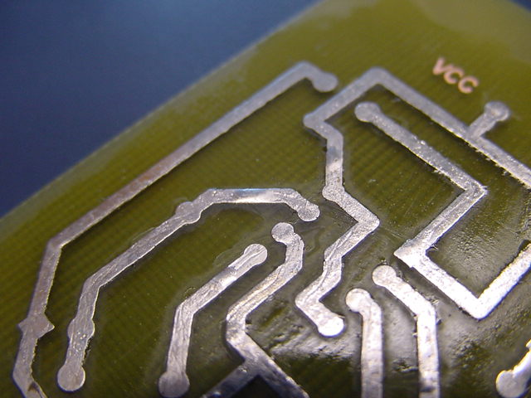
Tinning: Soldering 5
Surplus solder left on pads will create drilling problem
Use iron to drag solder back along trace

Slide 31
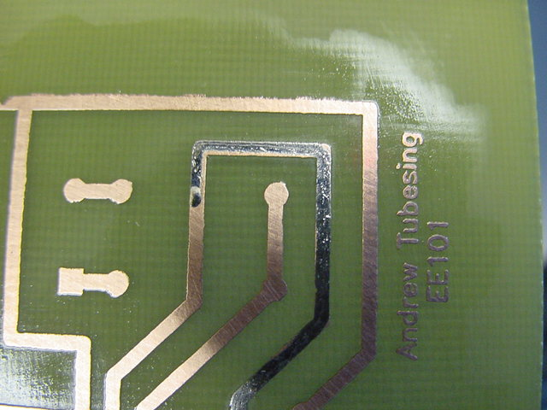
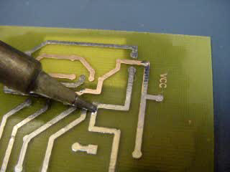
Tinning: Soldering 6
Incomplete trace coverage caused by not enough heat (iron moving too fast) or not enough solder
Extra solder can be transferred to another trace by dragging with iron

Slide 32
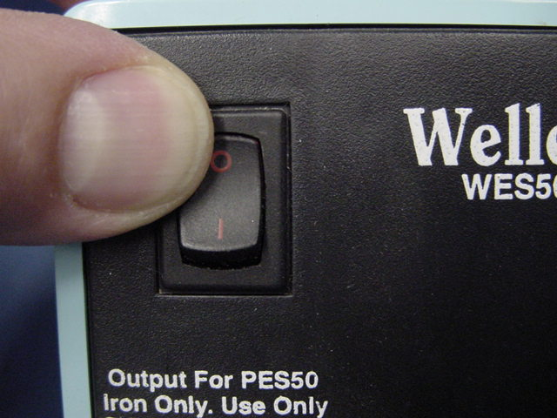
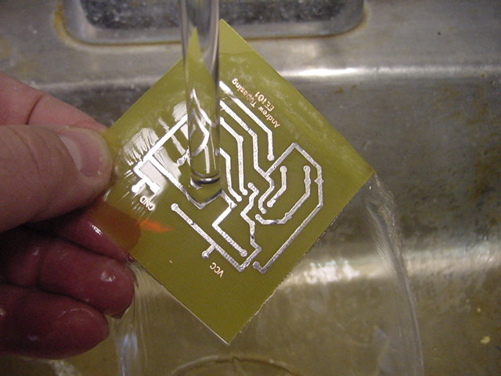
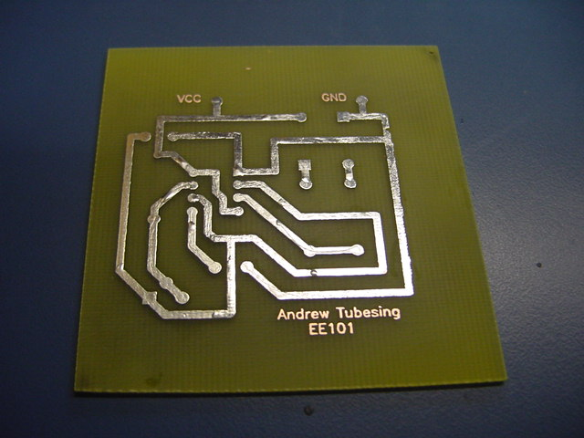
Tinning: Cleanup
Turn off Iron
Wash off flux
Viola!

Slide 33
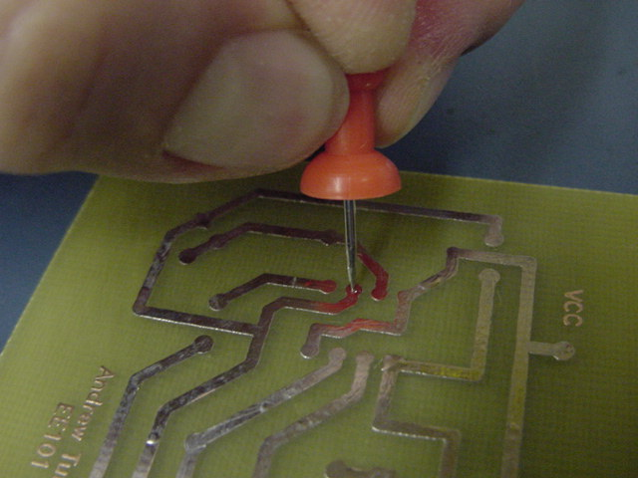
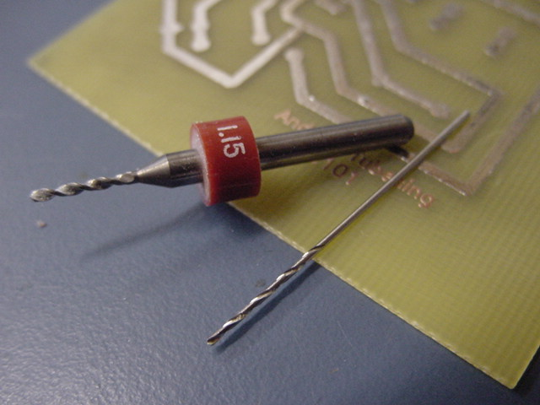
Drilling: Prep
If some pads still have solder bumps they will be hard to drill through
Use a pin to poke a divot in the center of the mounded pad so drill bit will start easier
Use the 1.15 bit for large, square, or flat leads
Use the thinner #69 bit for standard wire leads

Slide 34
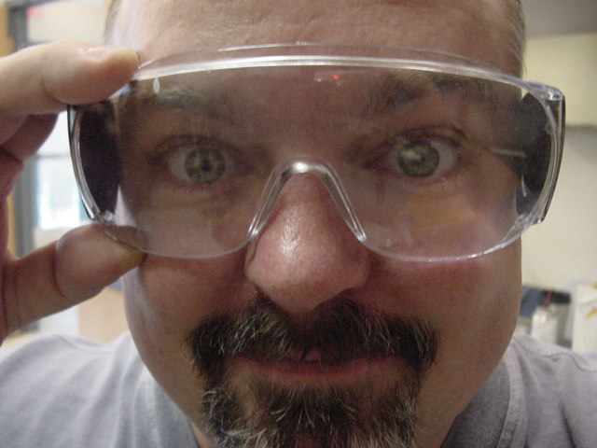
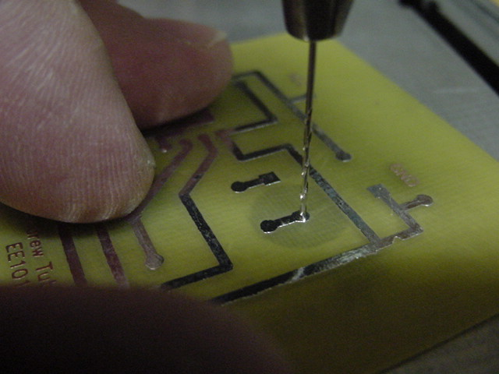
Drilling: Safety & Accuracy
Wear safety glasses, you don’t want a broken drill bit in your eye!
Line up the bit and try to drill exactly in the center of the pad
Adjust your lighting, viewing angle, and technique to ensure accurate hole locations
Be sure you find all the holes you need to drill – it’s very hard to drill holes after you’ve started inserting components

Slide 35
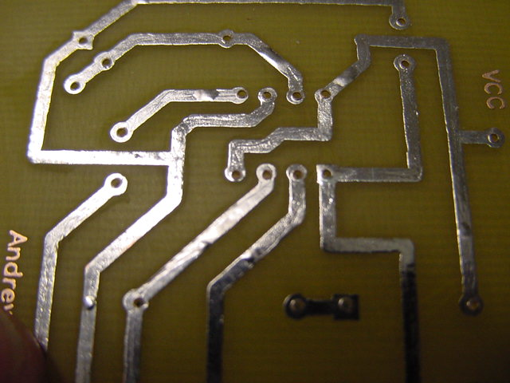
Drilling: Technique
Centered holes make better solder joints
Holes drilled partially off the pad will make poor solder joints
Sequences of un-centered holes make for difficult insertion of SIP & DIP components
Your PCB is now ready to populate

Slide 36


Populating 1
Have schematic and component diagrams handy for reference
Lay component across its holes to judge bending points
Use needle-nose pliers to bend leads for easy and tidy insertion

Slide 37


Populating 2
What’s wrong with this picture?
Components lay flat against board. One is bent nicely, one is not
Be sure to get the proper components in the right places

Slide 38


Populating 3
Bend leads slightly on underside to hold components in place
A tighter fit is accomplished by bending directly underneath board
Use care bending square LED leads, they are brittle and will fatigue easily.
Watch polarity! Square pads denote Negative terminal or Pin 1 for DIPs

Slide 39


Soldering: Prep
Before you start soldering, double-check your schematic and be sure you have the components placed properly
Use rosin core solder for component soldering
Preheat iron to 700° F
Wet tip of iron with a small dab solder to help conduct heat to component lead and trace (this is not the solder that makes the joint)

Slide 40


Soldering: Process
Heat transfer is the key to soldering
A good solder joint requires all parts reach solder melting temperature
Heat pad and lead together with tip of iron
Apply solder to lead and/or pad, NOT to iron
After solder is applied, wait for temp to equalize before pulling out

Slide 41

Soldering: Inspection – Bad Joints
Bad joints:
Too much solder (blobs)
Too little solder or not enough heat (gaps/holes)
Too much heat, uneven heat, or too many heat cycles (frosty, pitted, or non-uniform texture, scorched substrate)

Slide 42

Soldering: Inspection – Good Joints
Good solder joints:
Smooth volcano shape
Solder wicks along lead and trace
Uniform shiny surface
Retouch joints only if absolutely necessary
Retouching requires reheating the entire joint

Slide 43

Soldering: Trimming
Make a final inspection to be sure you’ve finished all joints
Trim leads when finished soldering
Wear safety glasses
Snipped leads become projectiles, face away from others

Slide 44

Soldering: Finishing Up
Not quite done yet…
Turn off your iron!

Slide 45


Finishing Up
Your finished product… or is it?
There, that’s better

Slide 46

Finished Product
Final working product
Adjust frequency by turning potentiometer

Slide 47
Key things to remember:
Safety first
Keep your materials clean for best transfer results
HEAT is the essential ingredient of tinning and soldering
Take the time to be organized, tidy, and thorough
Remember all of this so you don’t have to bug the lab manager when it’s time to make a PCB! ☺

Slide 48
The End
Thank you for listening, have a good day.

