Slide 1

Perf-Board Tips
Andrew Tubesing
University of St Thomas

Slide 2
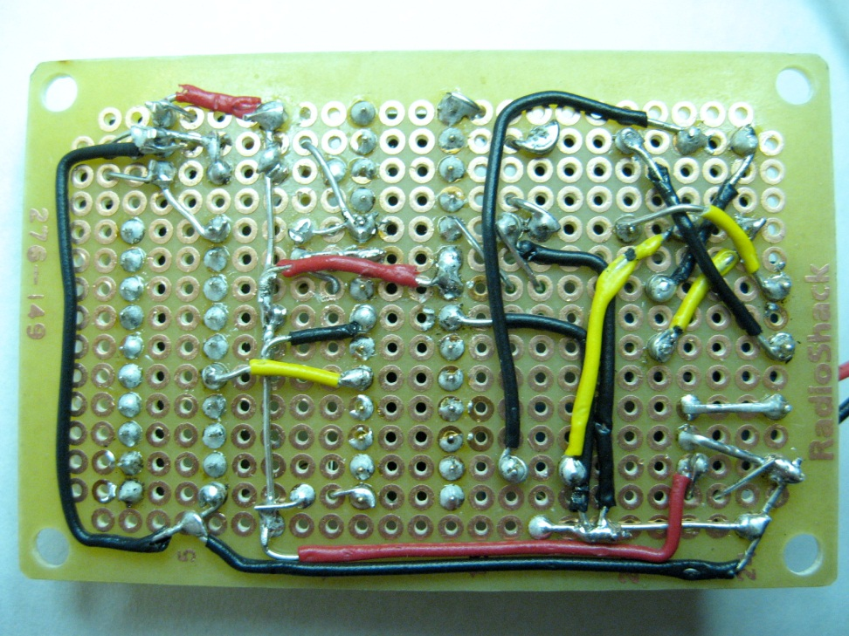
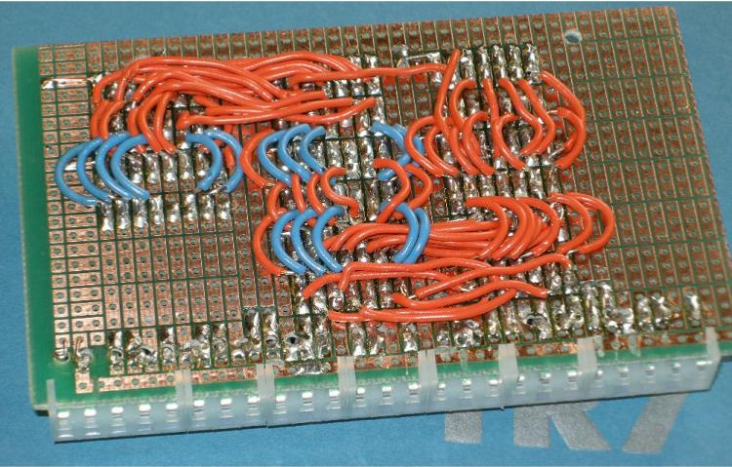
Perf-board Tips
Resist the urge
to wire on the bottom

Slide 3
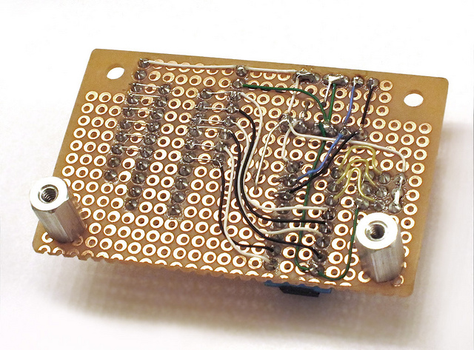
Perf-board Tips
Wiring on bottom is ok for special purposes, such as buses

Slide 4
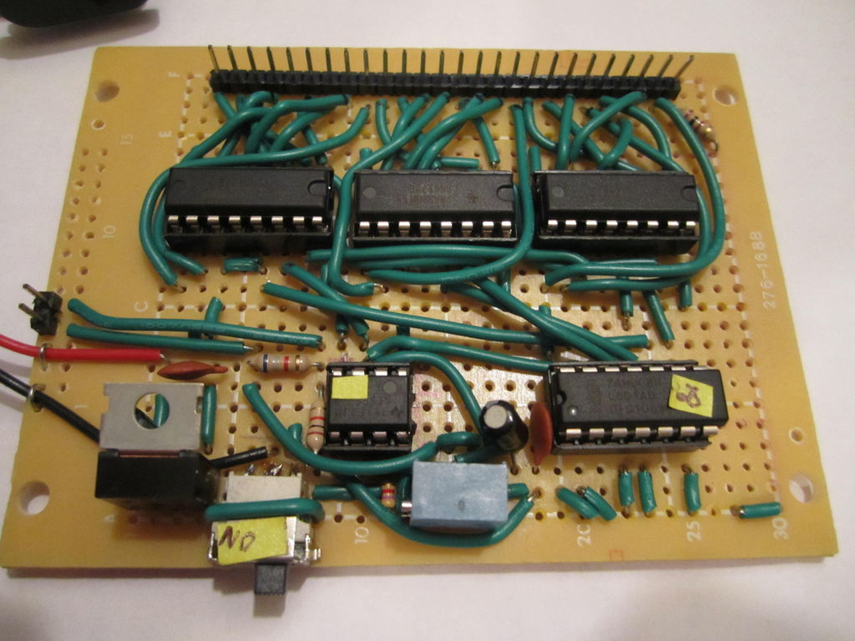
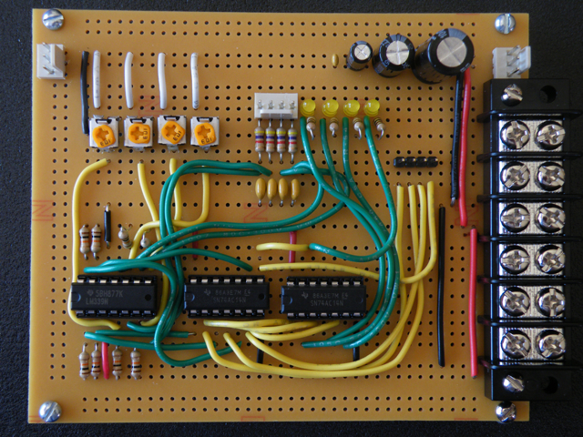
Per-board Tips
Route wires on top
whenever possible
Use multiple colors
All the same color is difficult to trace and troubleshoot

Slide 5
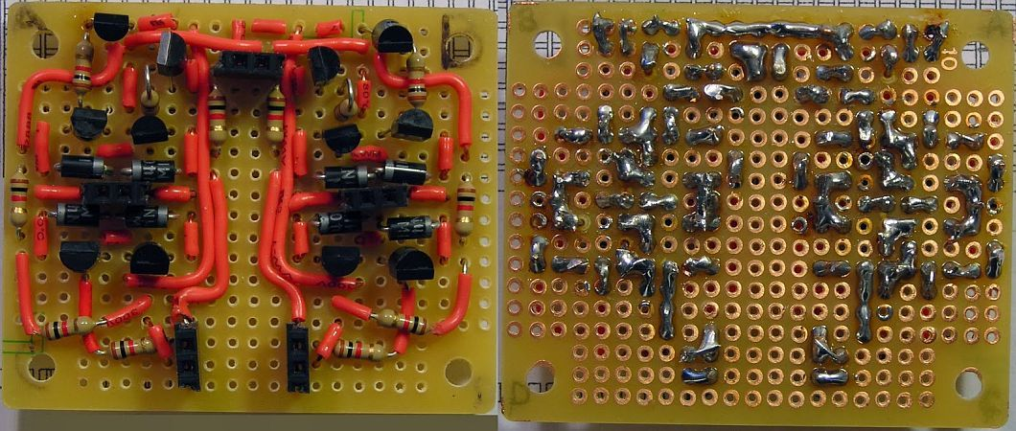
Per-board Tips
Treat wires like components:
Strip the end
Insert through neighboring hole
Bend short wire tip over toward neighboring lead
Snip it where it touches neighboring lead
Solder the two pads and leads together

Slide 6
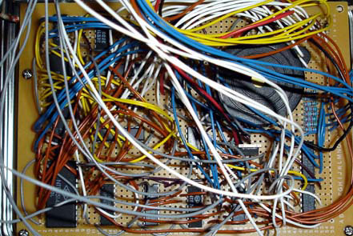
Perf-board Tips
Know when to get a PCB!

