Slide 1
Sentiment Analysis of Incoming calls on helpdesk
PIP4004 University Project
Review-0
Batch Number:CSD-G14
Under the Supervision of,
Mr. Yamanappa
Professor
School of Computer Science and Engineering
Presidency University
Roll Number | Student Name
20211CSD0034 | SIDDHARTHA G
20211CSD0036 | ANKITA HS
20211CSD0049 | KEERTHANA
20211CSD0013 | SHAIK MOHAMMED ADIL
Name of the Program: B.Tech
Name of the HoD: Dr. Saira Banu Atham
Name of the Program Project Coordinator: Dr. Manjula H M
Name of the School Project Coordinators: Dr. Sampath A K / Dr. Abdul Khadar A / Mr. Md Ziaur Rahman

Slide 2
Content
Problem Statement
Github Link
Analysis of Problem Statement
Timeline of the Project
References

Slide 3
Problem Statement Number:
Organization: Ministry of Commerce and Industries
Category (Hardware / Software / Both) :Software
Problem Description: The problem at hand involves developing a sentiment analysis solution specifically tailored for analyzing the sentiment of incoming calls in helpdesks, call centers, and customer services. With the ever-increasing volume of customer interactions in these domains, it is crucial for businesses to gain insights into the sentiments expressed by their customers during phone conversations. Sentiment analysis refers to the process of automatically determining the sentiment or emotional tone conveyed by a text or speech. In the context of incoming calls, sentiment analysis can provide valuable information about customer satisfaction, identify potential issues, and highlight areas for improvement in customer service delivery.
Difficulty Level: Simple

Slide 4
Github Link
The Github link provided should have public access permission.
Sentiment-Analysis-of-Incoming-calls-on-helpdesk/ at main · CapstoneProject-CSD-G14/Sentiment-Analysis-of-Incoming-calls-on-helpdesk

Slide 5
Analysis of Problem Statement
Technology Stack Components:
Frontend Components
1.HTML & CSS – For structuring and styling the web app.
2.JavaScript Frameworks & Libraries - React.js
3.Bootstrap / Tailwind CSS – For responsive design
4. Visual Studio Code (VS Code) – IDE for frontend & backend development.
Backend Components:
1. Node.js – Server-side runtime for handling requests
2. Python (Flask / FastAPI / Django) – For building the sentiment analysis model
3. MySQL / PostgreSQL – For structured data storage (customer logs, call metadata)
4. MongoDB – For unstructured data storage (transcriptions, feedback data)

Slide 6
Analysis of Problem Statement (contd...)
Software and Hardware Requirements:
1. Machine Learning Algorithms
Speech-to-Text Model – Convert customer calls into text using Google Speech API, IBM Watson Speech-to-Text, or AWS Transcribe.
Sentiment Classification Model – Use BERT, RoBERTa, VADER, or LSTM-based deep learning models to analyze customer sentiment.
Emotion Detection Model – Detect emotions like anger, frustration, satisfaction, happiness using NLP and deep learning.
Topic Modeling & Intent Recognition – Identify common customer concerns, complaints, and feedback trends using LDA or transformers.
Anomaly Detection – Detect unusual spikes in negative sentiment, call drop patterns, or recurring complaints using ML models.
2. Data Processing & Management
Speech Data Processing – Audio-to-text conversion, noise removal, speaker diarization (Sphinx, DeepSpeech, Kaldi).
Text Preprocessing – Tokenization, stopword removal, lemmatization using NLTK, spaCy.
Real-Time Data Processing – Stream and analyze live calls using Apache Kafka / RabbitMQ.
Data Annotation & Labeling – Label datasets for supervised learning using Label Studio / Prodigy.

Slide 7
Analysis of Problem Statement (contd...)
3.⁠ Database Management System (DBMS)
Relational Database (MySQL / PostgreSQL) – Store structured call metadata (call logs, timestamps, agent details).
NoSQL Database (MongoDB / Firebase / Cassandra) – Store unstructured call transcripts, audio files, customer feedback.
4.⁠ ⁠Software & Frameworks
Speech Recognition – Google Speech API, IBM Watson, Mozilla DeepSpeech
Natural Language Processing (NLP) – NLTK, spaCy, Hugging Face Transformers
Machine Learning Frameworks – TensorFlow, PyTorch, Scikit-learn
Web Scraping & Data Extraction – BeautifulSoup, Scrapy, Selenium (for gathering industry trends & customer sentiment from online forums)
API Integration – Twilio, Nexmo, Google Dialogflow (for integrating with call center systems)
Deployment & Cloud Services – AWS, Azure, Google Cloud (for model hosting and API services)

Slide 8
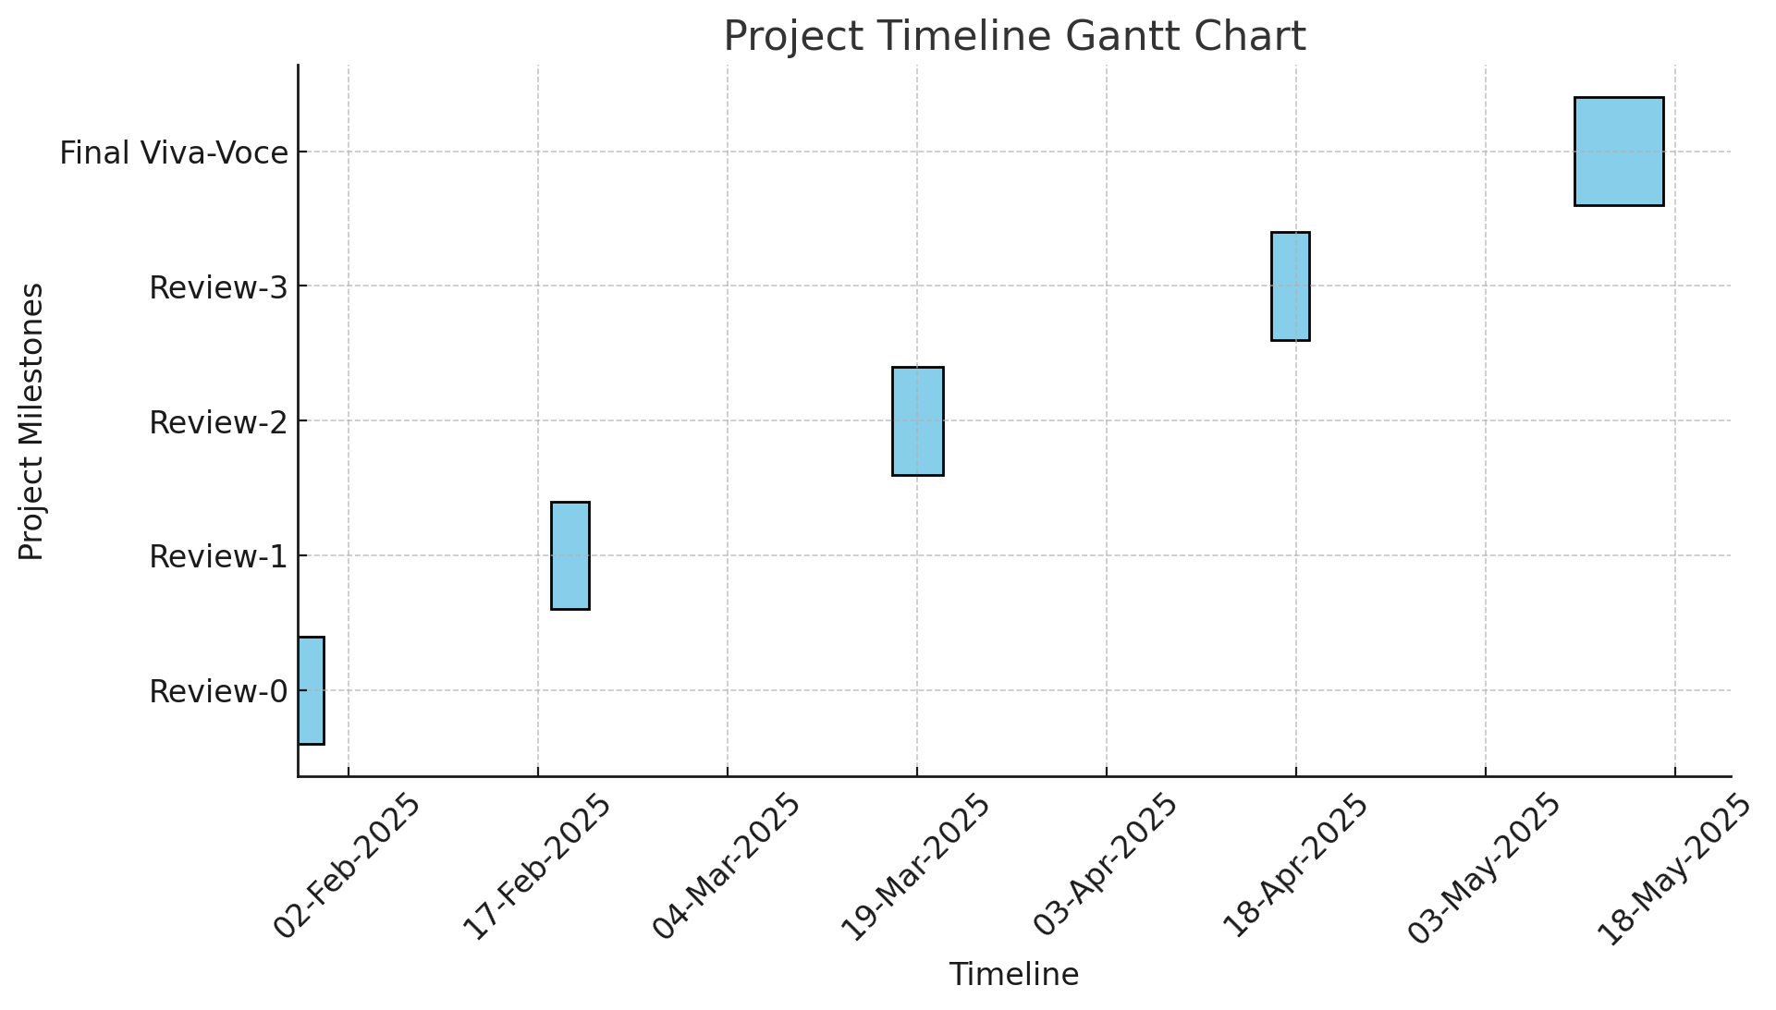
Timeline of the Project (Gantt Chart)

Slide 9
References (IEEE Paper format)
Add APA Citation for all references.
Use the below link for various APA styles :
https://www.indeed.com/career-advice/career-development/how-to-cite-a-research-paper

Slide 10


