Slide 1
Sentiment Analysis of Incoming calls on helpdesk
PIP4004 University Project
Review-1
Batch Number:CSD-12
Under the Supervision of,
Mr. Yamanappa
Assistant Professor
School of Computer Science and Engineering
Presidency University
Roll Number | Student Name
20211CSD0034 | SIDDHARTHA G
20211CSD0036 | ANKITA HS
20211CSD0049 | KEERTHANA
20211CSD0013 | SHAIK MOHAMMED ADIL
Name of the Program: B.Tech
Name of the HoD: Dr. Saira Banu Atham
Name of the Program Project Coordinator: Dr. Manjula H M
Name of the School Project Coordinators: Dr. Sampath A K / Dr. Abdul Khadar A / Mr. Md Ziaur Rahman

Slide 2
Introduction
Understanding customer sentiment is essential for improving service quality in today’s customer-driven market.
The Call Sentiment Analysis System utilizes speech recognition and natural language processing (NLP) to analyze customer interactions.
It transcribes customer calls and classifies sentiment as positive, neutral, or negative.
The system is built using Python and Flask for efficient processing and deployment.
It records calls, converts speech into text, and stores sentiment insights in a database.
Businesses can assess customer satisfaction levels and identify service gaps using sentiment insights.
The system helps refine strategies by analyzing vocal tone and conversation context.
Enhances customer engagement and loyalty by providing valuable insights.
Aims to optimize service delivery and improve support efficiency.

Slide 3
Literature Review
Sl. No. | Paper Name | Description
1 | A Deep Learning System for Sentiment Analysis of Service Calls | Explores a deep learning approach to analyze customer sentiment in service calls. The study focuses on leveraging neural networks to improve sentiment classification accuracy and enhance customer experience insights.
2 | A Survey on Sentiment Analysis | Provides an overview of various sentiment analysis techniques, methodologies, and their applications across different domains, including social media, reviews, and customer service interactions.
3 | Acoustic and Lexical Sentiment Analysis for customer service calls | Investigates the use of acoustic (voice tone) and lexical (word choice) features for sentiment analysis in customer service calls, aiming to improve sentiment detection accuracy.
4 | Automated Speech Recognition System in Advancement of Human - Computer Interaction | Discusses advancements in speech recognition technology and its implications for enhancing human-computer interactions, including applications in customer support systems.
5 | Call center sentiment analysis systematic review | Systematically reviews existing research on sentiment analysis in call centers, highlighting trends, challenges, and potential future research directions.

Slide 4
Proposed Method
Call Recording
Speech to Text Transcription
Sentiment Analysis using NLP
Data Storage in SQL Database
Web – Storage Dashboard for Data Visualization
Insights and Business Recommendations

Slide 5
Objectives
The objective of this project is to develop an intelligent system that integrates sentiment analysis and speech-based analysis to accurately interpret human emotions from both textual and vocal inputs. By leveraging natural language processing (NLP) techniques for sentiment analysis and speech recognition technologies for vocal tone and pattern analysis, the system aims to provide deeper insights into user emotions. This can be applied in various domains such as customer feedback evaluation, where businesses can assess customer satisfaction and detect dissatisfaction in both written and spoken reviews. Additionally, in virtual assistants and AI-driven communication systems, incorporating sentiment and speech analysis can enhance user interactions by enabling more empathetic and context-aware responses. Overall, this project aims to bridge the gap between textual and vocal emotion recognition, improving human-computer interactions and decision-making processes.

Slide 6
Methodology
Speech Transcription: Convert recorded customer calls into text using speech recognition technology, enabling further analysis of conversation content.
Sentiment Analysis: Apply natural language processing (NLP) models to classify the sentiment of transcribed text as positive, neutral, or negative.
Database Storage: Store recorded calls, transcriptions, and sentiment scores in a structured database for future reference and trend analysis.
Web Interface: Develop a Flask-based web application that allows users to view call transcriptions, listen to recordings, and analyze sentiment trends over time.
Service Improvement Insights: Use sentiment trends and vocal tone analysis to identify service gaps, improve customer satisfaction, and enhance overall service strategies.

Slide 7
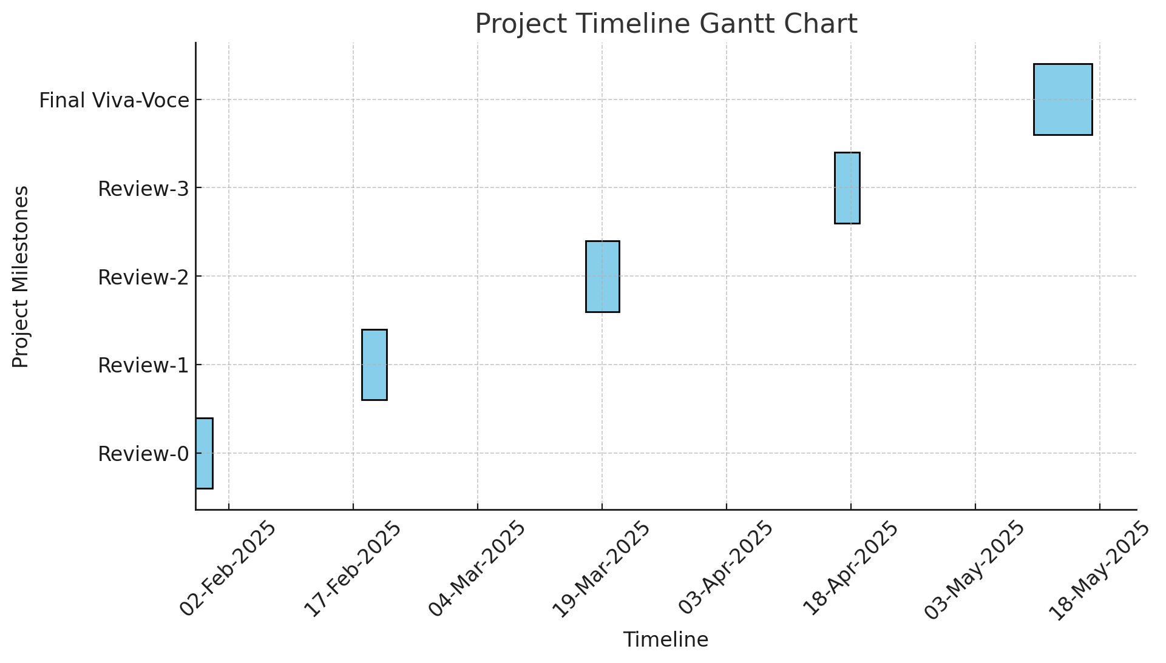
Timeline of Project

Slide 8
Expected Outcomes
Improved Customer Satisfaction Monitoring: Enable businesses to assess customer sentiment in real time, identifying concerns and areas for improvement.
Enhanced Service Quality: Provide insights into service gaps and agent performance, helping businesses refine customer service strategies.
Actionable Business Insights: Analyze sentiment trends over time to make data-driven decisions for better customer engagement and loyalty.
Efficient Call Analysis: Automate call transcription and sentiment classification, reducing manual effort and improving response efficiency.
Data-Driven Decision Making: Use stored call data and sentiment scores to generate reports and recommendations for optimizing customer interactions and service delivery.

Slide 9
Conclusion
The “Sentiment Analysis of Incoming Calls on Helpdesk Project” enhances customer service by leveraging speech recognition and NLP to analyze customer interactions. By transcribing calls and classifying sentiment, businesses gain valuable insights into customer satisfaction, service gaps, and areas for improvement. The Flask-based web interface provides easy access to call records and sentiment trends, enabling data-driven decision-making. This system not only streamlines sentiment analysis but also helps businesses refine their customer engagement strategies, leading to improved service quality and loyalty. Ultimately, it empowers organizations to make informed adjustments that enhance customer experience, optimize support operations, and drive long-term business growth.

Slide 10
References
A Deep Learning System for Sentiment Analysis of Service Calls (Yanan Jia, 2020)
A Survey on Sentiment Analysis (R Raja Subramanian, 2021)
Acoustic And Lexical Sentiment Analysis For Customer Service Calls (Bryan Li, 2019)
Automated Speech Recognition System in Advancement of Human - Computer Interaction (Soumya Priyadarsini Panda, 2019)
Call center sentiment analysis systematic review (K J Shrikrishna Narayana, 2023)

Slide 11
Thank You

