Slide 1




How to use the
application?
Use the slides to get the step-by-step guide for the app.
This project has received funding from the European Union's Horizon Europe research and innovation programme under GA No 101094714 (University of Oslo). UK participants in BEYOND are supported by UKRI grant number 10062742 (Trilateral Research) and by UKRI grant number 10067440 (Heriot-Watt University). Views and opinions expressed are, however, those of the author(s) only and do not necessarily reflect those of the European Union, Research Executive Agency, or UKRI. Neither the European Union nor the granting authority nor UKRI can be held responsible for them.

Slide 2
Reflection Compass is an application that helps …
find out what the students are learning;
evaluate teaching is effective;
monitor how students understand the ethics/integrity-related content covered in a course;
implement formative assessment and provide feedback to students during a course;
students think about their learning and support the development of students’ reflection skills;
support students in learning to evaluate their own understanding.

Slide 3

1. Teacher sets up the course and assignments
The teacher signs in with university credentials.
Click on ’New course’
Fill in the information about the course:
Course title, a unique course ID, start and end dates
Add assignments that require student reflection and self-evaluation:
Write the topic to be reflected on (can be a specific topic or an activity, even an entire learning session)
Set the dates when the assignment is accessible.
Save the course.

Slide 4

2. Sharing the assignment with the learners
After saving the course a course list will be displayed.
At the end of each course description there are 5 symbols:
Edit the course and assignments
Copy the course (to be used again in the future, but you need to change the course ID!)
Delete the course and assignments
Look at the results of responses
Share the link to invite learners to use the application.
Student list – to modify the participant list of the course.
Click on the ’share’ symbol to copy the link with invitaion – paste it to Moodle or other platform or create a QR code with the link to be shared on mobile devices.
Notify learners about the link and the assignment.

Slide 5
3. Students access the assignment and do the tasks
Students use the link or the QR code (created by the teacher) to access the the assignment.
After clicking on the link the application asks learners to sign in with their university credentials.
The assignment(s) to be done is (are) opened after signing in – check the dates of the assignment, after the ending date the assignment cannot be completed or edited by the student.
The student clicks on the assignment to be done and is asked to describe what they have been learning on the topic specified in the assignment heading.
This description is a written reflection of what the student has been learning, how it is going and how well they have understood the content of the sessions. It is a good idea to include examples, personal insights, experiences, changes etc.
(continues)

Slide 6
3. Students access the assignment and do the tasks
The student is then asked to choose the phrase that they think best describes their current level of understanding – there are 5 statements based on the SOLO taxonomy levels (see the explanation in the following slides).
The student then submits the response. The response can be edited until the end of the assignment end date.
After submission, the student receives automated feedback describing the level of understanding they had picked.
The application encourages students to think if the reflection they submitted matches the level of understanding described in the feedback.
Students have a chance to go back to their response and edit either their written paragraph or their level of understanding.

Slide 7
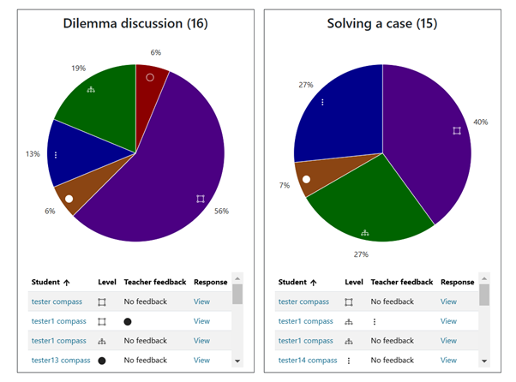
4. Teacher monitors the results (and provides feedback)
The application analyses the student self-evalaution levels and displays the results as a pie-chart (percentages of levels chosen).
The SOLO level symbols (explained in following slides) may indicate how well the students have understood the topics covered in training sessions.
The teacher can also read the reflection texts provided by learners by clicking on ’View’ link.
The teacher can see the student progress summary on the linear graph by clicking on the student’s name (which is a link).

Slide 8
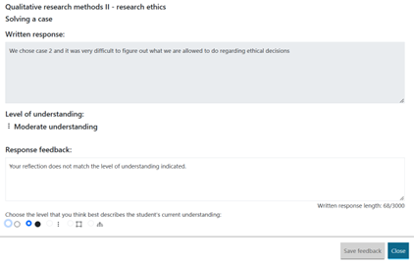
4. Teacher provides feedback (optional)
This step is optional, but may help students improve their reflection and self-evaluation skills.
When the teacher clicks on the ’View’ link, the student response text is displayed and the level of understanding the student has chosen.
The teacher may provide written feedback to the student by e.g. saying that the self-evaluation and reflection texts indeed match.
If the reflection text does not match the level indicated by the student, the teacher may write a comment for improvement and indicate the level of understanding at the bottom to match the content of the text.
Teacher then clicks on the ’Save feedback’ button to share their feedback.

Slide 9
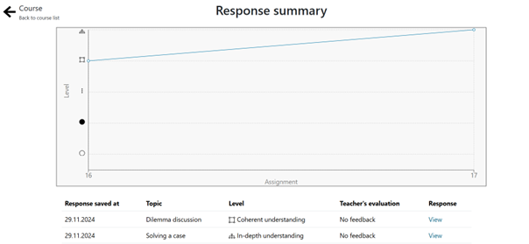
5. Student monitors their progress
The student can monitor their own self-evaluation levels on a linear graph.
This helps understand which topics may need further attention and which ones the student feels confident about.
The student also benefits from the feedback by the teacher – under the summary chart there is a link to teacher feedback (if provided) – the teacher may have provided a new level symbol and/or provided written feedback to the student.
It is advisable for the teacher and student to have discussion sessions occasionally about the progress displayed in the summary charts – e.g. How is the student progressing? Why are some topics more challenging? How is the reflection improving?

Slide 10

SOLO levels – symbols explained (+ how to improve)
Symbol indicates a need for help to understand. To improve their level of understanding the learner can improve their ethical competence by consulting relevant codes of conduct, and to discuss with experienced researchers how they think about making right choices in research.
Symbol indicates emerging understanding. The learner is encouraged to think of related questions, or new questions which may follow the initial issue, it is a good idea map who are concerned by a situation, and what kind of different questions they would raise about the situation.
Symbol indicates moderate understanding. The learner should try to see connections between different ethical aspects in research and think of examples to describe those connections.
Symbol indicates coherent understanding. The learner is advised to apply their knowledge in various contexts and provide help to others.
Symbol indicates in-depth understanding. The learner may have thought about themselves as a role model in promoting good scientific practice in the research community more broadly, and in helping to create an ethically sustainable research culture.

Slide 11
Recommendations for use
There should be several assignments set by the teacher for reflection during one course – this provides a progress graph of the learning.
Student self-evaluation as well as reflection will become more accurate and proficient with repeated use of the application.
While using the app mainly supports students’ reflective learning and formative assessment during the course, the graph displaying the individual student’s learning process serves well as a foundation for a subsequent ‘reflection journal’.
The graph functions as a prompt for students as they summarise their learning process in the reflection journal.
The reflection journal can also be used for the purpose of summative assessment, that is, as a graded assignment contributing to the final assessment in the course, usually the grade.
Repeated use of the application provides teachers insights on how the students are progressing, which topics seem to be more challenging, and which ones have been mastered.
Students can also see their own progress on the graph, and by reading the feedback provided by the application and the teacher, can work on their reflection skills.

Slide 12
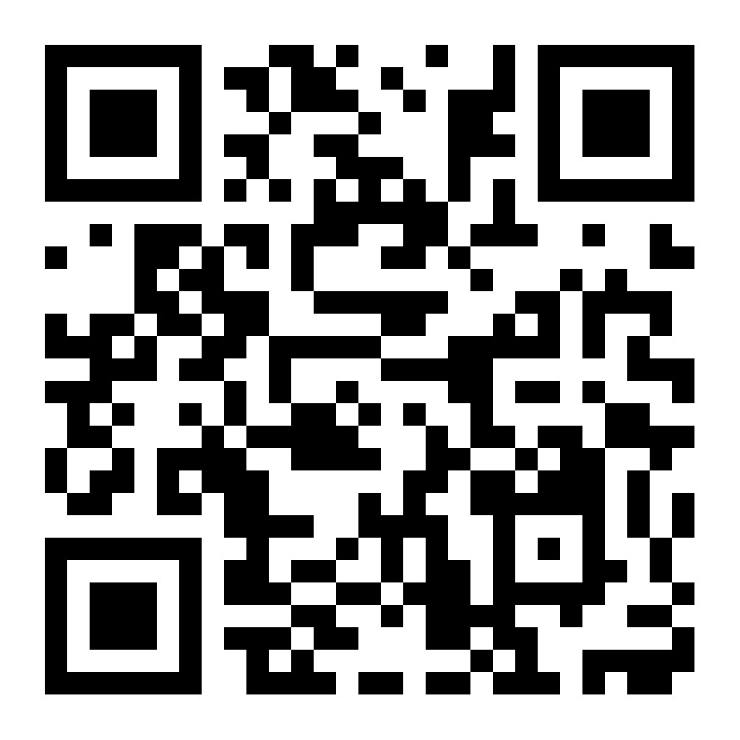
Link to the application
Contact information
If there are any comments or question, please let us know:.
Erika Löfström: erika.lofstrom@helsinki.fi
Anu Tammeleht: anu.tammeleht@helsinki.fi
Link to the application:
https://reflection-compass.it.helsinki.fi

