Slide 1

CSED NOTICE BOARD
Submitted To :
Dr. Anoj Kumar
Submitted By : Group - 10
Saurabh
Saurav Kumar Chaudhary
Shekhar Kumar
Shivam Agrawal
Shivam Anand

Slide 2

Introduction :
Admin control to authorised persons only, to post notice and prevent fake news.
Calendar for all CSED event notice
Notification for new events.
Event joining feature.
One place solution to manage all CSED events.

Slide 3
Problem Statement :
Computer Science and Engineering Department is one of the most active departments of MNNIT with various activities taking place throughout the year. So sometimes it becomes quite difficult for students as well as the faculty to know the exact date of a particular event. So there is a need of digital platform where all the department related announcements and notices shall be displayed. This would remove any discrepancy regarding any notice. Also there is a problem of circulation of false notices . There should be a calendar and students should receive notification regarding any particular event. The person approving notice should be authorized and authenticated.

Slide 4
Features :
Authentic Login to prevent fake notices
Calendar of entire year of all important events of CSED
Notifications prior to any important activity to all students.
Students can create events and mark some dates.

Slide 5
Software/Hardware Requirement :
Software Requirements:
PHP , MySQLi
Bootstrap Libraries, JavaScript
HTML and CSS
Visual Studio Code (text editor)
Platform Used- Windows/Linux (Both Supported)
XAMPP/LAMPP for making server
Browser (Mozilla, Google Chrome)
Hardware Requirements :
Processor - Intel Pentium Series (1.5Ghz)
RAM - 4.0 GB
System Type - 64-bit OS , X64-based processor
Free Space - 500MB

Slide 6
Project Modules :
LOGIN/SIGNUP : ( 100 - 150 Loc ))
This module forms the first layer of security of the application. A separate login for the admin to post/approve notices.
SERVER MODULE: ( 150-200 Loc)
This module is responsible for handling all the database queries in the application.

Slide 7
Project Modules :
CALENDAR MODULE : ( 300-400 Loc )
It will handle all the created events and notices. These will appear on a calendar
NOTIFICATION : ( 230-250 Loc )
This module provide the information about any upcoming event .

Slide 8
Project Modules :
EVENT CREATION: ( 250-300 Loc )
It will handle all the activities related to created events and notices.

Slide 9
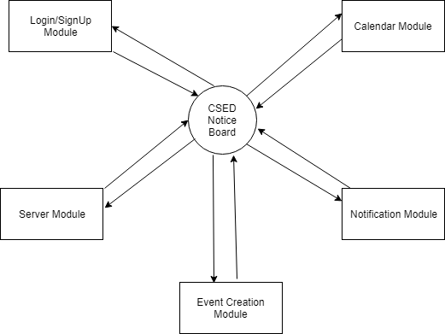
Zero Level DFD CSED Notice Board

Slide 10
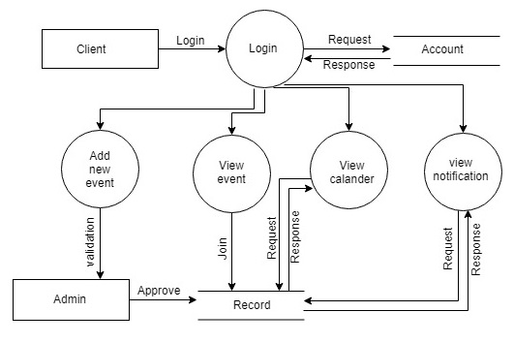
Level 1 DFD

Slide 11
Status of project :
Requirement Engineering
Design
Prototype
Implementation and Unit Testing
System Testing

Slide 12
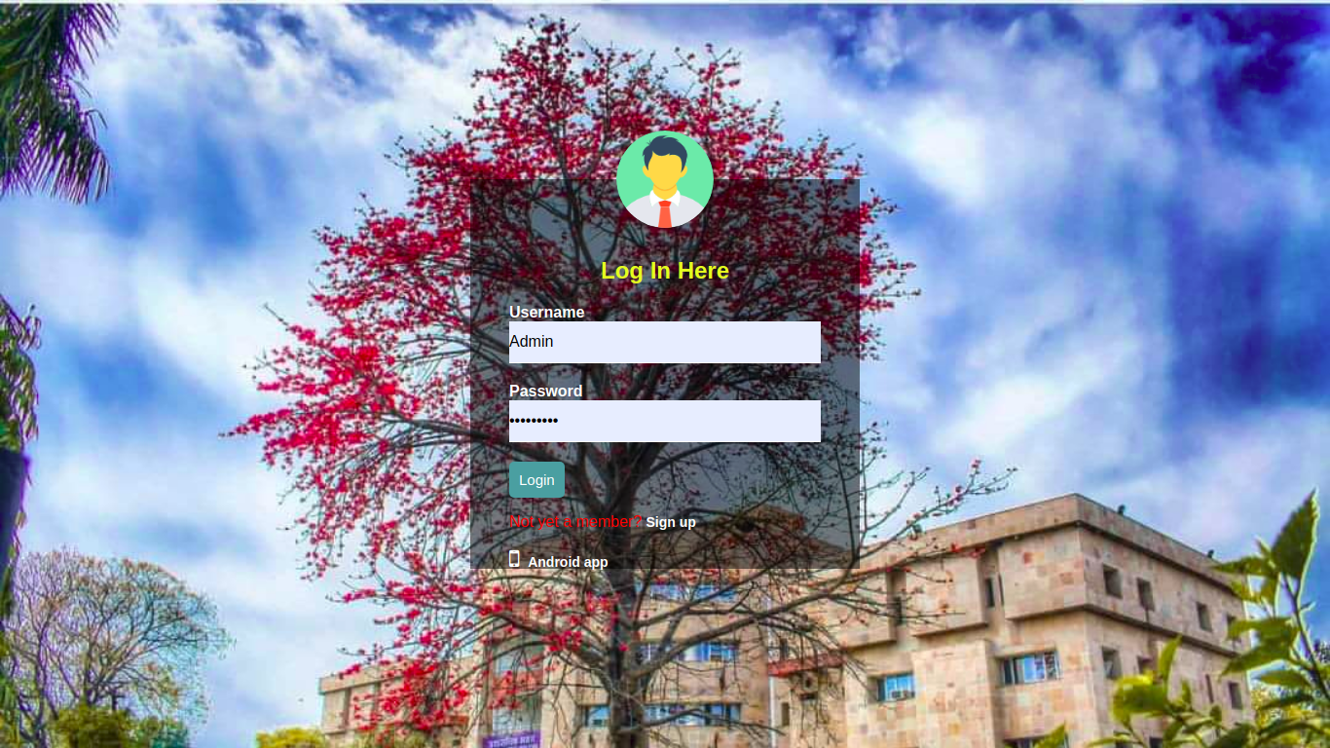
Output :

Slide 13
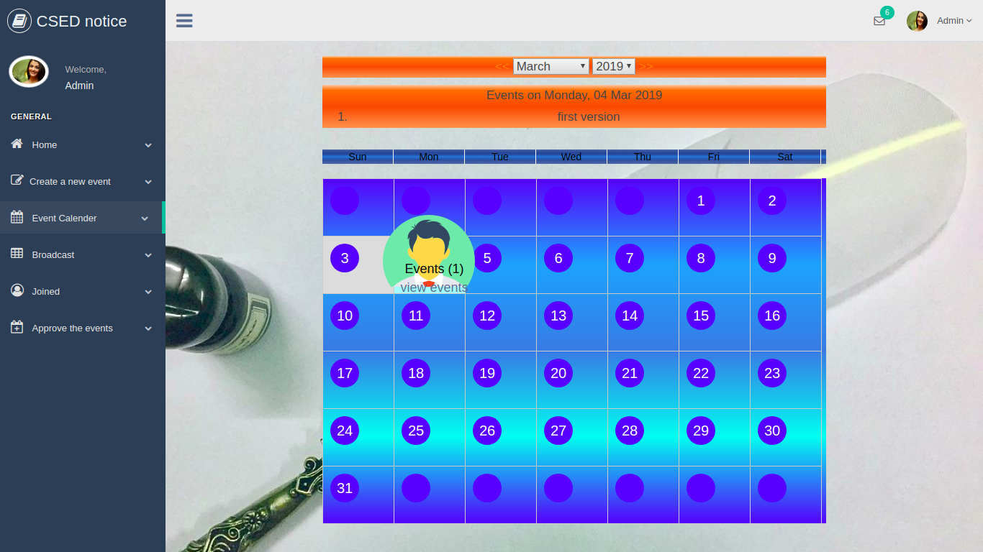

Slide 14
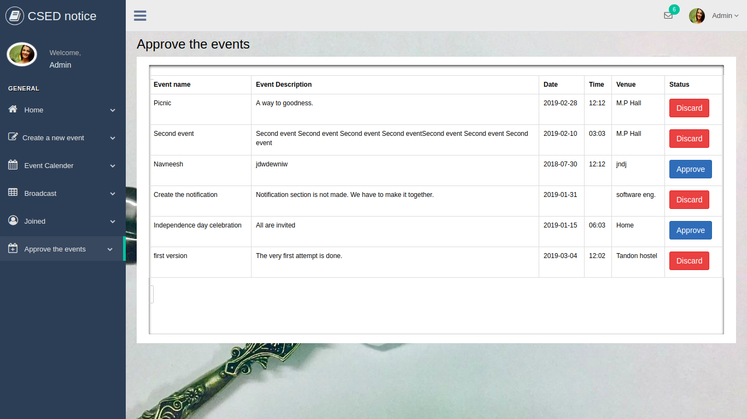

Slide 15
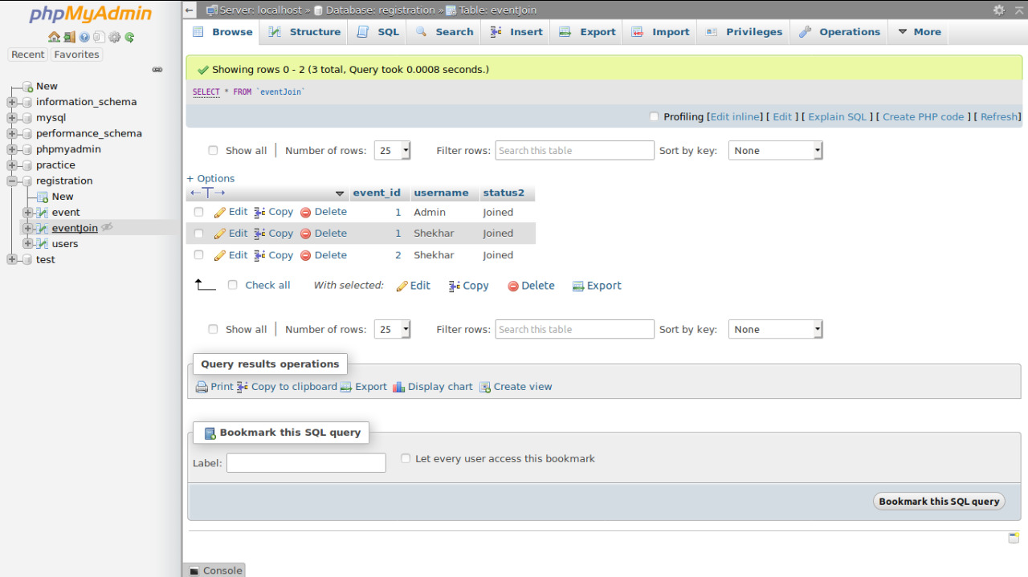

Slide 16
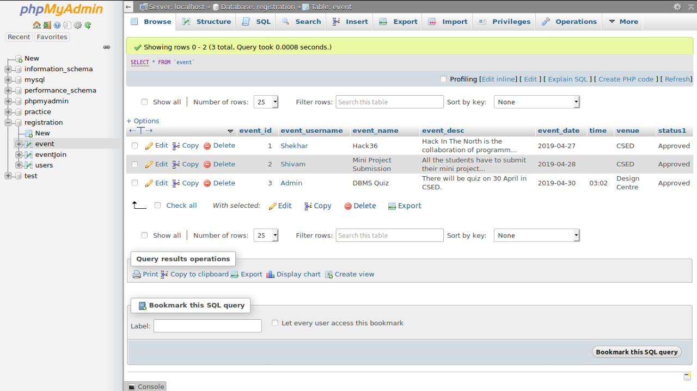

Slide 17
Conclusion :
CSED Notice Board is an effective and one stop solution regarding any notice or event of CSED.
Easy to use as it will have an interactive UI .
Risks include team changes , incomplete specification,unforeseen implementation and testing issues.

Slide 18
Future Aspects :
Future Aspects would include addition of more security features and enhancement of UI.
Multiple notification methods could be added in future.

Slide 19
References :
http://ijsetr.org/wp-content/uploads/2014/06/IJSETR-VOL-3-ISSUE-6-1712-1715.pdf
http://php.net/manual/en/index.php
https://www.w3schools.com/
https://github.com/Subtech-tk/notice-board
https://developer.mozilla.org/bm/docs/Web/JavaScript

Slide 20
THANK YOU

