Slide 1
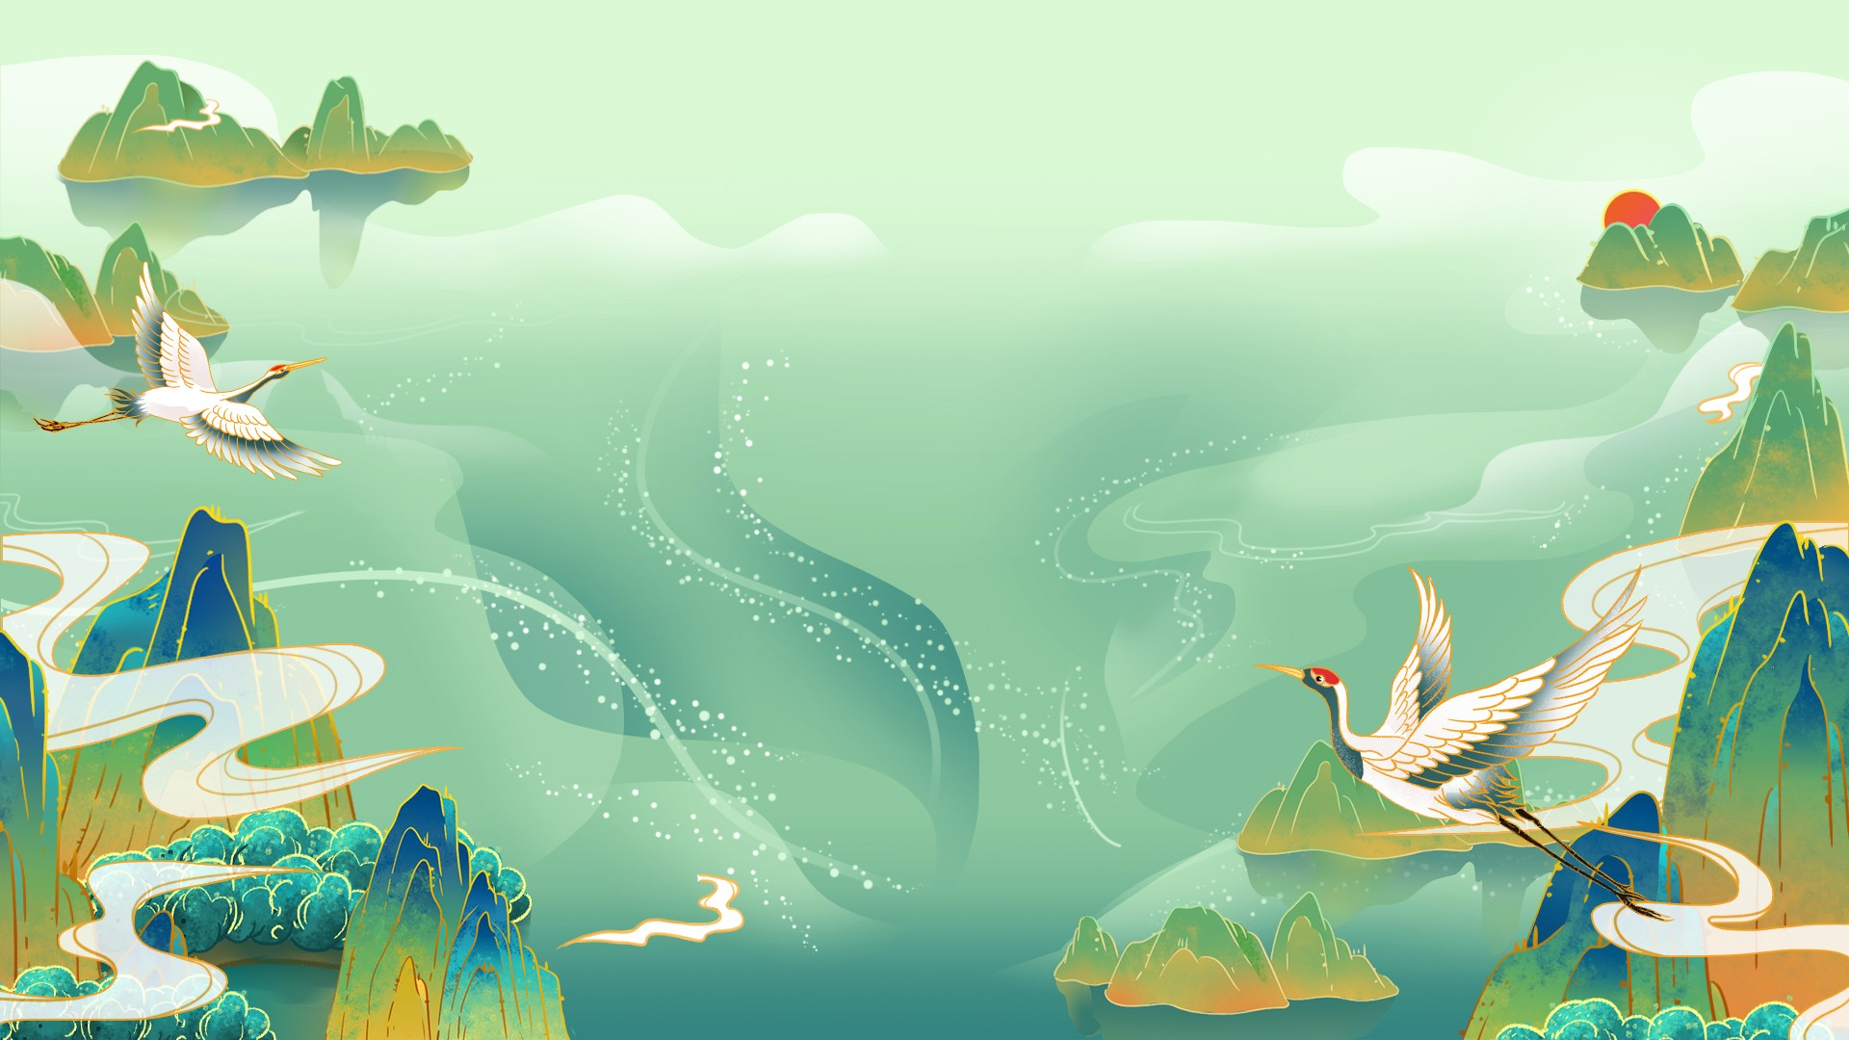
My favorite music
——Foreign popular music

Slide 2


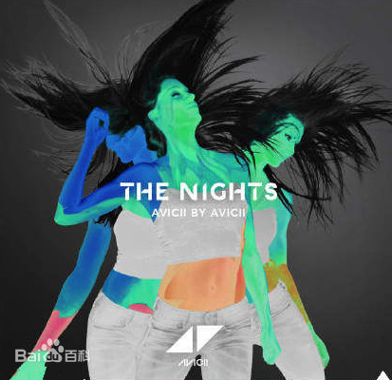

Some classic songs
Beautiful now The Nights Despacito

Slide 3



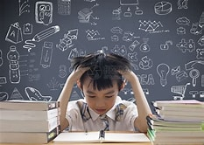
Tired
Excited

Slide 4

Thank you !

