Slide 1
VALUE-BASED DECISION MAKING
Same choices. Different decision processes?
A practical comparison of Softmax and Drift-Diffusion Models
39 participants • 3,862 food-choice trials • Subject-level model fitting
Case study: Subjects 10 and 13
Question: Can two people make similarly value-consistent choices, but take different routes to deciding?
01
Notes:
~55 seconds. Introduce the motivating question. We are modeling two-alternative food choices from Krajbich et al. (2010), using participant-specific subjective value differences, binary decisions and reaction times. Our case-study pair was selected exploratorily after inspecting fits.

Slide 2
EXPERIMENTAL DATA
One task, two levels of explanation
Participants choose between two foods with pre-rated values
Trial predictors: ΔV = left value − right value
Outcomes: selected item and reaction time
Fit both models separately for each of 39 participants
Softmax uses choices only • DDM uses choices + response times
02
Notes:
~65 seconds. Describe the trial table and fitting strategy. Both models see the same choice variable and ΔV. Softmax maximizes choice likelihood; the DDM fits the joint RT-choice density. Each subject contributes approximately 100 trials; these are exploratory independent fits, not hierarchical estimates.

Slide 3
MODEL 1
Softmax: values become choice probabilities
P(left) = 1 / [1 + exp(−β × ΔV)]
One fitted parameter: inverse temperature β
Large β → choices track value more consistently
Does not independently predict decision time
Choice rule, not a temporal mechanism
03
Notes:
~70 seconds. Explain the logistic curve: at ΔV=0, P(left)=0.5; as ΔV grows, the curve approaches 1. The fitted logit file here uses a one-parameter zero-bias model, so P(left) is exactly one-half for a value tie. Inverse temperature measures fitted value-to-choice sensitivity and is not intrinsically a neural processing speed.

Slide 4
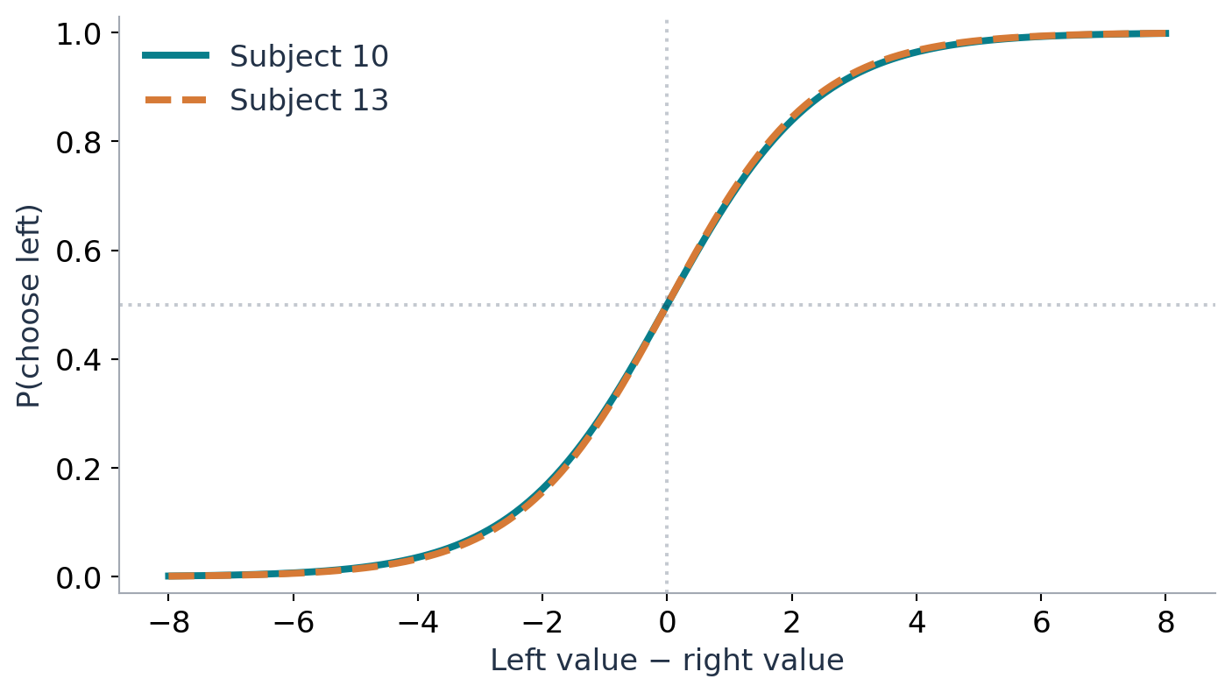
SUBJECTS 10 AND 13
A pair Softmax sees as very similar
SUBJECT 10
β = 0.824
SUBJECT 13
β = 0.845
Nearly identical fitted choice curves
04
Notes:
~60 seconds. Reveal the fitted pair. For a fixed value difference, the two models give nearly identical choice probabilities. This does not mean their trial-by-trial choices or offered foods were identical, only that their fitted relationships between ΔV and choices are similar.

Slide 5
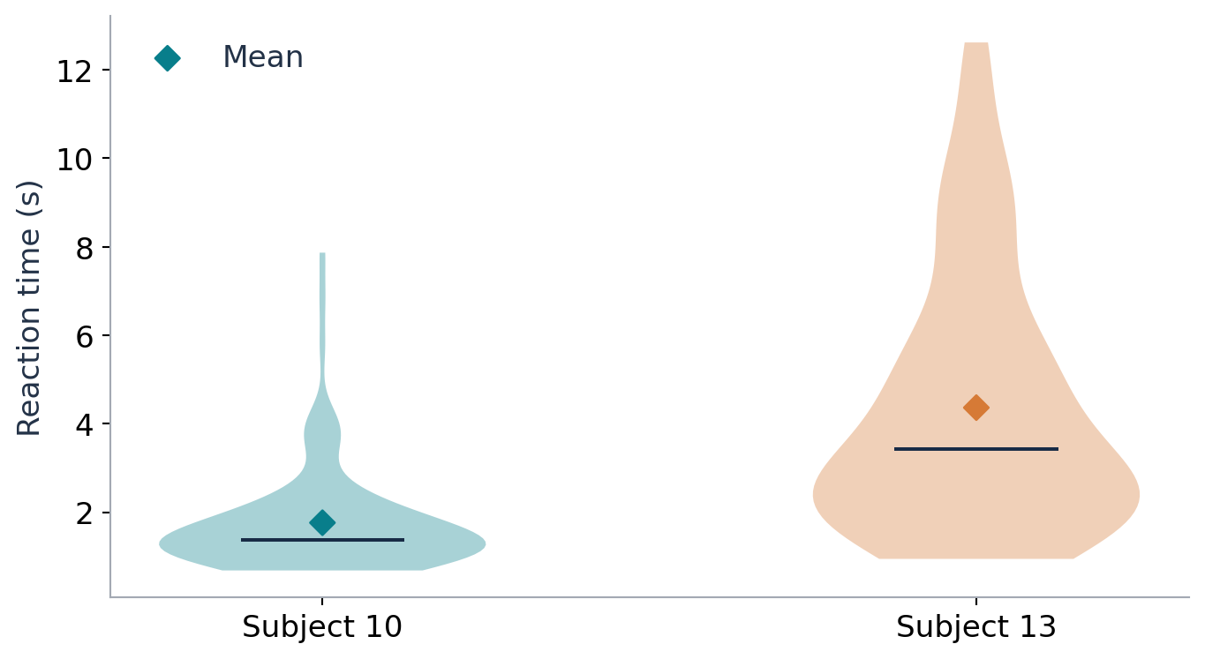
OBSERVED DATA
But their decision times differ dramatically
1.76 s
Subject 10 mean RT
4.36 s
Subject 13 mean RT
2.48× slower
05
Notes:
~60 seconds. This is actual trial-level reaction time data from the uploaded MAT file, not a model simulation. The violin plots show substantial shifts in the distributions. A choice-only model was not designed to describe this difference. Ask the audience how to reconcile nearly identical choice sensitivity with a 2.5x mean RT difference.

Slide 6
MODEL 2
DDM: choices emerge from evidence accumulation
dX = (βDDM × ΔV)dt + dW
Drift sensitivity βDDM: influence of subjective value
Boundary B: evidence required to commit to a choice
Nondecision time t₀: encoding and motor components
A noisy trajectory ends when it reaches ±B
Same choice probabilities can arise from different βDDM–B combinations.
06
Notes:
~85 seconds. Describe a stochastic diffusion: moment by moment evidence follows a random path biased by the subjective value difference. The first boundary crossed determines the choice and its time. We fix noise=1 and symmetric ±B boundaries, with unbiased starting point. Nondecision time shifts RT, and is not the same as decision time. A fitted DDM is a hypothesis about latent processes, not proof that brains literally diffuse evidence.

Slide 7
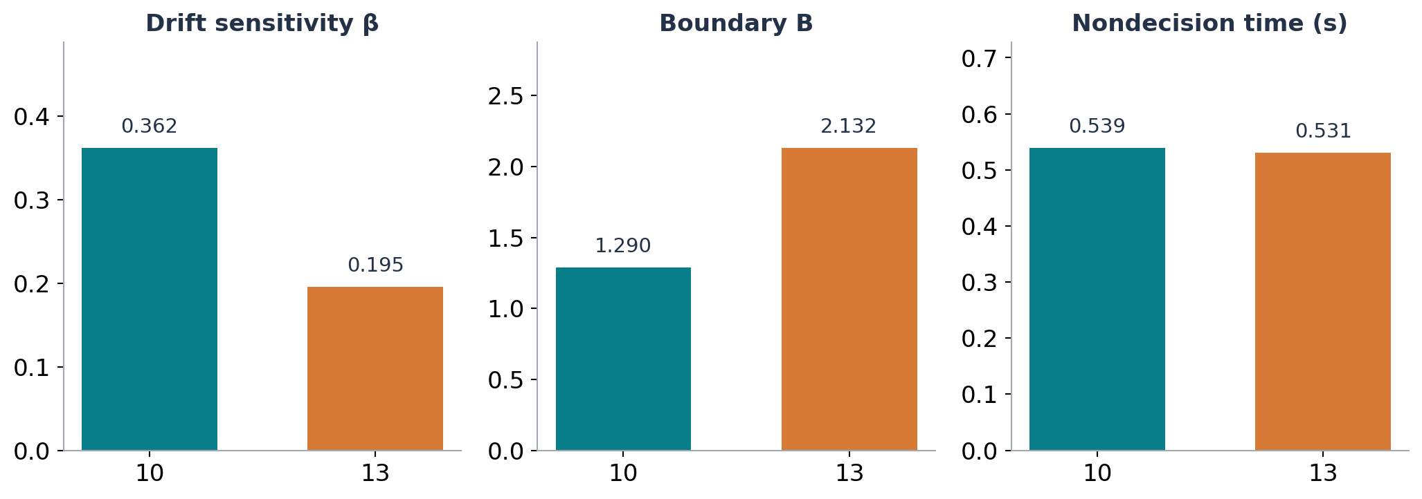
FITTED PARAMETERS
DDM separates the pair
Subject 10: stronger value drift, lower threshold
Subject 13: weaker value drift, higher threshold
07
Notes:
~65 seconds. Read off fitted coefficients: subject 10 drift β=.36185, B=1.290, t0=.539; subject 13 drift β=.19546, B=2.132, t0=.531. Their nondecision estimates are nearly identical, while drift and threshold differ. Neither has a boundary warning. This pattern could explain the observed temporal difference, but subject fits have uncertainty with about 100 trials.

Slide 8
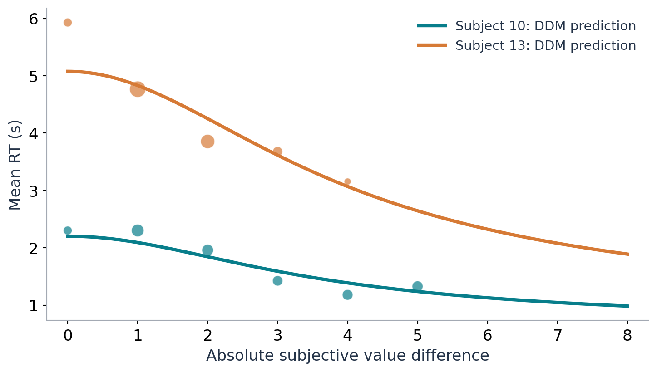
MODEL CHECK
Do the DDM predictions resemble the observed RTs?
Lines
DDM-predicted mean RT
Dots
Observed mean RT by |ΔV|
Dots shown for bins with ≥3 trials
08
Notes:
~80 seconds. The solid lines use the analytic mean first-passage time for a constant-drift symmetric DDM plus fitted nondecision time, conditional on absolute value difference. Dots are actual observed means grouped by |ΔV|; dot size reflects number of trials. The model captures much of the between-subject difference and predicts faster responses for easier value comparisons, but individual observed bins are noisy and this is an in-sample descriptive check, not cross-validated proof.

Slide 9
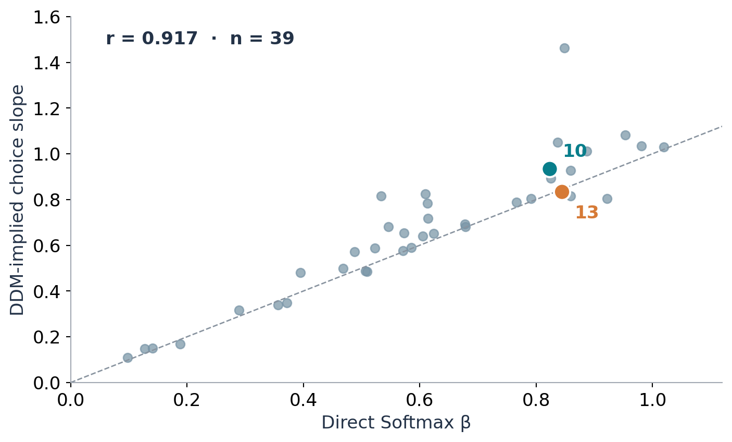
ACROSS 39 PARTICIPANTS
The broader sample: shared choice information
r = 0.917
Correlation between fitted Softmax β and DDM-implied choice slope
DDM-implied β = 2B × βDDM
09
Notes:
~65 seconds. Across 39 participants the correlation is r=.917. Explain the exact logistic relationship for the underlying symmetric diffusion model: P(left)=logistic(2 B βDDM ΔV), with diffusion noise fixed to one. This is why the DDM-implied slope is commensurable with a one-parameter Softmax slope. An overlay mixture may make this an approximation for the full fitted model. This agreement is not independent validation because both models use choices.

Slide 10
CONCLUSIONS
Takeaway: models change what we can infer
Softmax: how consistently do values predict choices?
DDM: what drift, threshold and nondecision time can account for choices and RTs?
Subjects 10 & 13: similar choice slopes, very different decision speeds
Interpretation is model-dependent—not proof of distinct neural mechanisms
Next test: held-out choice and RT predictions + parameter uncertainty
10
Notes:
~70 seconds. Summary and methodological caveats. Pair selection is post hoc, one hundred trials per participant limits precision, Softmax does not model RT, and raw cross-model NLLs are not directly comparable since they are fitted to different outcomes. Future work: cross-validation with same held-out choice trials, DDM RT posterior predictive checks, and bootstrap/ hierarchical uncertainty. Citation: Krajbich, Armel & Rangel, Nature Neuroscience (2010); analyses from supplied Krajbich 2010 MAT dataset.

