Slide 1
test
Made by seb

Slide 2
What is test?

Slide 3
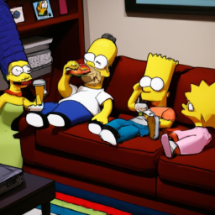
The making of the simpsons
There is no one answer to this question, as

Slide 4
Are there any questions?
Have a wonderful day!

