Slide 1
Client/Server
Edward, Trent, William, Melody

Slide 2
Task
We are tasked with creating:
Client/Server GUI with multithreaded
Image Data Transfer
Simple Image Processing

Slide 3
CLIENT
public class Client private DataInputStream in = null; private DataOutputStream out = null; public static final int SERVER_PORT = 50000; private Socket socket = null; public static void main(String[] args) Main Program public void start(Stage _stage) Textfield, TextArea and Buttons GUI public void handle(ActionEvent ae) Buttons Actions Connect Button Disconnect Button Send Image Button private void doConnect() Connect Button Socket private void doDisconnect() Disconnect Button Close socket private void doSendImage() Image Chooser (image file formats) PNG, JPEG, GIF String (Sent) to the Server String (Receive) from Server Adjusted Picture Colors
BASIC DIAGRAM
SERVER
public class Server private ServerSocket sSocket = null; public static final int SERVER_PORT = 50000; private ServerThread serverThread = null; public static void main(String[] args) Main Program public void start(Stage _stage) GUI with TextArea and button GUI public void handle(ActionEvent ae) Buttons Actions Start - ServerThread Stop - ServerThread private void doStart() Connect Button Change to Stop Button private void doStop() Disconnect Button Change to Start Button class ServerThread extends Thread public void stopServer() sSocket Waiting to accept Close socket class ClientThread extends Thread String (Receive) from the Client Any PNG, JPEG, or GIF String (Sent) to the Client Adjusted Picture Colors private void log(String message) String message
SENDS THE IMAGE
AND SELECTION
CHOOSES THE IMAGE
PROCESSES IMAGE
DISPLAYS THE IMAGE
SENDS CLIENT THE PROCESSED IMAGE

Slide 4
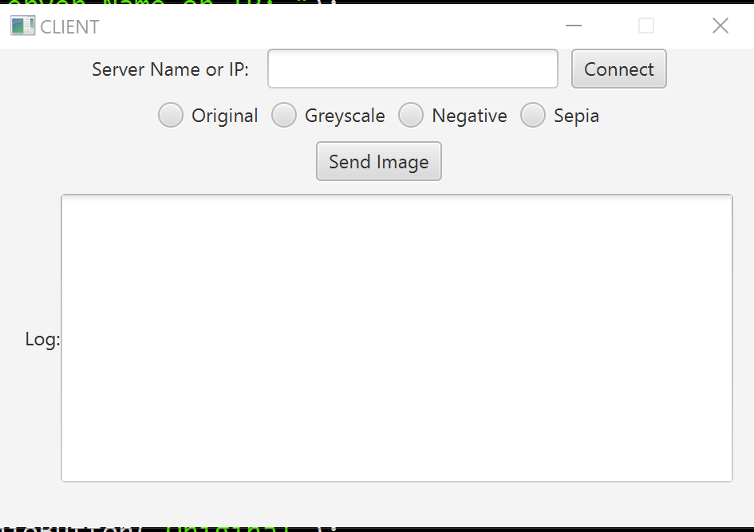
Client
In Client, we plan to have:
Graphical User Interface
Textfield with Connect/Disconnect button
A button called “Send Image”
TextArea contains LOG information
Radio Buttons
Original
Greyscale
Negative
Sepia
EventHandler
Connect Button - Socket
Disconnect Button - Close Socket
Send Image Button - Open, Select, and Send
NOT TO SCALE

Slide 5
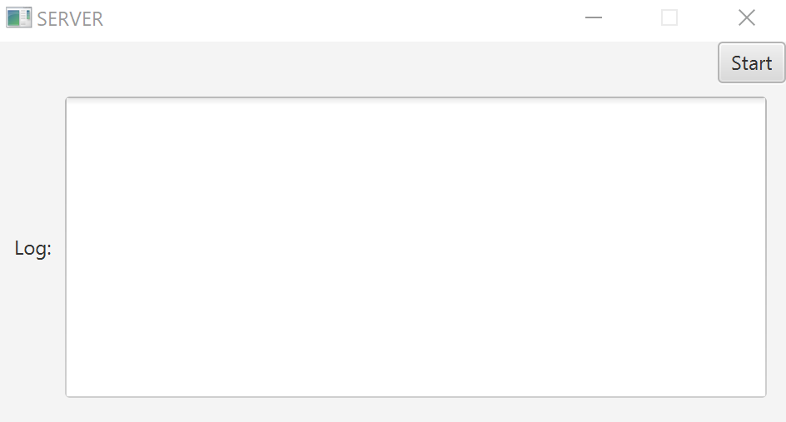
Server
NOT TO SCALE
In server, we plan to have:
ServerSocket
Server port
Server thread
Will have the main method and the start method for the GUI
Handler for Start/Stop Button along with methods for start and stop

Slide 6
Server-side Work
Once Client thread is generated, client sends image data and a command string
Once image data is sent:
server uses switch statements based on a command string to generate image processing job thread
The server waits for processing thread to finish.
Processed data is then sent back.
Thread closes.

Slide 7
ServerThread/ClientThread extends Thread (Inner class)
Inner class ServerThread will have a stop server method that both waits to accept new connections and closes the socket
Inner class ClientThread will receive the image from the Client in format PNG, JPEG, or GIF and adjust the color scheme
Log method will post messages of errors or server information

Slide 8
Image Processing In-Depth
Image converted to raw editable image data object
Object basically a multi-dimensional array of color aka bitmap
Based selected command each element in bitmap is modified.
Image converted back to original format

Slide 9
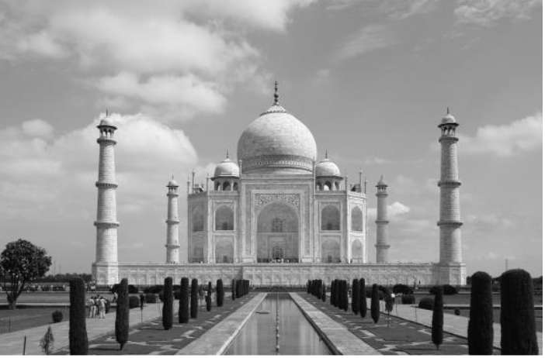
Greyscale Algorithm
int avg = (r+g+b)/3;
a_new = a;
r_new = avg;
g_new = avg;
b_new = avg;

Slide 10
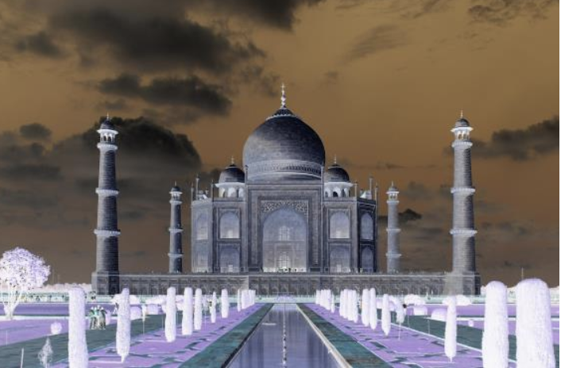
Negative Algorithm
a_new = a;
r_new = 255-r;
g_new = 255-g;
b_new = 255-b;

Slide 11
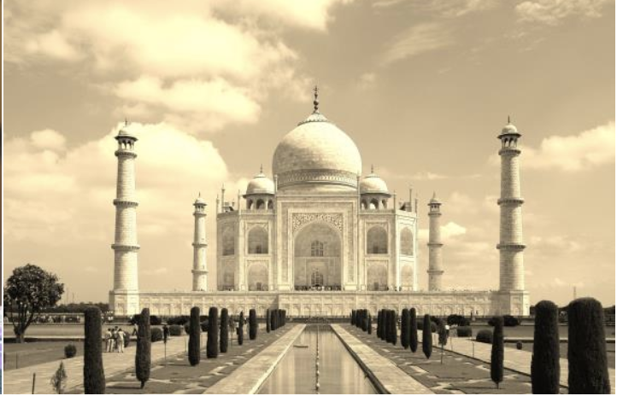
Sepia Algorithm
a_new = a;
r_new = (int)(0.393*r + 0.769*g + 0.189*b);
g_new = (int)(0.349*r + 0.686*g + 0.168*b);
b_new = (int)(0.272*r + 0.534*g + 0.131*b);
Notes:
Merge into one slide

Slide 12
How we plan to split it all up
Each person plans to work on methods for one color scheme change
Original
Grayscale
Negative
Sepia
William and Melody plans to work on additional work for Server
Trent and Edward plans to work on additional work for Client

Slide 13
Thank You!

