Slide 1
Child Computer Activity Monitor
Developed by: Jeffery Hatch
Graphical Design & Debugging: Trent Hardy
Project Collaborator: David Griffin

Slide 2
How it works
We used Windows User32 Library to compile user input into a ready-to-read text log using for statements.
We created an easy-to-use GUI that allows the user to create a password to be able to unlock the program.
We used a google-powered database of vulgar words and vocabulary that acts a filter as well as implemented the ability for users to create their own custom filter.
We created a fast-acting locked screen that activates after a user inputs words that are included in the filter.

Slide 3
Purpose of ccam
The purpose of our Child Computer Activity Monitor is to enforce a strict safety policy for children on the internet to avoid malicious and inappropriate content.

Slide 4
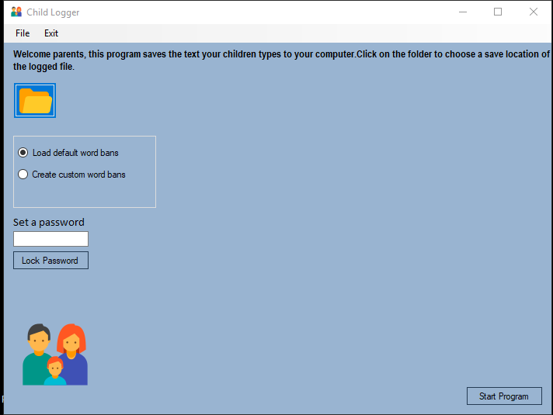
Program Explained
Parents can choose where they wish to save the log that records every word the child types
Parents insert their password and secure it with the lock button in a hashed format.
Parents can choose between using our predefined filter from a database of over 1,500 inappropriate words or create their own custom filter
Starting the program will begin the keylogger and make the program invisible so the child cannot close or see it

