Slide 1
ALIBABA CLOUD · AI少年 VIBE CODING
AI 学伴 / 2026
NeoMath
x(x − 1) = 0
↓ divide by x
x − 1 = 0
root lost: x = 0
A debugger for mathematical reasoning.
于东海 · 南京外国语学校 · Windows 10/11 x64 · Python + C++20

Slide 2
NEOMATH
Why are we still
debugging math
by hand?
LaTeX errors
algebraic slips
lost roots
extraneous roots
domain mistakes
manual verification
全球大量理工科学生、研究者和工程师，仍在把最昂贵的资源——人的注意力——
浪费在机械验证上。
01 / LOST ROOT 02 / EXTRANEOUS ROOT 03 / DOMAIN EXPANSION
NeoMath wants that time back.
02

Slide 3
NEOMATH
Who loses time to this?
01
Students
learn transformations through practice
make silent mistakes that go undetected
need evidence, not red crosses
02
Teachers
inspect derivations · locate the first invalid step · explain why
03
Independent learners
no immediate feedback · need deterministic verification
03

Slide 4
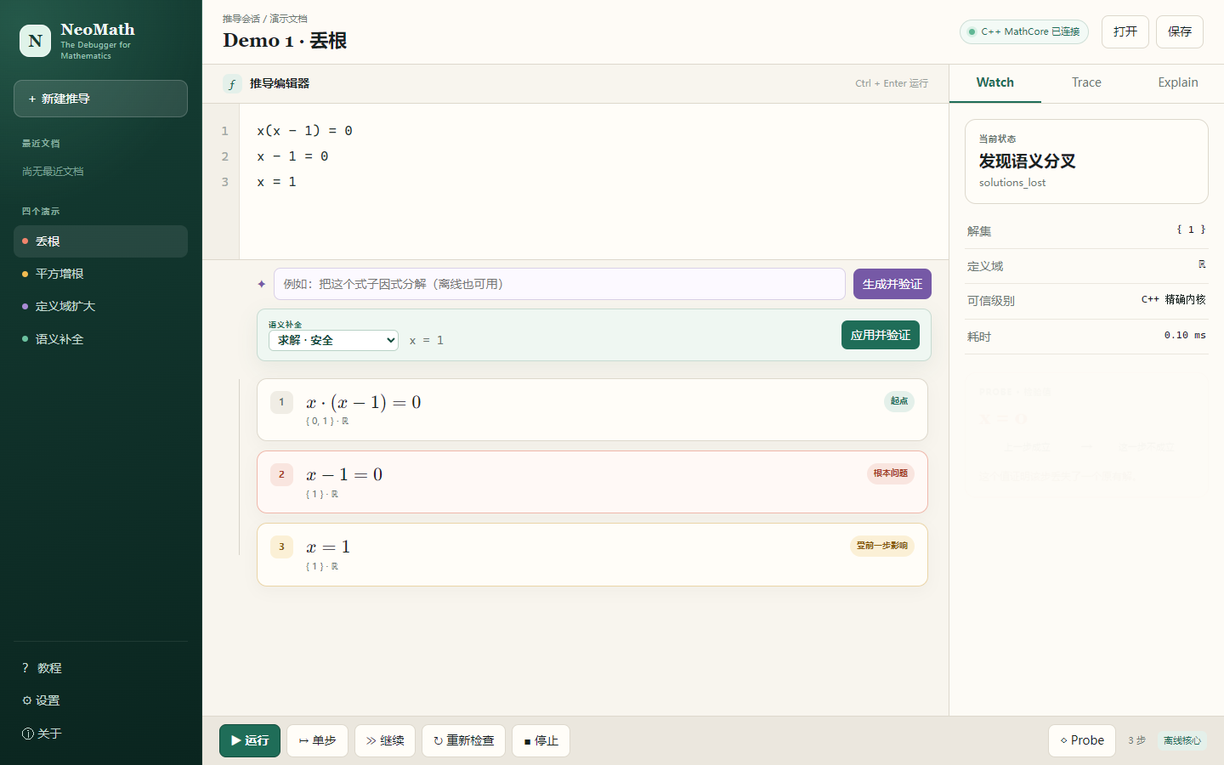
NEOMATH
面向中学生的一元代数推导调试器
NeoMath puts
math under a debugger.
• 逐行写推导，C++ 精确验证每一步
• Probe 用具体值证明差异，而不是只给红叉
• 离线完整运行，不依赖网络
不是拍照搜题，也不是标准答案生成器。
04

Slide 5
NEOMATH
WRITE
01 写下推导
COMPLETE
02 补全操作
RUN
03 运行语义
BREAK
04 定位分叉
EXPLAIN
05 解释原因
FIX
06 修正步骤
REPLAY
07 重新检查
推导 = Program 语义分歧 = Bug 反例 = Debug trace
05

Slide 6
NEOMATH
The error is not in a line.
It lives between two lines.
x(x − 1) = 0
结论：丢失了解 x = 0
Probe 证明发生了什么，
但不武断猜测学生执行了哪个动作。
↓ divide by x
x − 1 = 0
检验值 x = 0
0(0 − 1) = 0 ✓
上一步成立
0 − 1 = 0 ✗
这一步不成立
06

Slide 7
NEOMATH
SEMANTIC COMPLETION
语义补全只推荐 C++ 能验证
并签发证书的操作
::expr x² − 4 = 0
Ctrl + Space
(x − 2)(x + 2) = 0
风险：safe
^ factor
识别 Difference of Squares
验证
展开目标 = 规范化源式
证书
Verified · ExactExpansion
解集
{−2, 2} 保持不变
07

Slide 8
NEOMATH
NOTEBOOK
step execution
root fault
witness
structured transform
incremental replay
← first divergent state
← witness: x = 0
08

Slide 9
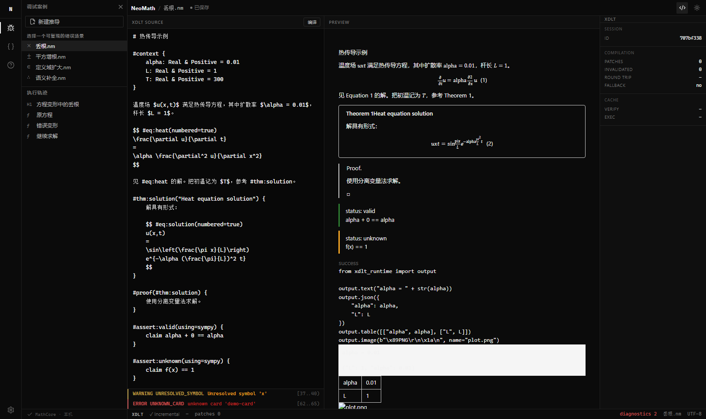
NEOMATH
Math should have semantics
before it has pixels.
.hw
parse
词法/语法分析
↓
semantic
语义降低
↓
graph
依赖图 + 增量失效
↓
verify
SymPy 断言验证
↓
render
HTML 构建 + 编号
↓
exec
Python 运行器
↓
cards
知识卡片注册
↓
session
编辑 → 增量重编译 → patch
09

Slide 10
NEOMATH
React 19 / TypeScript / KaTeX
│
│ HTTP :8765
↓
Python orchestration
XDLT / pywebview / LLM interface
│
│ pybind11
↓
C++20 MathCore
exact rational arithmetic
recursive-descent parser
polynomial solver
solution set
domain
equivalence
witness
One source of
mathematical truth.
AI never owns this layer.
10
值语义优先 · 无裸拥有指针 · 精确判断不用浮点 · 超限返回 Unverified

Slide 11
NEOMATH
COARSE-GRAINED BOUNDARY
pybind11 边界按业务操作设计，
而不是按 AST 节点设计
parse_document(source)
参数在持有 GIL 时校验
计算阶段释放 GIL
返回前重新获取 GIL
异常映射为结构化错误
不暴露指针或可变 AST
run_trace(document)
replay(document, changed_step)
get_completions(document, step)
execute_transformation(document, step, intent)
evaluate_probe(document, probe)
一次调用完成一件事。数学状态可直接 JSON 序列化。运行时不需要 Node.js。
11

Slide 12
NEOMATH
AI helps.
AI does not arbitrate.
Qoder
百炼 / Qwen
UI implementation
component iteration
test assistance
code review
explain verified results
natural language → intent
transformation suggestions
graceful degradation
Mathematical truth never comes from the LLM.
Qwen unavailable? Core verification still works.
Candidate → Schema → Allowlist → C++ Executor → Certificate
12

Slide 13
NEOMATH
Built with AI.
Not delegated to AI.
01
→
02
→
03
→
04
architecture
implementation
AI-assisted iteration
verification
system boundaries
AI trust model
reuse parser / VM
C++ MathCore
XDLT compiler
pybind11 bindings
Qoder / frontend
tests
review
10,000 differential cases
258+ automated tests
0 mismatch
Normalize → Candidates → Domain → Substitute → Accept
Verified / Unverified / Unsupported 明确分开；无法证明时不猜。
13

Slide 14
NEOMATH
10,000
0
SymPy differential cases
mismatches
< 0.3 ms
0.006 ms
13.6%
20-step trace P95
单行解析 P95
pybind11 边界占比
258+ automated tests 10 C++ Catch2 30 Python/Integration/Golden
不伪造通过：所有数字来自本机实际执行报告。随机系数范围 −10…10，Seed 20260724。
01 丢根 x(x−1)=0 → x−1=0 Probe x=0 02 增根 √x=x−2 → 平方 Probe x=1
14
03 定义域 (x−1)/(x−1)=1 Probe x=1 04 补全 x²−4 → (x−2)(x+2) Verified

Slide 15
NEOMATH
A derivation
is a program.
state
= solution set + domain
divergence
= bug
counterexample
= witness
incremental semantics
XDLT .hw compiler
deterministic MathCore
exact rational arithmetic
coarse-grained pybind11
15

Slide 16
NEOMATH
What survived contact
with reality
01
AI is useful at the edge,
not at the source of truth.
02
Architecture matters when
different layers fail differently.
03
A real counterexample teaches
more than a red cross.
04
Trust is earned through tests.
16

Slide 17
next /
higher-degree equations
multivariable
mobile
API
classroom
geometry
Stop debugging
math by hand.
NeoMath
A debugger for mathematical reasoning.
于东海 · 南京外国语学校 · AI少年 Vibe Coding 2026

