Slide 1
Secure Data Hiding in Images using Steganography
CAPSTONE PROJECT
Presented By: Mukul Choudhary
Student Name : Mukul Choudhary
College Name & Department : Central University of Himachal Pradesh & MCA

Slide 2
OUTLINE
Problem Statement
Technology used
Wow factor
End users
Result
Conclusion
Git-hub Link
Future scope

Slide 3
Problem Statement
Traditional encryption methods are vulnerable to cyber threats. This project secures sensitive data by hiding messages inside images using steganography, making it undetectable to attackers.

Slide 4
Technology used
Programming Language: Python
GUI: Tkinter
Libraries: OpenCV, PIL (Pillow), hashlib
Hashing: SHA-256 for password protection

Slide 5
Wow factors
Hidden message encryption inside images
Password protection for decoding messages
Detects encrypted images automatically
Displays image hash for verification

Slide 6
End users
Cybersecurity professionals for secure communication.
Government agencies for confidential data exchange.
Journalists & Activists for secure messaging.
General users to protect personal data.

Slide 7
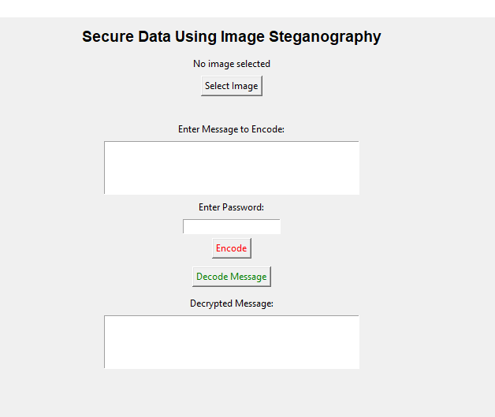
Results
Application Interface

Slide 8
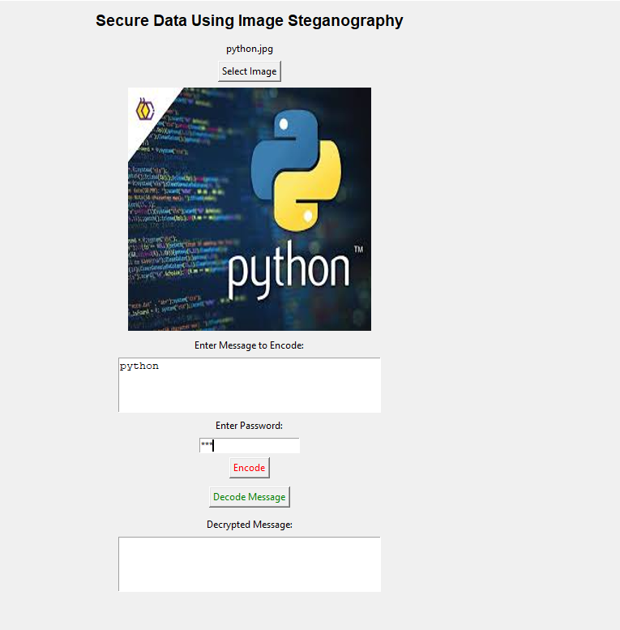
Results
Encoding

Slide 9
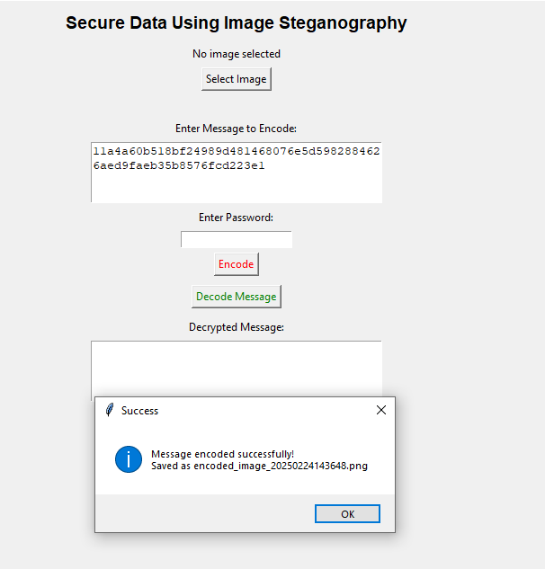
Results
Encoding

Slide 10
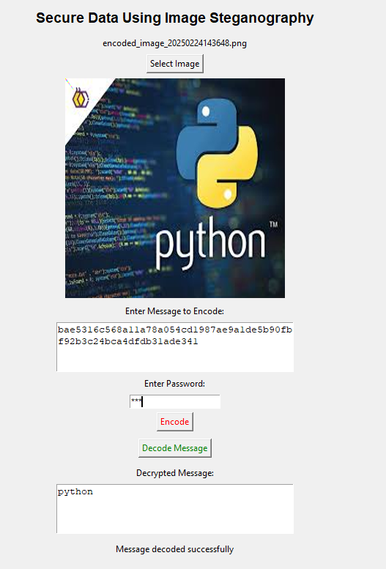
Results
Decoding

Slide 11
Conclusion
This project enhances digital security by embedding :-
Encrypted messages into images,
Making them undetectable.
It ensures safe and reliable communication in sensitive environments.

Slide 12
GitHub Link
https://github.com/UnknownUser1901/Stenography-main.git

Slide 13
Future scope(optional)
Improve encryption strength using AES encryption.
Implement video steganography
Enhance multi-layer security for better protection

Slide 14
THANK YOU

