Slide 1
CS1010X Tutorial 6: Lists & Sequences
19th April

Slide 2
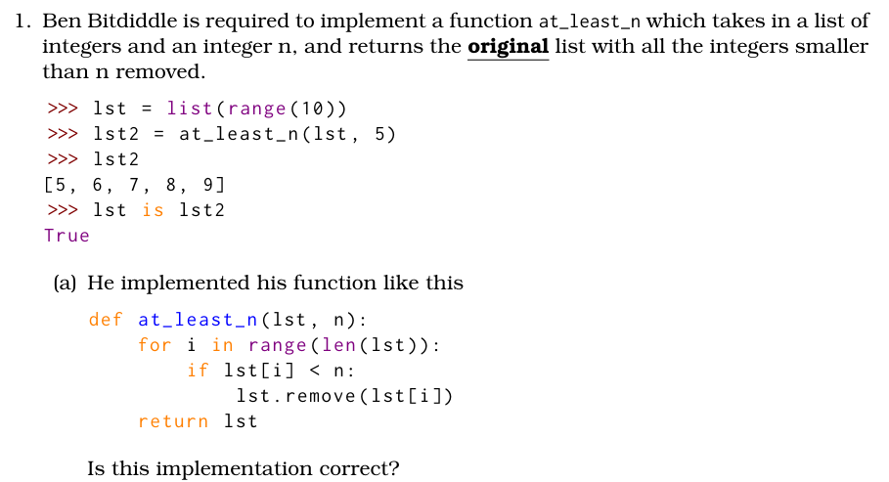
Q1: a) – Question Analysis
What is the key information?
What is the function trying to achieve?
What does Ben’s implementation actually do?

Slide 3
Q1: a) – Answer: No
Function wants to remove all values < n from a list
Ben’s function iterates over the length of a list whilst removing values
What happens in this line?
We are iterating over the length of the list, whilst removing values from the list. This means our ‘i’ will skip over certain values.
E.g (if n = 5)
At i = 2, 3 is removed as < 5
Now i increments to 3, and is compared against 10, skipping 2
[9, 5, 3, 2, 10, 6]
[9, 5, 2, 10, 6]

Slide 4
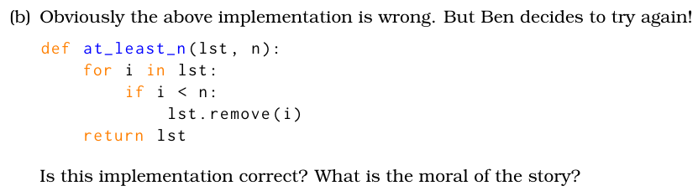
Q1: b) – Question Analysis
What is the key information?
What does Ben’s implementation actually do?

Slide 5
Q1: b) – Answer: No
Ben’s function removes the value at index i
What happens in this line?
We are removing a value from the list but the pointer remains at the same location
Dangerous to mutate a list whilst iterating through it using a for loop
At i = 0, 1 is removed as < 3
Now i increments to 1, and is compared against 2, skipping the second 1
[1, 1, 2, 5, 6]
[1, 2, 5, 6]

Slide 6
Q1: c) – Question Analysis
What is the key information?
What different methods can we use to implement this question?
Notes:
I will go through the most straightforward options first, followed by some other possible methods

Slide 7
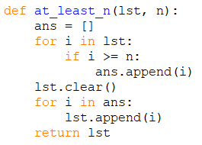
Q1: c) – Answer: Option 1
Potential Solution 1 – Append onto new list
Keeping in mind that we want to amend the original list
Time Complexity: O(n)
.append() is O(1), .clear() is O(n)
both loops are at most O(n)
Space Complexity: O(n)
ans stores at most n elements

Slide 8
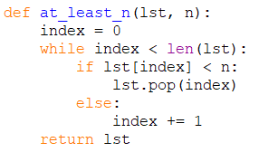
Q1: c) – Answer: Option 2
Potential Solution 2 – Use while loop
Time Complexity: O(n^2)
loop is at most O(n), .pop() is O(n)
Popping the last element is O(1)
Popping any other element is O(n) as the list must be shifted.
Space Complexity: O(1)
no additional data stored

Slide 9

Q1: c) – Answer: Option 3
Potential Solution 3 – Use a copy of the list
Time Complexity: O(n^2)
loop is at most O(n), .remove() is O(n)
Similar logic to .pop()
Space Complexity: O(n)
creating a copy of the list

Slide 10
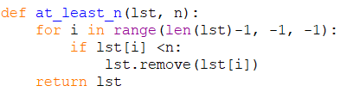
Q1: c) – Answer: Option 4
Potential Solution 4 – Iterate from the back
Time Complexity: O(n^2)
loop is at most O(n), .remove() is O(n)
Similar logic to .pop()
Space Complexity: O(1)
modifying original list

Slide 11

Q1: c) – Answer: Option 5
Potential Solution 5 – Use filter()
Time Complexity: O(n)
filter() is O(n)
Space Complexity: O(n)
filtered list can take up to ‘n’ space

Slide 12
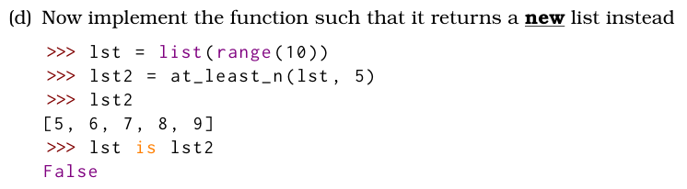
Q1: d) – Question Analysis
What is the key information?
How can we create a new list?

Slide 13
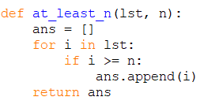
Q1: d) – Answer: Option 1
Potential Solution 1 – Append to a new list
This should be a lot easier (no need to maintain original list) and can be similar to previous solutions demonstrated.
Time Complexity: O(n)
loop is at most O(n), append() is O(1)
Space Complexity: O(n)
new list created

Slide 14

Q1: d) – Answer: Option 2
Potential Solution 2 – using filter
Time Complexity: O(n)
filter() is O(n)
Space Complexity: O(n)
filtered list can take up to ‘n’ space

Slide 15
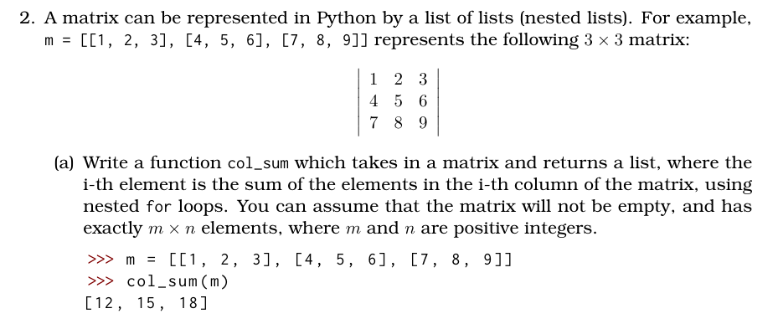
Q2: a) – Question Analysis
What is the key information?
How can we approach this question?

Slide 16
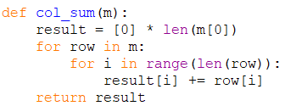
Q2: a) – Answer: Option 1
Potential Solution 1 – nested For loops
m – meaning number of rows
n – meaning numbers of cols
Time Complexity: O(mn)
outer loop is at most O(m), inner loop at most O(n)
Space Complexity: O(n)
n is the number of cols

Slide 17
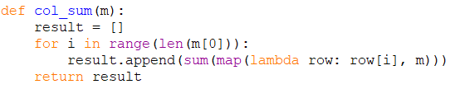
Q2: a) – Answer: Option 2
Potential Solution 2 – using map()
Time Complexity: O(mn)
outer loop is at most O(m), map is at most O(n)
Space Complexity: O(n)
n is the number of cols

Slide 18

Q2: a) – Answer: Option 3
Potential Solution 3 – using zip() – Not in syllabus
Time Complexity: O(mn)
outer loop is at most O(m), map is at most O(n)
Space Complexity: O(n)
n is the number of cols

Slide 19
Q2: b) – Question Analysis
What is the key information?
How can we approach this question?

Slide 20
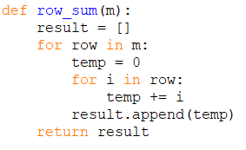
Q2: b) – Answer: Option 1
Potential Solution 1 – nested For loops
m – meaning number of rows
n – meaning numbers of cols
Time Complexity: O(mn)
outer loop is at most O(m), inner loop at most O(n)
Space Complexity: O(m)
m is the number of cols

Slide 21

Q2: b) – Answer: Option 2
Potential Solution 2 –using map()
m – meaning number of rows
n – meaning numbers of cols
Time Complexity: O(mn)
outer loop is at most O(m), inner loop at most O(n)
Space Complexity: O(m)
m is the number of cols

Slide 22
Q2: b) – Answer: Option 3
Potential Solution 3 – using col_sum and transpose
Make use of existing function col_sum and transpose our matrix so that we don’t need to implement new functions…
This leads into part c

Slide 23

Q2: c) – Question Analysis
What is the key information?
How can we transpose a matrix without creating a new one?

Slide 24
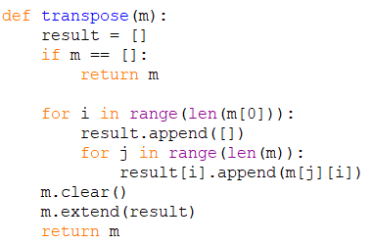
Q2: c) – Answer: Option 1
Potential Solution 1 – creating a new matrix & for loops
m – meaning number of rows
n – meaning numbers of cols
Time Complexity: O(mn)
outer loop is at most O(m), inner loop at most O(n)
Space Complexity: O(mn)
creating a temporary matrix of size mxn
Similarly to previous solutions we’ve seen, we could use map or zip (won’t show these again)

Slide 25
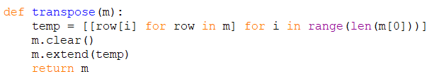
Q2: c) – Answer: Option 2
Potential Solution 2 – List Comprehension
Time Complexity: O(mn)
two for loops in the list comprehension, one of size m and the other size n
Space Complexity: O(mn)
temporary matrix of size mn

Slide 26
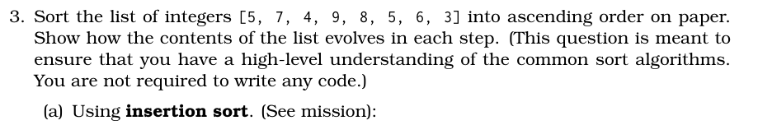
Q3: a) – Question Analysis
What is insertion sort?
https://visualgo.net/en

Slide 27
Q3: a) – Answer: Insertion Sort
Insertion Sort –
Split list into a sorted sublist (green) and unsorted (black).
Increment the sorted sublist 1 element at a time (highlighted in red)
Pointer | Before | After
0 | [5, 7, 4, 9, 8, 5, 6, 3] | [5, 7, 4, 9, 8, 5, 6, 3]
1 | [5, 7, 4, 9, 8, 5, 6, 3] | [5, 7, 4, 9, 8, 5, 6, 3]
2 | [5, 7, 4, 9, 8, 5, 6, 3] | [4, 5, 7, 9, 8, 5, 6, 3]
3 | [4, 5, 7, 9, 8, 5, 6, 3] | [4, 5, 7, 9, 8, 5, 6, 3]
4 | [4, 5, 7, 9, 8, 5, 6, 3] | [4, 5, 7, 8, 9, 5, 6, 3]
5 | [4, 5, 7, 8, 9, 5, 6, 3] | [4, 5, 5, 7, 8, 9, 6, 3]
6 | [4, 5, 5, 7, 8, 9, 6, 3] | [4, 5, 5, 6, 7, 8, 9, 3]
7 | [4, 5, 5, 6, 7, 8, 9, 3] | [3, 4, 5, 5, 6, 7, 8, 9]

Slide 28
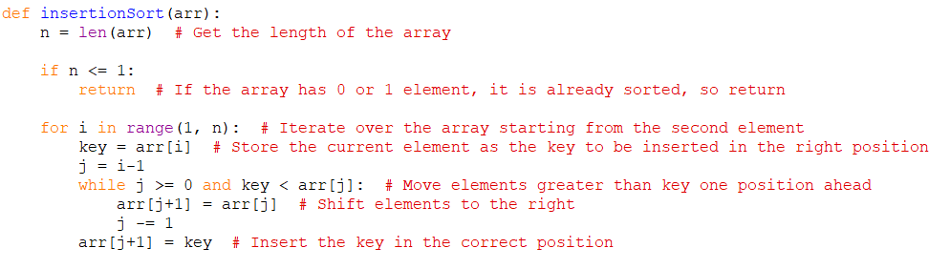
Q3: a) – Answer: Insertion Sort
Insertion Sort – Sample Sorting Codes (sourced from geeksforgeeks)
Time Complexity O(n^2)
Space Complexity O(1)

Slide 29

Q3: b) – Question Analysis
What is the key information?
What is selection sort?

Slide 30
Q3: b) – Answer: Selection Sort
Selection Sort –
Split the list into a sorted (green) and unsorted (black segment)
Loop through the unsorted list, find the min element (highlighted in red)
Swap this with the element at the start of the unsorted segment
Iteration | Before | After
0 | [5, 7, 4, 9, 8, 5, 6, 3] | [3, 7, 4, 9, 8, 5, 6, 5]
1 | [3, 7, 4, 9, 8, 5, 6, 5] | [3, 4, 7, 9, 8, 5, 6, 5]
2 | [3, 4, 7, 9, 8, 5, 6, 5] | [3, 4, 5, 9, 8, 7, 6, 5]
3 | [3, 4, 5, 9, 8, 7, 6, 5] | [3, 4, 5, 5, 8, 7, 6, 9]
4 | [3, 4, 5, 5, 8, 7, 6, 9] | [3, 4, 5, 5, 6, 7, 8, 9]
5 | [3, 4, 5, 5, 6, 7, 8, 9] | [3, 4, 5, 5, 6, 7, 8, 9]
6 | [3, 4, 5, 5, 6, 7, 8, 9] | [3, 4, 5, 5, 6, 7, 8, 9]
7 | [3, 4, 5, 5, 6, 7, 8, 9] | [3, 4, 5, 5, 6, 7, 8, 9]

Slide 31
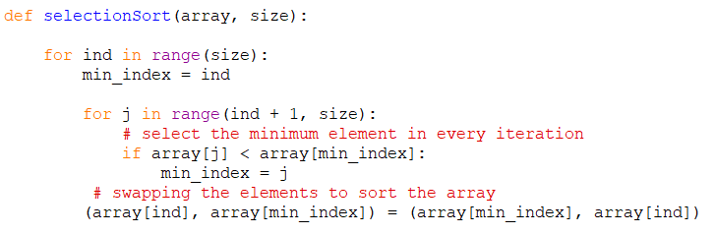
Q3: b) – Answer: Selection Sort
Selection Sort – Sample Sorting Codes (sourced from geeksforgeeks)
Time Complexity O(n^2)
Space Complexity O(1)

Slide 32

Q3: c) – Question Analysis
What is the key information?
What is bubble sort?

Slide 33
Q3: c) – Answer: Bubble Sort
Bubble Sort –
Compare elements side by side and swap them if they are in the wrong order.
Largest value will always be sorted to the furthest right leading to a sorted and unsorted list
Iteration | Before | After
0 | [5, 7, 4, 9, 8, 5, 6, 3] | [5, 4, 7, 8, 5, 6, 3, 9]
1 | [5, 4, 7, 8, 5, 6, 3, 9] | [4, 5, 7, 5, 6, 3, 8, 9]
2 | [4, 5, 7, 5, 6, 3, 8, 9] | [4, 5, 5, 6, 3, 7, 8, 9]
3 | [4, 5, 5, 6, 3, 7, 8, 9] | [4, 5, 5, 3, 6, 7, 8, 9]
4 | [4, 5, 5, 3, 6, 7, 8, 9] | [4, 5, 3, 5, 6, 7, 8, 9]
5 | [4, 5, 3, 5, 6, 7, 8, 9] | [4, 3, 5, 5, 6, 7, 8, 9]
6 | [4, 3, 5, 5, 6, 7, 8, 9] | [3, 4, 5, 5, 6, 7, 8, 9]
7 | [3, 4, 5, 5, 6, 7, 8, 9] | [3, 4, 5, 5, 6, 7, 8, 9]

Slide 34
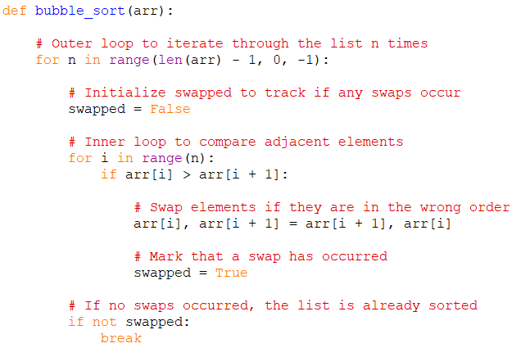
Q3: c) – Answer: Bubble Sort
Bubble Sort – Sample Sorting Codes (sourced from geeksforgeeks)
Time Complexity O(n^2)
Space Complexity O(1)

Slide 35
Q3: d) – Question Analysis
What is the key information?
What is merge sort?

Slide 36
Q3: d) – Answer: Merge Sort
Merge Sort –
Divides a list recursively into two sublists until reaching a list of size 1
Then combines lists back up whilst sorting them
[5, 7, 4, 9, 8, 5, 6, 3]
[5, 7, 4, 9]
[8, 5, 6, 3]
Log(n) calls
[5, 7]
[4, 9]
[8, 5]
[6, 3]
[5]
[7]
[4]
[9]
[8]
[5]
[6]
[3]
n calls

Slide 37
Q3: d) – Answer: Merge Sort
Merge Sort –
Divides a list recursively into two sublists until reaching a list of size 1
Then combines lists back up whilst sorting them
[3, 4, 5, 5, 6, 7, 8, 9]
[4, 5, 7, 9]
[3, 5, 6, 8]
Log(n) calls
[5, 7]
[4, 9]
[5, 8]
[3, 6]
[5]
[7]
[4]
[9]
[8]
[5]
[6]
[3]
n calls

Slide 38
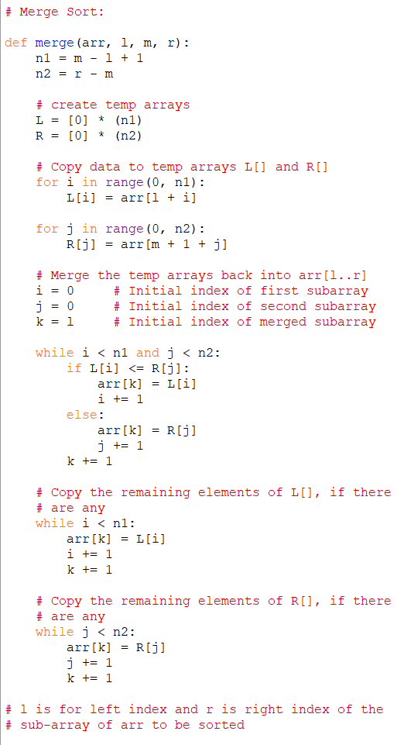
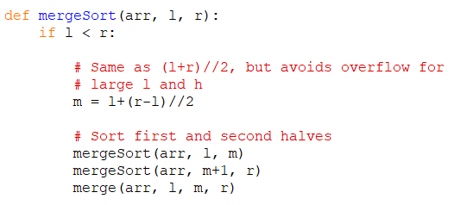
Q3: d) – Answer: Merge Sort
Merge Sort – Sample Sorting Codes (sourced from geeksforgeeks)
Time Complexity O(nlogn)
Space Complexity O(n)

Slide 39
Q3: Summary Table
Inplace Sorting: Does not require additional space, sorts in original list
Stability: Duplicated items value is not affected
For example (1, “A”) and (1, “B”) sorted in terms of the number 1
will stay in the same order of “A” and “B”
 | Best Case Time Complexity | Worst Case Time Complexity | Space Complexity | In Place | Stability
Insertion Sort | O(n) | O(n^2) | O(1) | Yes | Yes
Selection Sort | O(n^2) | O(n^2) | O(1) | Yes | No
Bubble Sort | O(n) | O(n^2) | O(1) | Yes | Yes
Merge Sort | O(nlogn) | O(nlogn) | O(n) | No | Yes

Slide 40
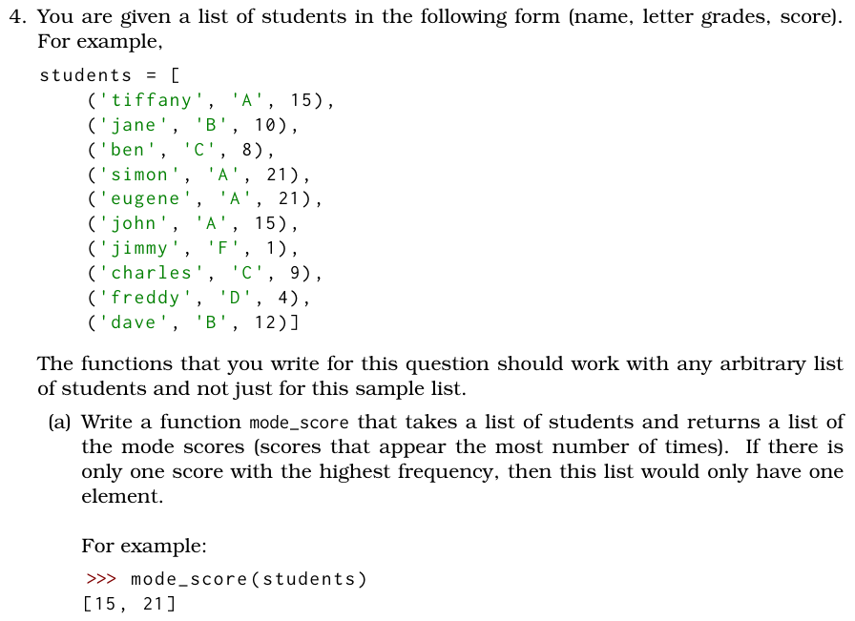
Q4: a) – Question Analysis
What is the key information?
How can we implement this?

Slide 41
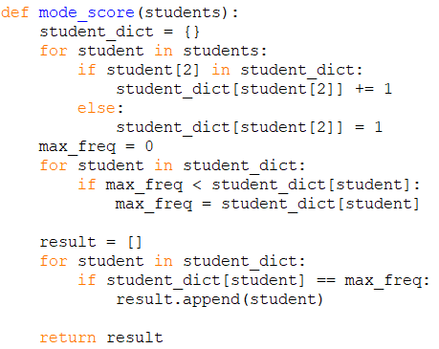
Q4: a) – Answer: Option 1
Potential Solution 1 – Using a dictionary

Slide 42
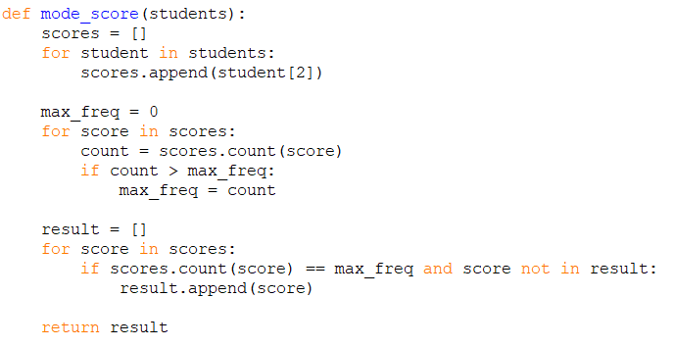
Q4: a) – Answer: Option 2
Potential Solution 2 – using for loops and .count()

Slide 43
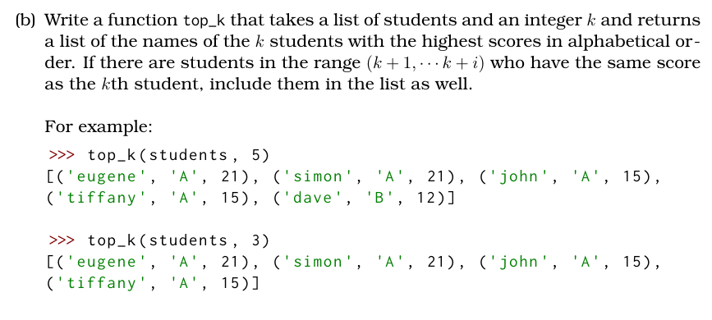
Q4: b) – Question Analysis
What is the key information?
How can we filter out the top k values?

Slide 44
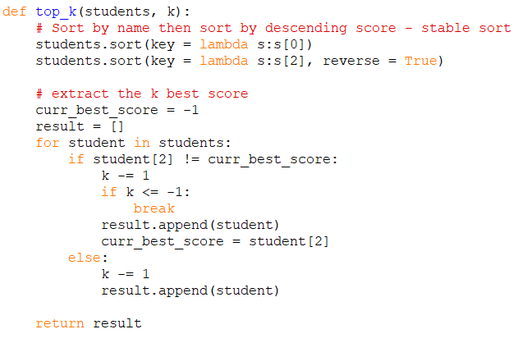
Q4: b) – Answer: Option 1
Potential Solution 1 – using .sort()

Slide 45
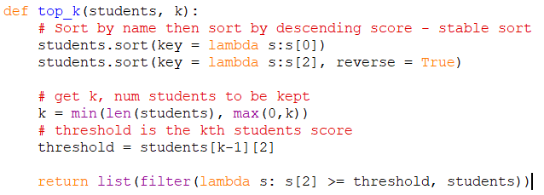
Q4: b) – Answer: Option 2
Potential Solution 2 –

Slide 46
Any Questions?

Slide 47
Additional – If Extra Time
Key Concepts to Practice
Matrices
Sorting
Practice/Challenge Q’s:
Implement the different sorting types
Additional Resources (Visualize Sorting): https://visualgo.net/en
Extra Pointer
Matrix Multiplication

