Slide 1
Tutorial 7: List Processing and Data Structures
26th April

Slide 2
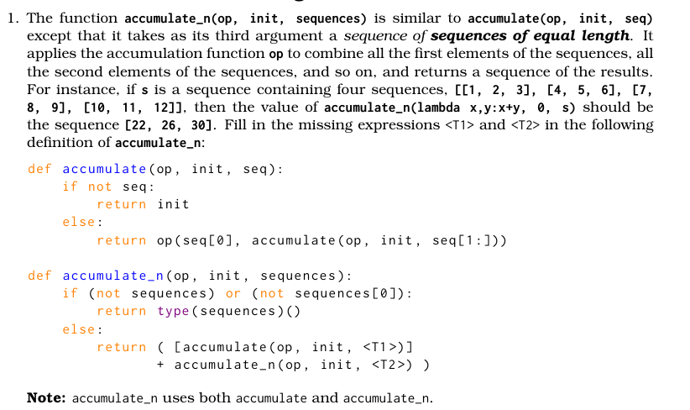
Q1: Question Analysis
What is the key information?
What is different about accumulate_n?
What are we supposed to achieve?

Slide 3
Q1: Question Analysis
1 | 2 | 3 | 4
5 | 7 | 3 | 1
4 | 3 | 6 | 8
10 | 12 | 12 | 13

Slide 4
Q1: Question Analysis
def accumulate_n(op, init, sequences):
if (base case) => return base value
return [op applied to first elem from each sequence] + accumulate_n(op, init, each sequence with first element removed

Slide 5
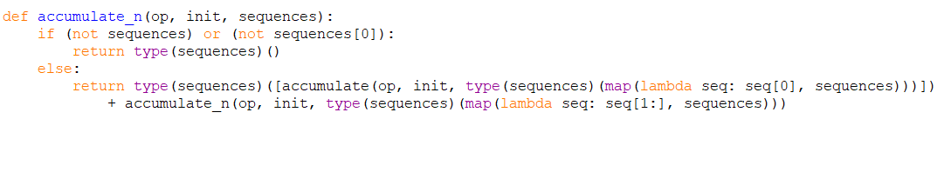
Q1: Answer
Solution – Using stream processing (map)
Suppose there are m lists in sequences, and the total number of elements is n

Slide 6
Q1: Time Complexity
Suppose there are m lists in sequences, and the total number of elements per list is n
Time Complexity for accumulate: O(m)
Recurrence Relation: T(n) = O(m) + T(n - 1)
= m + m + …. (how many times?)
Time Complexity for accumulate_n: O(nm)
Is this correct? Have we missed anything?

Slide 7

Q1: Time Complexity
List Slicing is O(k), where k is the length of the list!
Time Complexity for accumulate: O(m^2)
NEW Recurrence Relation: T(n) = O(m^2) + O(mn) + T(n-1)
= $\sum_{1}^{n}{m^{2}+mi}$
= $\sum_{1}^{n}{m^{2}+\sum_{1}^{n}{mi}}$
= nm^2 + m $\sum_{1}^{n}{i}$
= nm^2 + m(n+1)(n) / 2
= O(nm^2 + mn^2)
Time Complexity for accumulate_n: O(nm^2 + mn^2)
Is this correct? Have we missed anything?

Slide 8
Q1: Time Complexity
List Concatenation is also O(k) time, where k is the length of the created list!
Final Recurrence Relation: T(n) = O(m^2) + O(mn) + O(n) + T(n-1)
However, luckily the O(n) can get absorbed by the O(mn) term.
So change to our final answer!
Time Complexity for accumulate_n: O(nm^2 + mn^2)

Slide 9
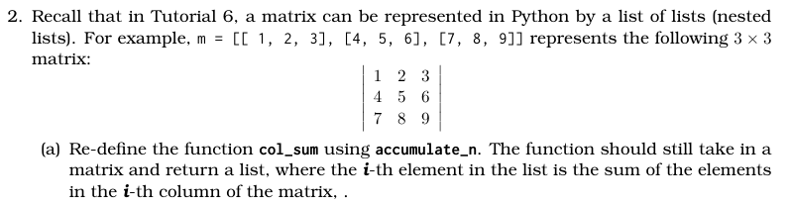
Q2 (a): Question Analysis
What is the key information?
What are we trying to achieve?

Slide 10
RECALL: Q1
1 | 2 | 3 | 4
5 | 7 | 3 | 1
4 | 3 | 6 | 8
10 | 12 | 12 | 13

Slide 11

Q2 (a): Answer

Slide 12
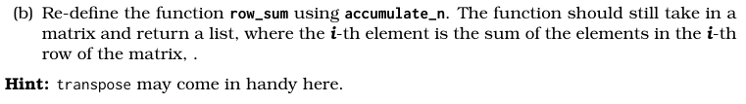
Q2 (b): Question Analysis
What is the key information?
How can we reuse part (a)?
How does the hint help us?

Slide 13
Q2 (b): Transpose
1 | 2 | 3
4 | 5 | 6
7 | 8 | 9
1 | 4 | 7
2 | 5 | 8
3 | 6 | 9
Transpose

Slide 14
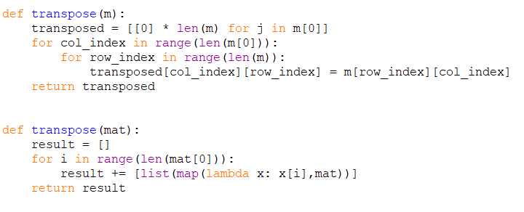
Q2 (b): Transpose

Slide 15

Q2 (b): Transpose with accumulate_n?

Slide 16

Q2 (b): Answer

Slide 17
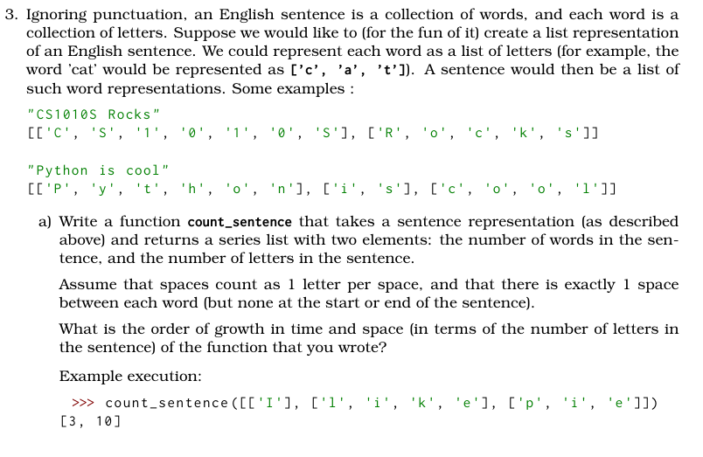
Q3 a): Question Analysis
What is the key information?
How are words / sentences expressed?
What are we supposed to achieve?

Slide 18
Q3 a): Question Analysis
A sentence is a list of words
Number of words == length of sentence
A word is a list of characters
Number of characters == sum of length of words + number of spaces
Every word except for the last has a space after it
Number of spaces == number of words - 1

Slide 19
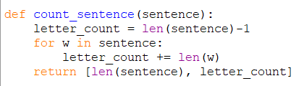
Q3 a): Answer
Suppose w is the number of characters
What is the time / space complexity?
Time Complexity: O(w)
Space Complexity: O(1)

Slide 20
Q3 a): Alternate Answer

Slide 21
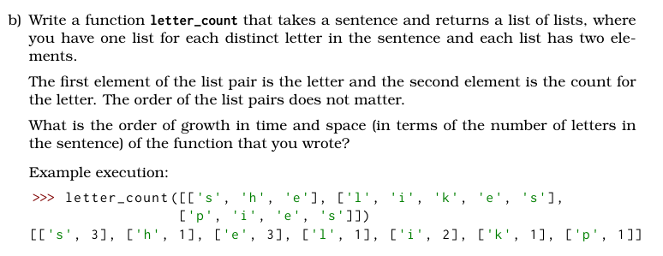
Q3 b): Question Analysis
What is the key information?
How are words / sentences expressed?
What is different?

Slide 22
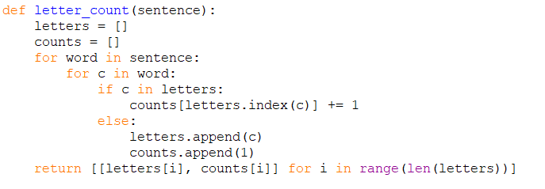
Q3 b): Answer 1
Suppose n is the number of characters
What is the time / space complexity?

Slide 23
Q3 b): Answer 1
Let’s assume in the worst case, that every character is distinct.
Thus, there will be n unique entries in our final result
We will iterate through every character once.
For each character, we will check if its in letters and get its index, which is O(n) time
Therefore, final time complexity is O(n^2)
Space complexity is O(n), due to space required to store result

Slide 24
Q3 b): Answer 1
Is our assumption that there could be n unique characters valid?
Assuming our input is only English, there are only a finite number of possible characters!
Letters (a – c), numbers (0-9), punctuation, etc.

Slide 25
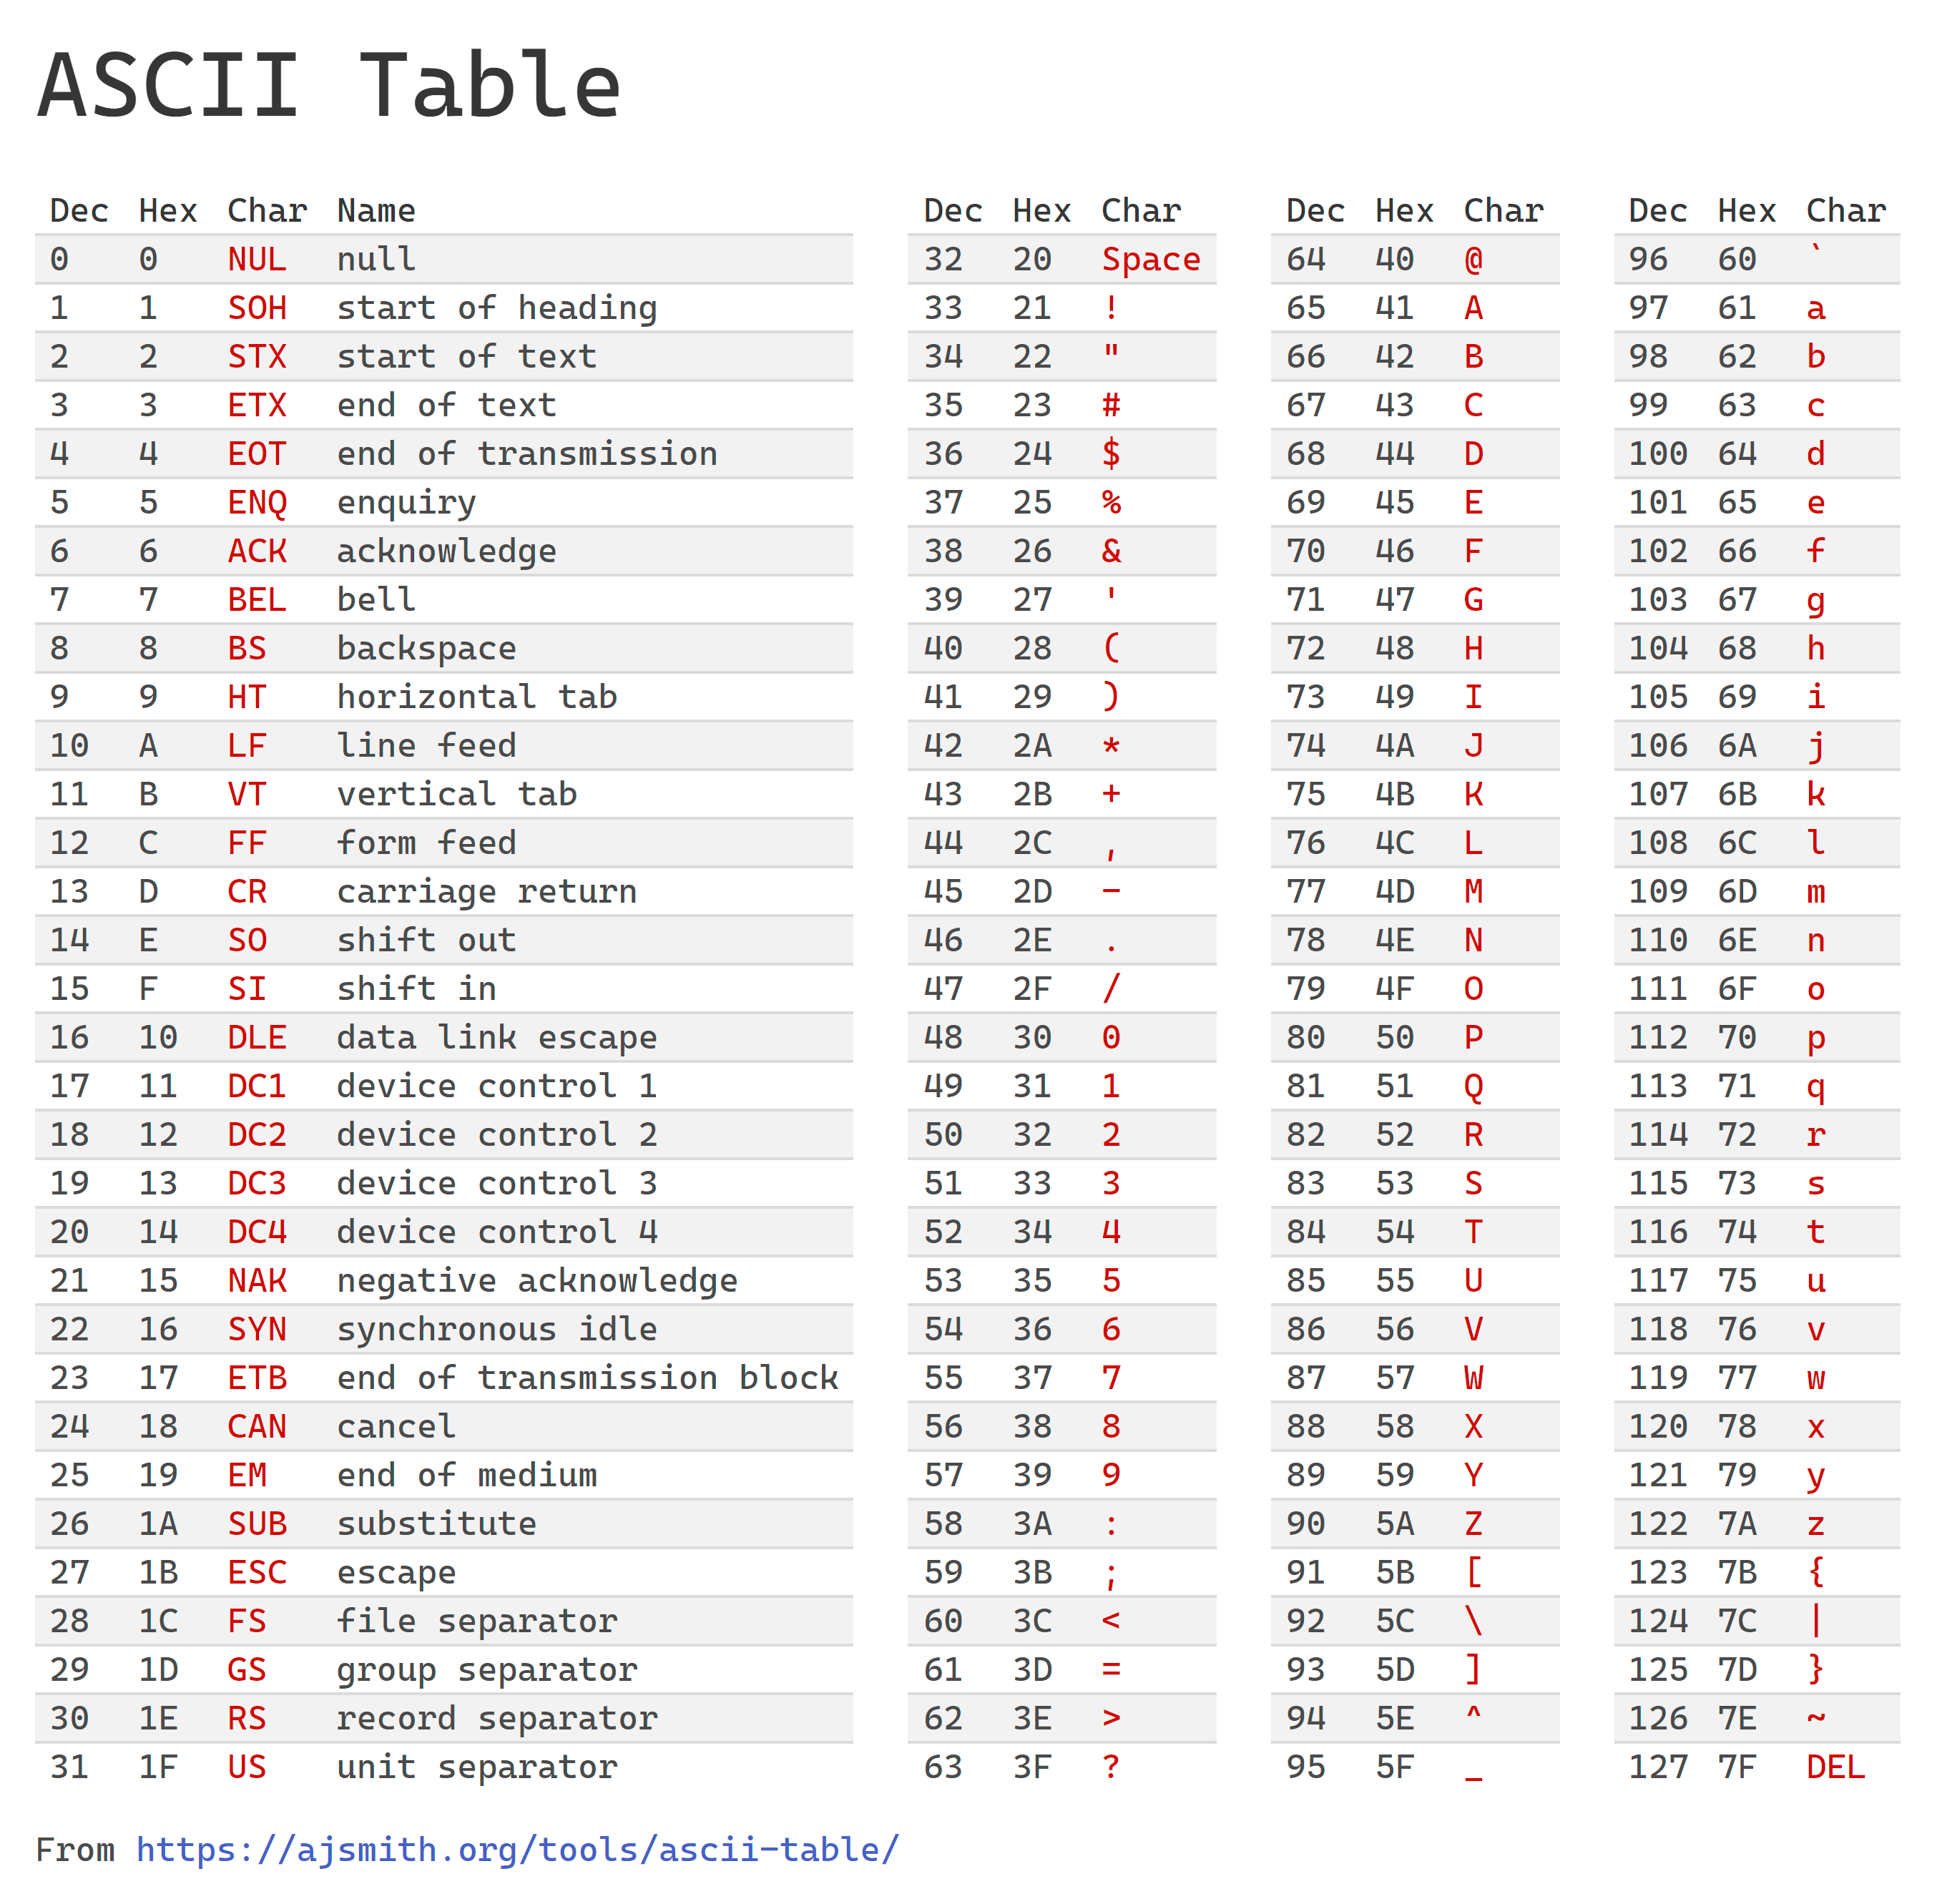
Q3 b): ASCII Table

Slide 26
Q3 b): Answer 1
With this assumption, there is a finite constant upper bound for the number of entries
in our letters array and our result!
Thus, Time Complexity can be reduced to O(n)
And Space Complexity to O(1)

Slide 27
Q3 b): Alternate Approach
What data structure does this remind you of?
A Dictionary!
KEY | FREQUENCY
‘a’ | 3
‘b’ | 5
‘c’ | 1

Slide 28
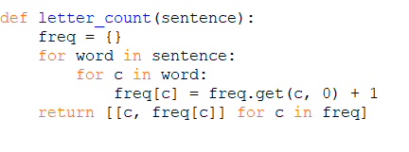
Q3 b): Alternate Approach
Suppose n is the number of characters
What is the time complexity?
Time Complexity: O(n)
Regardless of our assumption
on the number of distinct characters

Slide 29
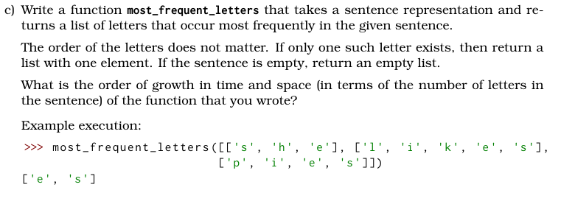
Q3 c): Question Analysis
What is the key information?
What is different now?
How can we reuse the previous part?

Slide 30
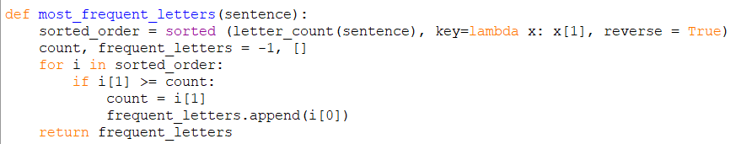
Q3 c): Answer 1
Suppose letter_count is O(n)
What is the time complexity?
Time Complexity: O(nlog(n))
Seems like the sorting is slowing us down
Can we do better?

Slide 31
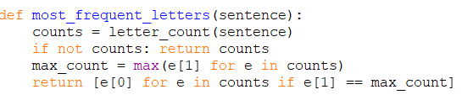
Q3 c): Answer 2
Suppose letter_count is O(n)
What is the time complexity?
Time Complexity: O(n)
Space Complexity: O(n)

Slide 32
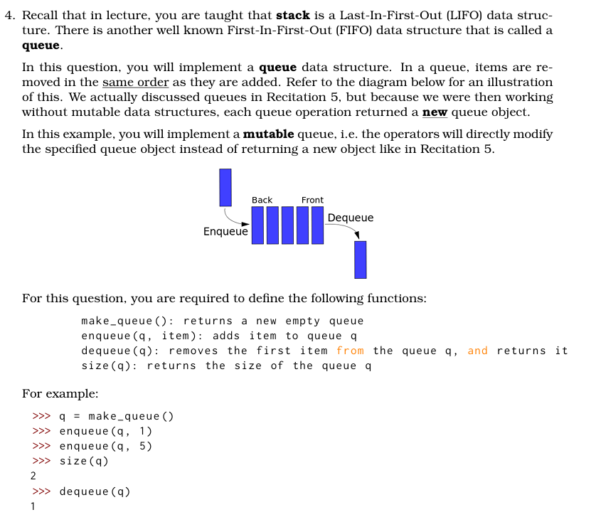
Q4: Question Analysis
What is the key information?
What information does our ADT need to store?

Slide 33
Q4: Queue
Linked List (Single, Doubly), Stack, Queue, Deque - VisuAlgo

Slide 34
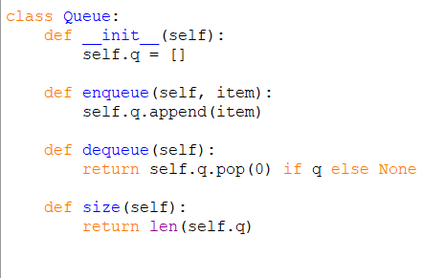
Q4: Answer

Slide 35
Q4: Answer
Not all programming languages allow for resizable array.
Can we still make a queue?
IDEA: Use a pointer to keep track of the head and tail of the queue!

Slide 36
Q4: Queue
Queue visualization - Search

Slide 37
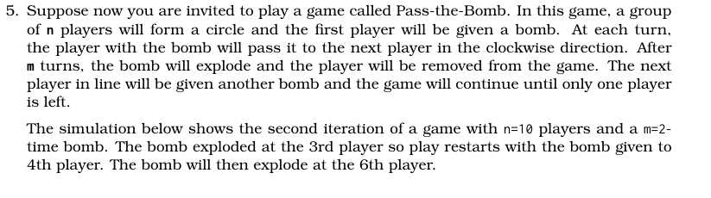
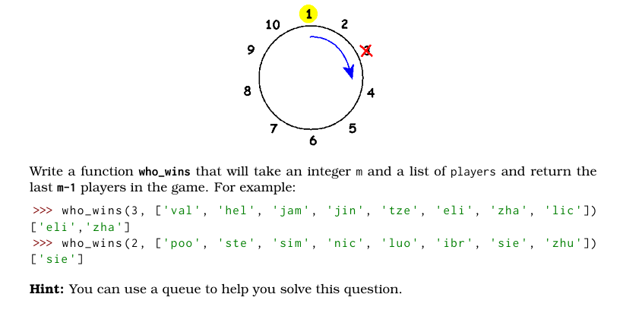
Q5: Question Analysis

Slide 38
Q5: High Level Idea
What if we had a queue => keep enqueing and dequeing players m times
The next player we deque would have a bomb exploder
So we just deque him, without enquing again
Repeat until only m players left

Slide 39
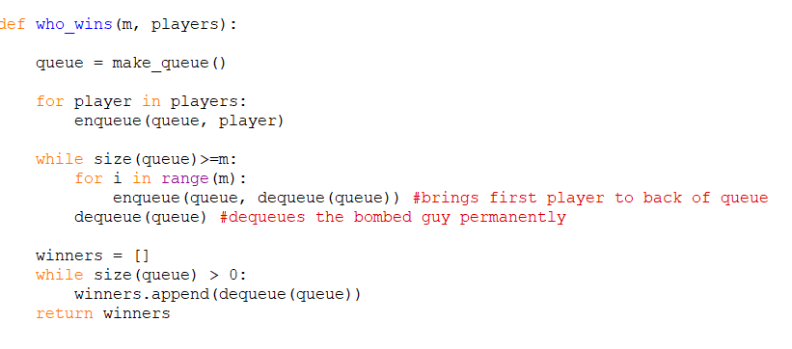
Q5: Answer

Slide 40
The End

Slide 41
Min stack

Slide 42
Making a Queue using a stack

Slide 43
Bonus (if time permits)
Implement Queue using Stacks – LeetCode
Min Stack - LeetCode

