Slide 1

UNKOV
The Unified Control Plane for Machine-Age Governance
AI-NATIVE IDENTITY
GRAPH ORCHESTRATION
RELATIONSHIP_GRAPH_v2.0
CONFIDENTIAL | MARCH 2026
SEED ROUND: $4.0M

Slide 2

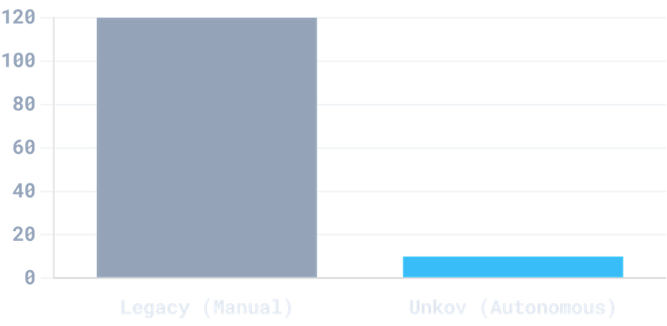
MANUAL IDENTITY GOVERNANCE IS AN OPERATIONAL AND SECURITY CRISIS
$1.2M
ANNUAL "MANUAL REVIEW TAX" PER ENTERPRISE
120+ HRS
3-5 DAYS
Quarterly manual labor spent on soul-crushing spreadsheet verification.
Onboarding delay for new hires due to manual approval chains.
40% GAP
1,062 APPS
Source: Unkov Internal Analysis & 2026 Enterprise Security Reports
Access requests approved without proper verification due to human fatigue.
Average SaaS footprint managed by IT teams without automated intelligence.
// DATASET_ID: CRISIS_ANALYSIS_2026_V1

Slide 3

144:1 — THE NEW IDENTITY PERIMETER IS NON-HUMAN
95%
144:1
FORTUNE 500 ADOPTION OF AUTONOMOUS AI AGENTS
BOT-TO-HUMAN RATIO (2026)
65%
BOT PERMISSION DRIFT RATE ("GHOST ACCESS")
The "Agentic Shift" has fundamentally broken the human-centric security model. Enterprises are now governing a machine-majority workforce.
// CRITICAL_VULNERABILITY: RELATIONAL_DATABASE_OVERLOAD
ZERO
LEGACY IAM VISIBILITY INTO AGENTIC TOXIC COMBINATIONS
// TELEMETRY_SOURCE: AGENTIC_ECONOMY_REPORT_2026

Slide 4




MOVING FROM DIGITAL FILING CABINETS TO PREDICTIVE INTELLIGENCE
01 // DISCOVER
02 // DECIDE
03 // REMEDIATE
IDENTITY SOCIAL FABRIC
INTENT ENGINE
SELF-HEALING FABRIC
Maps the multi-dimensional relationships between humans, bots, and resources in real-time.
Predicts access needs by analyzing functional peer-clones and organizational context.
Automatically purges orphaned accounts and kills toxic bot-links the moment risk is detected.
Amazon Neptune Graph Core
Peer-Clone Provisioning
Usage-Based Rightsizing
Lateral Movement Detection
< 10 Min Onboarding
Hard Kill-Switch for Bots
Hidden Bridge Discovery
Behavioral Scoring
Continuous Verification
ZERO-TOUCH DEPLOYMENT
Live "Identity Drift" dashboard generated in under 30 minutes.
// SYSTEM_STATUS: AUTONOMOUS_GOVERNANCE_ACTIVE

Slide 5

A $30B FRONTIER AT THE INTERSECTION OF IGA & ITDR
TOTAL ADDRESSABLE MARKET
TARGET SEGMENTS
SECURITY ROI
$30B+
19K
$1.9M
Combined 2026 Opportunity
Mid-Market Accelerator
Avg. Savings Per Incident
$10.7B Identity Governance (IGA)
>
500–19,000 employee enterprises
>
80-day reduction in breach detection
>
$19.6B Threat Detection (ITDR)
>
High-compliance BFSI & Healthcare
>
Automated lateral movement prevention
>
Hyper-growth driven by AI agent proliferation
>
"Agent-Heavy" tech organizations
>
Elimination of "Manual Review Tax"
>
REGULATORY TAILWINDS & COMPLIANCE DRIVERS
PCI DSS 4.0
HIPAA
SOC 2
GDPR v2
// MARKET_INTEL: GARTNER_IGA_GUIDE_2026 | MARKETSANDMARKETS_ITDR_2026

Slide 6

BUILT ON THE GRAPH: OUR STRUCTURAL MOAT
STRUCTURAL_ADVANTAGE
DATA_ADVANTAGE
SPEED_ADVANTAGE
AMAZON NEPTUNE CORE
THE NETWORK EFFECT
SUB-SECOND DETECTION
99.2%
∞
<1s
Predictive precision from modeling relationships directly. Relational tables miss multi-dimensional toxic combinations.
Each deployment enriches our behavioral dataset, creating a compounding intelligence loop legacy vendors cannot match.
Real-time relationship mapping enables sub-second risk detection across millions of nodes for prompt remediation.
LEGACY: RELATIONAL (FLAT LISTS)
UNKOV: GRAPH-NATIVE (SOCIAL FABRIC)
Built for humans, not agents. Static tables fail to detect lateral movement and complex bot-to-resource interactions.
Built for the machine age. Our architecture maps the social fabric of the business to reveal lines others miss.
// ARCHITECTURE_ID: NEPTUNE_GRAPH_ORCHESTRATOR_v2.0

Slide 7
SCALABLE SAAS WITH HIGH-EFFICIENCY "INFERENCE ECONOMICS"
HYBRID SAAS MODEL
INFERENCE ECONOMICS
UNIT ECONOMICS
-30%
> 5:1
Platform Fee
Annual base subscription for core governance modules and standard support.
LOWER COST-PER-INFERENCE (CPI)
TARGET LTV:CAC RATIO
Task-specific, optimized models outperform generic "AI wrappers," ensuring profitable autonomous remediation at scale.
75-80%
Node-Based Tiers
TARGET GROSS MARGIN
Usage-based pricing scaled by active "Identity Nodes" (Humans + Bots).
> 115%
NET REVENUE RETENTION (NRR)
// MODEL_ID: INFERENCE_ECONOMICS_2026_PROJECTION

Slide 8

UNKOV SITS ALONE IN THE FUTURE-FACING QUADRANT
FUTURE-FACING
UNKOV
FEATURE
LEGACY
UNKOV
Architecture
Relational
Graph-Native
Identity
Human-Only
Unified (H+B)
Philosophy
Reporting
Remediation
Setup
Months
< 30 Mins
AUTONOMOUS CAPABILITY
AI Core
Bolt-on
Native
Legacy vendors are reporting tools; Unkov is a remediation engine architected for the agentic era.
Okta
SailPoint
CyberArk
LEGACY / MANUAL
// COMPETITIVE_LANDSCAPE_v2026.4
ARCHITECTURE MODERNITY

Slide 9

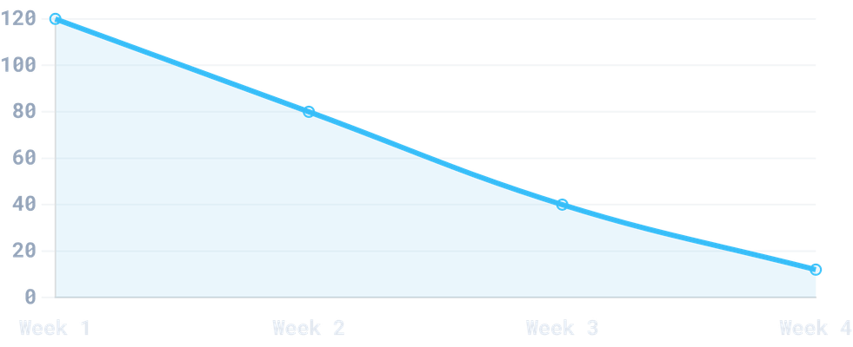
FROM VISION TO VALIDATION: PILOT ROI
90%
REDUCTION IN MANUAL IT LABOR
100%
PILOT RETENTION RATE
$1.9M
01
3 Pilots Completed with Tier-1 Fintech and Healthcare partners.
AVG. SAVINGS PER INCIDENT
02
Real-time autonomous revocation enabled for "Toxic" bot-links.
03
Achieved 100% audit readiness for SOC2 in under 30 days.
// VALIDATION_LOG: PILOT_PHASE_01_COMPLETE

Slide 10




MULTI-CHANNEL DISTRIBUTION FOR RAPID MARKET PENETRATION
CHANNEL 01 // MSPS
CHANNEL 02 // CLOUD
CHANNEL 03 // DIRECT
PARTNERSHIP MODEL
AWS MARKETPLACE
ENTERPRISE GROWTH
Partnering with top-tier Managed Service Providers to embed Unkov in security bundles.
Simplified procurement for IT directors using existing cloud budgets and AWS credits.
High-touch consultative process targeting CISOs in high-compliance BFSI & Healthcare.
10+ TARGET MSPs IN PIPELINE
ZERO-FRICTION PROCUREMENT
30-MIN PROOF OF VALUE
20% PARTNER MARGIN TARGET
CO-SELL OPPORTUNITIES
FOCUS ON COMPLIANCE ROI
SEED PHASE TARGET MILESTONE
$500K ARR WITHIN 24 MONTHS
// GTM_STRATEGY_v2026.1 | DISTRIBUTION_ORCHESTRATION

Slide 11




THE ARCHITECTS OF THE GRAPH AGE
CEO & FOUNDER
CTO & FOUNDER
ADVISORY BOARD
CYBER-INTELLIGENCE EXPERT
FORMER AWS GRAPH ARCHITECT
STRATEGIC INDUSTRY LEADERS
Specialist in enterprise security architecture and identity threat intelligence.
Architected core components of Amazon Neptune and large-scale graph inference engines.
Former CISOs and security executives from Fortune 500 Financial Services and SaaS scale-ups.
15+ Years in Cybersecurity
Graph Database Pioneer
Fortune 500 CISOs
Former Security Lead
AWS Infrastructure Expert
SaaS Scale-up Experts
Identity Strategy Expert
ML/AI Systems Architect
IAM Industry Veterans
// TEAM_ID: UNKOV_FOUNDING_ARCHITECTS_v2026

Slide 12

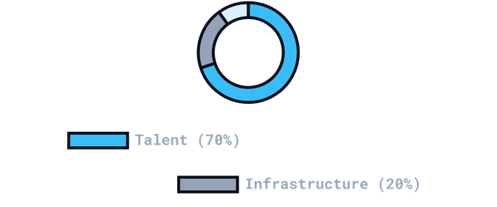
$4.0M SEED ROUND TO FUEL THE UNIFIED CONTROL PLANE
01 // THE TERMS
02 // USE OF FUNDS
03 // MILESTONES
SEED ROUND
ALLOCATION
SERIES A READINESS
TARGET RAISE
REACH $300K - $500K ARR
$4,000,000
15-20 ENTERPRISE CUSTOMERS
SOC 2 TYPE II CERTIFICATION
INSTRUMENT
LAUNCH COMPLIANCE AUTOPILOT
Post-Money SAFE
VALUATION CAP
$20,000,000
PROJECTED CASH RUNWAY
32 MONTHS FROM CLOSE
// FUNDING_REQUEST_v2026.1 | SEED_ROUND_ORCHESTRATION

Slide 13

PROACTIVE STRATEGIES FOR ECONOMIC, TECHNICAL, AND REGULATORY RESILIENCE
01 // ECONOMIC
02 // TECHNICAL
03 // REGULATORY
INFERENCE ECONOMICS
SECURITY GATING
AUDIT INTEGRITY
Task-specific, optimized models keep Cost-Per-Inference (CPI) low and margins high, preventing the "AI Margin Trap."
"Permission Gating" on every tool call prevents prompt injection backdoors and ensures autonomous actions are auditable.
Verifiable, immutable audit trails ensure compliance with "AI Washing" scrutiny and global data residency laws.
STRATEGY: MARGIN_PROTECTION_ACTIVE
STRATEGY: INJECTION_SHIELD_V2.1
STRATEGY: COMPLIANCE_AUTOPILOT_READY
// RISK_MITIGATION_FRAMEWORK_2026 | RADICAL_TRANSPARENCY

Slide 14

INVESTOR DATA ROOM: PROOF-READY FOR DUE DILIGENCE
01 // FINANCIAL
02 // TECHNICAL
03 // LEGAL
CAPITALIZATION PROOF
AI DEFENSIBILITY
CORPORATE HYGIENE
Detailed 3-Year Forecast
System Architecture Diagram
Delaware C-Corp Formation
Clean Cap Table (15% ESOP)
Data Provenance & Rights
IP Assignment Agreements
Itemized Use of Funds
18-Month Product Roadmap
Executed Pilot LOIs
STATUS: FINANCIAL_AUDIT_READY
STATUS: TECH_DUE_DILIGENCE_READY
STATUS: LEGAL_COMPLIANCE_READY
// DATA_ROOM_ID: UNKOV_SEED_DILIGENCE_v2026

Slide 15

THE FUTURE IS AGENTIC.
JOIN US IN BUILDING IT.
investors@unkov.com
unkov.com
Unkov: From Digital Filing Cabinets to Predictive Intelligence. Architecting the Unified Control Plane for Machine-Age Governance.
UNKOV

