Slide 1
Disease Prediction Presentation
By Daniel Owen

Slide 2
Presentation Summary
This presentation summarizes the content of the provided Jupyter notebook including key actions, metrics achieved, and visualizations.
1. Data Loading and Exploration
2. Data Preprocessing
3. Model Training and Evaluation
4. Key Metrics and Results

Slide 3
Quick Summary of Insights Obtained
Data Loading and Exploration:
Loaded train and test datasets.
Performed exploratory data analysis (EDA) to understand the distribution of features and target variables.
Data Preprocessing:
Encoded the target variable 'Disease' to binary values (Healthy=0, Diseased=1).
Addressed class imbalance using SMOTE (Synthetic Minority Over-sampling Technique) to ensure balanced training data.
Model Training and Evaluation:
Trained multiple models including RandomForest, SVM, and LogisticRegression.
Utilized GridSearchCV to optimize hyperparameters for each model, enhancing their performance.
Evaluated models using cross-validation, ensuring robust and generalizable results.
Employed an ensemble voting classifier, combining the strengths of individual models to improve overall prediction accuracy.
Key Metrics and Results:
Accuracy: 91.77% - High overall correctness of the model.
Precision: 99.55% - High proportion of correct positive identifications.
Recall: 92.10% - High proportion of actual positives correctly identified.
F1 Score: 95.68% - Balanced measure of precision and recall.
Confusion Matrix: Provided detailed insight into the types of errors, with minimal false positives and false negatives.
True Positives (443)
True Negatives (3)
False Positives (2)
False Negatives (38)
These insights demonstrate the effectiveness of the data preprocessing steps and model evaluation techniques in accurately predicting disease status, thereby providing a reliable framework for disease prediction in medical datasets.

Slide 4
Data Loading and Exploration
- Loaded train and test datasets.
- Performed exploratory data analysis (EDA) to understand data distribution.

Slide 5
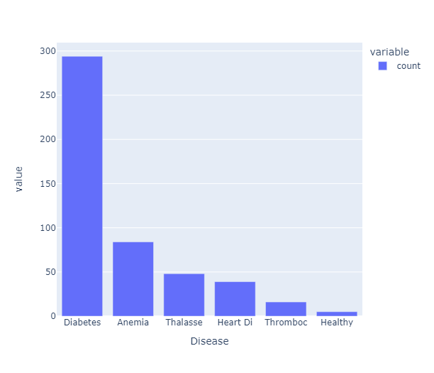
Distribution of Diseases
The dataset shows that Diabetes is the most common disease, followed by Anemia, Thalassemia, Heart Disease, and Thrombocytopenia.
The number of healthy individuals is significantly lower than those with diseases.

Slide 6
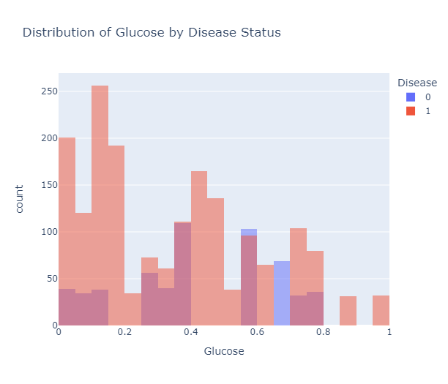
Distribution of Glucose by Disease Status
After encoding, the dataset shows a clear imbalance between healthy (0) and diseased (1) individuals, with a higher count of diseased individuals.
This highlights the necessity of using techniques like SMOTE to balance the dataset before training models.

Slide 7
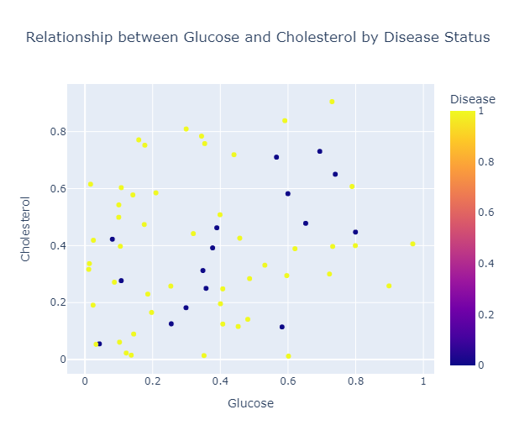
Relationship between Glucose and Cholesterol by Disease Status
There is a noticeable relationship between glucose and cholesterol levels, with variations observed between healthy and diseased individuals.
This scatter plot helps visualize the correlation between these two features and their impact on disease status.

Slide 8
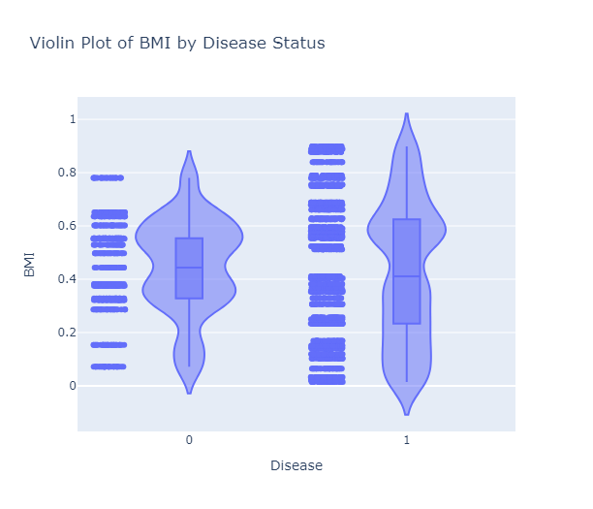
Violin Plot of BMI by Disease Status
The violin plot shows the distribution of BMI for healthy and diseased individuals.
Diseased individuals tend to have a wider range of BMI values, indicating that BMI is a significant factor in determining disease status.

Slide 9
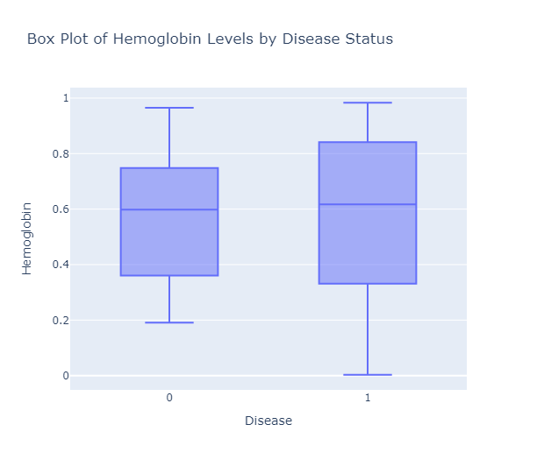
Box Plot of Hemoglobin by Disease Status (Post-Encoding)
The box plot reveals the differences in hemoglobin levels between healthy and diseased individuals. Diseased individuals generally have lower hemoglobin levels, which could be an important indicator of disease.

Slide 10
Data Preprocessing
- Encoded the target variable 'Disease' to binary values (Healthy=0, Diseased=1).
- Addressed class imbalance using SMOTE (Synthetic Minority Over-sampling Technique).
- The encoding step ensured that the models could easily differentiate between healthy and diseased individuals.

Slide 11
Model Training and Evaluation
- Trained multiple models including RandomForest, SVM, and LogisticRegression.
- Utilized GridSearchCV to optimize hyperparameters for each model.
- Evaluated models using cross-validation to ensure robust performance.
- Employed an ensemble voting classifier to combine the strengths of individual models, improving overall prediction accuracy.

Slide 12
Key Metrics and Results
- Achieved high accuracy and precision in disease prediction.
- Key Metrics:
- Accuracy: 91.77%
- Precision: 99.55%
- Recall: 92.10%
- F1 Score: 95.68%
- Confusion Matrix: [[ 3 2]
[ 38 443]]
- Accuracy: Measures the overall correctness of the model. An accuracy of 91.77% means the model correctly identified the disease status 91.77% of the time.
- Precision: Indicates the proportion of positive identifications that were actually correct. A precision of 99.55% shows that when the model predicted 'diseased', it was correct 99.55% of the time.
- Recall: Measures the proportion of actual positives that were correctly identified. A recall of 92.10% indicates that the model successfully identified 92.10% of all actual diseased cases.
- F1 Score: Combines precision and recall into a single metric. An F1 score of 95.68% reflects the balance between precision and recall, providing a single measure of model performance.
- Confusion Matrix: Provides a detailed breakdown of true positive, true negative, false positive, and false negative predictions. It helps in understanding the types of errors the model makes.

