Slide 1
Time Series Forecasting for Market Prices
ARIMA, SARIMA, and LSTM Models
Owen Daniel
30/05/2024

Slide 2
Introduction
Objective: Forecast market prices using time series models.
Models Used: ARIMA, SARIMA, and LSTM.
Evaluation Metrics: MSE, MAE, RMSE.

Slide 3
Data Overview
Data Source: Market Price Prediction dataset.
Features: Year, Quantity, PriceMin, PriceMax, PriceMod, Market, Month, State, City.
Preprocessing: Handling missing values, encoding categorical variables with one-hot encoding , and scaling data with MinMaxScaler

Slide 4
Data Preparation
Convert 'date' column to datetime and set as index.
Sort data by date.
Create datasets for models with time steps.

Slide 5
Model Training - ARIMA
ARIMA parameters: (2, 1, 2) for Quantity, (1, 1, 1) for Prices.
Metrics for Test data:
ARIMA Quantity Metrics: MSE: 27864794831.035, MAE: 81499.624, RMSE: 166927.514
ARIMA PriceMin Metrics: MSE: 1911978.246, MAE: 1100.303, RMSE: 1382.743
ARIMA PriceMax Metrics: MSE: 5315439.892, MAE: 2057.992, RMSE: 2305.524

Slide 6
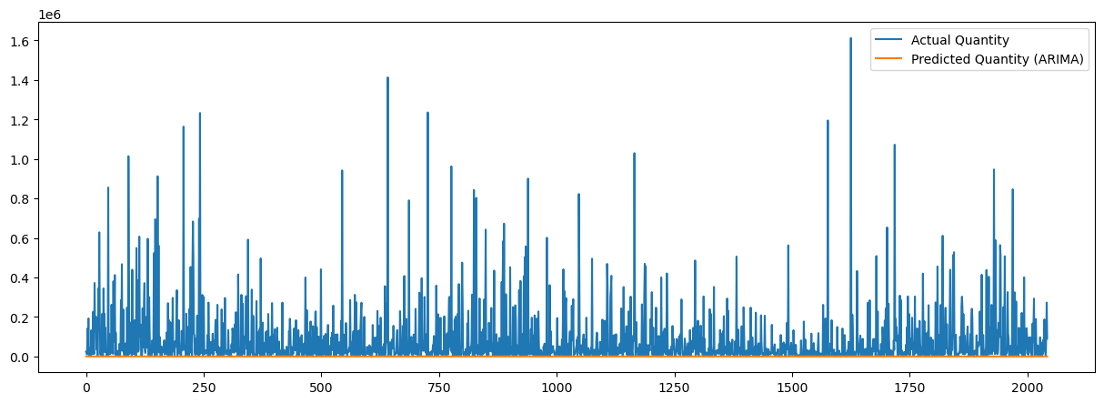
ARIMA Model Performance

Slide 7
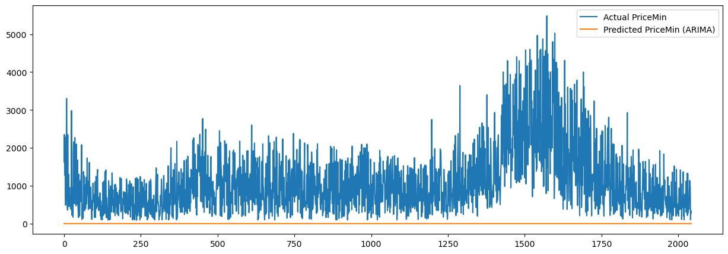

Slide 8
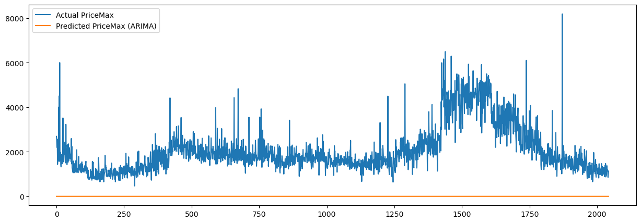

Slide 9
Model Training - SARIMA
SARIMA parameters: (2, 1, 2) (1, 1, 1, 12) for Quantity, (1, 1, 1) (1, 1, 1, 12) for Prices.
Metrics for Test data:
SARIMA Quantity Metrics: MSE: 27864795163.893, MAE: 81499.626, RMSE: 166927.515
SARIMA PriceMin Metrics: MSE: 1913659.167, MAE: 1100.978, RMSE: 1383.351
SARIMA PriceMax Metrics: MSE: 5315021.794, MAE: 2057.900, RMSE: 2305.433

Slide 10

SARIMA Model Performance

Slide 11


Slide 12


Slide 13
Model Training - LSTM
LSTM Quantity Metrics:
MSE: 28644315439.943, MAE: 95839.824, RMSE: 169246.316
LSTM PriceMin Metrics: MSE: 701093.970, MAE: 631.559, RMSE: 837.314
LSTM PriceMax Metrics: MSE: 352932.463, MAE: 423.631, RMSE: 594.081

Slide 14
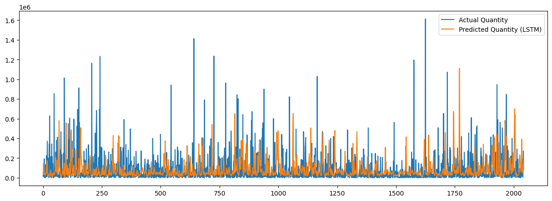
LSTM Model Performance

Slide 15
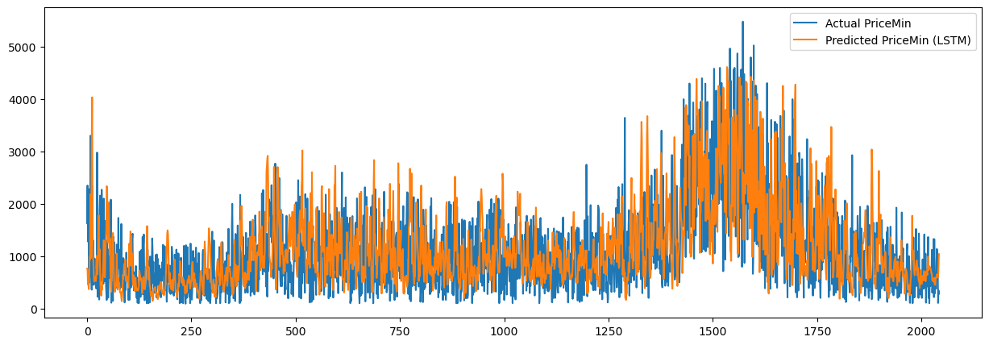

Slide 16
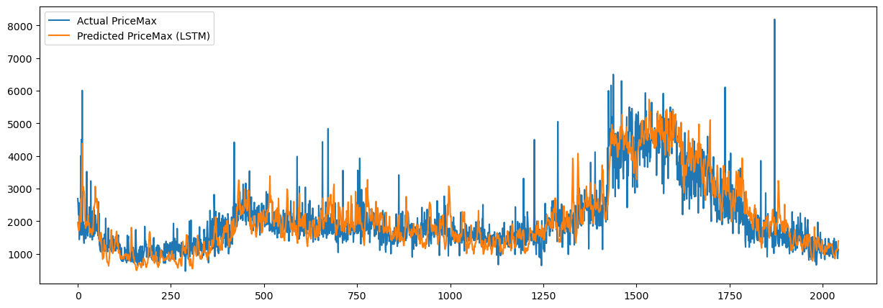

Slide 17
Model Comparison
The three graphs you've shared compare the actual maximum price values with predictions from different models: LSTM, SARIMA, and ARIMA.
1. LSTM Model:
- The first graph shows that the LSTM model's predicted values (orange line) closely follow the actual values (blue line). This indicates a good performance by the LSTM model in capturing the patterns and fluctuations in the data.
2. SARIMA Model:
- The second graph shows a significant discrepancy between the actual values and the predicted values from the SARIMA model. The SARIMA model predictions (orange line) are almost flat and do not follow the actual data at all. This suggests that the SARIMA model failed to capture the underlying patterns in the data.
3. ARIMA Model:
- The third graph is similar to the SARIMA model, where the ARIMA model predictions (orange line) are also nearly flat and do not match the actual data. This indicates that the ARIMA model, like the SARIMA model, was not able to effectively model the data.

Slide 18
Conclusion
Summary:
- The LSTM model appears to be significantly better at predicting the maximum prices compared to the SARIMA and ARIMA models.
- Both SARIMA and ARIMA models show poor performance in this case, with their predictions failing to follow the actual data trends.
If you need further analysis or have specific questions about the models, feel free to ask!

Slide 19
Q&A
Open floor for questions.

Slide 20
References
List any references or sources used in the project.

