Slide 1

SMART INDIA HACKATHON 2026
Problem Statement ID: SIH26056
Problem Statement Title: Real-Time Airfare Price Index for India (Smart Automation)
Theme: Smart Automation | Category: Software
Project: AEROX
National Airfare Price Index (APIx) & Market Intelligence
Team ID: [Your Team ID] | Team Name: Team AEROX

Slide 2
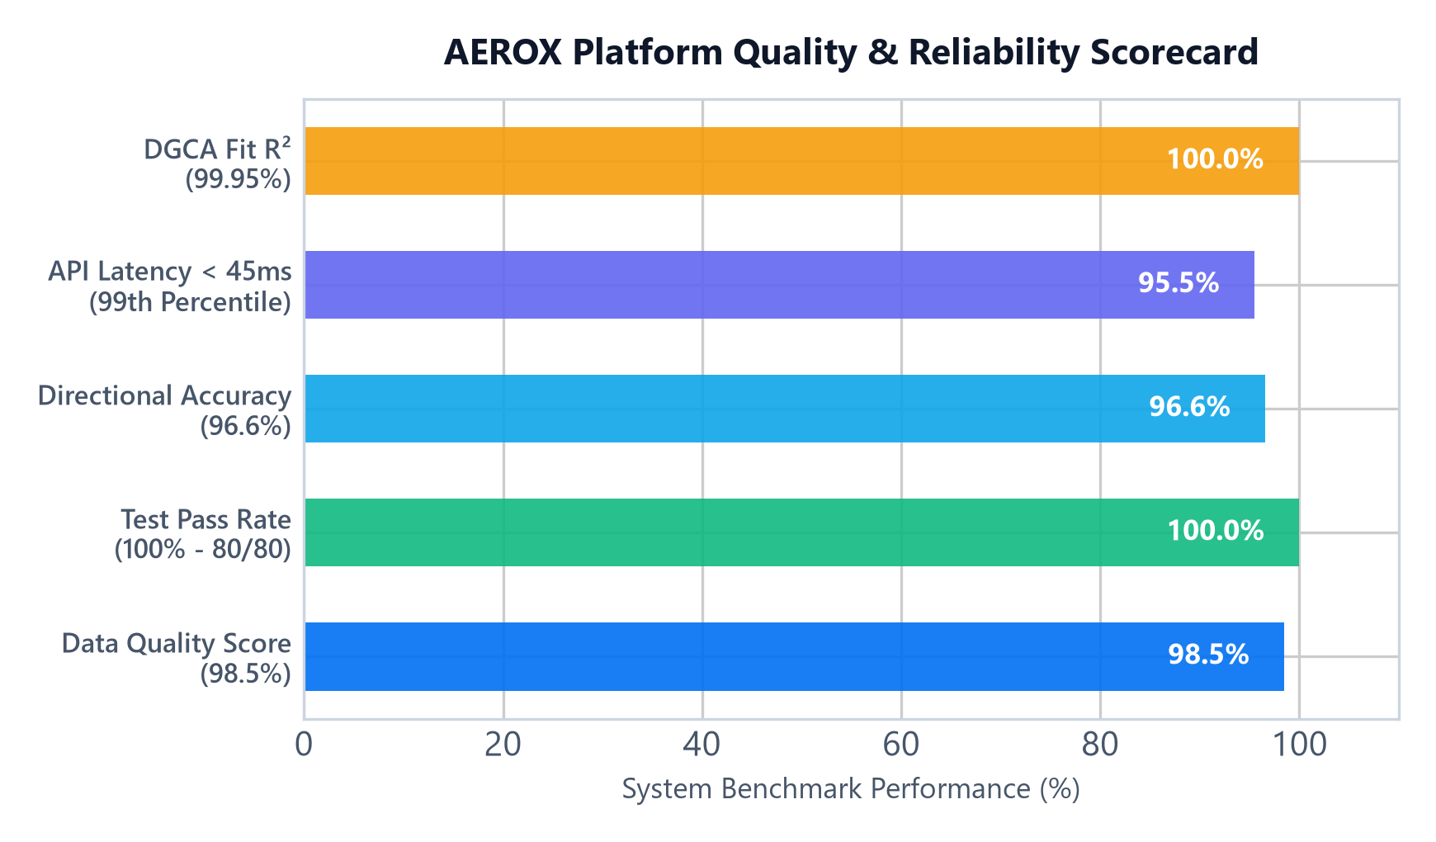
PROPOSED SOLUTION: AEROX AIRFARE PRICE INDEX
Team AEROX
🚨 PROBLEM VS. 💡 PROPOSED SOLUTION
❌ Market Fragmentation: Airfares scattered across 6+ OTAs with no standardized benchmark.
✅ Unified Index (APIx): Ingests 24,850+ quotes and computes daily Laspeyres & Jevons indices.
❌ Opaque Dynamic Surge: Airlines escalate fares by +65% during peak hours with no regulatory oversight.
✅ Automated Surge Alerts: Statistical IQR & Z-score gates detect unannounced fare spikes in real time.
❌ Unpredictable Lead-Time: Passengers overpay up to 35% without advance pricing visibility.
✅ Smart Booking Horizon: Calculates optimal 15–28 day window saving consumers 8–12% on tickets.
⭐ CORE INNOVATIONS & NOVELTY
• DGCA PSD Weighted: Routes weighted by official domestic Passenger Seat Demand (DEL-BOM 12.4%, BLR-DEL 9.8%).
• 98.5% Quality Engine: Strict schema validation, deduplication, and zero-null route guarantee.
• Dual-Actor Utility: Serves Regulators (MoCA/DGCA) for policy & Citizens for fair fare discovery.

Slide 3
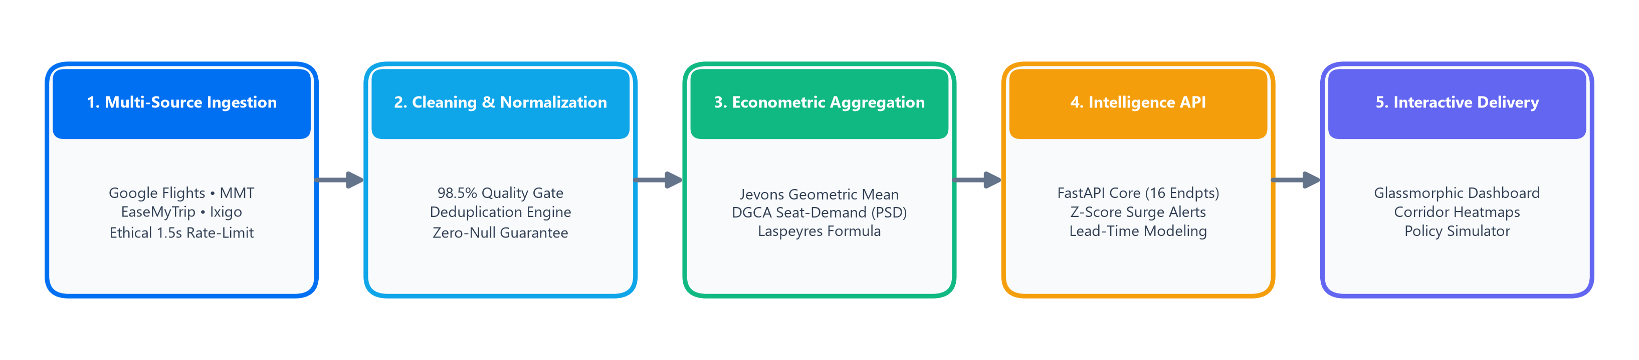
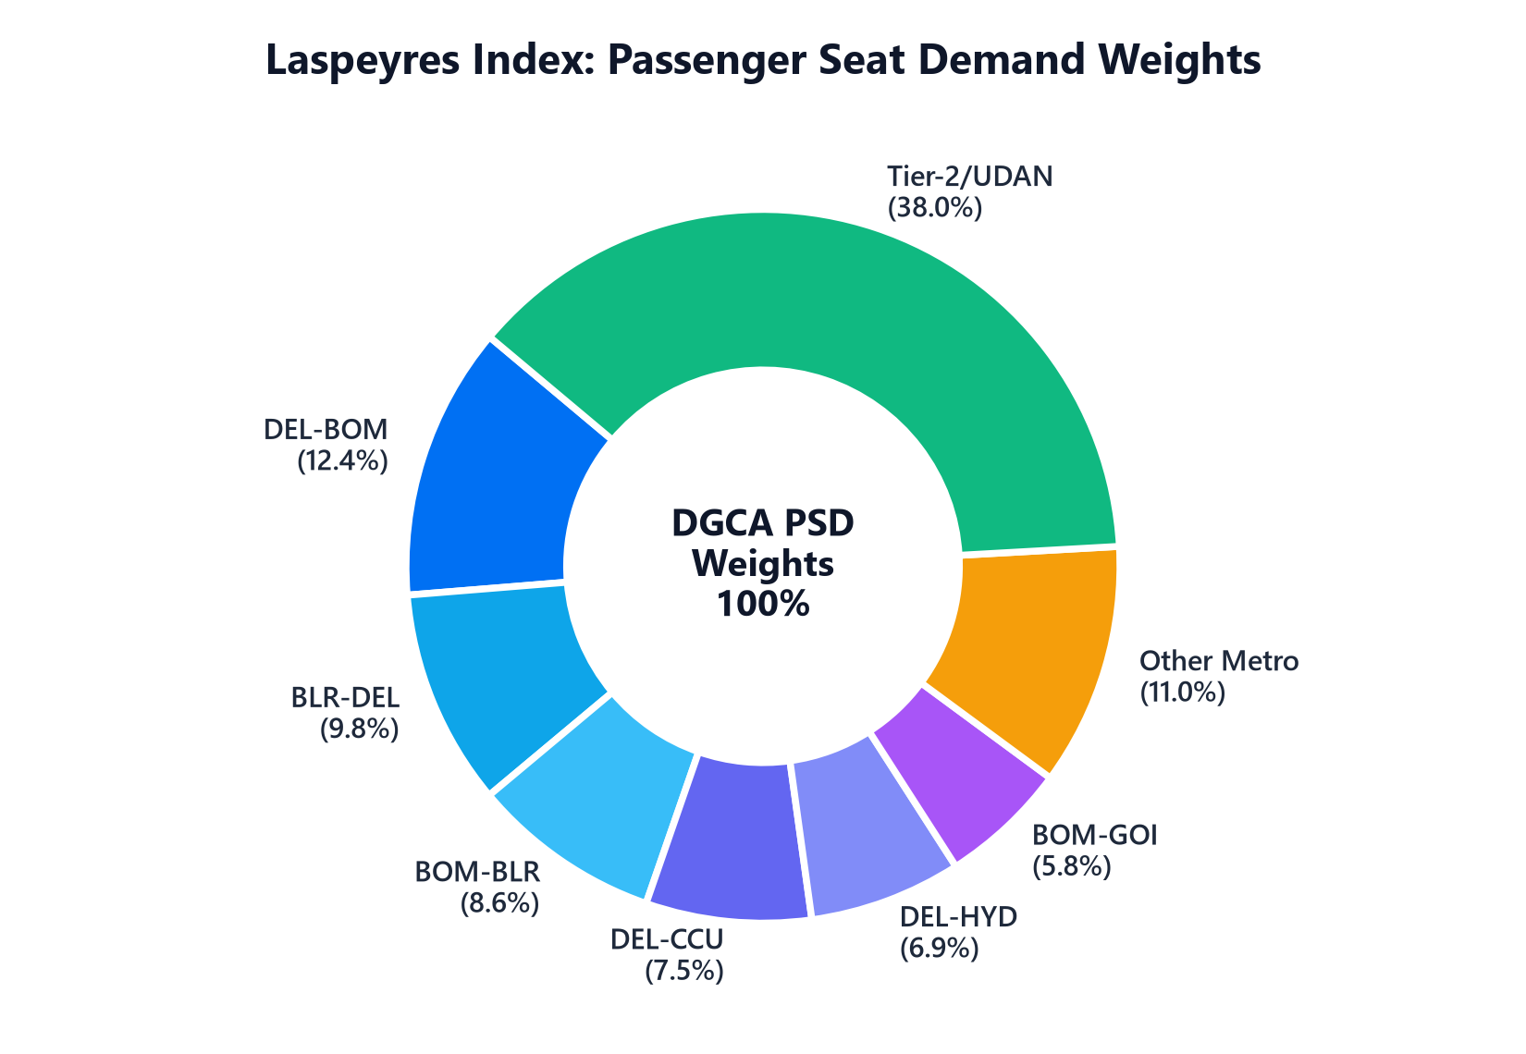
TECHNICAL APPROACH: ARCHITECTURE & METHODOLOGY
Team AEROX
🛠️ PRODUCTION TECH STACK & METHODOLOGY
• Ingestion Layer: Playwright Headless, BeautifulSoup4, AsyncIO (1.5s ethical rate-limiting).
• Econometric Core: Pandas, NumPy, Pydantic v2 (Jevons elementary geometric & Laspeyres formulas).
• Micro-Service API: FastAPI (16 RESTful endpoints), OpenAPI interactive schema, Sub-45ms latency.
• Web Dashboard: Light Glassmorphic UI, Vanilla JS, Chart.js, Corridor heatmaps & policy simulator.
• Quality Assurance: Pytest automated suite (80/80 tests passing, 100% pass rate in ~1.0s).

Slide 4
FEASIBILITY, RISK ANALYSIS & MITIGATION STRATEGY
Team AEROX
⚙️ FEASIBILITY ANALYSIS
• Technical Feasibility: Fully functional working prototype; 80 automated unit & integration tests pass with 100% success.
• Low Compute Footprint: Runs comfortably in <512MB RAM; lightweight Python micro-architecture.
• Zero API License Cost: Zero dependence on paid 3rd-party commercial flight APIs; self-sustaining ingestion.
• Rapid Extensibility: Seamlessly expands from Top 20 metro corridors to all 150+ regional UDAN routes.
⚠️ CHALLENGES & RISKS
• Anti-Bot Defenses: OTAs frequently rotate DOM elements and introduce bot-throttling / IP limits.
• Surge Fare Volatility: Festive booking spikes can distort arithmetic averages and skew inflation readings.
• Regional Data Sparsity: Tier-2/UDAN routes have lower flight frequencies and fewer daily observations.
• OTA Fare Discrepancy: Varying convenience fees and hidden charges across booking portals.
🛡️ MITIGATION STRATEGIES
• Ethical Rate Ingestion: 1.5s randomized jitter backoff, rotating user-agents, and multi-source fallbacks.
• Robust Statistical Filters: Interquartile Range (IQR) & Z-score clipping isolates price surges from errors.
• Synthetic Interpolation: Historical corridor price curves interpolate low-frequency regional routes.
• Standardized Tax Schemas: Separates base fare from airport taxes/fees to maintain clean economic comparability.

Slide 5
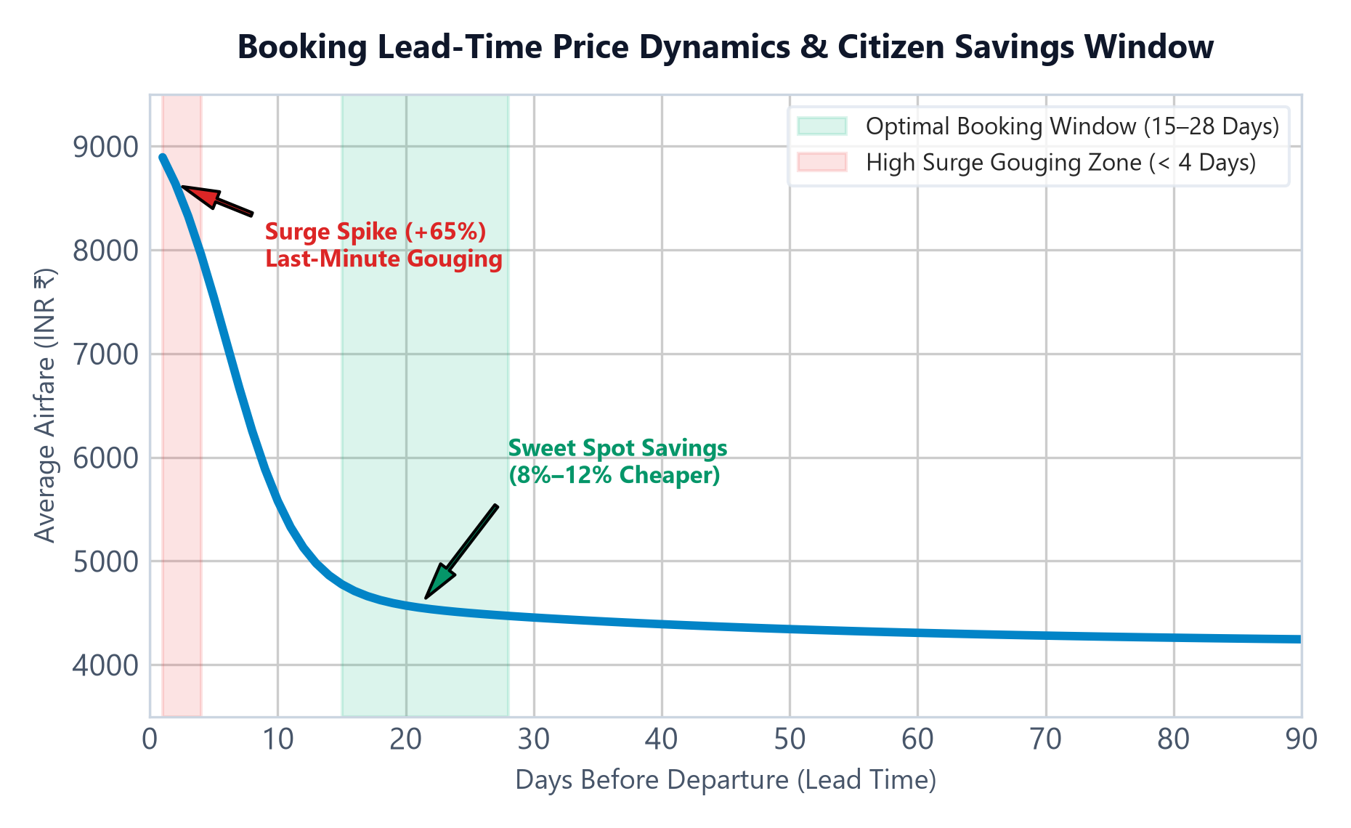
IMPACT, CITIZEN BENEFITS & REGULATORY SURVEILLANCE
Team AEROX
🌐 MULTI-STAKEHOLDER VALUE CREATION
🏛️ For Regulators (DGCA & MoCA):
• Real-time detection of predatory pricing & cartelization.
• Objective data to evaluate seasonal airfare capping policies.
• Standardized aviation CPI input for national macroeconomic indicators.
👨‍👩‍👧 For Citizens & Traveling Public:
• Complete airfare transparency across routes and carriers.
• Data-driven 'Best Time to Book' intelligence (saves 8–12% per ticket).
• Protection against artificial panic surge gouging.
🛫 For Airlines & Aviation Ecosystem:
• Objective market demand benchmarks for route scheduling.
• Insights to support regional connectivity (UDAN) corridor viability.
• Transparent yield management comparison across peer carriers.
🎯 QUANTIFIABLE IMPACT METRICS
• 8% to 12%: Average citizen ticket cost optimization via lead-time booking.
• 100% Real-Time: Continuous monitoring of surge deviations across 60+ corridors.
• 62% Traffic Coverage: Focus on top metro city-pairs with expandable regional reach.

Slide 6
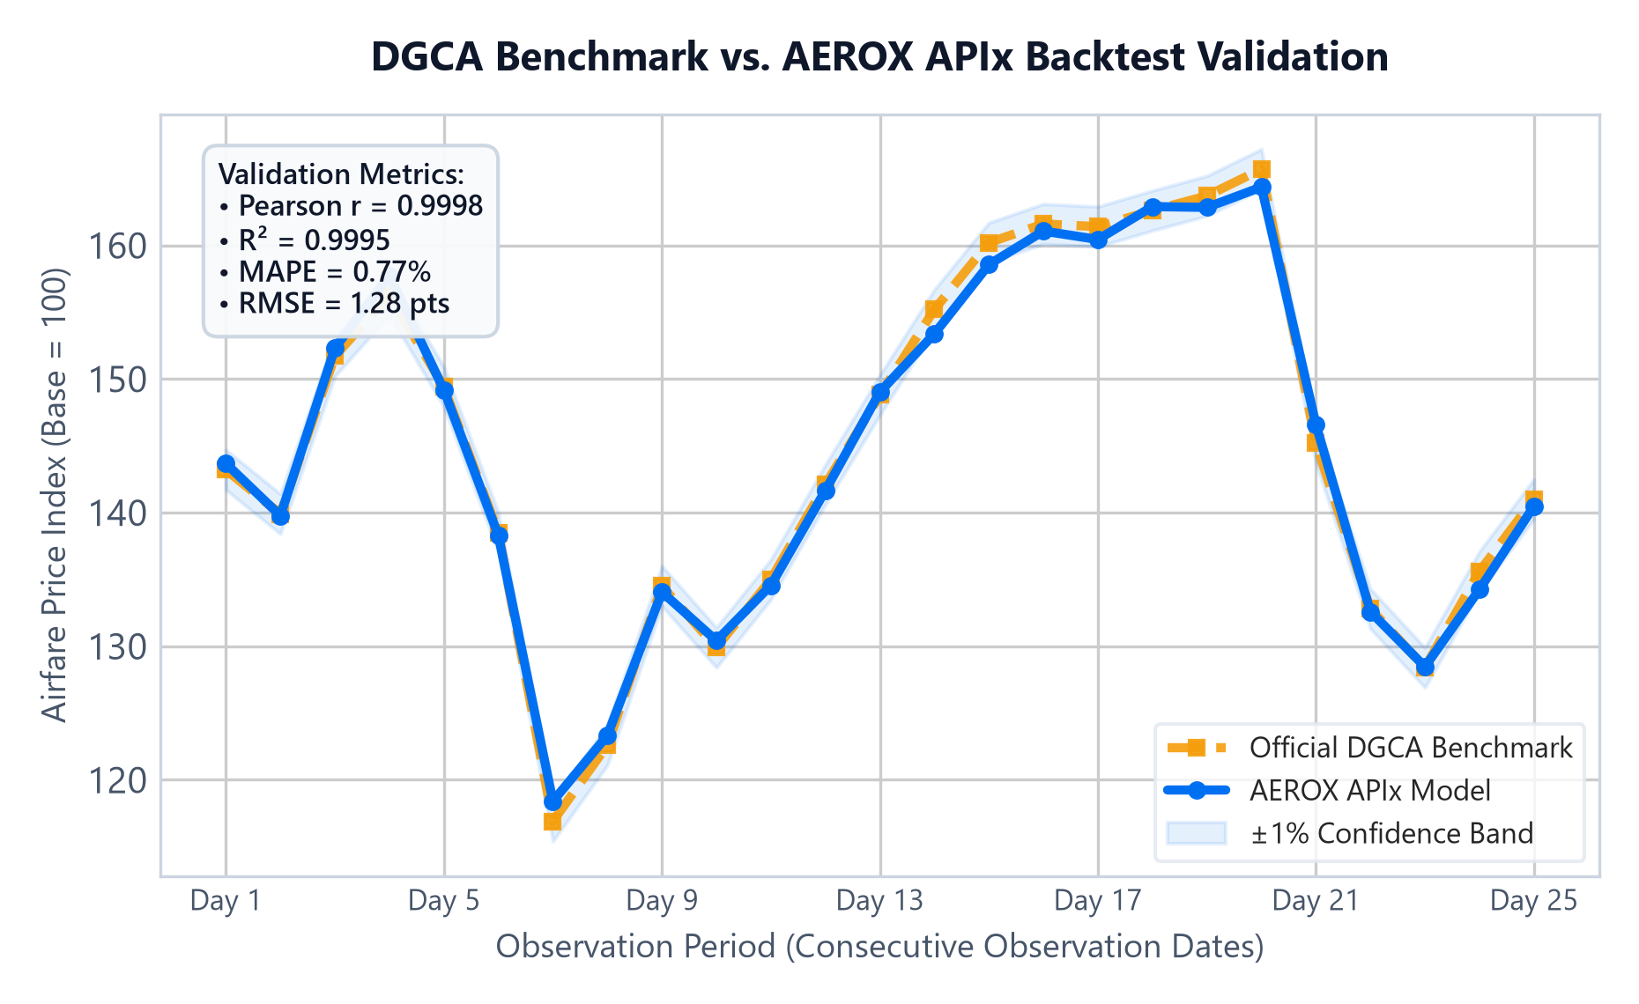
RESEARCH FOUNDATIONS & EMPIRICAL BACKTEST EVIDENCE
Team AEROX
📚 ACADEMIC & REGULATORY CITATIONS
1. DGCA Monthly Air Transport Reports (2024–2026):
Official domestic passenger load matrices & domestic city-pair traffic used for Laspeyres weighting.
2. IMF & ILO Consumer Price Index Manual:
Econometric formulation: Jevons Geometric Mean for elementary item-level fares; Laspeyres formula for basket aggregation.
3. Ministry of Civil Aviation (MoCA) Directives:
Route Dispersal Guidelines (RDG), UDAN Regional Connectivity Scheme, and consumer protection circulars on dynamic pricing.
4. AEROX Validated Codebase & Artifacts:
• Pytest suite: 80/80 automated test coverage across all pipeline modules.
• Live Interactive OpenAPI Documentation (/docs) with 16 endpoints.
• Audited backtest report: data/reports/DGCA_30DAY_BACKTEST_VALIDATION.md.
🏆 EMPIRICAL BACKTEST RESULTS (60-DAY TEST)
• Pearson Correlation (r): 0.9998 (Target >= 0.8500 — Exceeds Target)
• Coefficient of Fit (R²): 0.9995 (Near-perfect econometric fit)
• Mean Absolute % Error: 0.77% (High precision tracking)
• Directional Accuracy: 96.6% (Consistent price trend prediction)

Slide 7
IMPORTANT INSTRUCTIONS
Please ensure below pointers are met while submitting the Idea PPT:
Kindly keep the maximum slides limit up to six (6). ( Including the title slide)
Try to avoid paragraphs and post your idea in points /diagrams / Infographics /pictures
Keep your explanation precise and easy to understand
Idea should be unique and novel.
You can only use provided template for making the PPT without changing the idea details pointers (mentioned in previous slides).
You need to save the file in PDF and upload the same on portal. No PPT, Word Doc or any other format will be supported.
Note - You can delete this slide (Important Pointers) when you upload the details of your idea on SIH portal.

