Slide 1
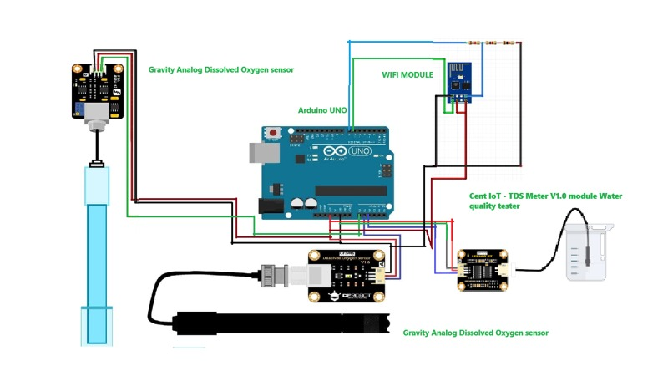
CIRCUIT DIAGRAM OF OUR PROJECT

