Slide 1
Microbial Growth Kinetics

Slide 2
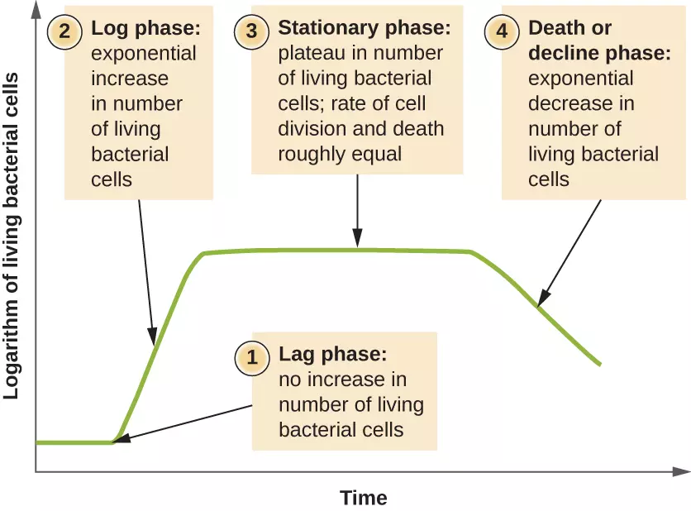
Batch Culture

Slide 3
Phases of growth: Lag phase

Slide 4
Phases of growth: Log phase

Slide 5
Phases of growth: Log phase

Slide 6
Phases of growth: Stationary phase

Slide 7
Phases of growth: Death phase

