Slide 1

MINI PROJECT
ON
IMAGE CLASSIFICATION IN HEALTH CARE
Name: Unnati Rastogi
Section: H
Class no.: 67
University roll no.: 21022874
Mentor name: Ms. Ankita Nainwal
Course: B.Tech.
Branch: CSE
Semester: 5
Session: 2022-23

Slide 2
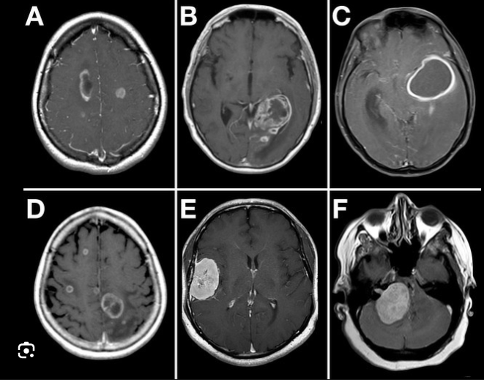
INTRODUCTION
An image classification project in healthcare involves using machine learning and computer vision techniques to analyze medical images and categorize them into different classes or labels. This type of project has significant applications in various medical fields, including diagnosis, treatment planning, and monitoring of diseases.
This project leverages deep learning, particularly Convolutional Neural Networks (CNNs), to automatically learn and recognize patterns within medical images. The primary goal is to develop a model that can accurately classify medical images into predefined categories, such as identifying specific diseases, anomalies, or anatomical structures.

Slide 3
Problem statement
The aim of this project is to build a Deep Learning model that can accurately classify medical images into predefined categories, such as identifying specific diseases. The approach that is used in this project is based on CNN or Convolutional neural network which is a deep learning technique.

Slide 4
Methodology
The basic steps that were involved in the development of this project involved methods like data preprocessing, data modelling etc., the following steps are:
STEP 1: Load data set
In this step we loaded our data set i.e., brain-tumor dataset from Kaggle

Slide 5
STEP 2: Read and pre-process the data
Clean and preprocess the medical images to ensure consistency and remove any noise or artifacts that may affect the model's performance.
Step 3:Visualizing and labelling our training data
Annotate the images with the correct labels or classes. In healthcare, these labels might represent different diseases, anatomical structures, or conditions.

Slide 6
Step 4: Model Creation
We will be creating a Convolutional Neural Networks (CNN) model which is very popular while classifying images as it extracts the features of images using several hidden layers or we say several layers of filters.
Step 5: Training and making predictions
Now we are going to use our model which we have created to make test predictions.

Slide 7
RESULT AND DISCUSSION
In this project A system was successfully developed in this machine learning project that successfully detect the brain images and predict that whether it contains tumor or not i.e. ‘Yes brain tumor’ and ‘No brain tumor’.
As a result of this, the system can be said to perform and predict the desired result as per requirement and with ample enough accuracy and precision.

