Slide 1

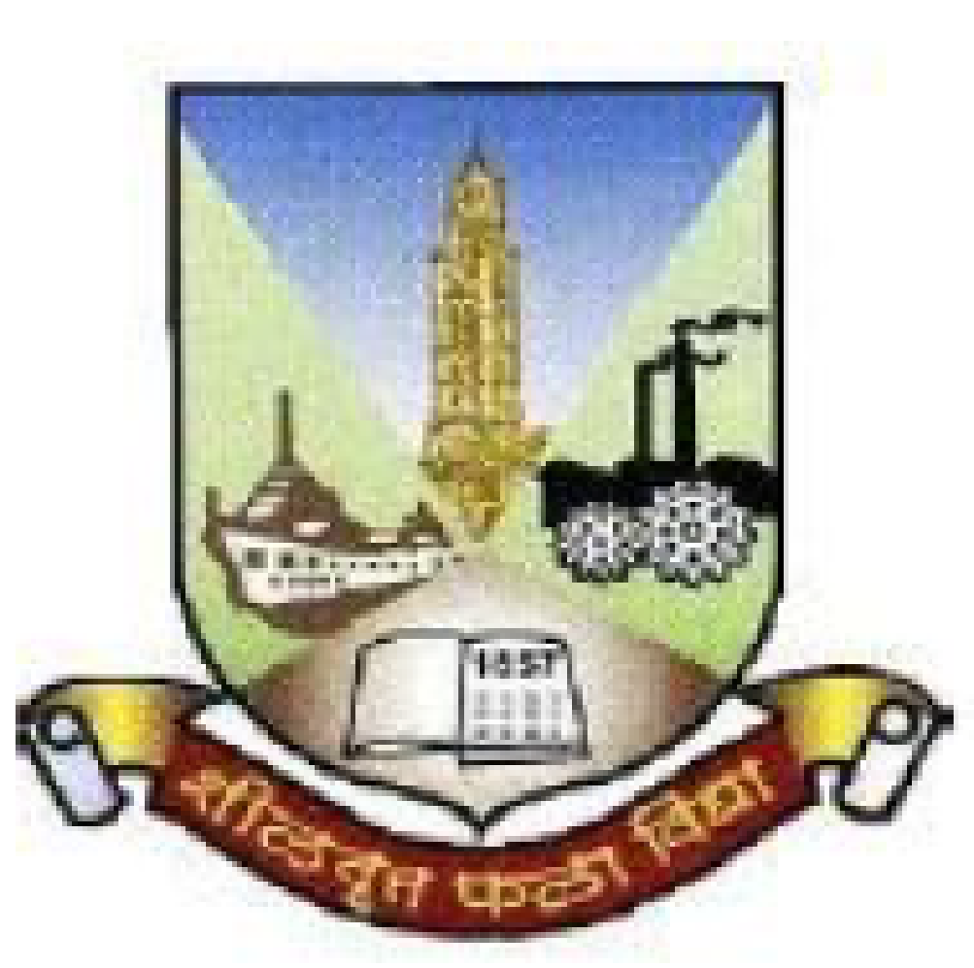
Mid Term Continuous Assessment
(Semester VI)
Vivekanand Education Society’s Institute of Technology
Electronics and Telecommunication Engineering
Title of Project: Re-Creation of First Picture Experiment- View from Window
Group No. : 4
Unnati Ayalwar-02 (D14B)
Thanmai Chunduru-13 (D14B)
Sakshi Ganjewar-19 (D14B)
Riddhi Solanke-59 (D14B)
Name of Guide: Mr. Mrugendra Vasmatkar

Slide 2
Contents to be covered
Problem Statement
Proposed Solution
Block Diagram of Proposed System
Components requirement
Methodology
References

Slide 3
Problem Statement
Goal is to recreate the iconic photograph, "View from the Window at Le Gras," known as one of the oldest surviving photos ever taken.

Slide 4
Proposed Solution
Through conducting thorough research on Nicéphore Niépce's groundbreaking experiment, "View from the Window," we aim to meticulously recreate the process he undertook. This involves delving into historical records, studying his techniques and materials, and understanding the context in which the experiment occurred.

Slide 5
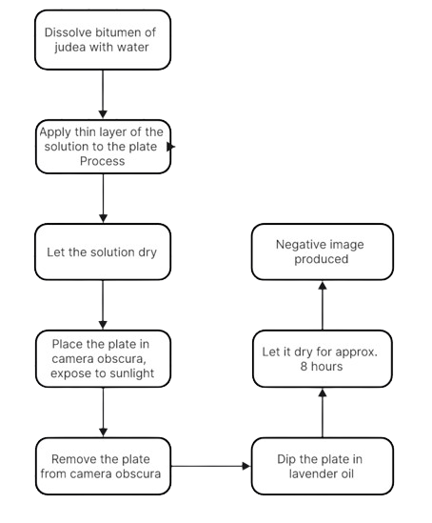
Block Diagram of Proposed System
Fig No.1 Block Diagram of project

Slide 6
Components Required
Table No. 1 components required
Sr No. | Components Required
1. | Glass/copper/tin
2. | Bitumen of Judea
3. | Lavender oil
4. | Cardboard box
5. | Black paper

Slide 7
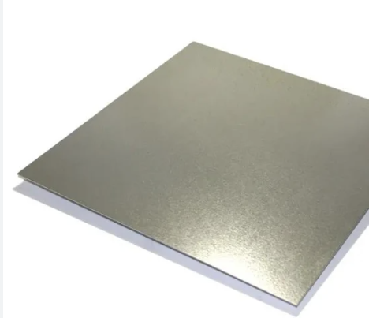
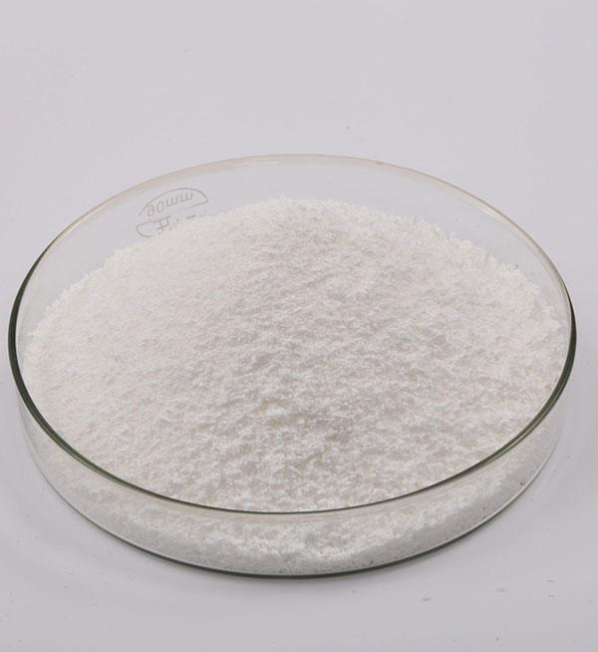
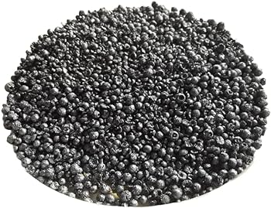
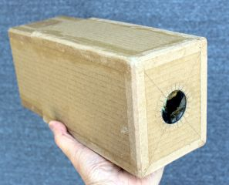
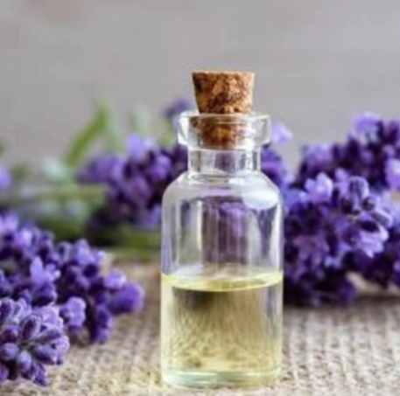
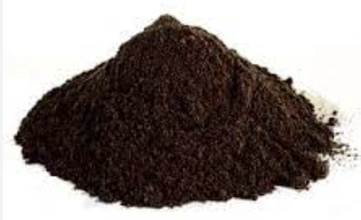
Tin Plate
Silver chloride
Iodine crystals
camera-obscura
Lavender oil
Bitumen of Judea

Slide 8
Methodology
Nicéphore Niépce conducted pioneering experiments in May 1816 to capture images of nature.
He used a camera obscura and positioned a plate coated with solution of bitumen of judea and diluted water solution inside and expose it to sunlight.
Niépce allowed the projected image from outside to imprint onto the light-sensitive surface of the coated paper.
After approximately 8 days, remove the plate from camera obscura.

Slide 9
Dip the plate in diluted lavender oil bath, that would dissolve the bitumen parts that have not been exposed or little exposed to sunlight.
The process produced a negative image.
Further, by exposing the plate to iodine vapours in a box, we can obtain a positive image.
The project seeks to recreate Niépce's process, including preparing the camera obscura and coating plate with light-sensitive materials.

Slide 10
Conclusion
The experiment demonstrates a historical photographic process known as heliography, which was pioneered by Joseph Nicéphore Niépce in the early 19th century. By dissolving bitumen of Judea in water, applying it to a plate, exposing it to sunlight in a camera obscura, and subsequently treating it with lavender oil, a negative image is produced. This experiment provides valuable insight into the early methods of photography.

