Slide 1
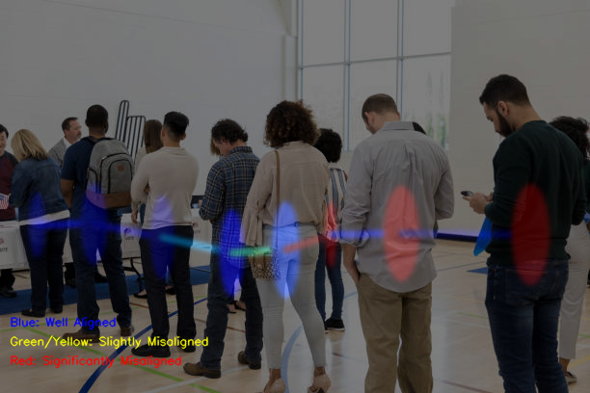
People color-coded according to their alignment

