Slide 1

Stocker
Stalk the stock market
- A Team decepticon presentation

Slide 2
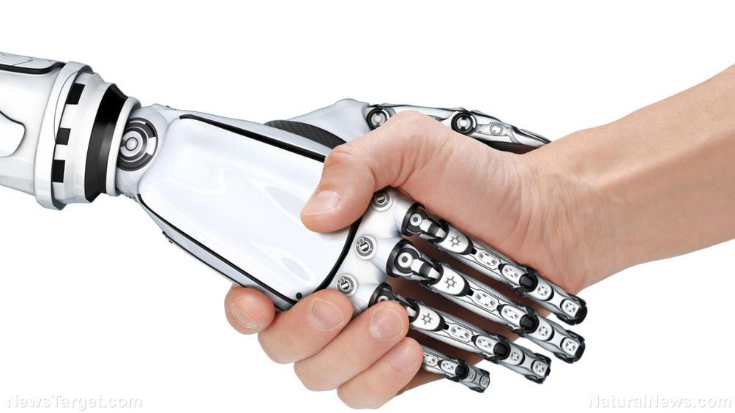
RPA?
RPA or Robotic Process Automation is another step in the evolution of business processes. It is the next logical step to significantly reduce the requirement for employees to perform rule based, high volume activities. Instead, RPA enables employees to focus on more strategic tasks that help the business – and the beauty of it all is that many organizations are just beginning to explore the use of RPA in different scenarios and situations.

Slide 3
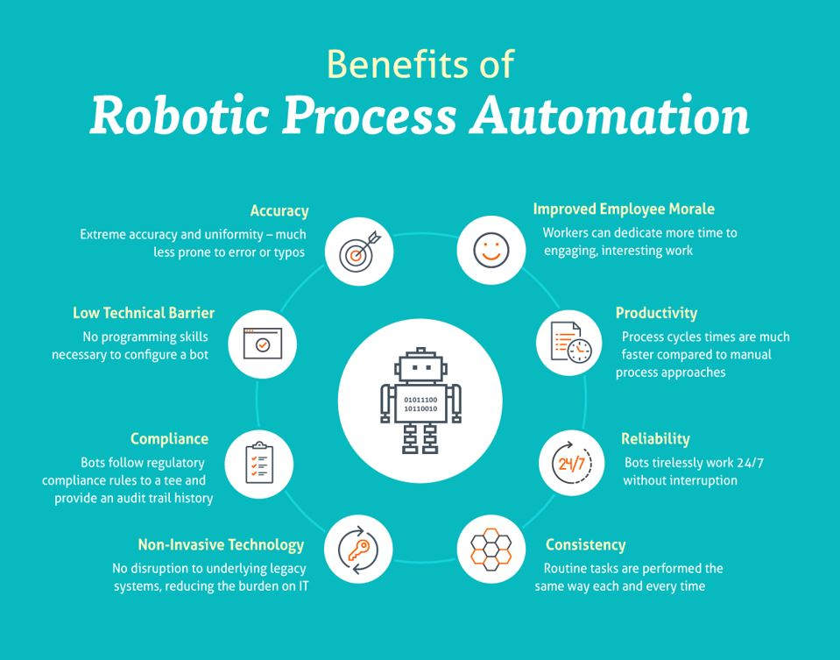
Benefits :

Slide 4
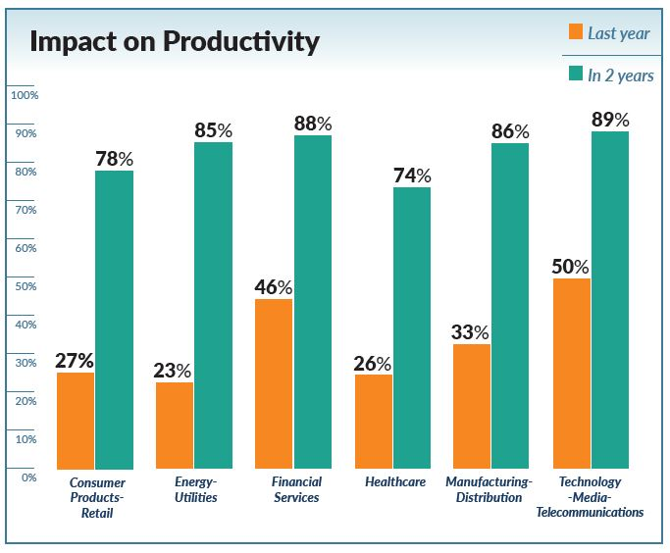
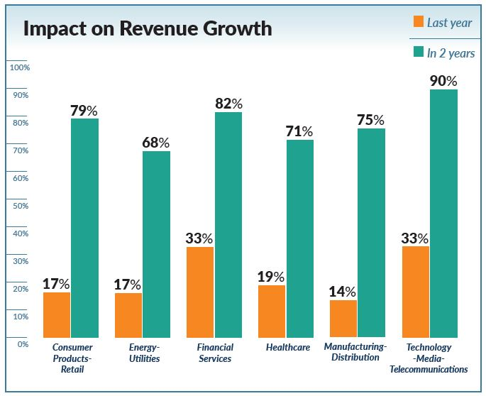
Business Impact :

Slide 5
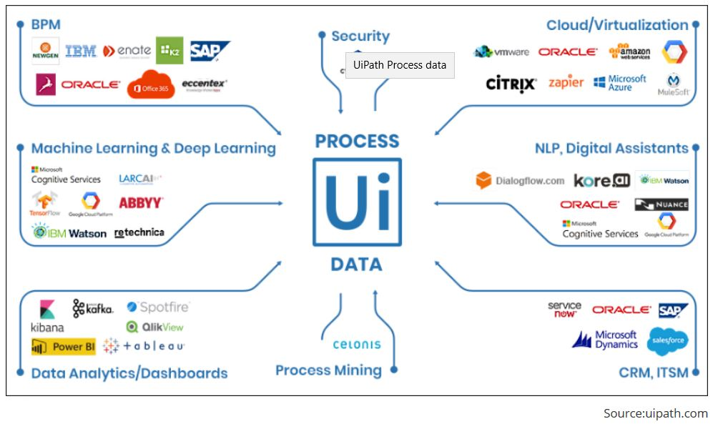
Weapon : UiPath

Slide 6

Idea :
In our country around 25 million people invest in stock market and monitors it daily. Usually they spend around 30 minutes on a daily basis per share to see it's growth/fall or trend. Now it might happen that on a busy schedule you just missed the perfect chance to make something big. So why not involving a robot to sweat all day long and notify you about all the details you need. They neither get tired nor ask for any cut ;-)

Slide 7
How It Works?
Users need to mail an input file (admins would share a master file for the first time with users if they opt for this service, it contains all listed stock details of BSE & NSE) with all their wish listed stocks to Bot mail id arijitghosh.da@gmail.com the mail subject should contain the keyword “Stocker” (case insensitive) as identifier.
Bot runs as per schedule for all available mails and it searches over the web for all possible attributes that you might be interested in (we're using www.moneycontrol.com here for our design) and after analyzing all the data it sends a mail to your requestor’s mail id with an attached Excel file. Even on a busy schedule where you carry your mobile phone you can access your mails and take a quick decision just by looking at the excel file.

Slide 8
Why to choose it?
Cost : There are few Stock alerter in market which needs some additional investment. Here it’s for free.
Time : No monitoring time is needed let the Bot serve you.
Effort : Manual effort eliminated.
Accuracy : Bots don’t make mistakes ;-) Human error ruled out.
Flexibility : Bot can be enhanced or design can be changed as per user need.

Slide 9

Thank You

