Slide 1

Azure DevOps to manage infrastructure deployments and updates
Stefano d’Antonio

Slide 3
Stefano d’Antonio
Cloud solution architect at Microsoft
Infrastructure as code advocate
https://www.linkedin.com/in/stefanodantonio/
https://github.com/unosd
Notes:
Slide at the end

Slide 4
Survey time
Notes:
Uses public cloud?
Uses or knows IaC?
Uses CI/CD?
Uses Azure DevOps

Slide 5
ClickOps
Fast/easy
Manual
Good for PoCs
No peer reviews
No approvals
Notes:
What is ClickOps?
Why ClickOps? It’s fast/easy/way to do PoC
PoC end up in prod

Slide 6
Infrastructure as code
Azure ARM/Bicep
AWS CloudFormation
Google Deployment Manager
PowerShell and az cli scripts
Terraform
Pulumi
Notes:
Everyone knows ClickOps is bad practice, but they do it anyway
We have ARM…
Some believe PS/az cli is good but it has several pitfalls
Start with IaC, but then manually
Tech debt to update the script later (inconsistent, and broken)

Slide 7
Why is IaC best practice?
Idempotent
Reproducible
Secure
Fast
Self-documenting
Notes:
Idempotent (prereq for good IaC tooling/scripts)
Reproducible (multiple regions, dev costs savings)
Secure (avoid human error/don’t rely a key people)
UI can change (Process-driven people)
Defaults can change (E.G. TLS only)
Self-documenting (centralized self-describing envs)
- Diagrams as code

Slide 8


Infrastructure changes
When changes are applied in production in two minutes of clicking around
When changes are wiped out at the next deployment by the IaC scripts
Notes:
Firewall example

Slide 9
Why CD pipeline?
Governance
Gates
Permissions
Monitoring
History
Rollback
Accountability
Previews

Slide 10
Policy as code
Extra layer of safeguards
More freedom (less control)
Avoid insecure, expensive errors
FinOps
Cost forecasts
Notes:
Speaking of governance, thing can still go wrong
VM example: Massive VM size (D2 -> D24)
More safeguards = More freedom to teams
FinOps
- Cost forecasts

Slide 11
Approach
Start building PoCs with IaC
Machine-only permissions in environments

Slide 12


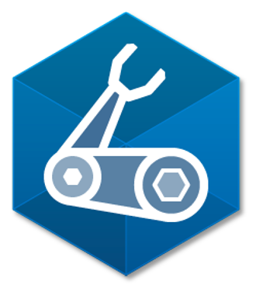

Demo
Notes:
Dedicated project (Repo, Pipelines)
Repo
- Folders for IaC tools
- Each folder has script + pipeline + local dev
ARM
- Non-human language
- Visual noise
- Resources
Terraform
- Industry standard
- No visual noise
- Resources
- State file
- New DSL
- Complex logic
Pulumi idea
Pulumi
- GP languages
- Full C#, .NET
- YAML
- Resources
- Terraform plain state
- Pulumi encrypted
Bicep
- Multi-cloud to be
- No state
- Microsoft supported
Pipelines
- Three stages
- Conditional destroy
- Run ARM
YAML pipeline
- Three stages
- Destroy condition
- Environment
Azure portal
ARM approval
Insight
All pipelines
Portal resource
Run ARM again, show no changes in preview
ARM destroy
Remember environments
Approvals and checks tab
- Approve your own
- Environment checks
YAML pipeline
- Remove environment line
- Deployment identity
Permissions and service connections
Integrations
Bicep, Terraform, Pulumi previews

Slide 13
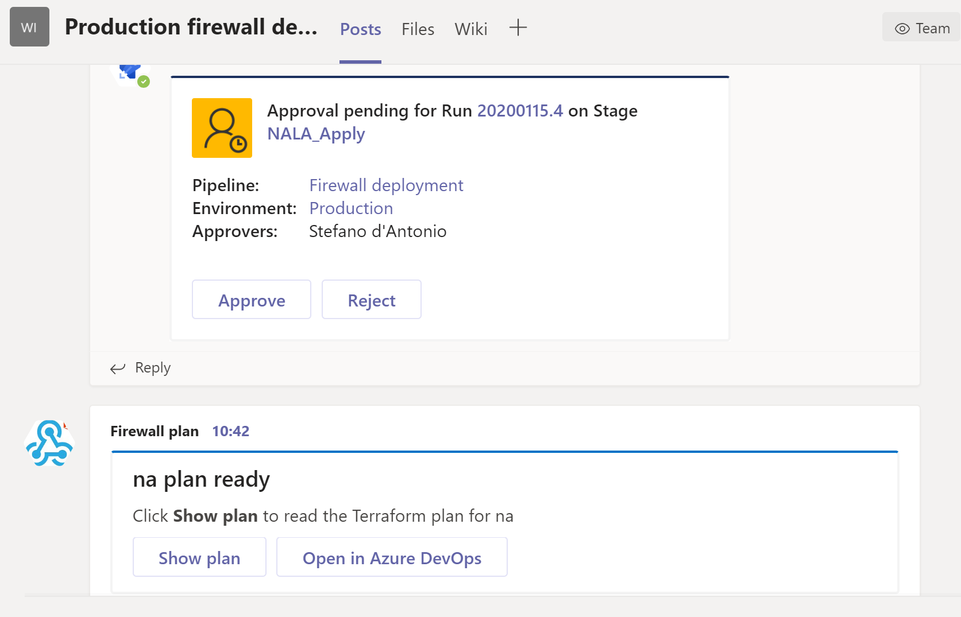
Integrate
Notes:
Make it easier, integrate
Preview
Approvals

Slide 14
Conclusions
Use and promote IaC (whichever tool you pick)
Lock environments
Orchestrate through CD pipelines
Implement gates and approvals

Slide 15
Q&A

Slide 16
Thanks!
Stefano (Stef) d’Antonio

Slide 17
Stefano d’Antonio
Cloud solution architect at Microsoft
Infrastructure as code advocate
https://www.linkedin.com/in/stefanodantonio/
https://github.com/unosd
Notes:
Slide at the end

