Slide 1


Transformation of Differential Algebraic Array Equations to Index One Form
Martin Otter¹ Hilding Elmqvist²
¹DLR Institute of System Dynamics and Control, Oberpaffenhofen, Germany
²Mogram AB, Lund, Sweden
Modelica’2017 Conference, Prague, May 15-17, 2017

Slide 2
Goal: Model and Simulate Large Systems (upto 10⁴..10⁶ differential equations)
Large multi-body systems with elastic bodies and contacts
Large electrical circuits and power electronics
Large thermo-fluid systems
Available algorithms for Modelica tools
reaching their limits
New algorithms are needed that move the limits!

Slide 3
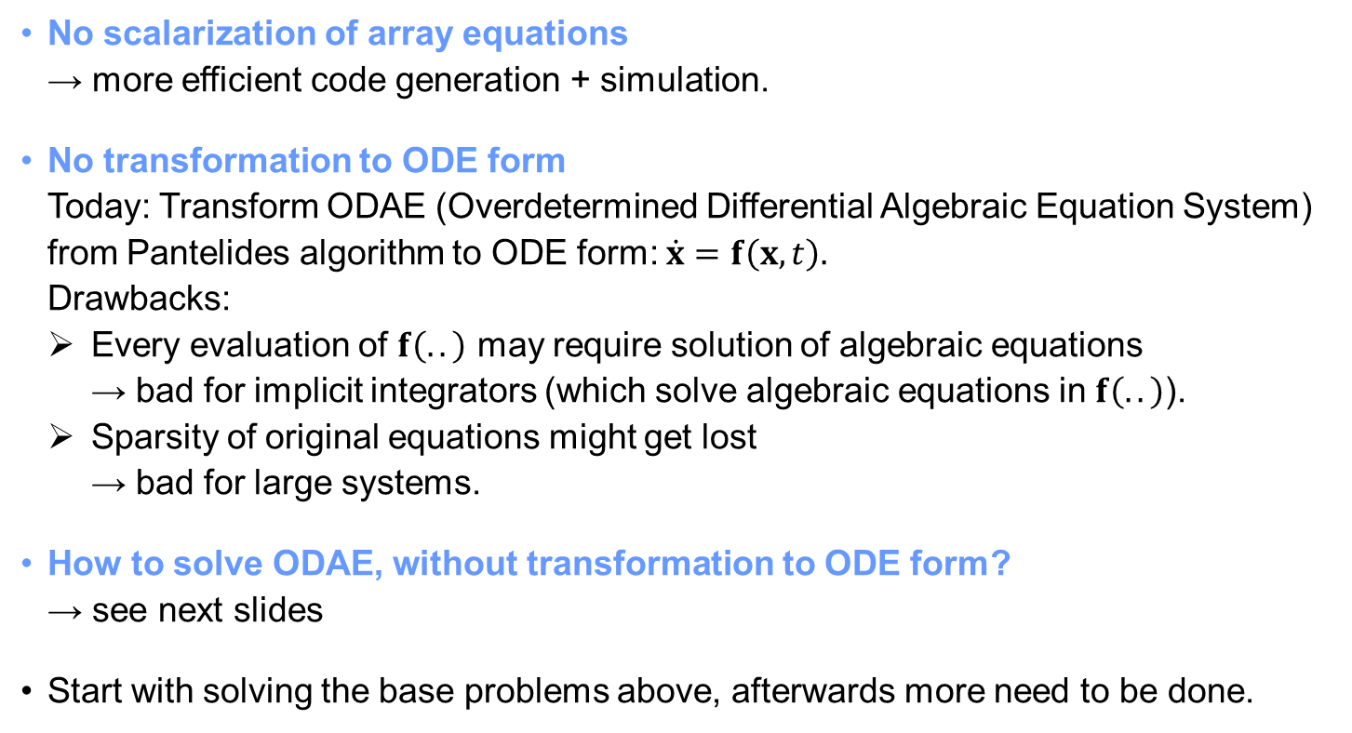
How to reach the Goal?
No scalarization of array equations → more efficient code generation + simulation.
No transformation to ODE form Today: Transform ODAE (Overdetermined Differential Algebraic Equation System) from Pantelides algorithm to ODE form: $\dot{x}=f\left(x,t\right).$ Drawbacks:
Every evaluation of $f\left(..\right)$ may require solution of algebraic equations → bad for implicit integrators (which solve algebraic equations in $f\left(..\right)$).
Sparsity of original equations might get lost → bad for large systems.
How to solve ODAE, without transformation to ODE form? → see next slides
Start with solving the base problems above, afterwards more need to be done.

Slide 4
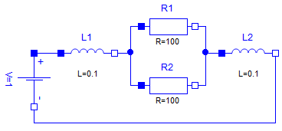




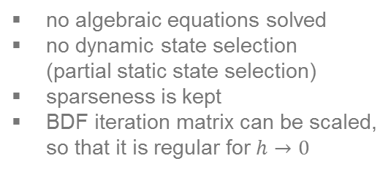
Differential Algebraic Array Equations
e.g.
$$r_{2}=r_{1}+ns$$
new
Removal of
non-structural singularities
remove equation: -L2.n.i - V.n.i = 0 (redundant)
add equation : L2.n.v = 0 (arbitrary value)
replace equation: -R1.p.i - R2.p.i - L1.n.i = 0 with: -L1.p.i + L2.p.i = 0 to make constraint structural
details: see paper
Transformation algorithms on array equations (Pantelides, BLT)
new
$$r_{2}=r_{1}+ns \\ {\dot{r}}_{2}={\dot{r}}_{1}+n\dot{s } \\ {\ddot{r}}_{2}={\ddot{r}}_{1}+n\ddot{s }$$
e.g.
no scalarization of equations
Transformation to special index 1 form
no algebraic equations solved
no dynamic state selection (partial static state selection)
sparseness is kept
BDF iteration matrix can be scaled, so that it is regular for $h→0$
$$\left[\begin{matrix}\frac{∂f_{d}}{∂\dot{x}} \\ \frac{∂f_{c}}{∂x}\end{matrix}\right] is regular$$
new
$$\left[\begin{matrix}f_{d}\left(\dot{x},x,t\right) \\ f_{c}\left(x,t\right)\end{matrix}\right]=0$$
DAE integrator with sparse matrix support
algebraic equations only solved by DAE integrator (not in model, as of today)
array equations intact (no scalarization)
sparse matrix handling

Slide 5
new algorithm
Symbolic Transformation of
Array Equations

Slide 6
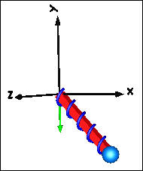
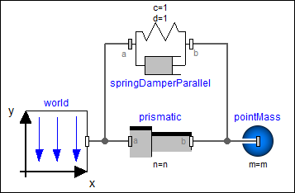
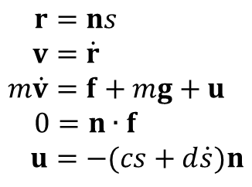


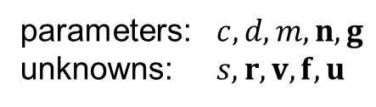

Example: Array equations of a sliding mass
parameters: $c,d,m,n,g$
unknowns: $s,r,v,f,u$
$$s$$
$$r$$
$$r=ns \\ v=\dot{r} \\ m\dot{v}=f+mg+u \\ 0=n∙f \\ u=−(cs+d\dot{s})n$$
$$n$$
Pantelides algorithm:
Determine, how often every equation must be differentiated until the highest derivative variables can be uniquely assigned to the highest derivative equations
Idea: Assign array variables to array equations
No scalar equation contains scalar $s$ → array equation must be scalarized
Scalar equation has no scalar unknown → array unknown $f$must be scalarized
→ Idea does not work

Slide 7
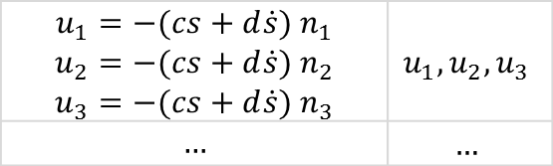
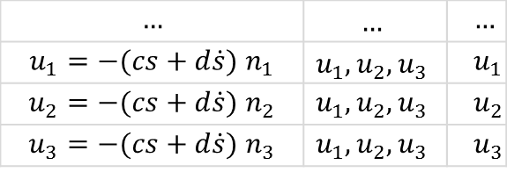
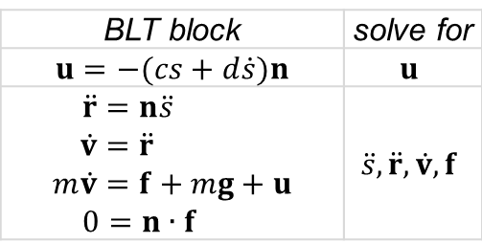
1. (Conceptually) scalarize using incidence of original array equations
2. Apply Pantelides
scalarized, highest derivative equations
unknowns (incidence)
assigned
variables
$$…$$ | $$…$$ | $$…$$
$$u_{1}=−(cs+d\dot{s}) n_{1}$$ | $$u_{1},u_{2},u_{3}$$ | $$u_{1}$$
$$u_{2}=−(cs+d\dot{s}) n_{2}$$ | $$u_{1},u_{2},u_{3}$$ | $$u_{2}$$
$$u_{3}=−(cs+d\dot{s}) n_{3}$$ | $$u_{1},u_{2},u_{3}$$ | $$u_{3}$$
3. Sort highest derivative equations (BLT) → array elements are in the same algebraic loop (= BLT block)
BLT block
unknowns
$$u_{1}=−(cs+d\dot{s}) n_{1}$$ $$u_{2}=−(cs+d\dot{s}) n_{2}$$ $$u_{3}=−(cs+d\dot{s}) n_{3}$$ | $$u_{1},u_{2},u_{3}$$
$$…$$ | $$…$$
4. (Conceptually) transform back to arrays
BLT block | solve for
$$u=−(cs+d\dot{s})n$$ | $$u$$
$$\ddot{r}=n\ddot{s} \\ \dot{v}=\ddot{r} \\ m\dot{v}=f+mg+u \\ 0=n∙f$$ | $$\ddot{s},\ddot{r}, \dot{v},f$$
5. Analytically differentiate array equations

Slide 8
new
new algorithm
Transformation
to Special Index 1 DAE Form

Slide 9

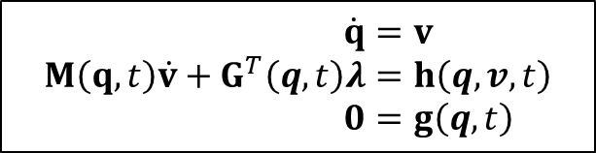
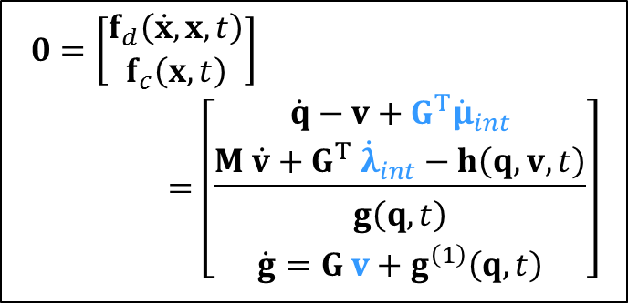


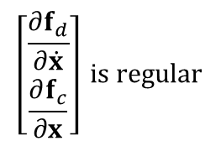
Example: Multi-Body Systems
$$\dot{q}=v \\ M\left(q,t\right)\dot{v}+G^{T}\left(q,t\right)λ=h\left(q, v,t\right) \\ 0=g\left(q,t\right)$$
Target equations
$$\left[\begin{matrix}\frac{∂f_{d}}{∂\dot{x}} \\ \frac{∂f_{c}}{∂x}\end{matrix}\right] is regular$$
$$\left[\begin{matrix}f_{d}\left(\dot{x},x,t\right) \\ f_{c}\left(x,t\right)\end{matrix}\right]=0$$
$$G=\frac{∂g}{∂q}, M=M^{T}>0$$
Pantelides algorithm
$$0=\left[\begin{matrix}f_{d}\left(\dot{x},x,t\right) \\ f_{c}\left(x,t\right)\end{matrix}\right]=\left[\begin{matrix}\underline{\begin{matrix}\dot{q}−v+G^{T}{\dot{μ}}_{int} \\ M \dot{v}+G^{T} {\dot{λ}}_{int}−h\left(q, v,t\right)\end{matrix}} \\ \begin{matrix}g\left(q,t\right) \\ \dot{g}=G v+g^{\left(1\right)}\left(q,t\right)\end{matrix}\end{matrix}\right]$$
$$\dot{q}=v \\ M\dot{v}+G^{T}λ=h\left(q, v,t\right) \\ 0=g\left(q,t\right) \\ 0=\dot{g}=G \dot{q}+g^{\left(1\right)}\left(q,t\right) \\ 0=\ddot{g}=G \ddot{q}+g^{\left(2\right)}\left(q,\dot{q},t\right) \\ \ddot{q}= \dot{v}$$
$$g^{\left(1\right)}=\frac{∂g}{∂t}, g^{\left(2\right)}=\dot{G} \dot{q}+{\dot{g}}^{\left(1\right)}$$
$x=[q;v;λ_{int};μ_{int}]$,$λ :={\dot{λ}}_{int}$
(Gear/Gupta/Leimkuhler 1985; Gear 1988)
Can be generalized to any DAE (where Pantelides algorithm can be applied, details see paper)

Slide 10
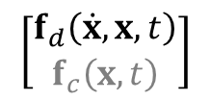
Variant of dummy derivative method → Index 1 DAE (Mattsson/Söderlind 1993)
Example:
BLT Block 1 |  | solve for
 | $$u=−(cs+d\dot{s})n$$ | $$u$$
BLT Block 2
 | BLT Block 2.1
 | $$r=ns$$ | $$s,r$$
 | BLT Block 2.2
 | $$\dot{r}=n\dot{s} \\ v=\dot{r}$$ | $$\dot{s},\dot{r},v$$
 | BLT Block 2.3
 | $$\ddot{r}=n\ddot{s} \\ \dot{v}=\ddot{r} \\ m\dot{v}=f+mg+u \\ 0=n∙f$$ | $$\ddot{s},\ddot{r}, \dot{v},f$$
Result of Pantelides algorithm:
BLT blocks | solve for
$$u=−(cs+d\dot{s})n$$ | $$u$$
$$\ddot{r}=n\ddot{s} \\ \dot{v}=\ddot{r} \\ m\dot{v}=f+mg+u \\ 0=n∙f$$ | $$\ddot{s},\ddot{r}, \dot{v},f$$
$$\left[\begin{matrix}f_{d}\left(\dot{x},x,t\right) \\ f_{c}\left(x,t\right)\end{matrix}\right]$$
$$x=[s;\dot{s}]$$
$$r :=ns \\ \dot{r} :=n\dot{s} \\ v :=\dot{r} \\ \ddot{r} :=n\ddot{s} \\ \dot{v} :=\ddot{r} \\ u :=−(cs+d\dot{s})n \\ f :=m\dot{v}−mg−u$$
With tearing on every BLT block, constraint equations are explicitly solved (here) and are local equations:

Slide 11
new algorithm
Tearing

Slide 12

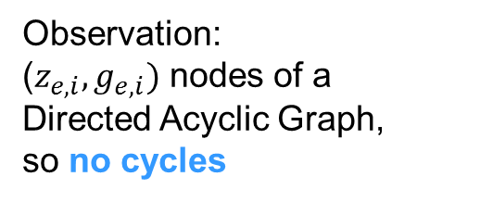
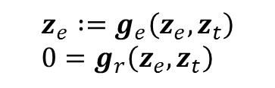
Tearing with retained solution space (Elmqvist/Otter 1999 (unpublished), Bender/Fineman/Gilbert/Tarjan 2016)
Observation: ($z_{e,i},g_{e,i})$ nodes of a
Directed Acyclic Graph, so no cycles
$$z_{e} :=g_{e}\left(z_{e},z_{t}\right) \\ 0=g_{r}\left(z_{e},z_{t}\right)$$
$$0=g\left(z\right)$$
solve explicitly
Example:
$$z_{1}=f_{1}\left(z_{4}\right) \\ z_{2}=f_{2}\left(z_{1,}z_{5}\right) \\ z_{3}=f_{3}\left(z_{2},z_{1}\right) \\ z_{4}=f_{4}\left(z_{3},z_{2}\right)$$
$$z_{4}$$
$$z_{4}$$
$$z_{4}$$
$${f_{1}:z}_{1}$$
$${f_{1}:z}_{1}$$
$${f_{1}:z}_{1}$$
$${f_{1}:z}_{1}$$
$$z_{5}$$
$$z_{5}$$
$$z_{5}$$
cycles?
$${f_{2}:z}_{2}$$
$${f_{2}:z}_{2}$$
$${f_{2}:z}_{2}$$
cylces?
$${f_{3}:z}_{3}$$
$${f_{3}:z}_{3}$$
Try all combinations of variables that can be explicitly solved for and check whether a cycle is present (with Depth First Search). Faster search with incremental cycle detection (Bender et al. 2016)
cycles?
$${f_{4}:z}_{4}$$
cycles?

Slide 13

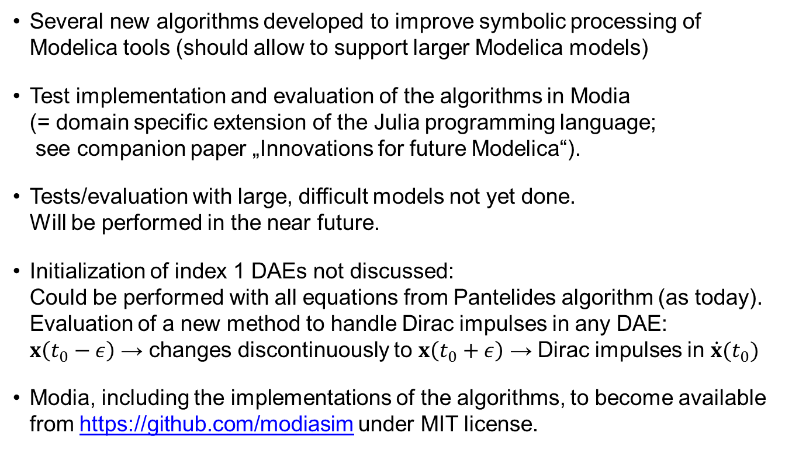
Conclusions and Future Work
Several new algorithms developed to improve symbolic processing of Modelica tools (should allow to support larger Modelica models)
Test implementation and evaluation of the algorithms in Modia (= domain specific extension of the Julia programming language; see companion paper „Innovations for future Modelica“).
Tests/evaluation with large, difficult models not yet done. Will be performed in the near future.
Initialization of index 1 DAEs not discussed: Could be performed with all equations from Pantelides algorithm (as today). Evaluation of a new method to handle Dirac impulses in any DAE: $x\left(t_{0}−ε\right)$ → changes discontinuously to $x\left(t_{0}+ε\right)$ → Dirac impulses in $\dot{x}(t_{0})$
Modia, including the implementations of the algorithms, to become available from https://github.com/modiasim under MIT license.
Modia

