Slide 1
SwiftLog Logistics
Supply chain intelligence and the road to predictive logistics
Mission DS05 · Data Science Track · Week 5
AnalystLab Africa Consulting · orders 1 Jan – 8 Sep 2026
Notes:
Opening: this is a data-driven review of SwiftLog operations from 12 linked tables and 5,000 orders.

Slide 2
Only one order in three is delivered, and most deliveries are late
33.2%
32.5%
63.7%
of orders reach Delivered status
of orders cancelled (7.23M of value)
of shipments delayed 3+ days
Business problem
Where are orders, time and money being lost between order and delivery?
Which warehouses, regions, products or suppliers need attention?
Can the current data support predictive models for delay and returns?
Notes:
The business problem: leadership needs to know where supply chain performance is leaking and whether predictive logistics is feasible today.

Slide 3
Data science methodology: from raw tables to evidence
1
2
3
4
5
6
7
Understand
Clean
Explore
Test
Engineer
Segment
Recommend
12 tables, keys, gaps
19 logged steps, no rows lost
29 charts
10 hypothesis tests
80+ features
customers, products, sites
15 actions
Reusable cleaning pipeline; outliers flagged and capped in a separate column, never silently removed
Three revenue views: gross, confirmed (excludes cancelled) and delivered
Where data is missing (suppliers, capacity, ship dates) we say so instead of inventing it
Notes:
Eight-step workflow; every step is reproducible in the notebook and the cleaning functions can be re-run on new extracts.

Slide 4
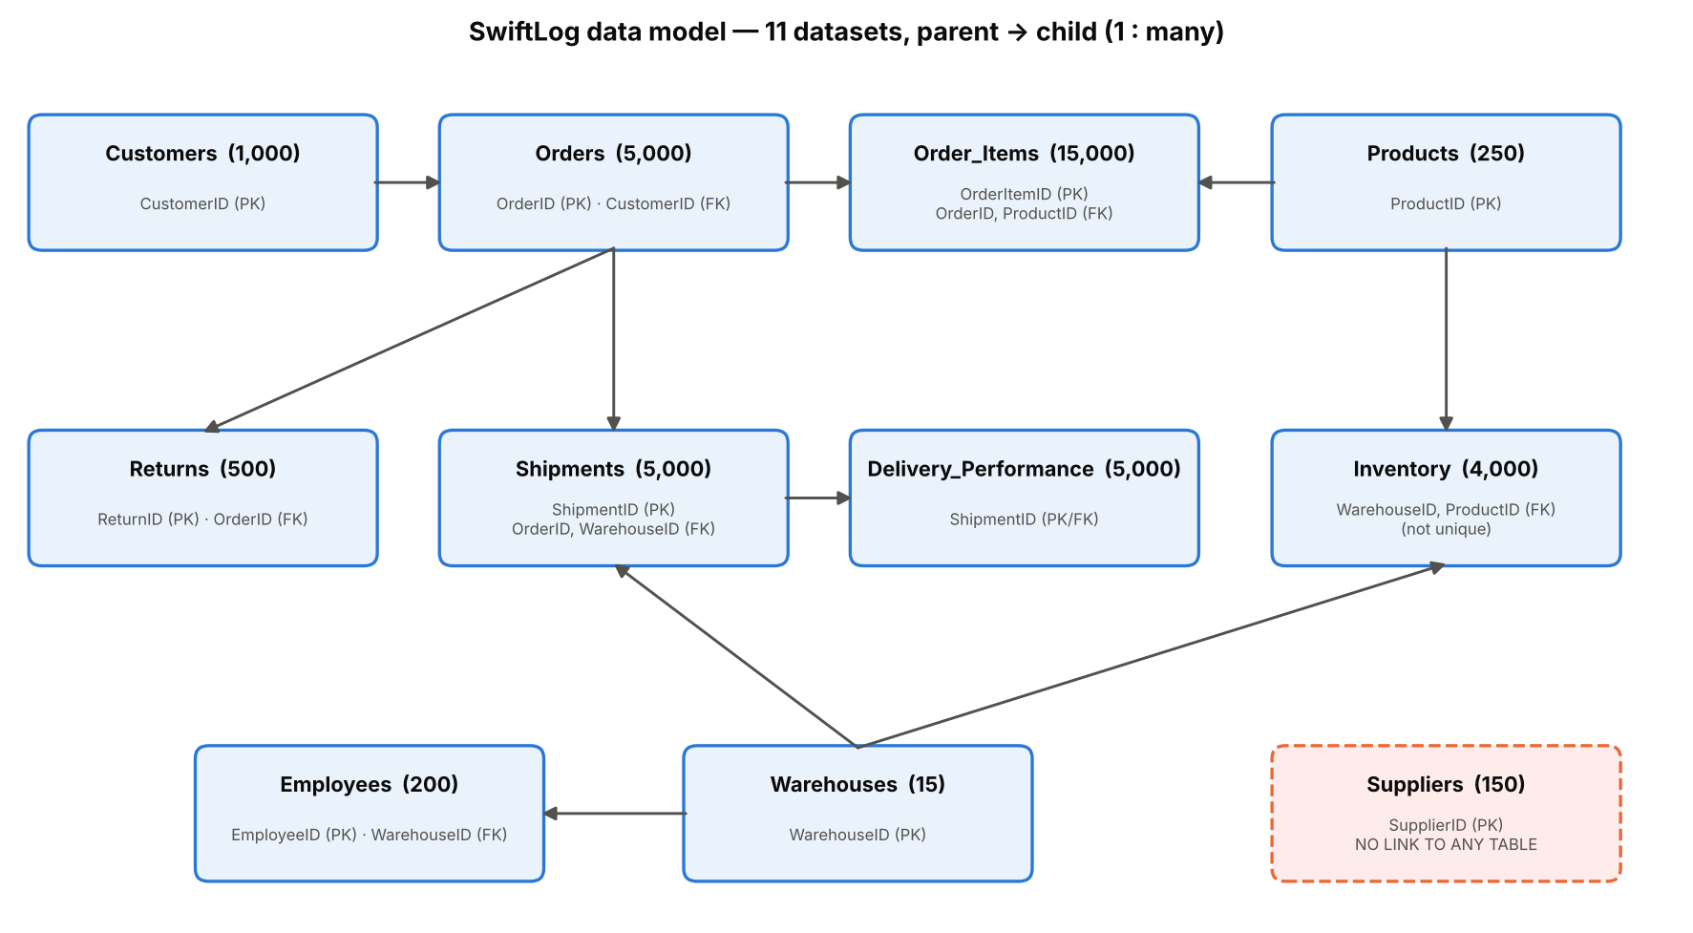
Data preparation: one clean order-level table, and clear gaps
12 tables linked on 8 keys; 0 orphan records, 0 missing values
5,000 orders joined to customers, items, shipments, warehouses and returns
96 duplicate lines merged; 3 duplicate stock rows dropped
236 orders have no line items
No supplier link, capacity or ship dates exist in the data
Notes:
The relationship diagram shows Orders as the hub. Suppliers are isolated: there is no supplier key anywhere else.

Slide 5
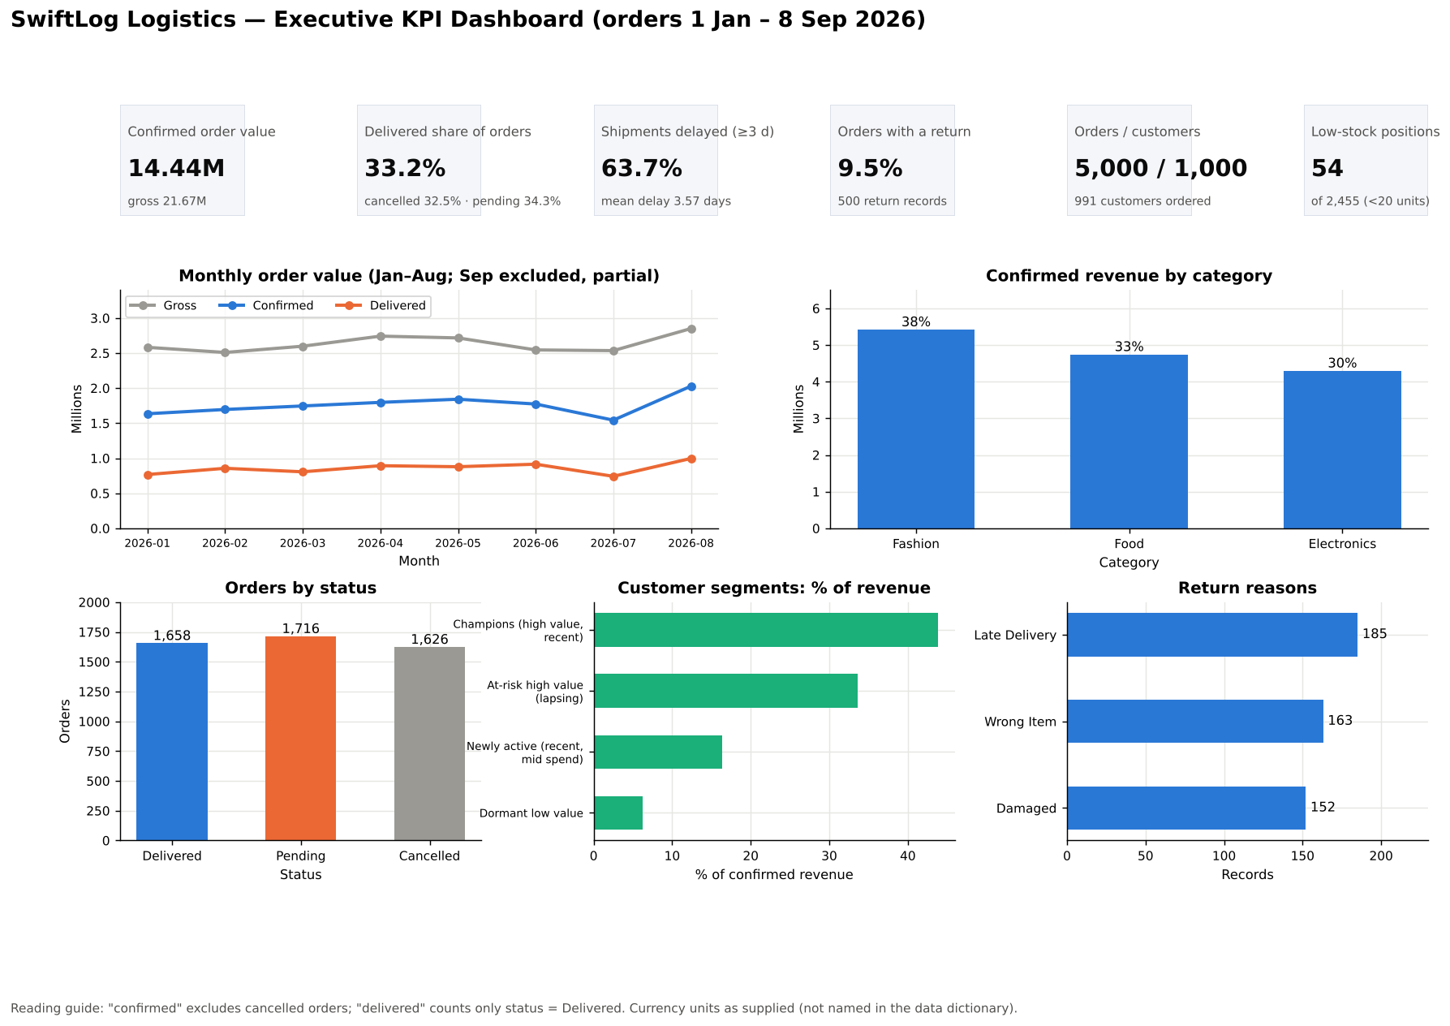
KPI summary: flat volume, low conversion, high lateness
Notes:
Dashboard 1 summarises the main KPIs. September is partial (data ends 8 Sep).

Slide 6
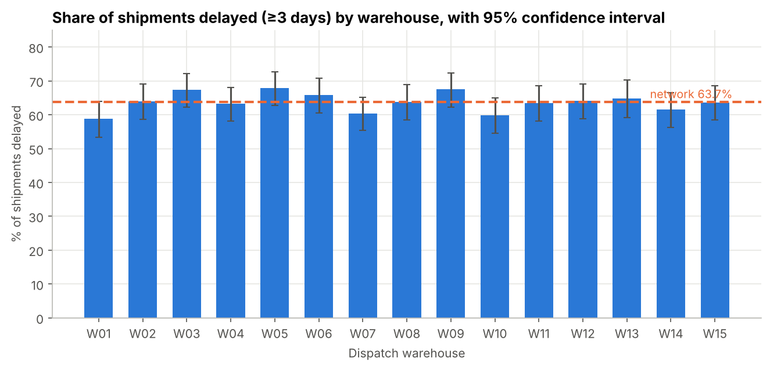
Finding 1: lateness is network-wide, not one bad warehouse
63.7% delayed; mean 3.57 days; spread evenly 0–7 days
Warehouses: p = 0.33; cities: p = 0.10
No single site or region to blame; the cause is upstream (carrier SLAs, dispatch planning, promise-date rule)
Notes:
Every warehouse confidence interval overlaps the network average; chi-square p = 0.33. Regions, weekdays and order types behave the same.

Slide 7
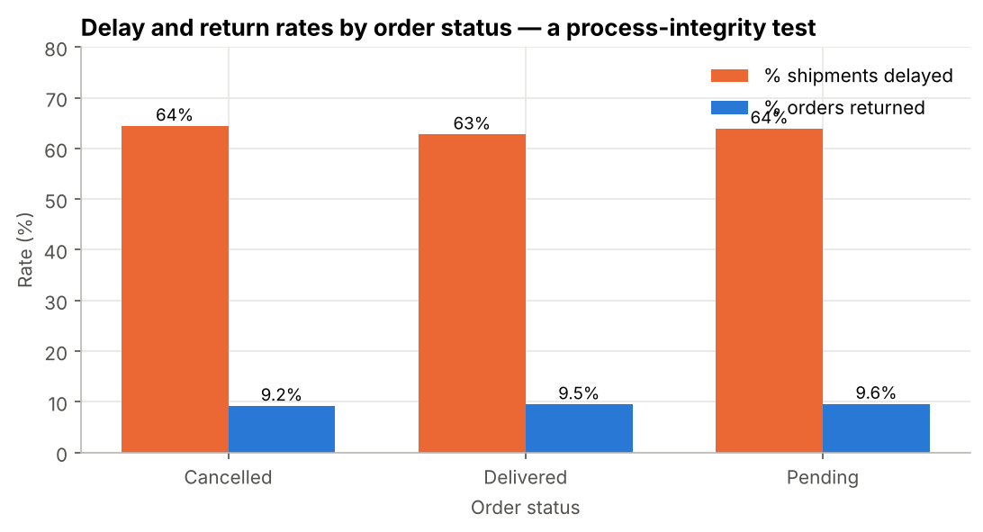
Finding 2: order status and shipment records disagree
1,626 shipments recorded on Cancelled orders
335 returns recorded on orders that were never delivered
Delivery KPIs are contaminated until status is reconciled
33% cancelled and 34% pending is a conversion leak worth 7.23M
Notes:
Cancelled orders have the same delay and return rates as delivered ones, which cannot be true if the status were accurate.

Slide 8
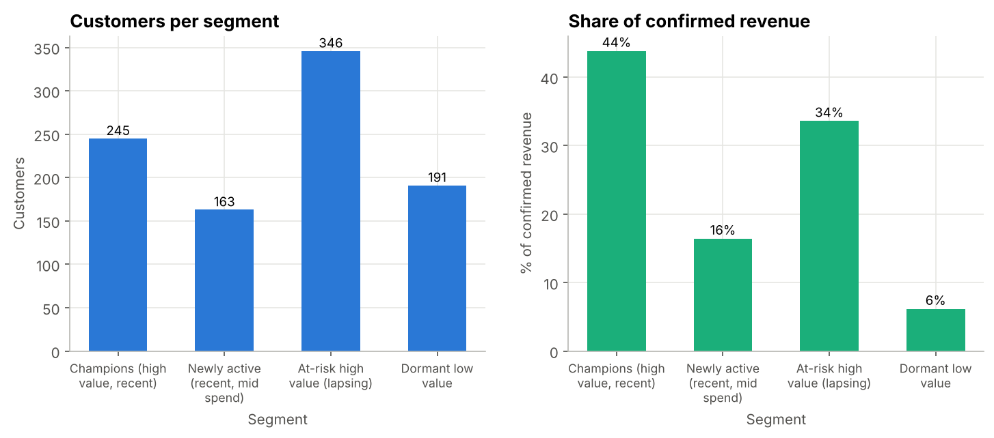
Finding 3: a third of revenue sits with lapsing high-value customers
Champions: 44% of revenue
At-risk high value: 34% of revenue, last order about 86 days ago
No whales: top 20% of customers give 41% of revenue (Gini 0.38)
Every segment experiences the same 62–68% delay rate
Notes:
RFM and K-Means segmentation; silhouette is modest so treat segments as planning buckets.

Slide 9
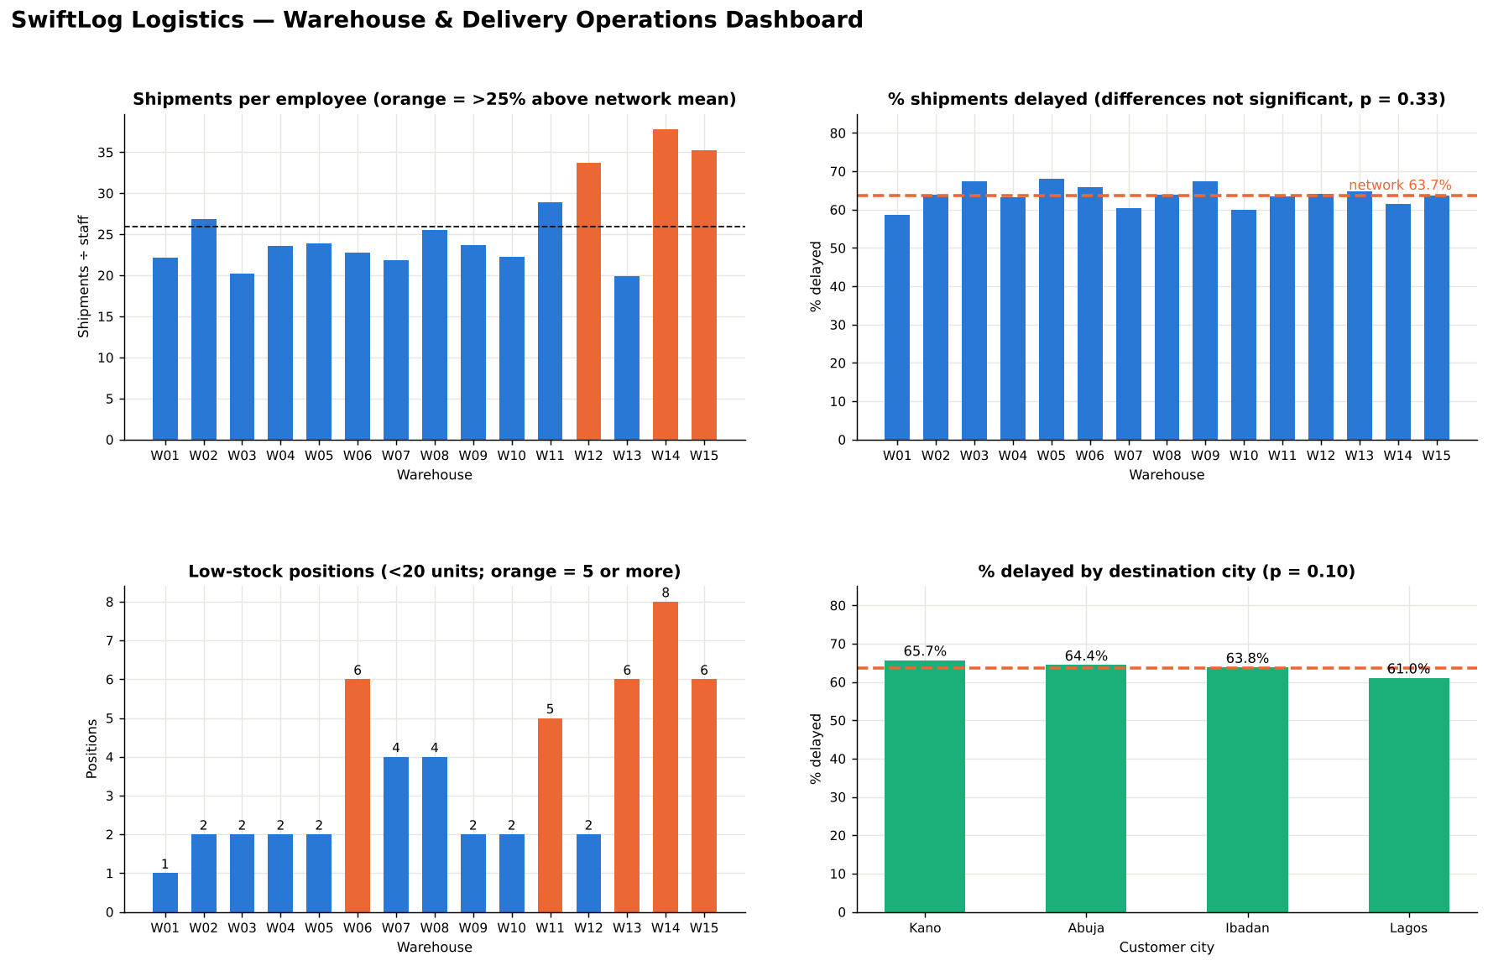
Finding 4: staffing is uneven and stock risk is concentrated
Shipments per employee: 20 (W13) to 38 (W14)
W14, W15, W12 are heavily loaded
54 of 2,455 stock positions are under 20 units; 8 are at W14
Workload does not explain delays (p = 0.93)
Notes:
Workload per employee ranges 20 to 38 with near-equal shipment volume. Low-stock positions cluster at W14, W06, W13 and W15.

Slide 10
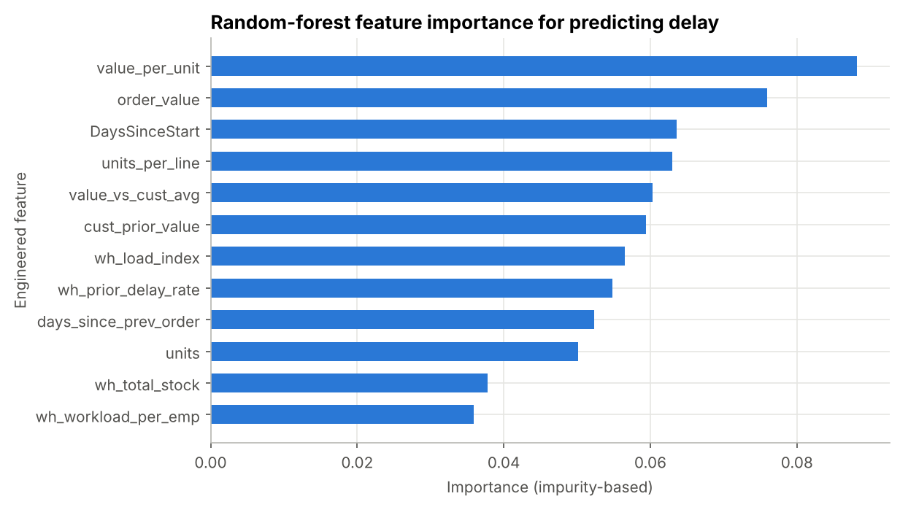
Statistics and ML: today's data cannot predict delays or returns
0 of 10
0.52
0.02
hypothesis tests significant at 0.05
best delay-model AUC (0.50 = chance)
largest operational correlation (rho)
Feature engineering is sound: history-based, no leakage, documented
The drivers of delay are simply not in the data
Needed: carrier, route distance, promised and actual dates, picker or shift, capacity
Notes:
None of ten tests was significant; effect sizes are negligible. Baseline models on a time split reach AUC about 0.52.

Slide 11
Recommendations: fix the basics first
Reconcile order status with shipment and return events
Network-wide on-time delivery programme (carrier SLAs, cut-offs, promise dates)
1
2
High priority
High priority
Funnel review of cancelled and pending orders
Rebalance staff to W14, W15, W12; replenish low-stock hotspots
3
4
High priority
Medium priority
Win-back programme for lapsing high-value customers
Capture supplier, carrier, dates and capacity data
5
6
High priority
High priority
Notes:
Fifteen recommendations are in the report; these six are the priority.

Slide 12
Expected impact and future ML opportunities
Expected business impact
Future ML opportunities
Recovering 10% of cancelled value is worth about 0.72M
Each 10-point cut in lateness lifts on-time delivery from 36% to about 46%
Win-back of lapsing customers protects about a third of revenue
Trusted KPIs after status reconciliation
Delivery-delay risk scoring (needs carrier, distance, promised dates)
Demand and revenue forecasting (needs longer history)
Customer churn and win-back propensity (RFM features ready)
Return-risk scoring (needs product defect and picker data)
Anomaly detection on status versus shipment events
Notes:
Impact figures are illustrative arithmetic on the observed data, not forecasts; they need cost data to convert into profit.

Slide 13
The next best step is data, not modelling
SwiftLog has a stable but flat order book and a network-wide delivery problem.
Reconcile status, fix the delivery process, win back lapsing customers.
Capture supplier, carrier and date fields; then build delay-risk and demand models.
Notes:
Close: the analysis is honest about what the data can and cannot say; the recommendations unlock the predictive work.

