Slide 1
HealthConnect Final Model & Data Science Package
What the data can and cannot predict, and what we recommend instead
[Your name] · Data Science track · AnalystLab Africa Experience Lab, Week 8

Slide 2
The problem and my role
• Project question: how can HealthConnect use data and AI to reduce missed appointments and improve patient support?
• My track: Data Science — build and judge the predictive model, set what it may be used for.
• Key constraint: the data has no attendance field, so I modelled hospital admission as a stand-in.
HealthConnect Clinic · AnalystLab Africa Experience Lab · Week 8 · Data Science
Notes:
Introduce yourself, then the question and the constraint.

Slide 3
The data and what Analytics showed
• 20,000 patients · 5,000 appointments · 60,000 bills
• Visits stable at ≈4,975 a month, no trend
• 6,662 high-risk patients (33.3%); only 1,498 had a 2026 appointment
• ≈0.92 bn RWF unpaid; 21,028 pending claims
• 0 of 26 admission factors significant after correction
HealthConnect Clinic · AnalystLab Africa Experience Lab · Week 8 · Data Science
Notes:
These are the validated findings from my Week 6 analysis; add your Analytics teammate's KPIs here.

Slide 4
How the model was tested
• Six acceptance criteria fixed before testing (AUC ≥ 0.65, interval above 0.5, calibration, stability, gain over baseline…)
• Untouched hold-out of 1,000 appointments; time split Oct–Dec
• Planted-signal and shuffled-label checks to prove the method works
• Seven refinements tried on development data only
HealthConnect Clinic · AnalystLab Africa Experience Lab · Week 8 · Data Science
Notes:
Emphasise the criteria were set in advance.

Slide 5
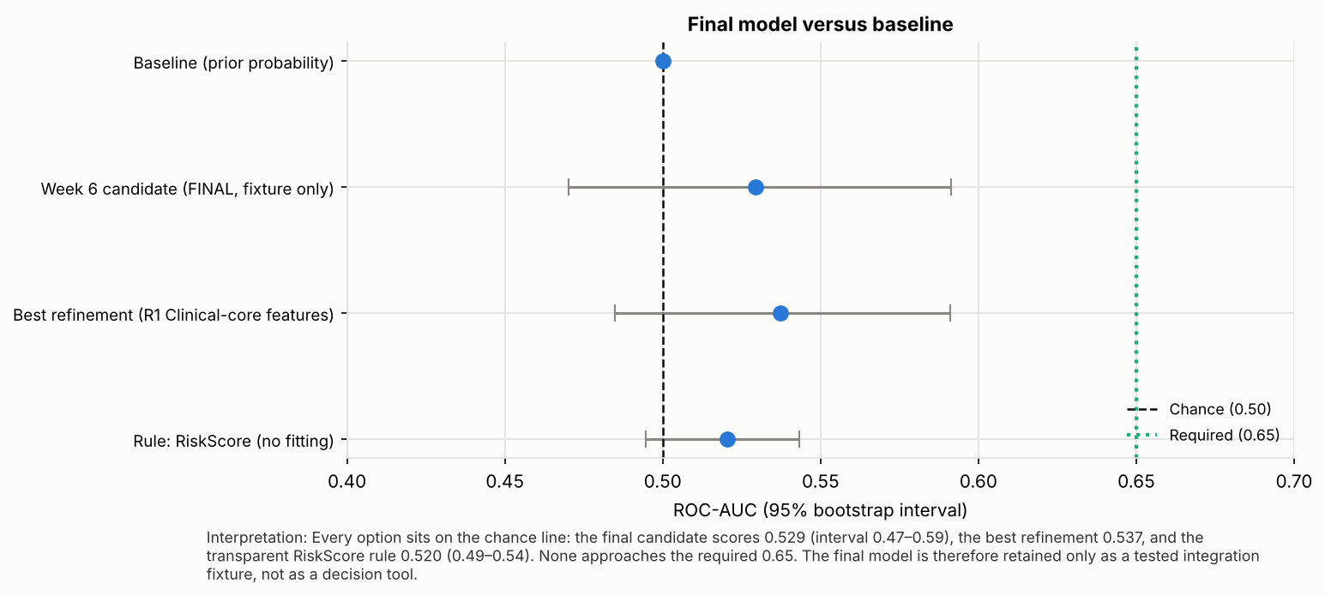
Result: no better than chance
• Hold-out AUC 0.53 (CI 0.47–0.59)
• Best refinement 0.54: not a real gain
• 0 of 6 criteria met
• The test would have found a real signal from AUC ≈ 0.57
HealthConnect Clinic · AnalystLab Africa Experience Lab · Week 8 · Data Science
Notes:
Point at the dashed 0.50 and dotted 0.65 lines.

Slide 6
Error analysis
• Flag top 20%: admission rate 12.7% vs 11.5% unflagged (p = 0.31)
• 459 of 586 admissions missed
• Flags follow department/weekday/province categories: noise, not outcome
• No segment where the model works
HealthConnect Clinic · AnalystLab Africa Experience Lab · Week 8 · Data Science
Notes:
The model's flags do not enrich for admissions.

Slide 7
Final model decision
A negative result, proven, is a deliverable.
• Kept: Week 6 logistic regression, unchanged
• Status: integration fixture. NOT approved for patient-level decisions
• Rejected: complex models (memorise noise), refinements (no gain)
• Interface hardened: tests 8/18 → 18/18
HealthConnect Clinic · AnalystLab Africa Experience Lab · Week 8 · Data Science
Notes:
Explain the decision rule.

Slide 8
What it can and cannot be used for
• CANNOT: rank patients, show risk %, predict no-shows, rank facilities
• CAN: test the ML pipeline end to end; reuse the test harness
• CAN (rule, not model): outreach to high-risk patients with no visit
• CAN: flat forecast for slot planning
HealthConnect Clinic · AnalystLab Africa Experience Lab · Week 8 · Data Science
Notes:
This is the business suitability slide.

Slide 9
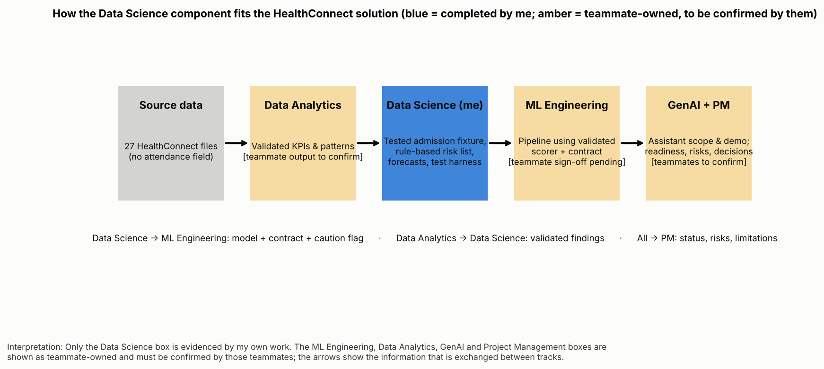
Integration across tracks
• Analytics → DS: validated findings [confirm]
• DS → ML Engineering: scorer, contract, requirements
• ML Engineering → DS: pipeline feedback [confirm]
• GenAI, PM: limits and risks [confirm]
HealthConnect Clinic · AnalystLab Africa Experience Lab · Week 8 · Data Science
Notes:
Fill in what teammates actually confirmed.

Slide 10
Business value and recommendations
• Outreach to the 5,164 high-risk patients with no 2026 visit
• Plan slots from a steady 4,975/month forecast
• Follow up unpaid bills and pending claims
• Collect appointment status to build the real no-show model
HealthConnect Clinic · AnalystLab Africa Experience Lab · Week 8 · Data Science
Notes:
Link back to the project question.

Slide 11
Limitations, risks and next steps
• No predictive skill; wrong target; one year; look-ahead feature
• Rule enrichment is weak: admission rate 13.2% vs 11.0%
• Next: get attendance data, retrain, rerun all six criteria
• Hand-off: FINAL_MODEL_REQUIREMENTS.md
HealthConnect Clinic · AnalystLab Africa Experience Lab · Week 8 · Data Science
Notes:
Close with the lesson learned.

