Slide 1
HealthConnect Rwanda: Healthcare Predictive Analytics & Population Health Intelligence
AnalystLab Africa · Experience Lab Week 6 · Data Science Track
Findings, models and recommendations

Slide 2
Context and data
• 22 source files (31 tables): 20,000 patients, 5,000 appointments, 60,000 bills, 20 facilities, 1,250 staff
• Goal: assess whether the data support demand forecasting, risk prediction and resource planning
• Approach: clean and integrate, explore, test hypotheses, model, then recommend
• Every model is compared with a naive baseline and a permutation null, so only real signal is reported
• Privacy: names, phones and emergency contacts excluded from all exports

Slide 3
Data quality: structurally inconsistent
• 108 checks: 8 critical, 14 high, 10 medium, 2 low
• Only 5,000 of 60,000 billed visits have an appointment record
• 95% of appointments reference a department/doctor from another facility
• 80% of bills are paid in full whatever 'Status' says
• Revenue summary 1.13 bn vs billing 9.31 bn RWF: no reconciliation
• Rows are clean (few missing values); links between tables are not

Slide 4
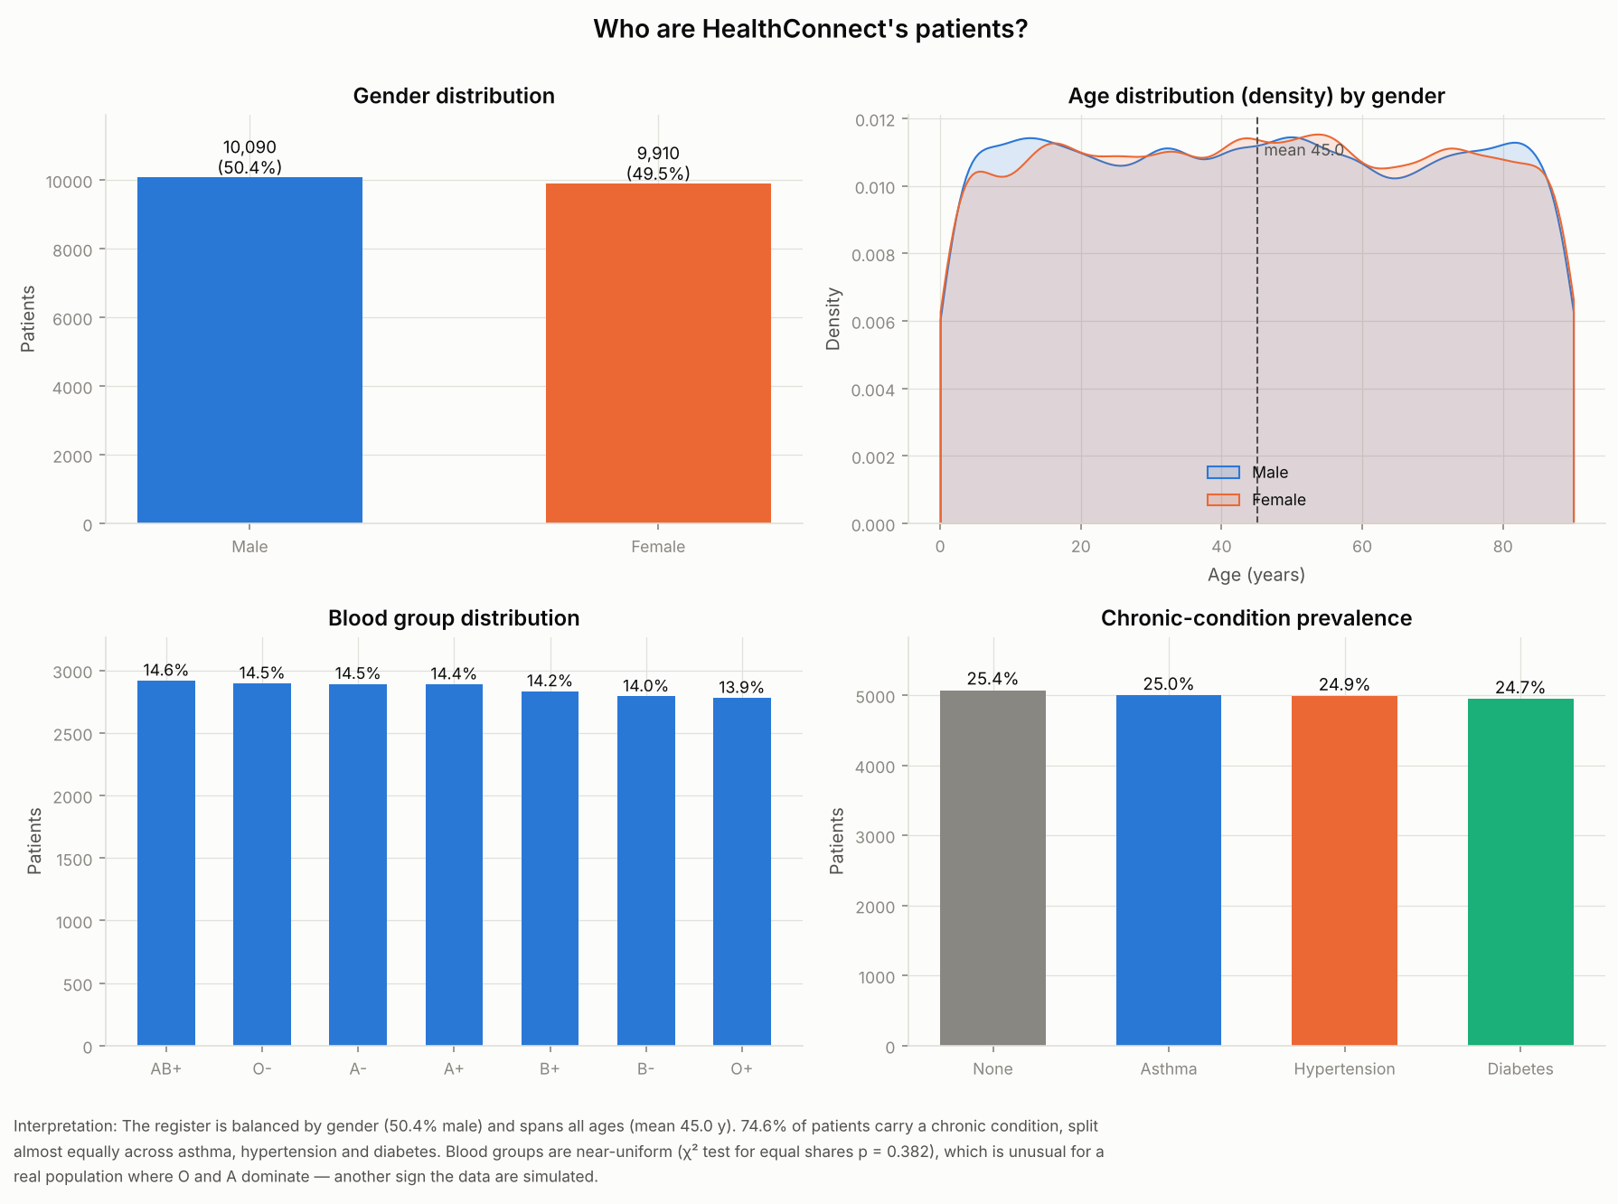
Who are the patients?
• Mean age 45; near 50/50 gender
• 75% have a chronic condition
• 33% meet the high-risk rule
• Evenly spread across 5 provinces; 100% insured

Slide 5
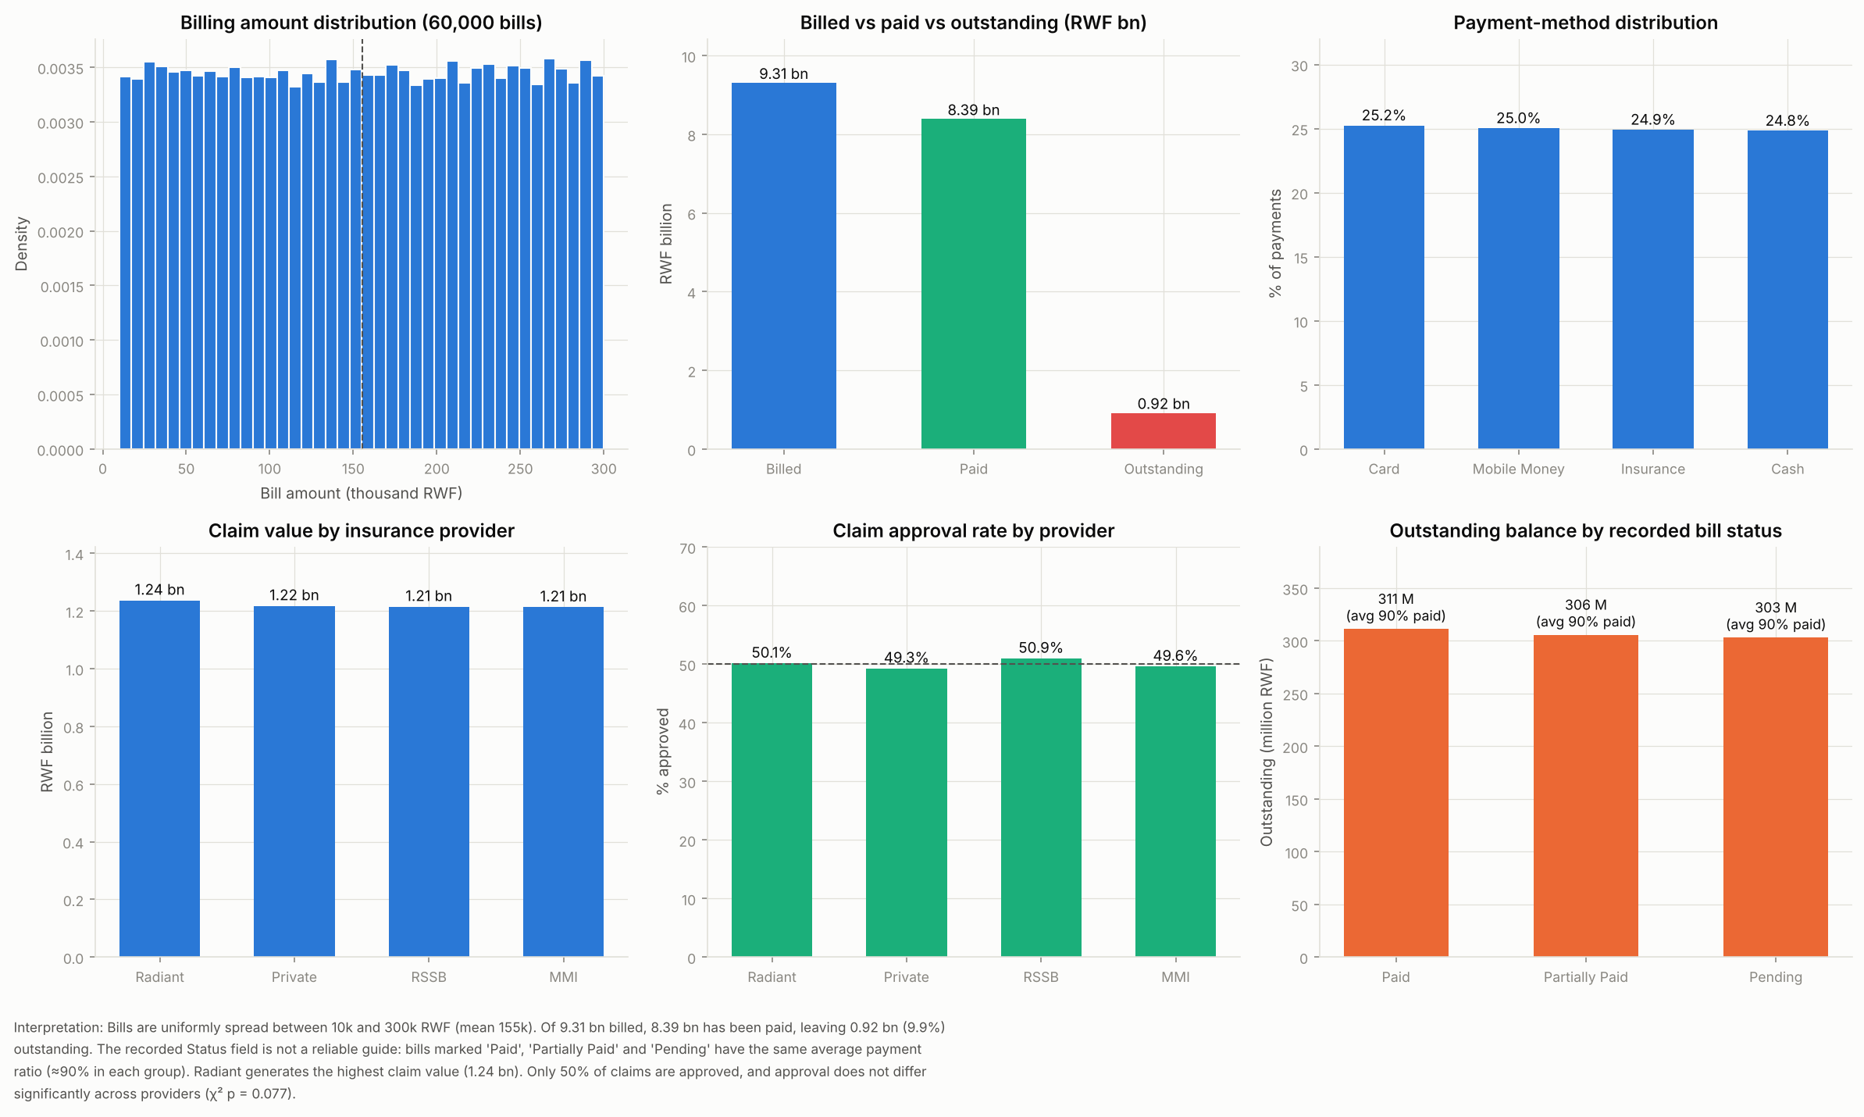
Revenue and collections
• Billed 9.31 bn RWF, paid 8.39 bn
• 0.92 bn outstanding (0.1%)
• 50% claim approval; 21,028 claims pending (2.44 bn)
• No difference between insurers

Slide 6
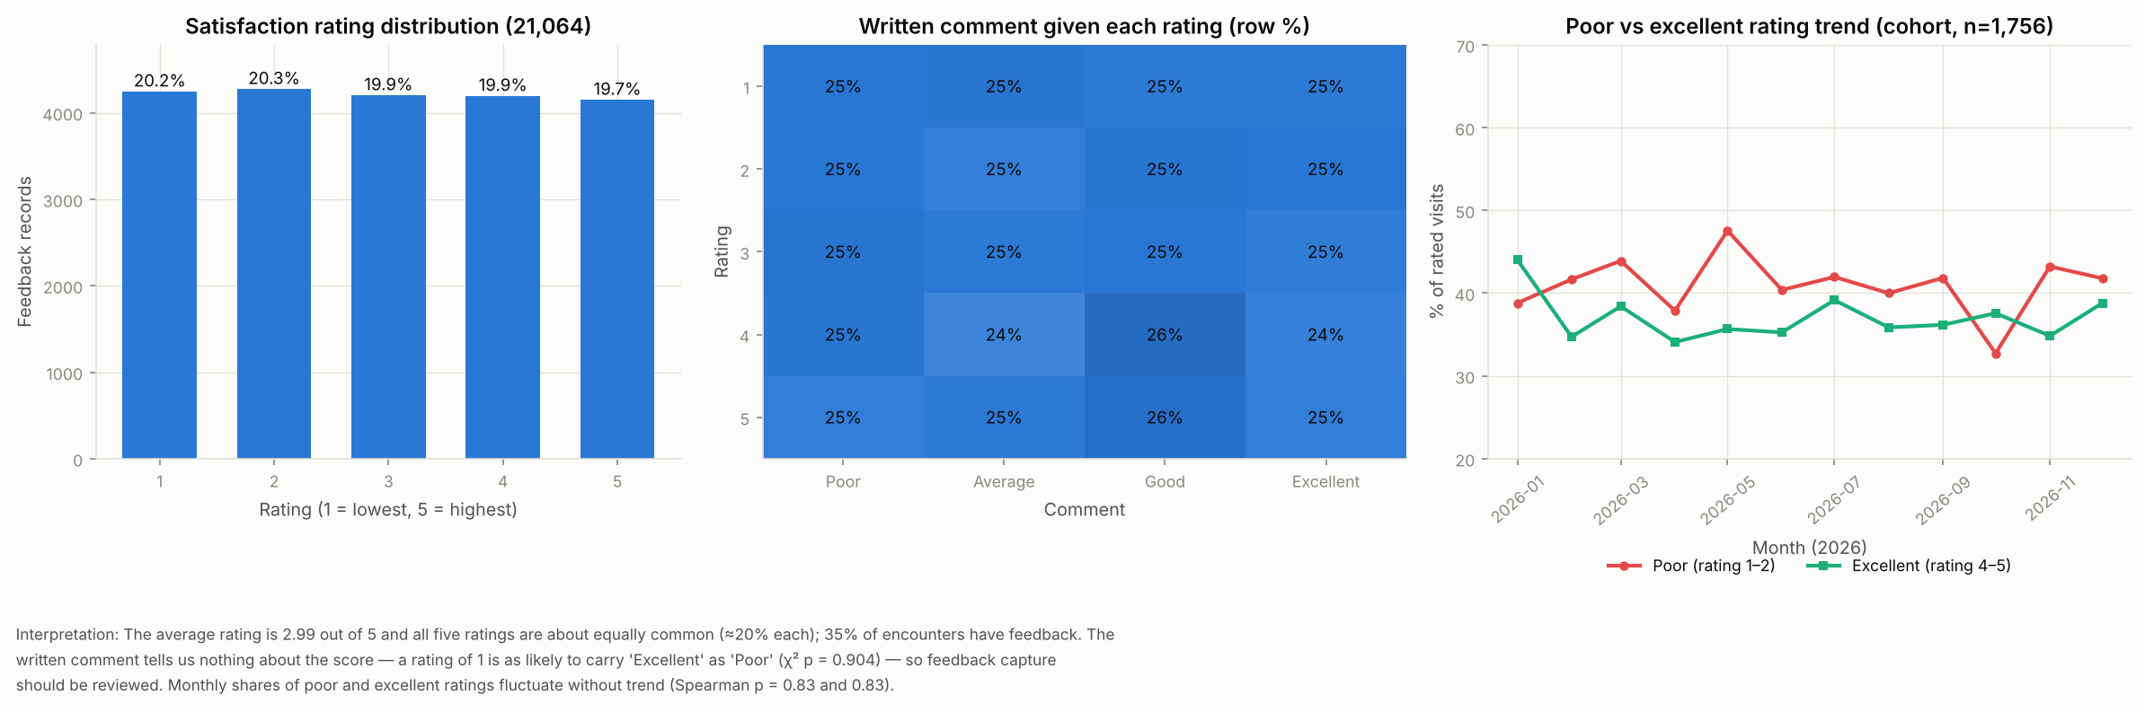
Patient experience
• Mean rating 2.99/5; 40% rate 1–2
• Ratings spread evenly 1–5
• Unrelated to comment text, diagnosis, billing, department or facility
• Instrument needs redesign

Slide 7
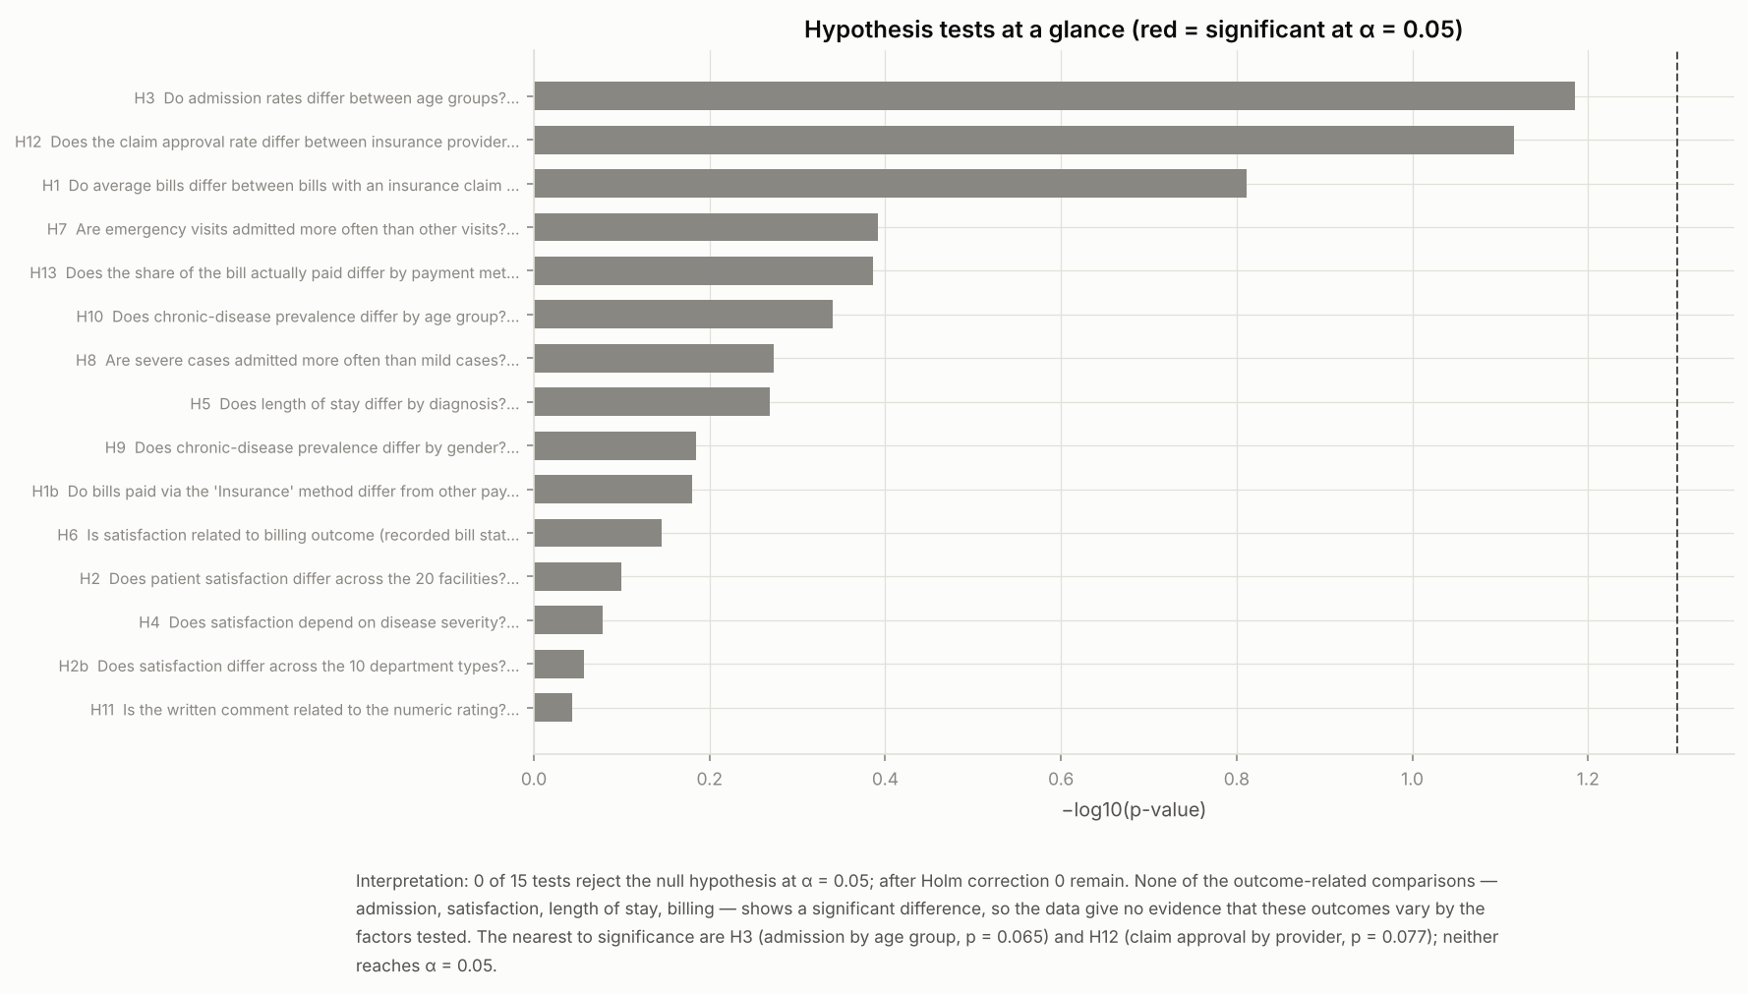
Statistical testing
• 15 hypothesis tests at α = 0.05
• 0 rejected after correction
• Admission factors: none of 26 significant
• Only strong correlation is mechanical (revenue vs volume)

Slide 8
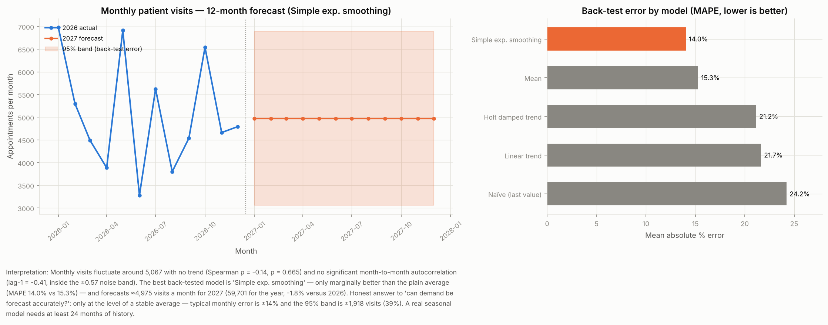
Visit forecast, 2027
• ≈4,975 visits/month (≈59,700/yr)
• MAPE 14.0% vs 15.3% for the mean
• No trend in 12 months
• Plan on a flat baseline

Slide 9
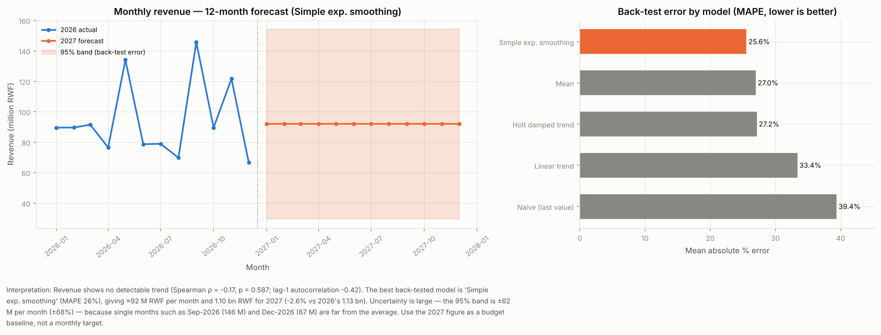
Revenue forecast, 2027
• ≈1.10 bn RWF (≈92 M/month)
• MAPE 26%; 95% band ±68%
• Sep-2026 peak and Dec-2026 trough need explaining
• Budget flat with a contingency reserve

Slide 10
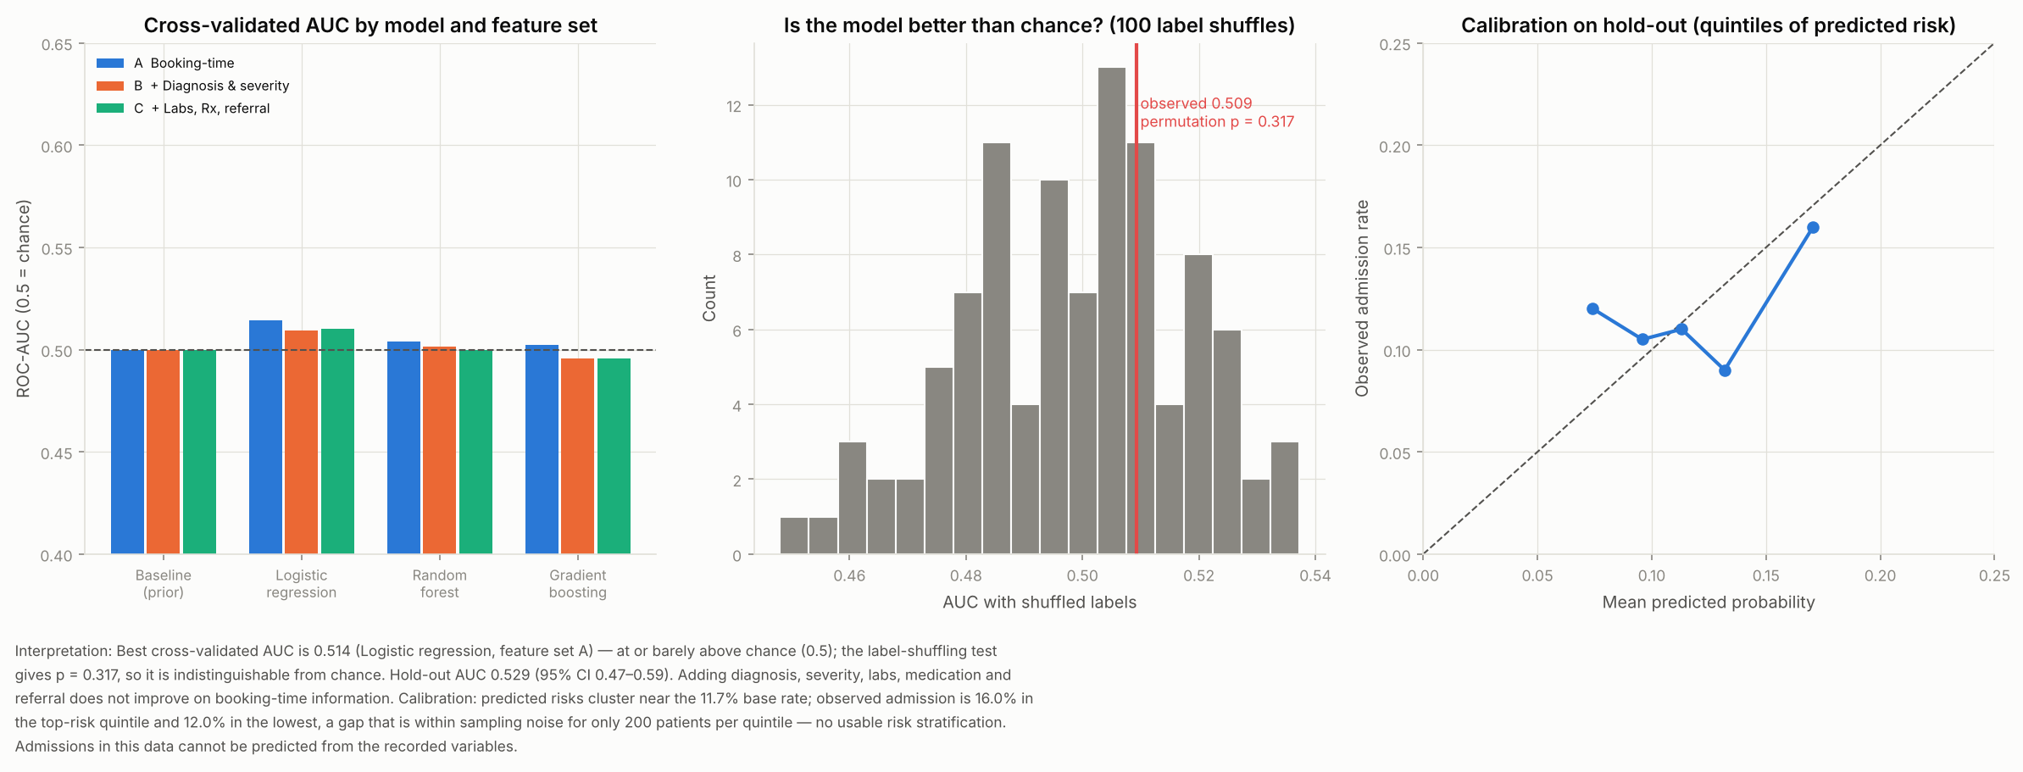
Admission prediction
• Best CV AUC 0.51 (chance 0.50)
• Permutation p = 0.32
• Hold-out AUC 0.53
• Diagnosis, labs, Rx add nothing: no usable signal

Slide 11
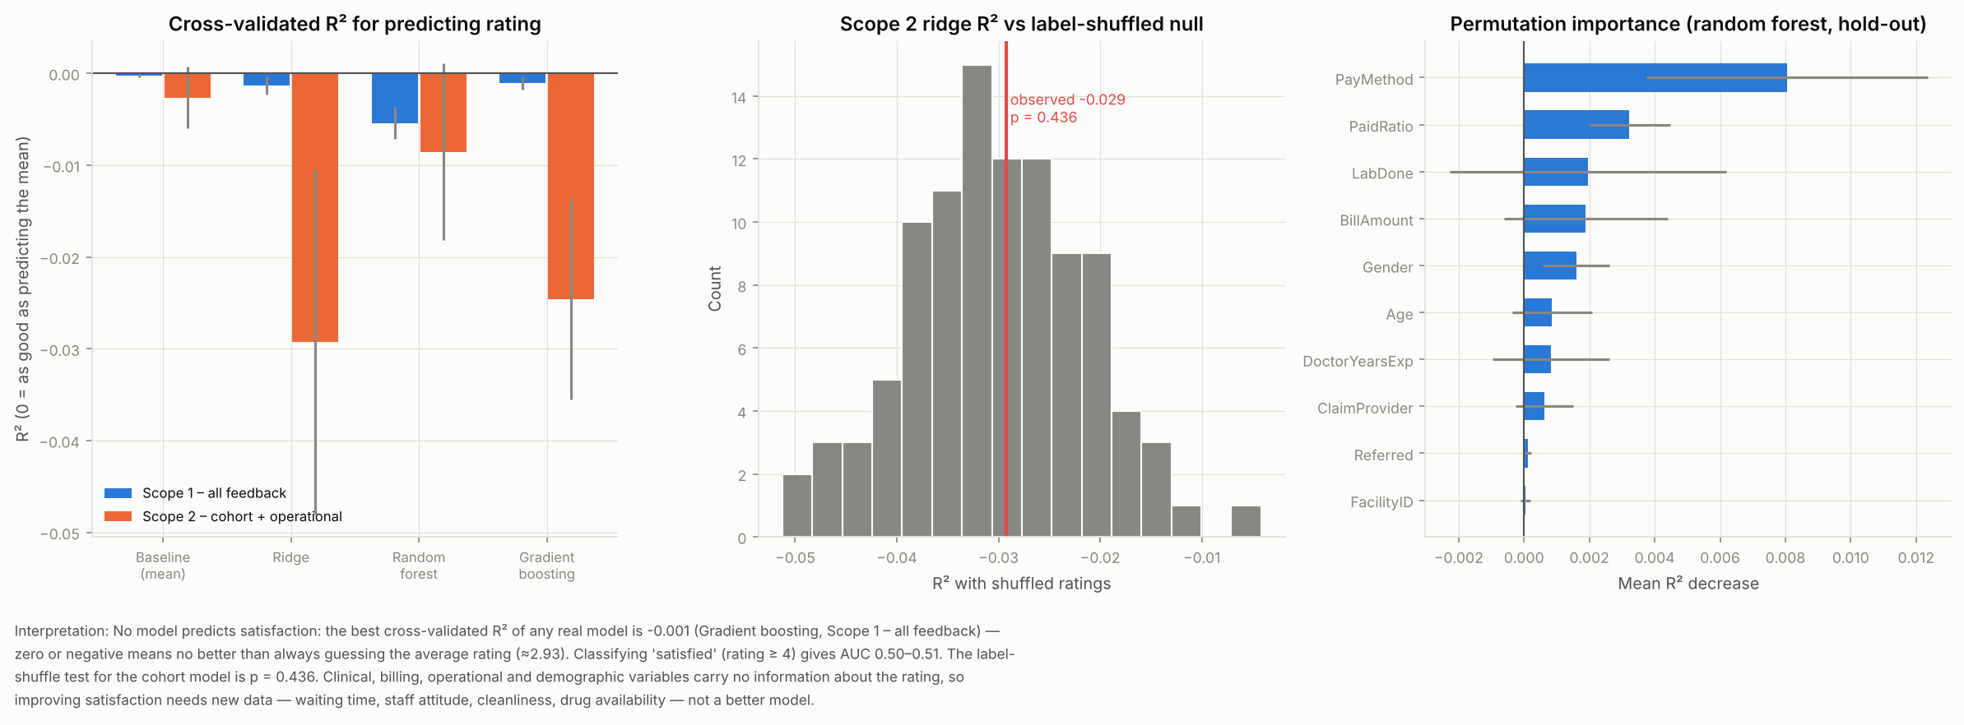
Satisfaction prediction
• Best real-model R² -0.001
• Worse than predicting the mean
• Satisfaction drivers are not recorded
• Collect wait time, courtesy, cleanliness

Slide 12
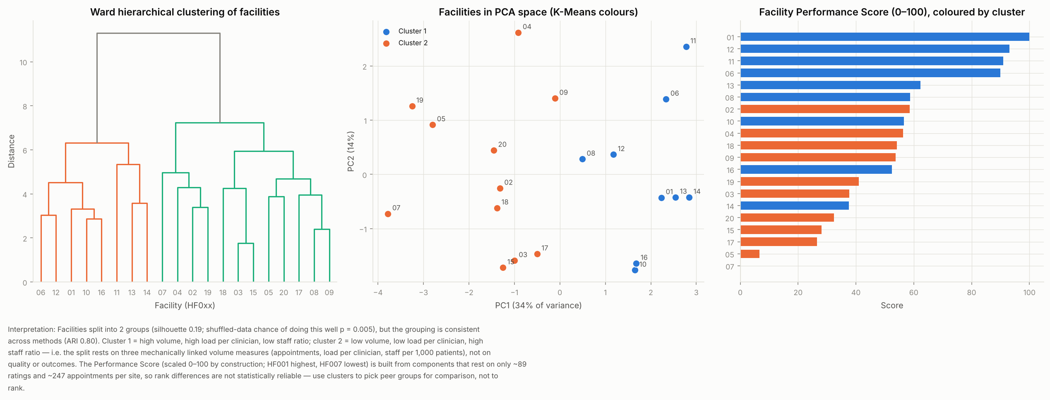
Facility clusters and workload
• Two peer groups, split by volume and load
• Not quality or outcome groups
• Staff 61–64 per site vs 28% volume spread
• Cardiology and Radiology: highest forecast load

Slide 13
Recommendations
Recommendation | Action
Fix the data foundation before further modelling | Re-extract Appointments for the full year; enforce Facility→Department→Doctor foreign keys; add Facility master, bed status and equipment condition fields.
Collect the outstanding balance and clear pending claims | Weekly ageing report on outstanding balances; dedicated follow-up team for pending claims; agree turnaround SLAs with all four insurers; 0.64 bn RWF of 'Insurance'-method payments have no claim on file — reconcile.
Make staffing follow patient volume | Move toward a staffing ratio per 1,000 appointments; rebalance rotas from the quietest sites toward HF013/HF011 as a pilot; review monthly with a rolling 3-month workload index.
Redesign the feedback instrument and capture real drivers | Add wait time, staff courtesy, cleanliness, drug availability and discharge-time questions; validate comment/rating consistency; collect ≥ 348 ratings per facility to detect a 0.3-point difference with 80% power (currently ≈ 89).
Target outreach with a rule-based list, not a predictive model | Call-back / screening programme for the high-risk list, prioritising patients aged 65+ with a chronic condition and no 2026 visit; evaluate uptake to validate the rule.
Do not expand on current evidence — build the evidence | Add facility geography (district, ownership, type) and ServiceID on bills; re-run province-level demand vs capacity once available. Prioritise Cardiology and Radiology for a staffing review (highest forecast load index, ≈105–109), but treat as provisional.

Slide 14
Limitations and next steps
• Poor linkage between tables and 12 months of history limit what can be concluded
• 'No effect found' means none detectable in these data, not proof of absence
• Next: fix data integrity, collect 24+ months, redesign feedback, add bed census and wait-time data
• Then re-run the notebook: models and reports regenerate automatically
• Deliverables: notebook, cleaned datasets, 4 reports, executive summary, 36 figures

