Slide 1
UE4 Protips
Justin Walsh

Slide 2
pro agenda
UE4 Protips
Frustum Select
Everything Is Super
Ready, Set, Begin Play, Bgine Play, Niebg Play…
GameMode, GameInstance, GameState, PlayerState
Asset Registry Metadata Winning Awesome WOW
Macros And Functions And Events Oh My
Localization (nothing clever about it)
3D User Interface… Almost
Custom Thunk AKA Advanced 💩

Slide 3
FRUSTOM SELECT
UE4 Protips
Box Select in Perspective Mode
CTRL + ALT + DRAG

Slide 4
everything is super
UE4 Protips
You must explicitly call the Super Class Function in a Blueprint if you want to invoke inherited behavior
Right Click -> Add Call To Super Function
i.e. BeginPlay, Tick, etc…

Slide 5
ready, set, begin play, bgine play, niEBG Play…
UE4 Protips
Begin Play order is not guaranteed
Look to GameInstance / GameMode for better control of initialization

Slide 6
gamemode, gameinstance, gamestate, playerstate
UE4 Protips
GameMode: Server, Authority
GameInstance: Client, Persists the life of the game
GameState: Server/Client, Stores Variables, Replicated
PlayerState: Server/Client, One per player, Replicated

Slide 7
ASSET REGISTRY metadata winning awesome WOW
UE4 Protips
UPROPERTY(AssetRegistrySearchable)
Tag Properties on Assets to find out information about them before even loading them
Use the FAssetRegistryModule at runtime to discover assets
Override the [AssetRegistry] block in DefaultEngine.ini
Look to BaseEngine.ini to see defaults

Slide 8
Landscape collision woes
UE4 Protips
Sometimes you just fall through your landscape because why not
In the console type RecreateLandscapeCollision

Slide 9
MACROS AND FUNCTIONs AND EVENTS OH MY
UE4 Protips
Event: Can’t return, Can Delay
Function: Can return, Simple Local Variables, Stand Alone
Macro: Can return multiples, Odd Local Variables, everyone who uses it must be recompiled when changed
Timers: Call a function or event, has no parameters to pass along

Slide 10
LOCALIZATION (nothing clever about it)
UE4 Protips
Use FText whenever you think something needs to be localized
4.12 Added the ability to add a namespace to FText fields in blueprints
When working with code the FTextInspector is your friend

Slide 11
3D USER Interface… almost
UE4 Protips
SceneCapture 2D
Color key the scene
Custom PostProcess the scene capture with blendables
Create a material to alpha out the color key
Render the texture with UMG
http://anticto.com/steamrolls-3d-user-interface/

Slide 12
CUSTOM THUNK AKA ADVANCED 💩
UE4 Protips
UFUNCTION(CustomThunk)
DECLARE_FUNCTION(execNameOfFunctionMarked) {}
Access the VM Stack directly
Use Reflection to inspect your data
https://forums.unrealengine.com/showthread.php?56537-Tutorial-How-to-accept-wildcard-structs-in-your-UFUNCTIONs

Slide 13
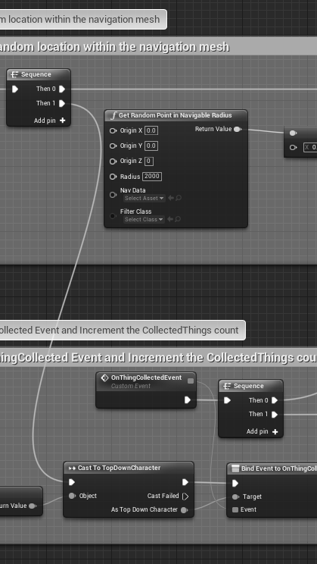
sharing is caring

